Slide 1
Graduate Clustering Assignment
Clustering Parkinson's
Telemonitoring Voice Measurements
Using Orange Canvas
Rakshan Urooj Syed · Bhaveen Mehta
UCI ML Repository · Parkinson's Telemonitoring Dataset
Notes:
Welcome everyone. Today we're presenting our clustering assignment on Parkinson's voice measurements. This is a group project — Rakshan covered K-Means and PCA, and Bhaveen handled Hierarchical Clustering. We used a single shared Orange Canvas workflow so all three methods were applied to the same processed dataset. Let's get started.

Slide 2
OVERVIEW
Assignment Goal & Research Question
🎯 Assignment Goal
Apply unsupervised clustering to biomedical voice data to discover natural acoustic groupings — without using any clinical severity scores as input.
🔬 Main Research Question
Can biomedical voice measurements from Parkinson's telemonitoring data be clustered into distinct acoustic profiles; and do those clusters show differences in UPDRS symptom severity scores?
K-Means
PCA Visualization
Hierarchical Clustering
Rakshan
Rakshan
Bhaveen
Key constraint: UPDRS scores were NOT used as clustering inputs — only used afterward to interpret results.
Notes:
Our goal was to find whether voice recordings alone naturally separate into meaningful groups. We used three methods: K-Means, PCA for visualization, and Hierarchical Clustering. The critical constraint across all three: UPDRS severity scores were never fed into the models. We only checked UPDRS afterward to see if our clusters aligned with clinical severity.

Slide 3
DATASET
Dataset Overview: Parkinson's Telemonitoring
5,875
42
22
16
Total Rows
Unique Patients
Total Columns
Voice Features Used
Each row is a voice recording session, not a unique patient. One patient may appear hundreds of times across the dataset.
Voice Features → Clustering Inputs (16)
Meta Variables → Reference Only
Jitter, Shimmer, NHR, HNR, RPDE, DFA, PPE and variants
subject# · age · sex · test_time · motor_UPDRS · total_UPDRS
Kept as metadata for interpretation — not used for clustering.
Source: UCI Machine Learning Repository — Parkinson's Telemonitoring Dataset (ID: 189)
Notes:
Quick overview of the dataset. 5,875 rows, 42 patients, recorded remotely over time. One important point we updated from our earlier approach: instead of fully excluding subject ID, age, sex, test_time, and UPDRS, we kept them as Meta variables in Orange. This means the clustering algorithm never sees them, but they stay attached to each row so we can pull them up afterward in box plots and tables without any extra steps.

Slide 4
FEATURES
Feature Selection: Voice Inputs & Meta Variables
✅ Voice Features — Clustering Inputs (16)
📎 Meta Variables (kept for reference)
Jitter(%), Jitter(Abs), Jitter:RAP, Jitter:PPQ5, Jitter:DDP
Shimmer, Shimmer(dB), Shimmer:APQ3, Shimmer:APQ5
Shimmer:APQ11, Shimmer:DDA
NHR — Noise-to-Harmonics Ratio
HNR — Harmonics-to-Noise Ratio
RPDE — Recurrence Period Density Entropy
DFA — Detrended Fluctuation Analysis
PPE — Pitch Period Entropy
subject# · age · sex
test_time
motor_UPDRS
total_UPDRS
Why Meta, not excluded?
Orange's Select Columns widget lets us mark these as Meta. The clustering algorithm ignores them completely, but they remain accessible in Box Plot and Data Table for post-hoc UPDRS comparison.
Notes:
We used 16 voice features as clustering inputs. Jitter and Shimmer capture pitch and amplitude instability. NHR and HNR measure noise vs. harmonic content — basically how clean or noisy the voice is. RPDE, DFA, and PPE are nonlinear measures of voice complexity. The six non-voice columns — patient ID, age, sex, time, and both UPDRS scores — were set as Meta variables in Orange's Select Columns widget. They're invisible to the clustering, but they travel with each data row so we can reference them afterward.

Slide 5
ORANGE WORKFLOW
Orange Canvas Workflow
📂
🔽
⚙️
🎲
File
Select
Columns
Preprocess
Data
Sampler
① Shared Preprocessing Path
K-Means Branch
PCA Branch
Hierarchical Branch
K-Means
PCA
Distances
Silhouette Plot
Box Plot
Data Table
Scatter Plot
Hierarchical
Clustering
Data Table
Box Plot
Notes:
This is the master Orange Canvas workflow. Everything flows through a shared preprocessing path: load the file, select the 16 voice features as inputs with the other columns as Meta, standardize in Preprocess, then sample down to 4,000 rows in Data Sampler. From that single sampled output, we branch into three analysis paths: K-Means for partition clustering, PCA for visualizing structure in the data, and Hierarchical Clustering for an agglomerative view. Using one shared path means all three methods see exactly the same processed data — so results are directly comparable.

Slide 6
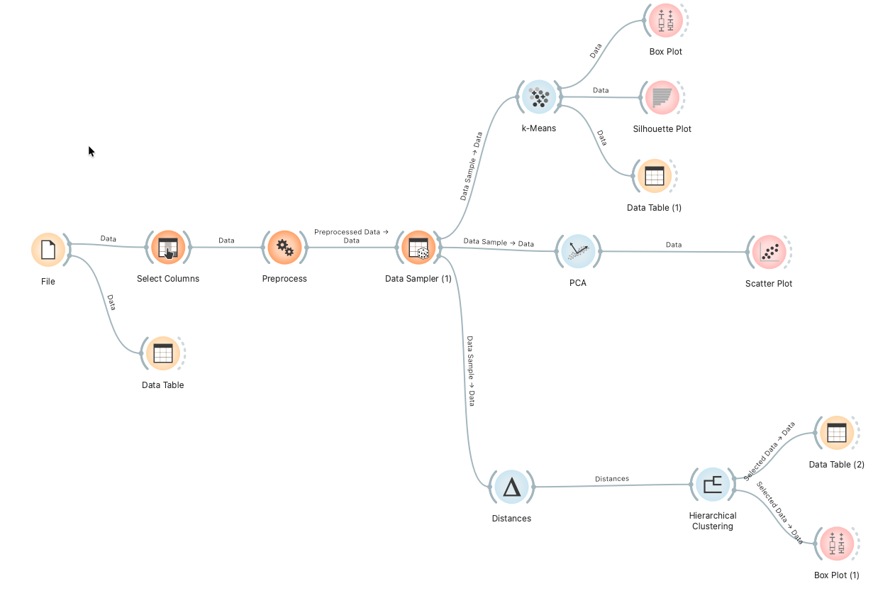
ORANGE WORKFLOW
Orange Canvas Workflow — Screenshot

Slide 7
PREPROCESSING
Preprocessing & Sampling Decisions
1
Load Dataset
2
Select Columns
Imported Parkinson's Telemonitoring CSV into Orange via the File widget.
Set 16 voice features as Attributes (clustering inputs). Set subject#, age, sex, test_time, motor_UPDRS, total_UPDRS as Meta (reference only).
3
Preprocess — Standardize
4
Data Sampler — 4,000 rows
Applied Z-score normalization so all 16 features contribute equally. Required because K-Means and distance-based methods are scale-sensitive.
Orange's Silhouette Plot cannot compute scores for datasets above 5,000 rows. Our dataset had 5,875, so we sampled 4,000 rows with a fixed seed for reproducibility.
Notes:
Four preprocessing steps, all standard. First, load the data. Second, Select Columns to route voice features as inputs and everything else as Meta. Third, standardize — this is non-negotiable for K-Means and distance-based methods; without it, large-scale features like HNR dominate. Fourth, sample to 4,000 rows because of Orange's silhouette limit. We used a fixed random seed so anyone running our workflow gets the same 4,000 rows.

Slide 8
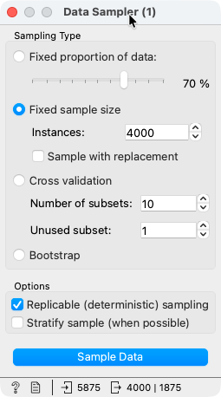
SAMPLING
Data Sampler Settings
Why we sampled
Orange’s Silhouette Plot cannot compute scores for datasets above 5,000 rows.
Our dataset had 5,875 rows — just over the limit. We sampled 4,000 rows with a fixed seed for reproducibility.
Settings:
• Fixed sample size: 4,000
• Replicable (deterministic) sampling: ON
• Sample with replacement: OFF

Slide 9
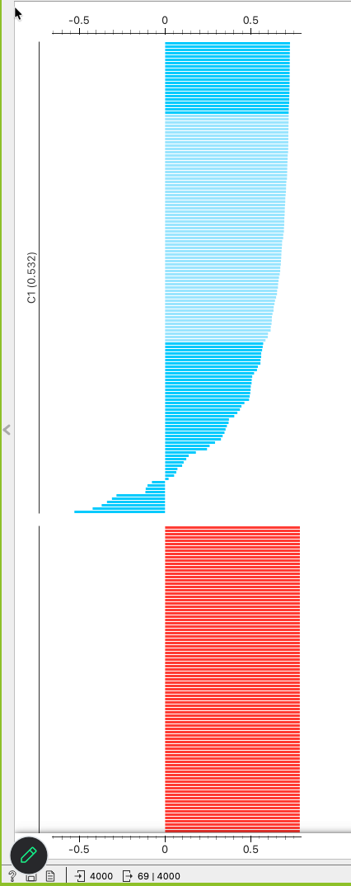
K-MEANS
K-Means: Method & Parameter Testing
K-Means Algorithm
Choosing k — Silhouette Score
Assigns each point to its nearest centroid
Iteratively re-computes centroids until stable
Minimizes within-cluster variance
Requires specifying k in advance
Silhouette score measures how tightly a point fits its own cluster vs. neighbouring clusters. Ranges –1 to +1; higher means better-defined clusters.
We tested k = 2 through 6 and picked the highest scoring k.
k values tested:
2
3
4
5
6
← Best
Notes:
K-Means is partition-based — you tell it how many clusters you want, and it optimizes placement. The challenge is choosing k. We used silhouette scores. We tested k = 2 to 6. A silhouette score near 1 means clusters are tight and well-separated. Near 0 means overlap. Below 0 means misassignment. Next slide shows the results.

Slide 10
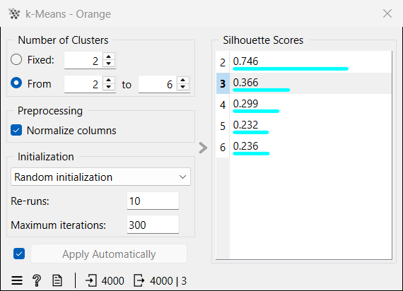
K-MEANS RESULTS
K-Means Silhouette Scores: k = 2 to 6
k = 2 selected as optimal
Notes:
The silhouette results were very clear. k = 2 scored 0.746 — strong, well-separated clusters. k = 3 dropped to 0.366. k = 4 and 5 dropped further. There's a tiny uptick at k = 6 but nowhere near k = 2. We selected 2 clusters. The data is clearly telling us two groups is the natural structure here.

Slide 11
CLUSTER PROFILES
K-Means: Cluster Profiles from Voice Features
C1 — Higher Acoustic Impairment
C2 — Lower Acoustic Impairment
Higher Jitter(%) — more pitch instability
Higher Shimmer — more amplitude variation
Higher NHR — more noise in voice
Higher RPDE & PPE — more complexity
Lower HNR — less clarity
Lower Jitter(%) — stable pitch
Lower Shimmer — consistent amplitude
Lower NHR — cleaner signal
Lower RPDE & PPE — simpler pattern
Higher HNR — better clarity
Acoustic instability · noise · low clarity
Stable voice · low noise · high clarity
Notes:
C1 shows every sign of acoustic instability: higher pitch variation, higher amplitude variation, more noise, lower clarity. C2 is the opposite: stable, clean, clear voice. These interpretations came entirely from box plots for each voice feature — no UPDRS involved. Next we check whether these acoustic clusters actually correlate with symptom severity.

Slide 12
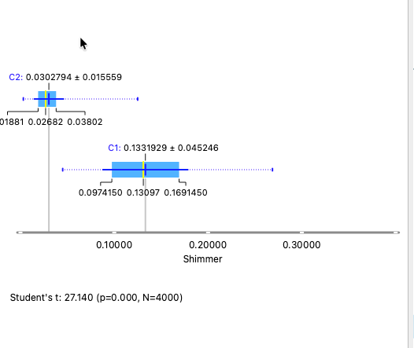
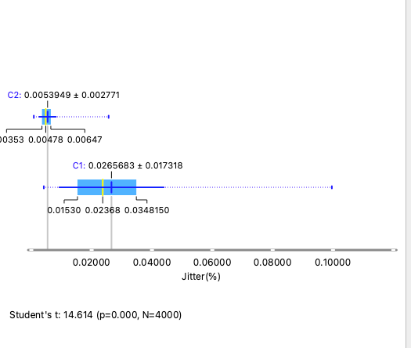
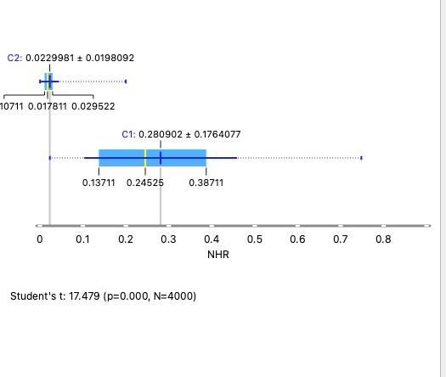
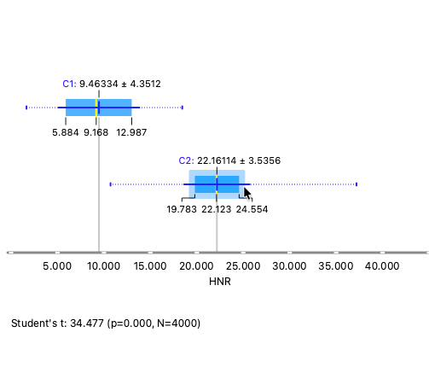
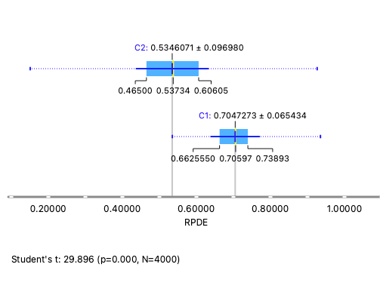
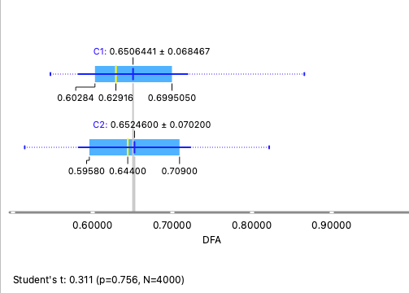
K-MEANS BOX PLOTS
Voice Feature Box Plots by Cluster
Shimmer
Jitter(%)
NHR
HNR
RPDE
PPE

Slide 13
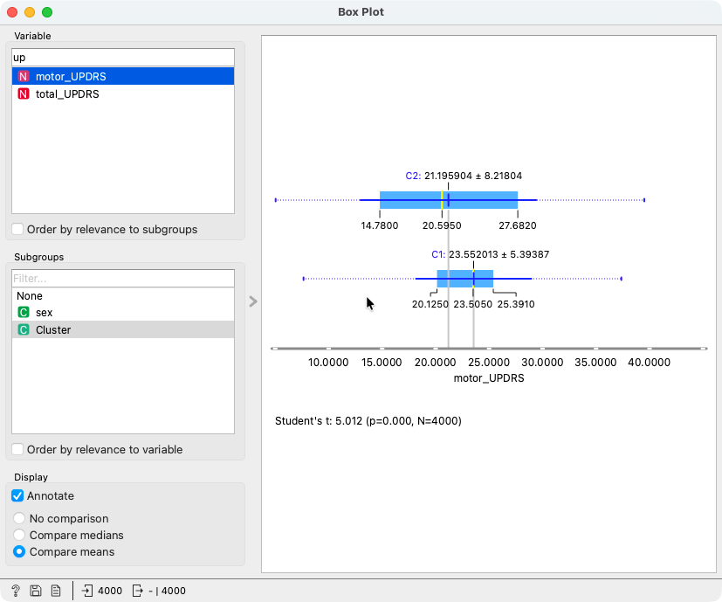
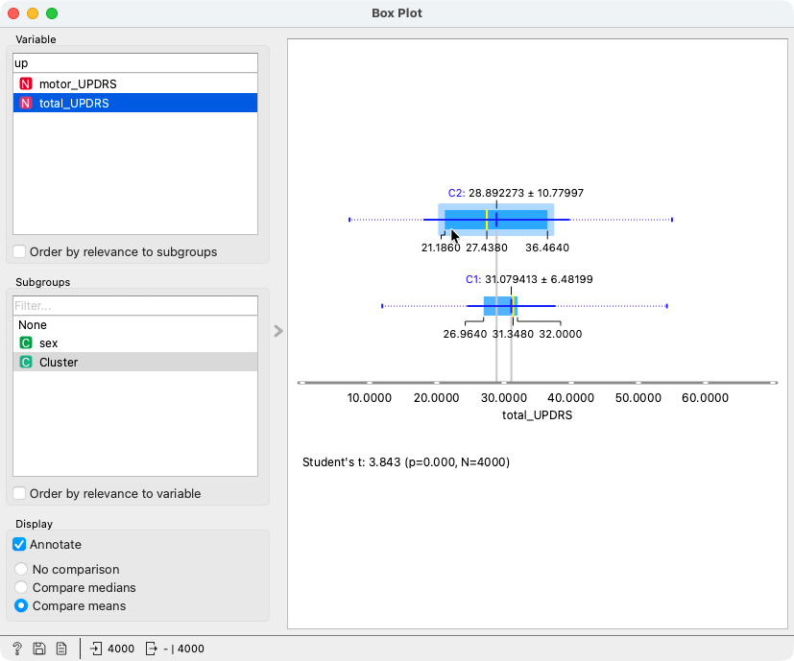
VALIDATION
UPDRS Box Plots by Cluster
motor_UPDRS by Cluster
total_UPDRS by Cluster
C1 (Higher Impairment): motor_UPDRS 23.55 · total_UPDRS 31.08 C2 (Lower Impairment): motor_UPDRS 21.20 · total_UPDRS 28.89

Slide 14
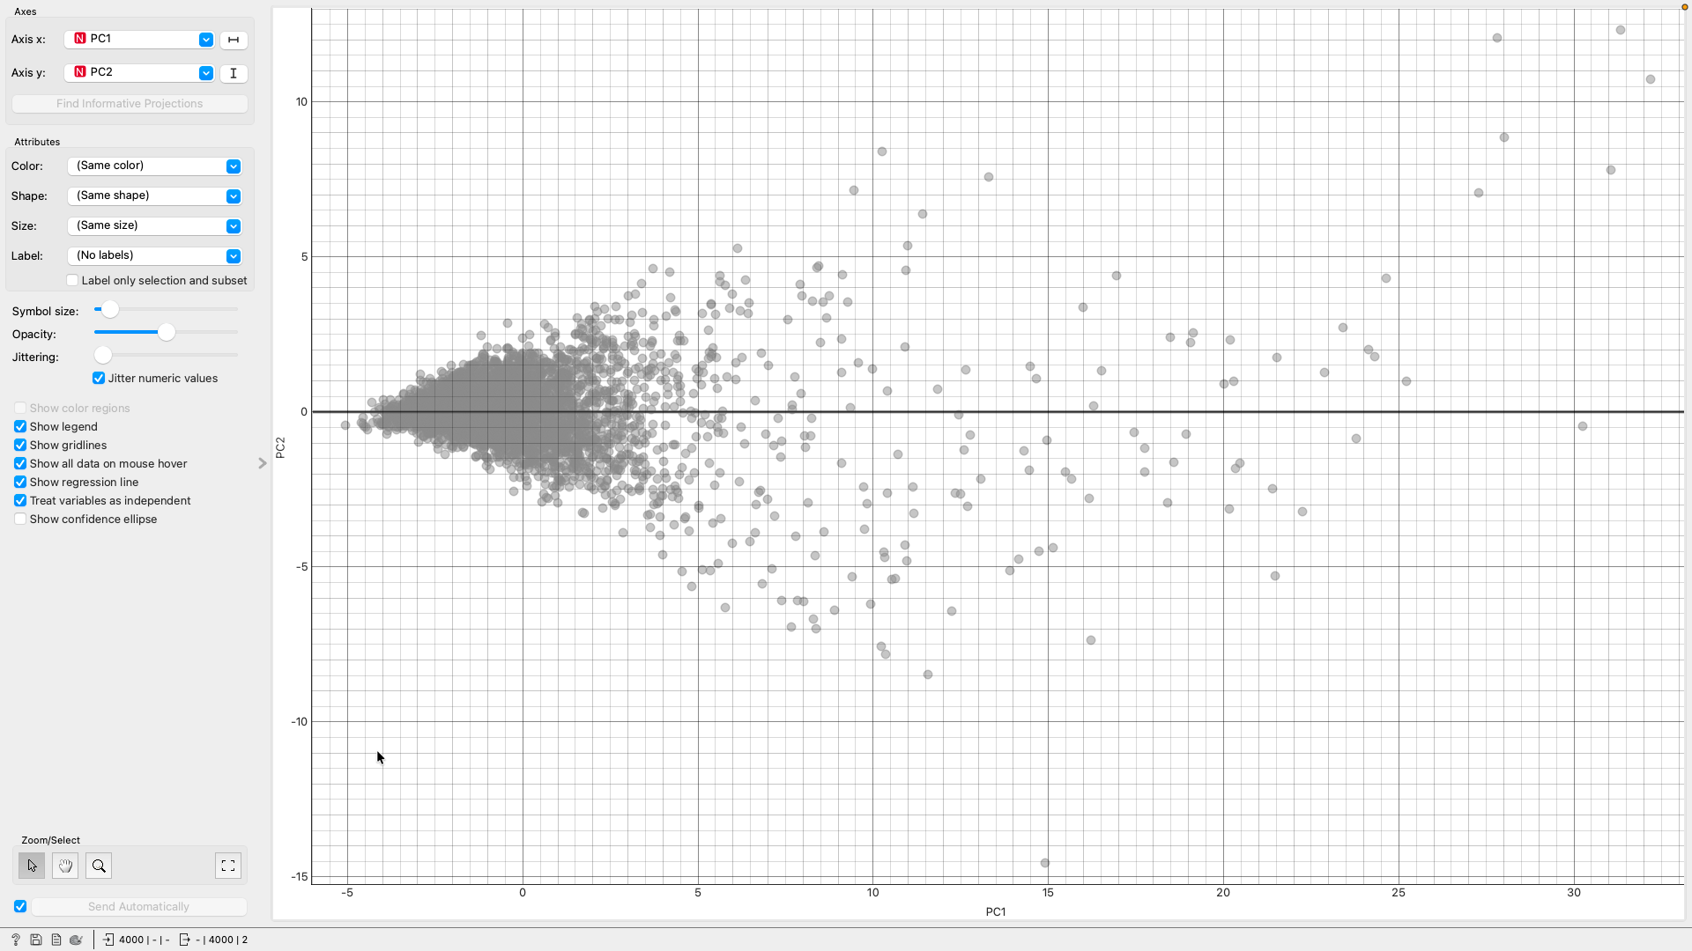
PCA
PCA: Visualizing Acoustic Structure
Why PCA?
PCA reduces 16 voice features to 2 principal components for visualization. It lets us see whether the K-Means clusters have clear visual separation in the data — without assuming any groupings.
Key Result
What this means
PC1 + PC2 explain ~80.8% of variance
80.8% of the variation in all 16 voice features is captured in just two dimensions. The Scatter Plot in Orange lets us visualize all 4,000 recordings in this 2D space, coloured by K-Means cluster label.
Notes:
PCA is not a clustering method — it's a visualization tool. We used it to check whether the structure K-Means found actually shows up visually. The first two principal components together explain about 80.8% of the variance in the 16 voice features. That's a strong result — it means most of the information in our 16-dimensional data can be represented in two dimensions. When we colour the PCA scatter plot by K-Means cluster labels, we can visually see how well-separated the clusters are. Strong visual separation in the PCA plot supports our k = 2 choice.

Slide 15
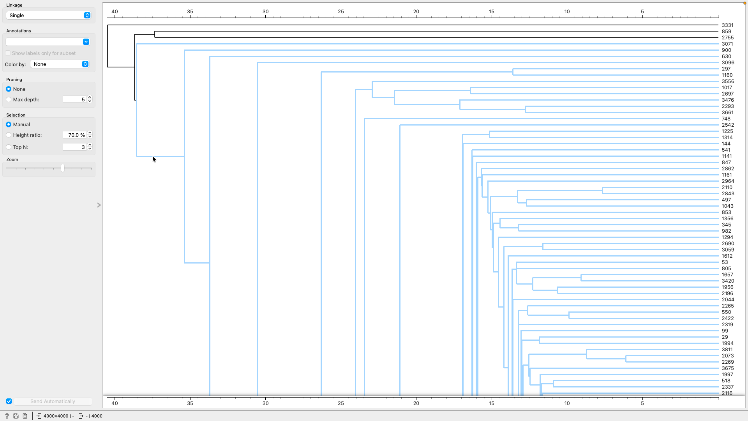
HIERARCHICAL CLUSTERING
Hierarchical Clustering: Method & Results
Dendrogram (Orange Hierarchical Clustering)
Hierarchical Method
Builds a tree (dendrogram) of cluster merges
Agglomerative: starts with each row as its own cluster, merges upward
Uses Distances widget to compute inter-row distances first
Does not require k upfront — cut the dendrogram where appropriate
Notes:
Hierarchical clustering takes a different approach. Instead of requiring k upfront, it builds a tree of merges. In Orange, the workflow is: Data Sampler → Distances widget → Hierarchical Clustering → Data Table and Box Plot. The dendrogram shows where natural cuts exist in the data. Our hierarchical analysis also supported a small number of dominant groupings — consistent with the K-Means finding of two clusters. This cross-validation between methods strengthens the conclusion that two acoustic profiles exist in the data.

Slide 16
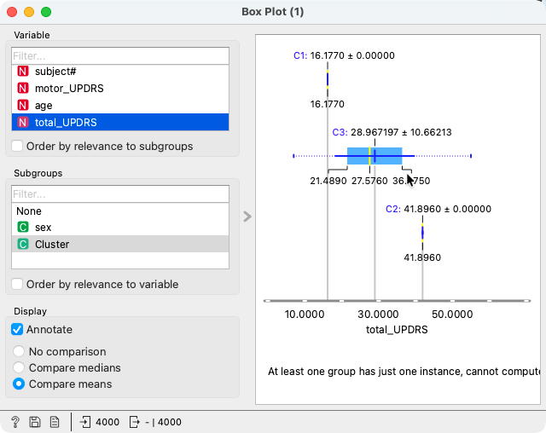
HIERARCHICAL CLUSTERING
UPDRS Severity by Hierarchical Cluster
What this shows
After clustering, we checked total_UPDRS as a Meta variable to see if clusters differed in severity — not used to build clusters, only to interpret them.

Slide 17
RESULTS SUMMARY
Results Across All Three Methods
🔵
k = 2 selected — silhouette score 0.746
Two clear acoustic profiles: Higher and Lower Impairment
K-Means
🔷
PC1 + PC2 explain ~80.8% of variance
Scatter plot shows visual separation supporting k = 2 clusters
PCA
🌿
Dendrogram supports a small number of dominant groupings
Consistent with K-Means two-cluster result
Hierarchical
Notes:
Here's the combined picture. K-Means found 2 optimal clusters with a silhouette of 0.746. PCA showed that the first two components explain 80.8% of variance, and the scatter plot visually confirms the separation. Hierarchical clustering's dendrogram also pointed to a small number of dominant groups, consistent with 2. Three different methods, all pointing to the same answer — that's a strong result.

Slide 18
Final Cluster Labels & Conclusion
Cluster C1
Cluster C2
Higher Acoustic
Impairment Profile
Lower Acoustic
Impairment Profile
motor_UPDRS: 23.55 · total_UPDRS: 31.08
motor_UPDRS: 21.20 · total_UPDRS: 28.89
① K-Means and Hierarchical Clustering both supported a two-profile structure in voice data.
② PCA confirmed visual separation, with PC1 + PC2 explaining ~80.8% of variance.
③ Acoustic clusters may reflect differences in UPDRS symptom severity — no clinical labels were used.
Notes:
To wrap up: we found two acoustic profiles across all three methods. C1 — higher acoustic impairment, more noise and instability, higher UPDRS on average. C2 — lower impairment, stable clean voice, lower UPDRS. PCA supports this with 80.8% variance in two components. Hierarchical clustering aligns with k = 2. Voice data alone was enough to surface these patterns — no clinical labels needed.

Slide 19
LIMITATIONS
Limitations & Future Work
⚠️ Repeated Measures
⚠️ Sampling Constraint
Multiple recordings per patient mean rows aren't independent. Cluster assignments may be driven by individual voice characteristics rather than disease state.
We used 4,000 of 5,875 rows due to Orange's silhouette limit. A different random seed could shift cluster boundaries slightly.
⚠️ Binary Interpretation
⚠️ Correlation, Not Causation
k = 2 is clean and interpretable, but acoustic impairment likely exists on a continuum — not as two discrete groups.
UPDRS differences across clusters are associations, not evidence that voice features cause symptom severity.
Future Work: Patient-level aggregation · DBSCAN or GMM · Longitudinal cluster tracking · Feature importance via PCA loadings
Notes:
Four honest limitations. Repeated measures means patient identity could be driving some cluster structure. Sampling introduces minor variability. k = 2 is a simplification of a continuous spectrum. And UPDRS correlations aren't causal. Future work: aggregate to patient level, try DBSCAN which doesn't need k, track clusters over time, and examine PCA loadings to see which features drive PC1.

Slide 20
References
[1] A. Tsanas & M.A. Little (2010). Parkinson's Telemonitoring Voice Measurements. UCI Machine Learning Repository. Dataset ID: 189. https://archive.ics.uci.edu/dataset/189/parkinsons+telemonitoring
[2] Tsanas, A., Little, M.A., McSharry, P.E., & Ramig, L.O. (2010). Accurate telemonitoring of Parkinson's disease progression by noninvasive speech tests. IEEE Transactions on Biomedical Engineering, 57(4), 884–893.
[3] Orange Data Mining. (n.d.). Orange Canvas — Visual Programming & Data Analysis. https://orangedatamining.com
[4] Rousseeuw, P.J. (1987). Silhouettes: A graphical aid to interpretation and validation of cluster analysis. Journal of Computational and Applied Mathematics, 20, 53–65.
[5] MacQueen, J.B. (1967). Some methods for classification and analysis of multivariate observations. Proceedings of the Fifth Berkeley Symposium on Mathematical Statistics and Probability, 1, 281–297.
[6] Jolliffe, I.T. (2002). Principal Component Analysis (2nd ed.). Springer.
Notes:
References are listed here. Added a PCA reference — Jolliffe 2002 is the standard citation for Principal Component Analysis. All other citations remain the same as before. Thank you — happy to take questions.

