Slide 1
Python
PROGRAMMING COURSE

Slide 2
Previous Topics…
Practice
  Django
  Pandas
  CSV

Slide 3
Topics…
Data Cleaning

Slide 4
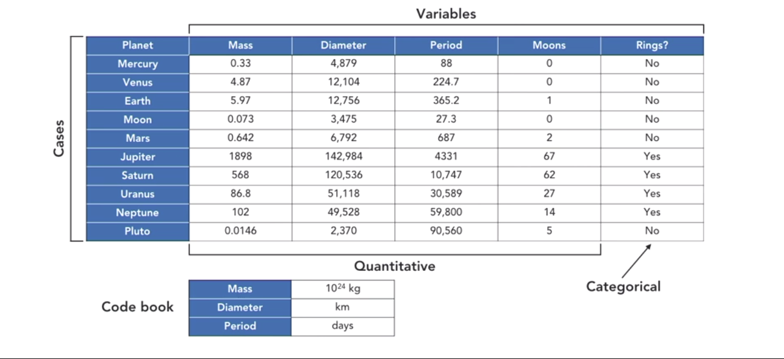
Structure of Data

Slide 5
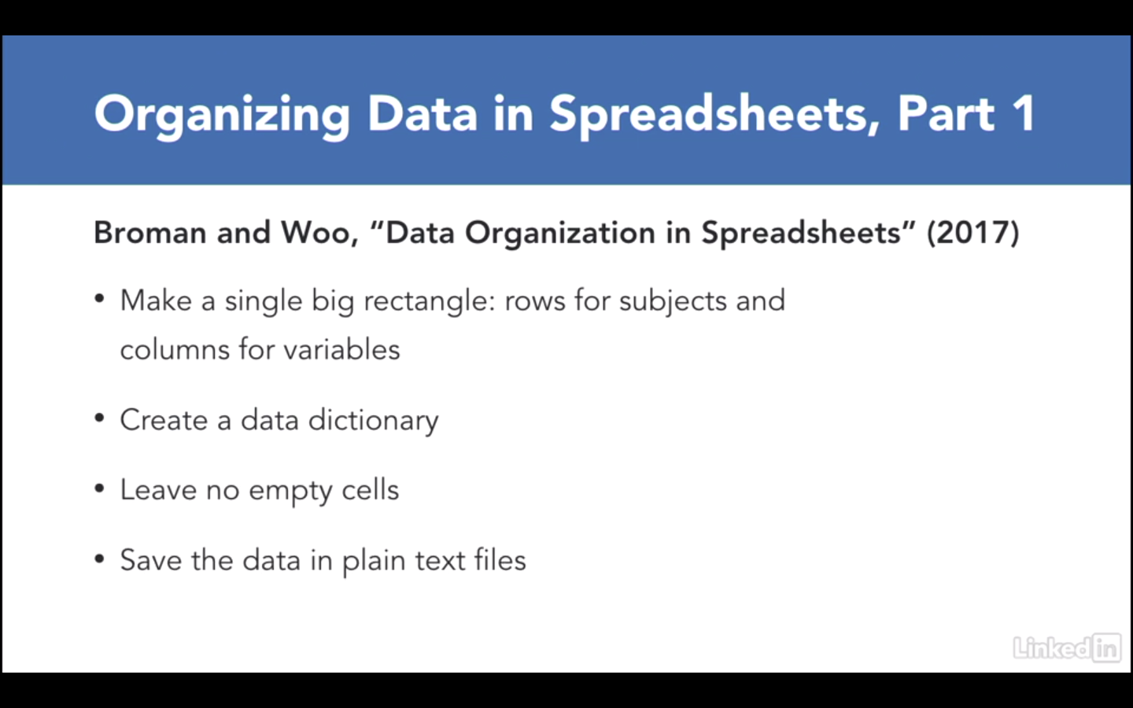
Structure of Data

Slide 6
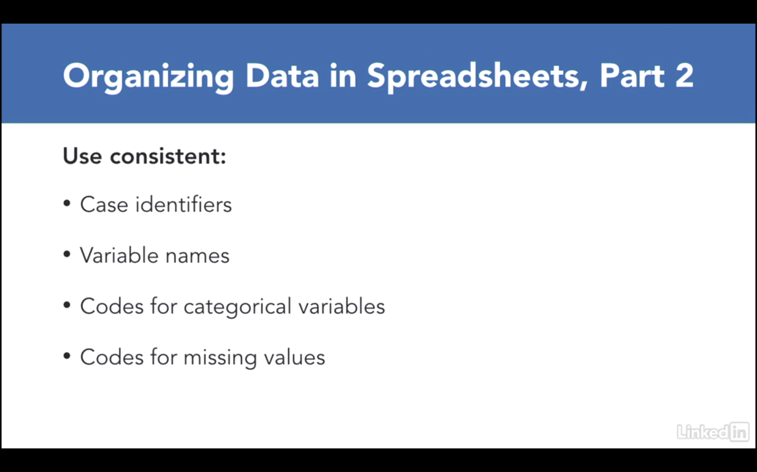
Structure of Data

Slide 7
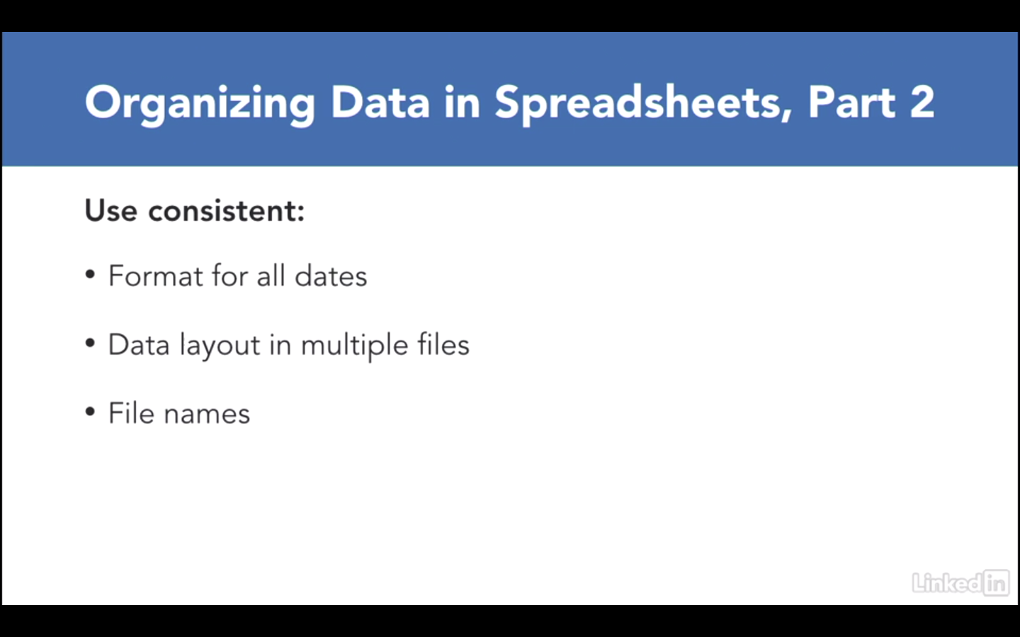
Structure of Data

Slide 8
Pandas
Load planet.csv using jupyter notebook
For data cleaning using pandas
Load billboard.csv using jupyter notebook

Slide 9
Task
Classwork/Homework:
  Clean the data set comes from the World Health Organization and it records the number of confirmed tuberculosis cases by country, year, and demographic group.
  Read tb.csv
  https://www.dropbox.com/sh/axkadqlst185jq3/AADeswzw6NRAUsMd6jHTfCiha?dl=0

