Slide 1

UNITY and C# Programming
Uroš Stanojkov 601/2018

Slide 2

What is Unity? – unity.com
Unity is a cross-platform game engine. The engine can be used to create 3D, 2D games, even a virtual reality games, and other simulations. The first launch was for Mac OS (2005.), and now it support over 25 platforms.
Unity is written in C++, and it is using C# as Unity Scripting API.
As C++, C# is object oriented programming languages. Everything is about objects that contain data and functions (methods).

Slide 3


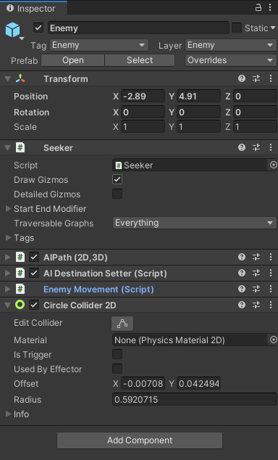
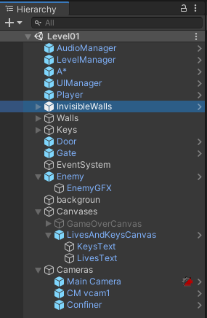
Unity has a lot of important features for making any project. The two most used and most common windows in Unity are
-the Hierarchy window – contains a list of every Game Object in the scene.
-the Inspector window – shows detailed information about the selected Game Object, and all his components and their properties.

Slide 4
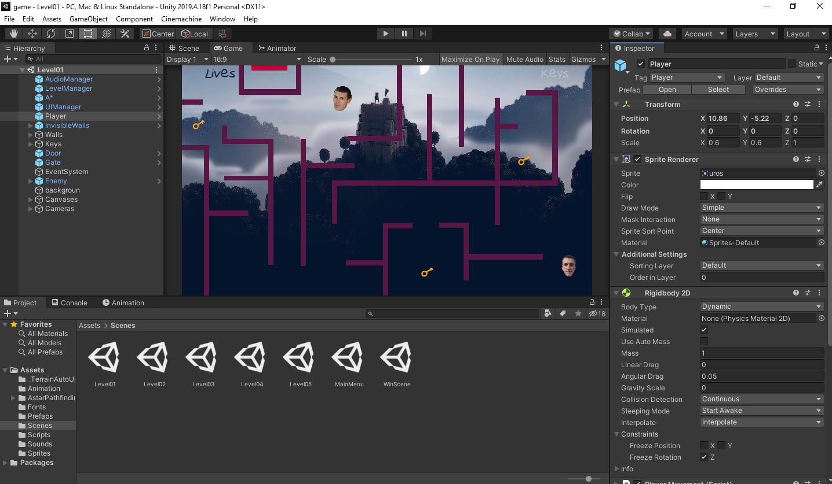

Slide 5
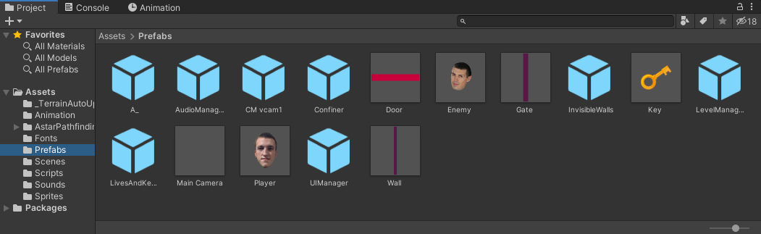
As we can see on the previous slide, there is completed image what programmer see when he is developing a game. Beside the hierarchy and inspector window, there are a lot more things to mention. Scene and game view take up most of the screen. We have project, console and animation tabs at the bottom of the screen, and at the bottom left we can see all the assets that we are using for the game. Parts of the assets are Scenes, Scripts, Prefabs, Sprites, etc.

Slide 6

Important classes in Unity
Transform
GameObject
Vectors
MonoBehaviour
Provides you with a variety of ways to work with a GameObject’s position, rotation and scale via script.
Represents the type of objects which can exist in a Scene.
Classes used for manipulating 2D, 3D points, directions and lines.
Time
The base class from which every Unity script derives by default.
Class that allows to control time and framerate of project.

Slide 7

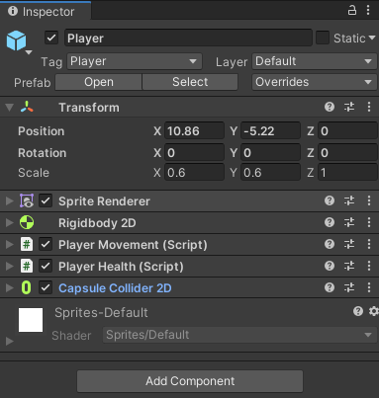
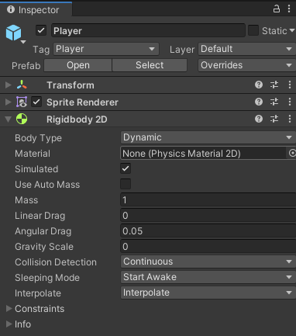
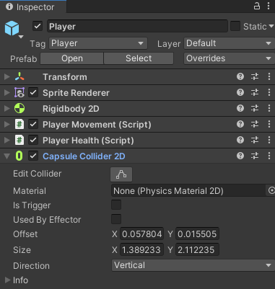
Function display in Unity
Transform
Rigidbody 2D
Colliders

Slide 8
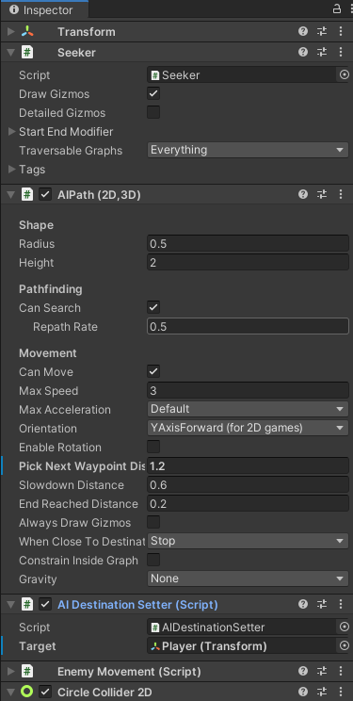
Scripting and some other functions
Public, private and protected variables and methods
Public – player movement speed, enemy movement speed
Private – only methods of this class can access the member
Protected – methods of this class and methods of derived class can access the member

Slide 9
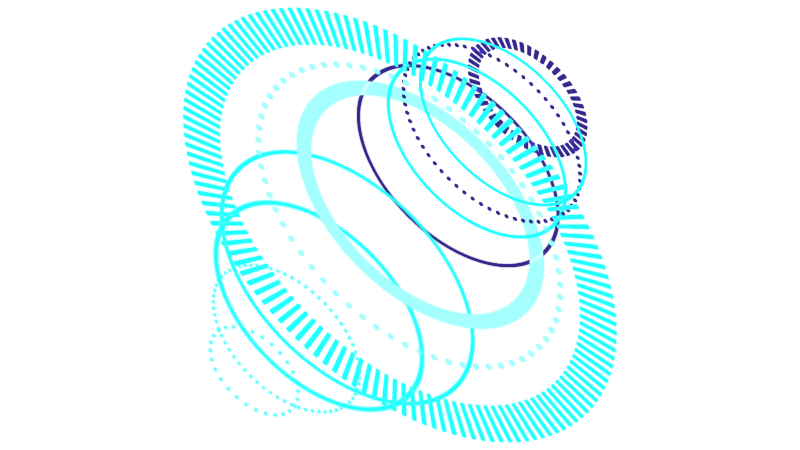
Other important classes
Awake
01
Start
02
Update
03
FixedUpdate
04
Called just after a prefabs are instantiated.
Called before the first frame update.
Called once per frame.
Can be called more times per frame. All physics calculations and update happens after FixedUpdate.

Slide 10
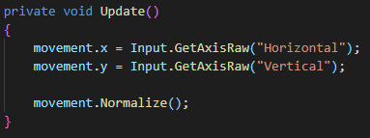


Update
FixedUpdate

Slide 11
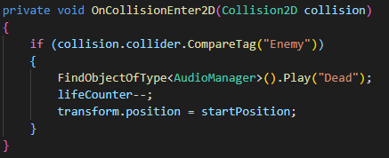

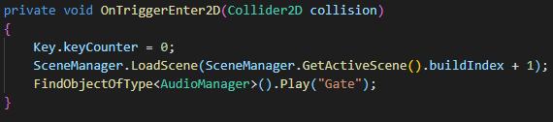
On Event functions
OnTriggerEnter2D
OnCollisionEnter2D
Sent when another object enters a trigger collider attached to this object (2D physics)
Sent when an incoming collider makes contact with the object’s collider (2D physics) Example: Player hits a wall, wall is represent as a collider

