Slide 1


World Happiness Report
Uroš Petković, Andre Novikov, Axana Raiser & Jennifer Dersjant

Slide 2
RESEARCH QUESTION
What are relevant factors that drive a nation’s happiness?
“
What are relevant factors that drive a nation’s happiness?
”

Slide 3








PROCESS
Step 4
Correlation calculations
Step 1
Data cleaning using Python with the packages Pandas and Numpy
Iterative process
Step 3
Visualisations of the data to answer the research question
Step 2
Checking and solving data for distribution, multicollinearity, outliers and nulls

Slide 4
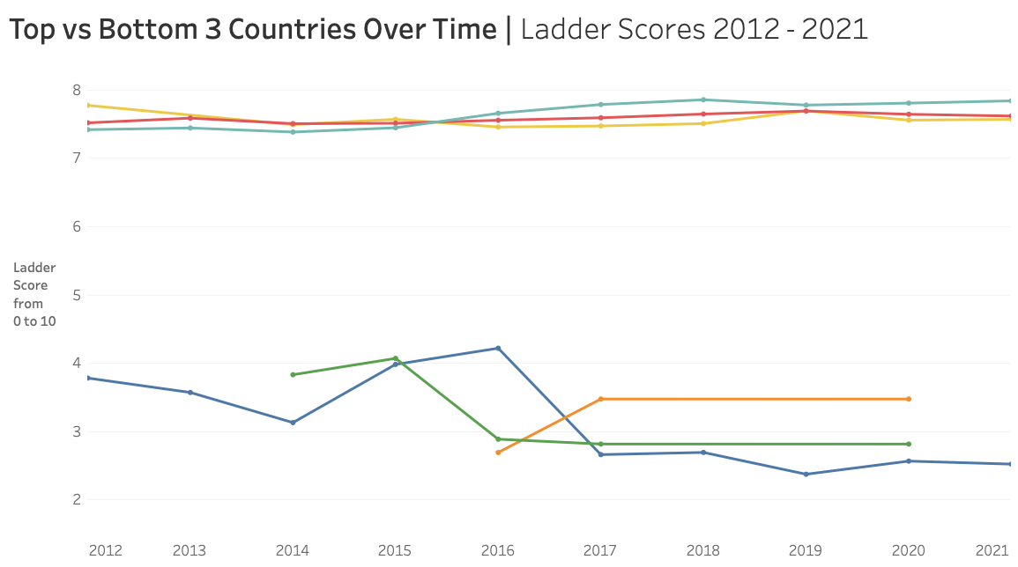
■ Finland ■ Denmark ■ Switzerland ■ South Sudan ■ Central African Republic ■ Afghanistan

Slide 5
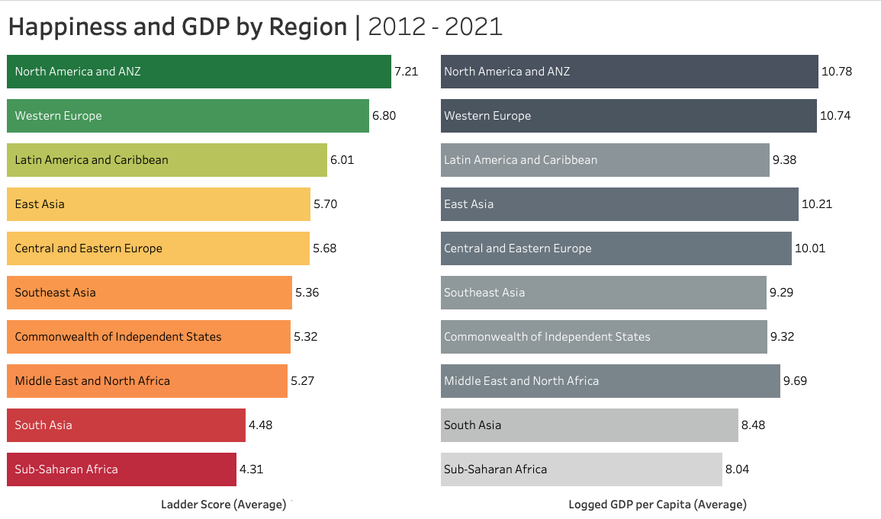
(Post-Sovjet Republic)

Slide 6
(Post-Sovjet Republic)

Slide 7
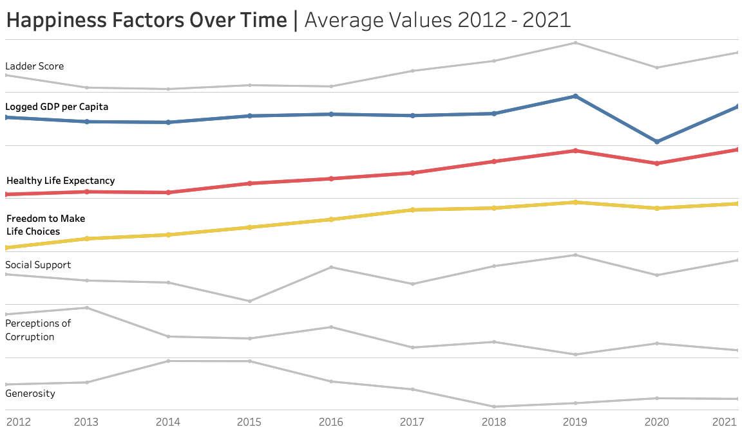

Slide 8
CORRELATIONS
0.78
0.75
0.72
Ladder Score &
Logged GDP per Capita
Ladder Score &
Healthy Life Expectancy
Ladder Score &
Social Support
0.54
-0.39
0.15
Ladder Score &
Freedom to Make Life Choices
Ladder Score &
Perception of Corruption
Ladder Score &
Generosity

Slide 9
Key takeaways
Money alone can’t buy you happiness,
but the lack of it can buy you misery
Standardised methodology might not work for
every country in the world
Future research should focus more on
nation-level analysis

Slide 10

Questions?

