Slide 1
RESEARCH PRESENTATION
Leveraging Large Language Models
for the Automated Generation of
Assessment Items Based on SOLO Taxonomy
Uroš Petrašković¹ · Goran Savić¹ · Mihaela Osmajić¹ · Milan Segedinac¹ · Peter Steiner²
¹ University of Novi Sad, Faculty of Technical Sciences, Serbia
² Pädagogische Hochschule St. Gallen (PHSG), Switzerland

Slide 2
01 · MOTIVATION
The Problem We're Solving
THE PROBLEM
OUR SOLUTION
Manual creation is slow, costly, and cognitively demanding.
An automated pipeline grounded in pedagogical theory.
Educators spend a lot of time writing assessments
It is hard to cover varied cognitive levels
Quality drops under deadline pressure
LLMs alone aren't enough
Raw generation lacks structure. Items drift away from intended learning outcomes.
SOLO taxonomy for cognitive depth
Ontology for structured knowledge
Theory + structure = quality
LLMs for SOLO Assessment Generation
2 / 14

Slide 3
02 · THEORETICAL BACKGROUND
The SOLO Taxonomy
Structure of Observed Learning Outcomes, a framework that categorizes the increasing complexity of a learner's understanding.
1
2
3
4
5
Prestructural
Unistructural
Multistructural
Relational
Extended Abstract
No understanding;
responses missed
or irrelevant
Grasps a single
aspect of the
concept
Understands several
aspects but not
their connections
Integrates pieces
into a coherent
whole
Generalizes &
applies to new
situations
Our system targets levels 2 → 5. Prestructural is excluded as it represents absent understanding.
LLMs for SOLO Assessment Generation
3 / 14

Slide 4
03 · RELATED WORK
Building on Prior Research
Rule-Based Generation
SOLO for Programming
Mitkov & Ha (2003)
Lister et al. (2006)
Used NLP rules to transform declarative sentences into questions. Effective for simple facts but produced awkward output on complex material.
Showed assessments can be classified by SOLO levels. Critiqued over-emphasis on low-level skills and gave us our taxonomic frame.
Distractor Quality
LLMs in Education
Liang et al. (2018)
Kasneci et al. (2023)
Proposed a learn-to-rank approach. Key insight: good distractors should be semantically related yet clearly wrong on close reading.
Reviewed ChatGPT in education — fast and diverse generation, but raised concerns about accuracy, bias, and need for teacher oversight.
LLMs for SOLO Assessment Generation
4 / 14

Slide 5
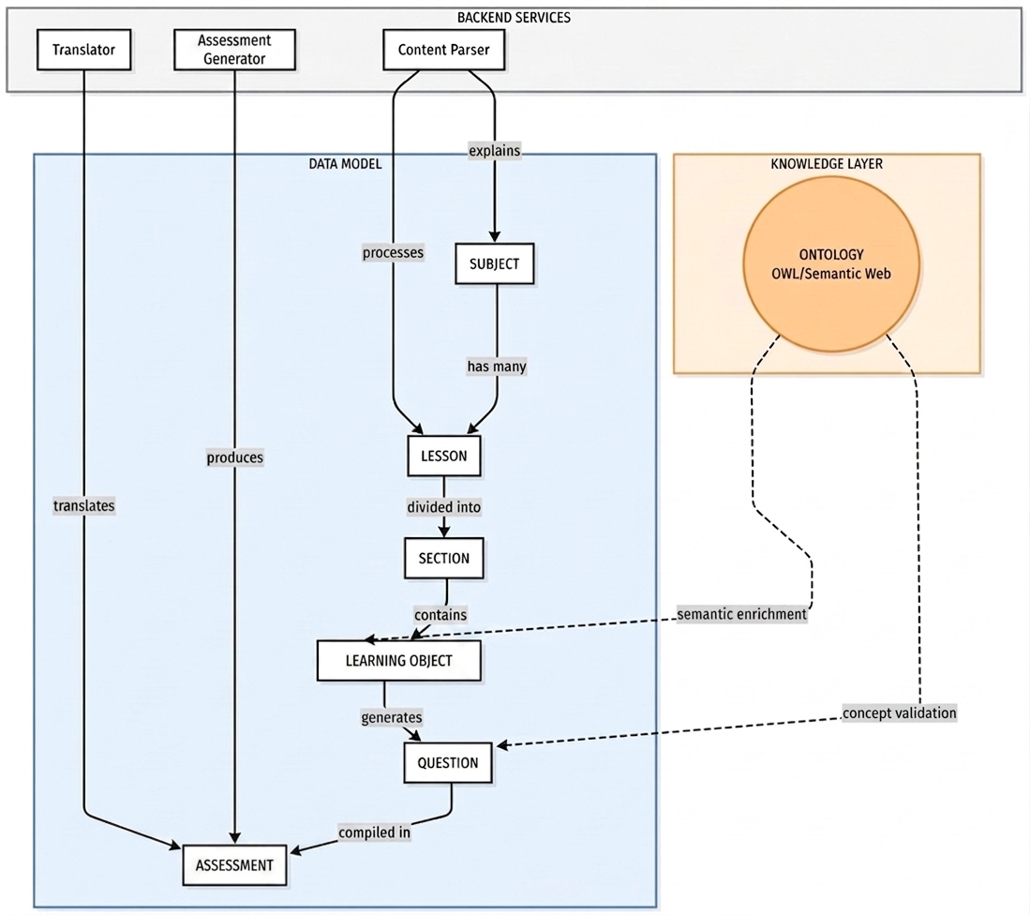
04 · SYSTEM OVERVIEW
Architecture & Workflow
Three-tier monolithic web application
Backend services: Translator, Assessment Generator, Content Parser
Data model - hierarchical structure: Subject → Lesson → Section → Learning Object → Question → Assessment
Knowledge layer - OWL ontology providing semantic enrichment and concept validation
Figure 1 Workflow diagram
LLMs for SOLO Assessment Generation
5 / 14

Slide 6
05 · PROCESSING PIPELINE
From PDF to Assessment
1
2
3
4
5
Ingest
Parse
Structure
Enrich
Generate
PDF lecture
notes uploaded
→
LLM extracts
logical components
→
Hierarchy stored:
Lessons → Sections
→ Learning Objects
→
Ontology relations
built, exported
as OWL
→
Items produced
for 4 SOLO levels
Model used in this study
Local Qwen 2.5 (14B parameters) - runs offline, no API keys required. Architecture is model-agnostic, so swapping in another LLM is straightforward.
LLMs for SOLO Assessment Generation
6 / 14

Slide 7
06 · GENERATION STRATEGY
Question Types Across SOLO Levels
Each level uses a tailored prompt adapted to its cognitive complexity. Every item is stored with options, correct answer, and explanation.
Unistructural
Multistructural
Relational
Extended Abstract
PROMPT FOCUS
PROMPT FOCUS
PROMPT FOCUS
PROMPT FOCUS
Single fact
Multiple facts
Connect concepts
Apply in new context
WHAT IT DOES
WHAT IT DOES
WHAT IT DOES
WHAT IT DOES
Asks about one isolated concept or definition.
Compares or lists several independent aspects.
Asks how two or more ideas link together.
Generalizes knowledge to an unfamiliar domain.
LLMs for SOLO Assessment Generation
7 / 14

Slide 8
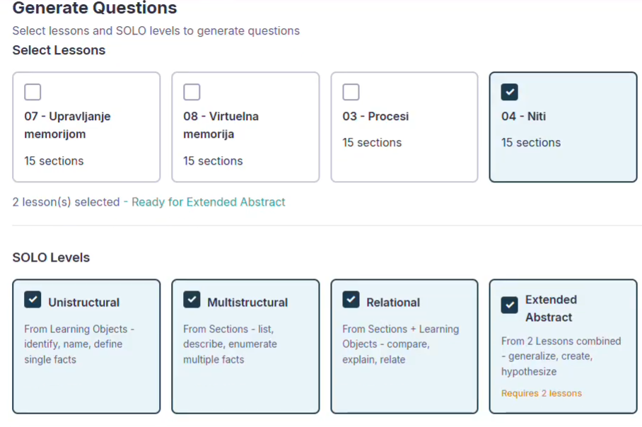
07 · USER INTERFACE
Configuring an Assessment
Educator workflow
Select desired lessons
Choose target SOLO levels
Specify number of questions per level
System assembles the assessment automatically
Lessons shown in this example were auto-generated from raw teaching materials in Serbian (Operating Systems course).
Figure 2 Setting parameters for an assessment
LLMs for SOLO Assessment Generation
8 / 14

Slide 9
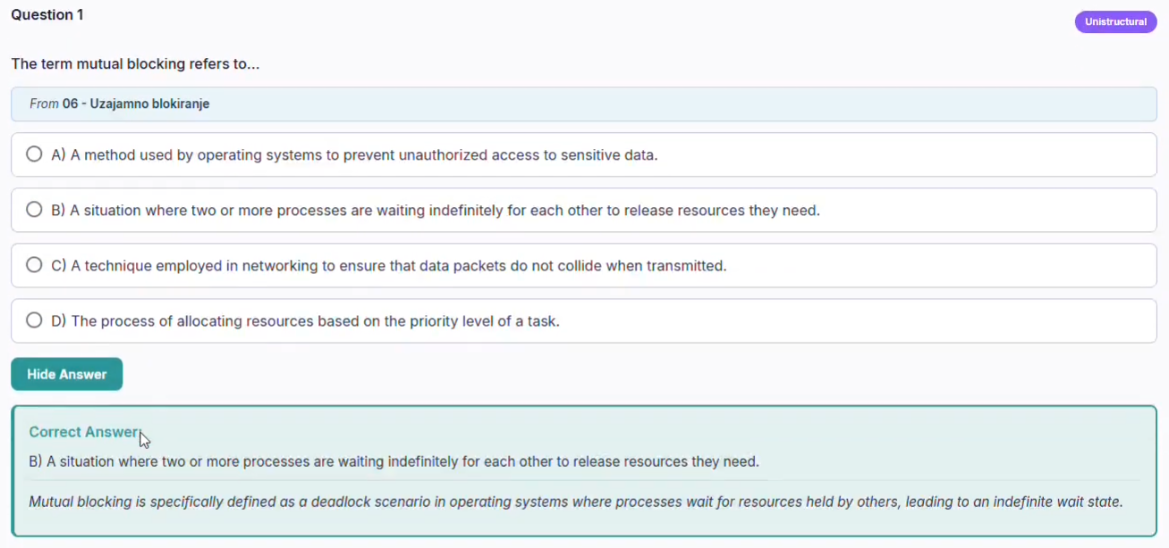
08 · USER INTERFACE
A Generated Assessment Item
Each item is presented with multiple-choice options, the correct answer, and a detailed explanation, visible to the educator for review.
Figure 3 An assessment item rendered in the system UI
SOLO level tag
Source attribution
Reveal answer + rationale
shown per question
from which lesson
for teacher review
LLMs for SOLO Assessment Generation
9 / 14

Slide 10
09 · EVALUATION
Pilot Study Design
Research questions
Study setup
RQ1
METHOD
Qualitative pilot evaluation
Do the automatically generated assessment items align with their assigned SOLO level?
DOMAIN
Operating Systems · Software Testing
FOCUS
Item validity & distractor quality
RQ2
Are the automatically generated distractors plausible?
LLMs for SOLO Assessment Generation
10 / 14

Slide 11
10 · EXAMPLE
Extended Abstract - A Closer Look
EXTENDED ABSTRACT
A web server receives 5,000 concurrent client connections, each requiring brief CPU work followed by long I/O waits. Spawning a full OS process per connection consumes too much memory due to PCB overhead. Which OS-level approach most effectively reduces per-connection overhead while still supporting concurrent execution?
A
Use kernel-level threads sharing a single process address space, where each thread has only a small TCB and shares memory mappings with sibling threads.
B
Use a single process with fork() called only when CPU work is needed, terminating each child immediately after the work completes to reclaim its PCB.
CORRECT
STRONG DISTRACTOR
Threads share address space; minimal per-connection cost
fork() still creates full PCBs; 5,000 cycles is expensive
C
Spawn 5,000 processes upfront at server startup and reuse them via a queue, avoiding per-request PCB allocation costs at runtime.
D
Disable context switching entirely so the OS doesn’t need to save state in PCBs or TCBs, processing connections strictly in arrival order.
STRONG DISTRACTOR
WEAK DISTRACTOR
Pre-allocating still consumes 5,000x PCB memory upfront
Eliminates concurrency entirely; defeats the purpose
LLMs for SOLO Assessment Generation
11 / 14

Slide 12
11 · FINDINGS
Quality Decreases with Cognitive Complexity
As taxonomic complexity increased, item quality decreased.
Lower levels excelled
Distractor redundancy
Unistructural and multistructural items aligned with intent and had plausible distractors.
Multiple options occasionally conveyed the same incorrect concept.
Higher levels struggled
Adhering to the course material
Relational and extended abstract items showed validity concerns, sometimes oversimplified.
Sometimes, especially in the case of extended abstract questions, the questions would contain things that aren’t specifically mentioned in the course material
LLMs for SOLO Assessment Generation
12 / 14

Slide 13
12 · CONCLUSION
Conclusion
Key takeaways
FUTURE WORK
1
An end-to-end pipeline that turns raw teaching materials into SOLO-classified assessments works in practice.
Where we go from here
Comprehensive empirical evaluation of question quality across all SOLO levels
Diagnose causes of quality drop at higher cognitive levels
Refine distractor generation for richer pedagogical utility
Extend beyond Multiple Choice Questions, short-answer and essay formats
2
Combining LLMs with ontology-driven structure gives the system a coherent knowledge layer.
3
Lower-cognitive-level items are already production-ready; higher levels need refinement.
LLMs for SOLO Assessment Generation
13 / 14

Slide 14
Thank you.
Questions, comments, and discussion welcome.
Corresponding author
Goran Savić
Faculty of Technical Sciences, University of Novi Sad
savicg@uns.ac.rs
Supported by the Ministry of Science, Technological Development and Innovation (No. 451-03-34/2026-03/200156) and the Faculty of Technical Sciences, University of Novi Sad (No. 01-3609/1).

