Slide 1
Out-of-distribution detection on ECG data
Bachelor Thesis
Final Presentation, April 9th 2024
Urska Rozman
Mentored by Dr. Marc Masana

Slide 2
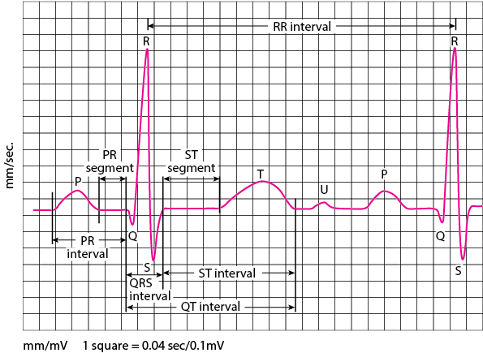
Motivation
Problems:
Manual annotation is time- and cost-intensive (labeling by experts)
Data scarcity
Class imbalance and generalization
Solutions:
Domain adaptation from synthetic data
Out-of-Distribution detection
https://www.msdmanuals.com/professional/multimedia/table/electrocardiography-ecg-waves
ECG analysis:
Importance in diagnosis’ of arrhythmias, heart attacks etc.
Assessment of abnormalities in the shape, timing, and sequence of the waves

Slide 3
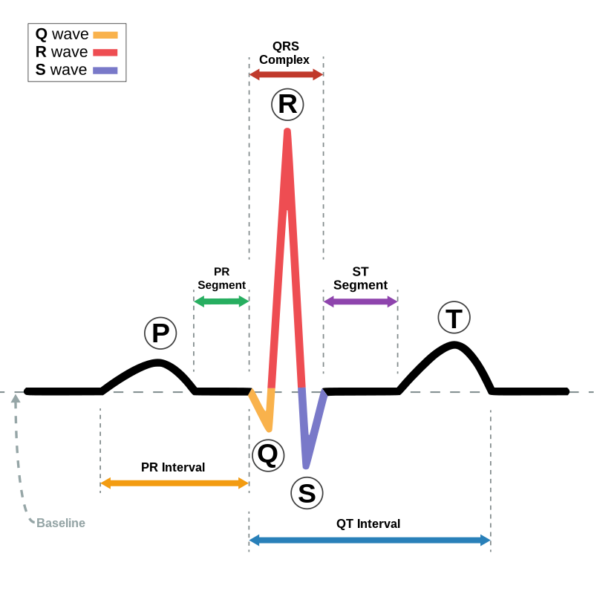
Background
P-wave: depolarization of the atria
QRS-complex: depolarization of the ventricles
T-wave: repolarization of the ventricles
P-wave:
normal duration: < 0.12 s
normal amplitude: < 2.5 mm
T-wave:
normal duration: 10 – 25 ms
normal amplitude: 12 – 66% of the R-wave, < 10 mm
QRS-complex
normal duration: 70 – 100 ms
Q-wave: < 6 mm in depth R-wave: < 26 mm in height S-wave: < 30 mm in depth
https://en.wikipedia.org/wiki/QRS_complex
https://en.m.wikipedia.org/wiki/File:ECG_principle_slow.gif

Slide 4
Datasets
Synthetic Dataset
LUDB Dataset
For the purpose of pretraining
Generated adhering to the metrics and parameters of healthy ECG signals:
For the purpose of finetuning
200 ECG signals with P, R and T annotations
Includes healthy and unhealthy data:
Wave | Amplitude | Duration
- | mV | ms
P | 4 – 30 | 100 – 200
Q | 4 – 60 | 10 – 20
R | 16 – 36 | 60 – 120
S | 4 – 30 | 10 – 20
T | 16 – 72 | 100 – 200
Rythm | Number of ECGs
Sinus rhythm | 143
Sinus tachycardia | 4
Sinus bradycardia | 25
Sinus arrythmia | 8
Irregular sinus rhythm | 2
Abnormal rhythm | 19
https://www.physionet.org/content/ludb/1.0.1/

Slide 5
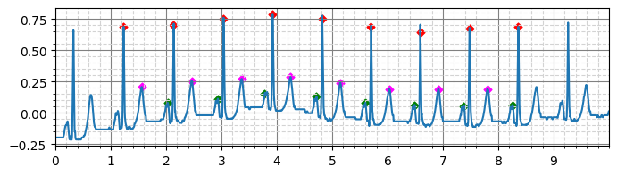
Preprocessing
Restricting the dataset to only:
II lead signals, since it usually gives a good view of the P wave and is most commonly used to record the rhythm strip (total: 200 signals)
data with all the P, R and T annotations (total: 176 signals)

Slide 6
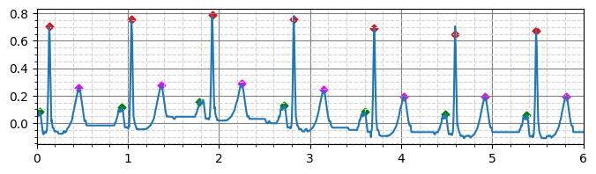
Preprocessing
Removing first and last 1000 values, since these lack labelling (before 5000 values long, now 3000)

Slide 7
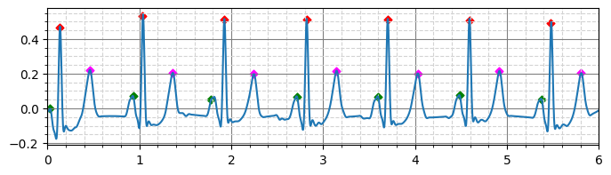
Preprocessing
Applying band pass filter to remove noise and drifting
low = 0.5 Hz / 0.5*fs
high = 20 Hz / 0.5*fs

Slide 8
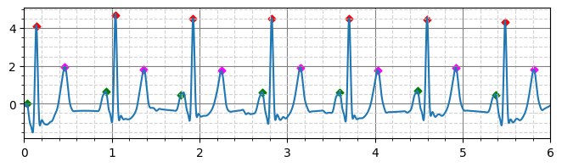
Preprocessing
Normalizing to a mean of 0 and standard deviation of 1

Slide 9
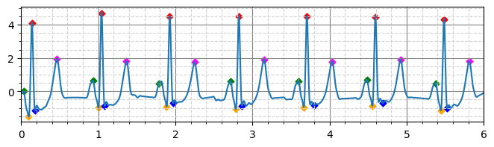
Preprocessing
Adding pseudo Q and S peaks (for some scenarios)

Slide 10
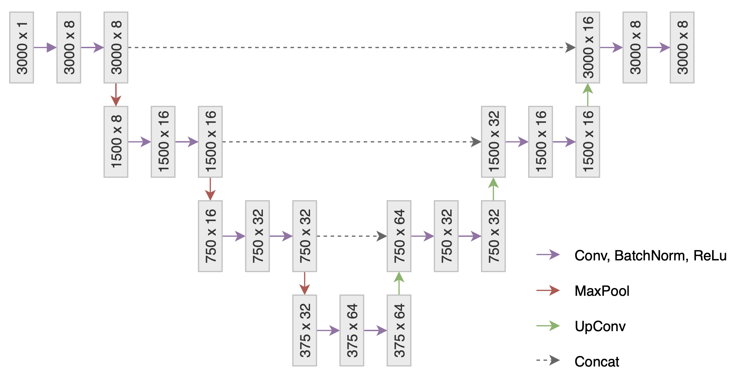
U-Net architecture

Slide 11
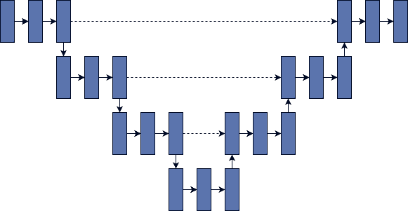
Our Proposed Approach
Model from scratch
Synthetic
Train
Domain adaptation
Real (H)
Train
PQRST predictions
CrossEntropyLoss
Weights: [0.04, 1.0, 1.0, 0.4, 1.0, 1.0]
Real (H)
Test
Latent space
OOD detection
P-value
Real (D)
Test
Latent space

Slide 12
Results
When comparing different scenarios:
Scenario | Init Dataset | Finetune Dataset | Accuracy (H) | Accuracy (D) | OoD
Synthetic only | Synthetic (PQRST) | – | 12.6% | 4.2% | 0.01837
Real only | Real (PRT) | – | 77.2% | 40.0% | 7.075e-9
Real only | Real (PRT + pseudo QS) | – | 57.3% | 20.0% | 0.04363
Real PRT | Synthetic (PQRST) | Real (PRT) | 90.7% | 42.9% | 5.4e-16
Real full | Synthetic (PQRST) | Real (PRT + pseudo QS) | 97.5% | 50.8% | 0.09256

Slide 13
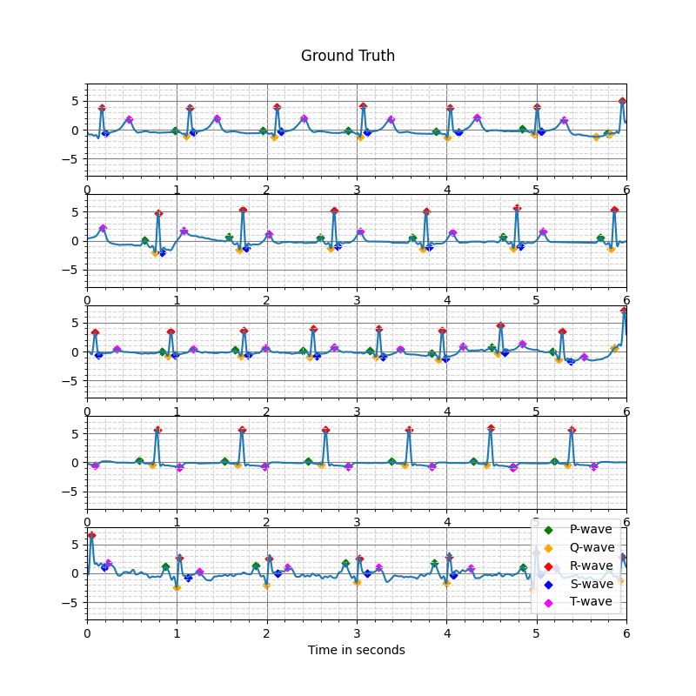
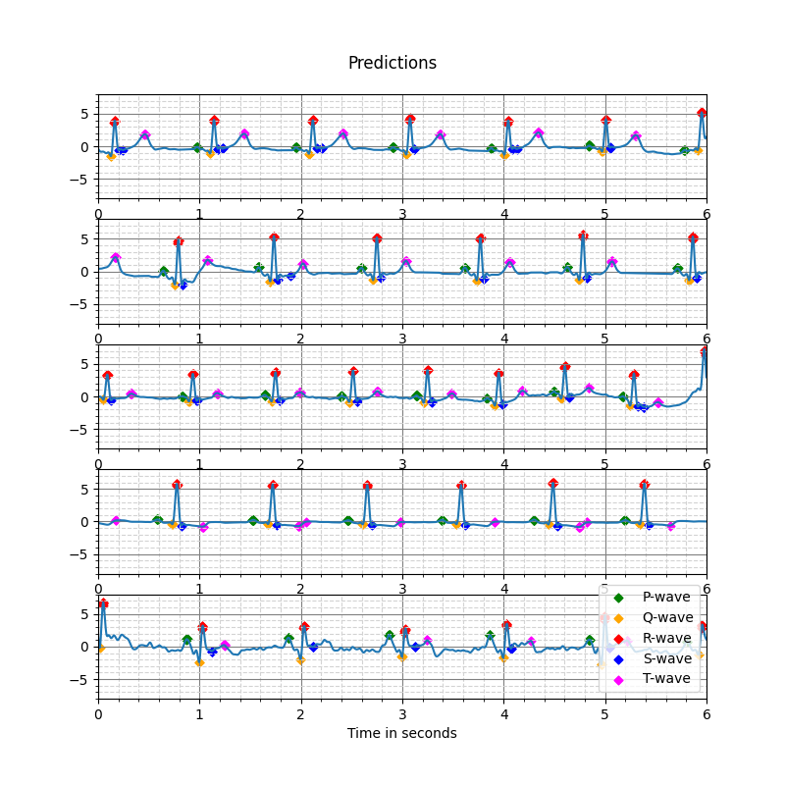
Results
Scenario Real full on healthy data

Slide 14
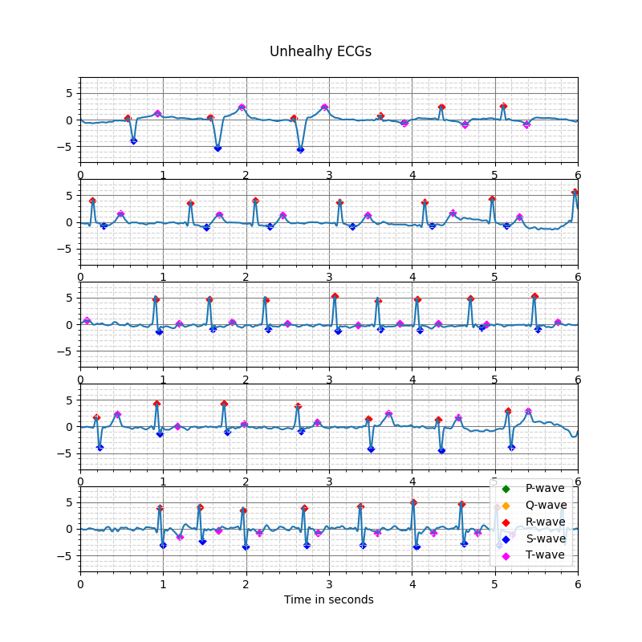
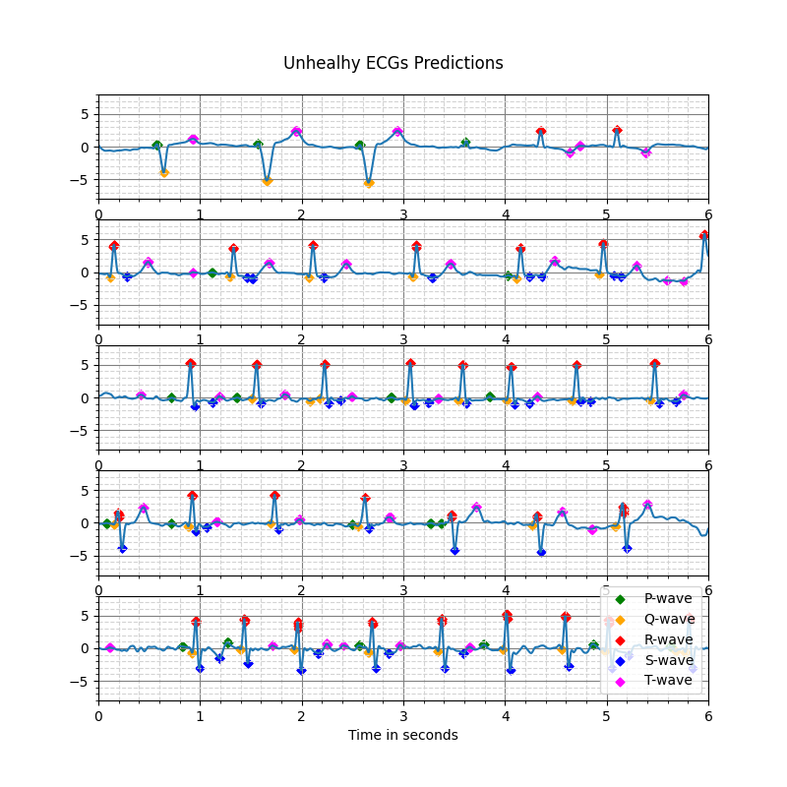
Results
Scenario Real full on diseased data

