Slide 1

Brand Guidelines
The semantic switchboard for utility rate plan data
Version 1.0 · January 2026 · LF Energy Standards and Specifications

Slide 2
Mission & Brand Overview
Mission
Promote market competition, affordability, transparency, and innovation in the energy sector by introducing an open standard for the exchange and publication of machine-readable utility rate plan data.
Brand Traits
Transparent
Open data, clear structures
Modern
Semantic web technologies
Interoperable
Works across systems
Community-driven
Open collaboration
Trustworthy
Reliable, validated, governed
Target Audience
Regulators · Software Developers · Utilities · Energy Service Providers · Researchers · Consumer Advocates

Slide 3
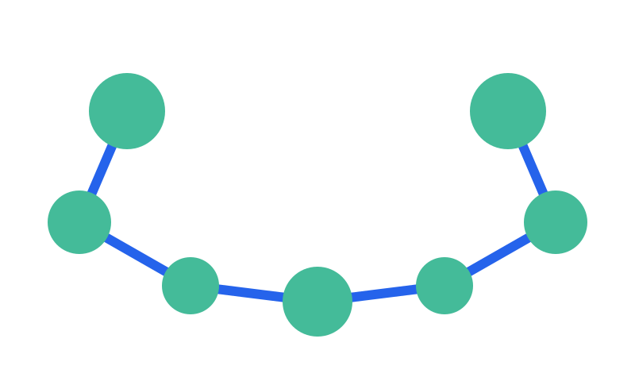



Logo Concepts
"Connected Smile" — nodes and edges forming a U-shape, representing rate plan data concepts connecting harmoniously.
Option A: Simple
Option B: Switchboard
Option C: Minimal
Teal nodes, blue edges
Grid motif with path
Single color (teal)
Horizontal Logo with Wordmark

Slide 4
Color Palette
Primary Colors
URPX Teal
URPX Blue
Dark Green
Dark Text
#44BB99
#2563EB
#008A5C
#1E293B
Primary brand, nodes
Accent, edges, links
Dark mode, contrast
Headlines, body
Extended Palette (Paul Tol Light — Accessibility)
#77AADD
#EE8866
#EEDD88
#FFAABB
#99DDFF
#44BB99
#BBCC33
#AAAA00
#DDDDDD
Use for infographics, data visualization, and charts. Color-blind safe.

Slide 5
Typography
Headings: Inter / Arial
Body: Inter / Arial
Aa Bb Cc 123
Aa Bb Cc 123
Type Scale
36-44pt
Page titles
URPX Brand
24-28pt
Section headers
Color Palette
14-16pt
Body text
Rate plan data exchange...
10-12pt
Captions, footnotes
Source: NLR, 2025

Slide 6
Terminology Standards
Consistent language builds recognition. Use these terms in all communications.
✓ Use | ✗ Avoid
Rate plan | Rate, tariff, rate schedule
Rate plan data | Rate data, tariff data
Charge | Fee, cost component
Customer profile | Customer type, class
Eligibility rule | Qualification, requirement
NLR | NREL
Key Phrase
"URPX acts as the semantic switchboard for transforming flat rate plan data into structured rate plans with executable cost modeling instructions."

Slide 7
Voice & Tone
Clear
Direct
Confident
No jargon without explanation
Say what needs to be said
We know this problem well
Collaborative
Pragmatic
Community-first approach
Focus on real problems
Do
Don't
Use "rate plan" consistently
Acknowledge complexity honestly
Focus on practical benefits
Use "tariff" or "rate" alone
Oversimplify (rate plans are complex)
Use hyperbolic language

Slide 8
Boilerplate Text
One-liner (25 words)
URPX is an open standard for exchanging machine-readable utility rate plan data, enabling transparent energy pricing across the industry.
Short (50 words)
URPX (Utility Rate Plan Exchange) is an open standard for machine-readable utility rate plan data. Built on semantic web technologies, URPX acts as the switchboard for transforming flat rate plan data into structured formats with executable cost modeling instructions. Hosted by LF Energy Standards and Specifications.
Medium (100 words)
URPX (Utility Rate Plan Exchange) is an open standard that enables transparent, machine-readable utility rate plan data exchange. While standards exist for customer usage data and grid operations, no comprehensive standard previously existed for the rate plan data that determines how customers are charged. Built on W3C semantic web technologies (RDF, OWL, SHACL), URPX provides a rich ontology for representing everything from simple flat-rate plans to complex time-of-use structures. Led by Flux Tailor with NLR collaboration, URPX is hosted by LF Energy Standards and Specifications (LFESS).

Slide 9
Resources & Contact
Working Group
lfess.energy
Project Lead
fluxtailor.com
GitHub
github.com/lf-energy/tac/issues/600
Contact
Klaar De Schepper, Flux Tailor
© 2026 Flux Tailor LLC · Licensed under Apache 2.0

