Slide 1

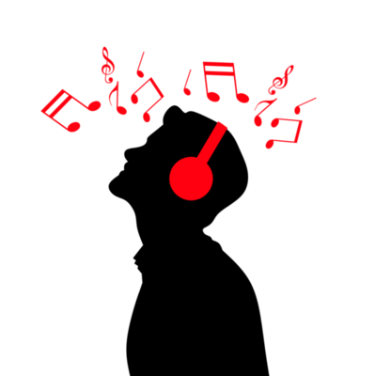
Echo Player
Let’s Feel the , Music , Allow your soul to Jump out of that jail.

Slide 2

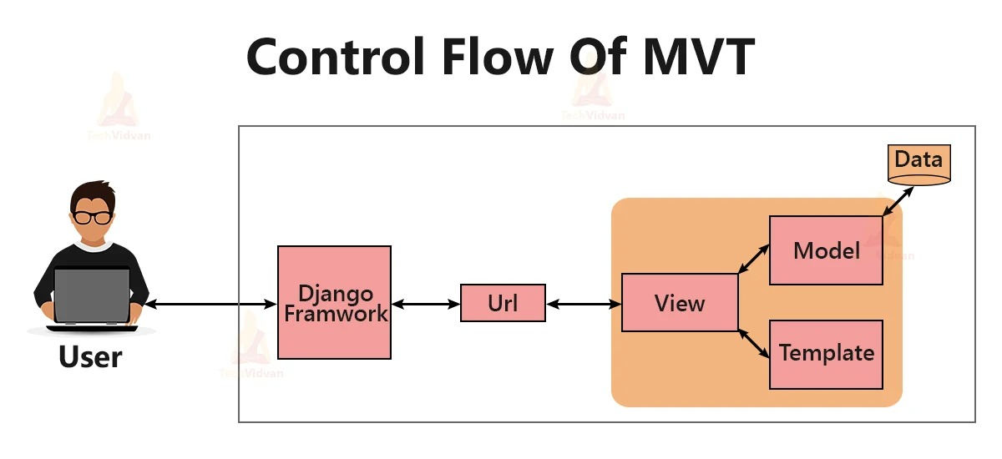
Media Player
A Music platform
Our Mission
create a Clone of music platform & cover all the operation which are included in Django Project , ( C R U D ) operations.
Our Goal is to CReate a clone of media player , and need to cover all the operation on database ( C R U D ).
Based on that we Follow the structure .
Update
delete
Create
retrieve
Songs
Upload Song
Home

Slide 3
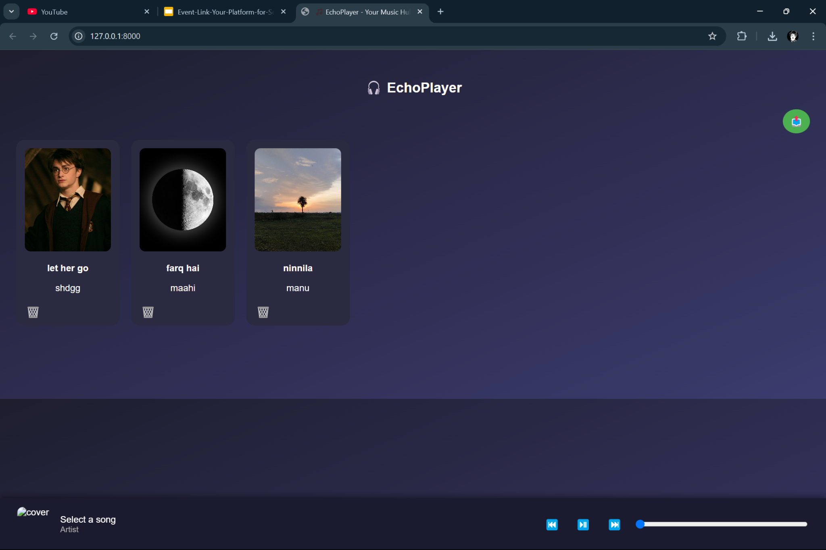
Home Page
In the home page , we retrieve all the songs from the database , and displaying them with good user interface.
and there are some logos which can allow to interact with the database and .
DustBin : TO delete Songs.
Post : That Post Symbol , to upload the song.
By Clicking on the details , we can also edit them.
Playing and pausing symbols , to interact with the data , ( play songs and traversing to other songs ).
A Music platform
Our Mission
create a Clone of music platform & cover all the operation which are included in Django Project , ( C R U D ) operations.

Slide 4
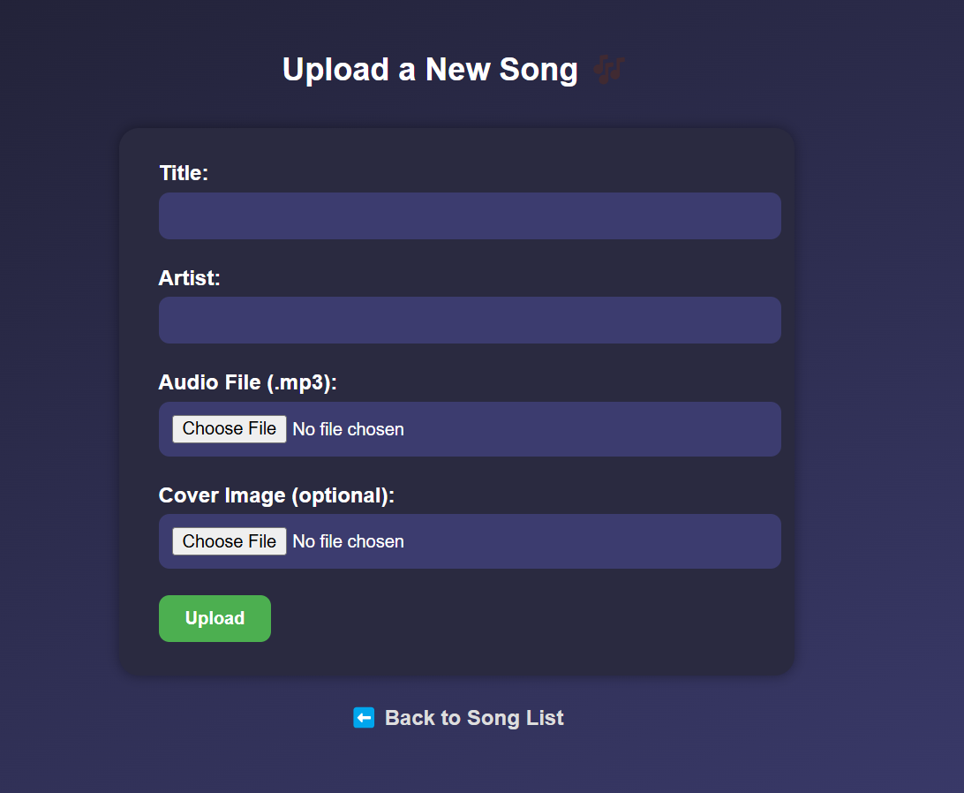
Uploading
In this page we can upload songs to the database ,
it contains :
Title of the song
Artist of the song
Audio File
Cover Image
Here we are performing the CREATE operation.
A Music platform
Our Mission
create a Clone of music platform & cover all the operation which are included in Django Project , ( C R U D ) operations.

Slide 5
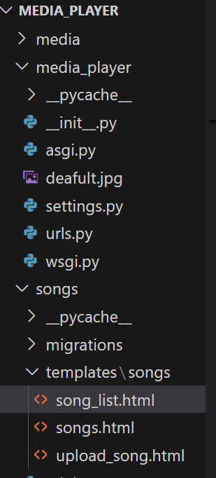
Project Structure
A Music platform
This is the structure we followed to implement the media player practically .
Our Mission
create a Clone of music platform & cover all the operation which are included in Django Project , ( C R U D ) operations.

Slide 6

THANK YOU

