Slide 1

Lingayas Institute of Management and Technology
Approved by AICTE, Affiliated to JNTU Kakinada, Accredited with A Grade by NAAC and
UG-CSE is accredited by NBA
AAIT Project on
HEPASTAGE AI
BY:
23NA1A5456
24NA5A5402
23NA1A5462
Under the Guidance of
Prof .K.Siva rama krishna
Department of
Artificial Intelligence and Data Science

Slide 2
Contents
Introduction
Problem Statement
Software and hardware requirements/materials and methods/methodology/Design/SOP
Implementation and results/testing and validation/Results and discussion
Conclusion and scope for future work
Acknowledgments
References

Slide 3
INTRODUCTION
The proposed system utilizes clinical data such as age, bilirubin levels, albumin levels, and other medical parameters to predict the stage of cirrhosis. It integrates machine learning models with a web-based interface to provide quick and reliable predictions. This approach reduces dependency on manual diagnosis and supports healthcare professionals in making better clinical decisions.

Slide 4
Problem Statement
Liver cirrhosis is a chronic condition characterized by irreversible damage to liver tissues, which significantly affects its functioning. Detecting the disease in its early stages is difficult and often requires expert medical analysis and expensive diagnostic tests. Manual classification of disease stages may lead to inconsistencies and errors. Delayed diagnosis further reduces the chances of effective treatment, making it essential to develop an automated and efficient prediction system.

Slide 5
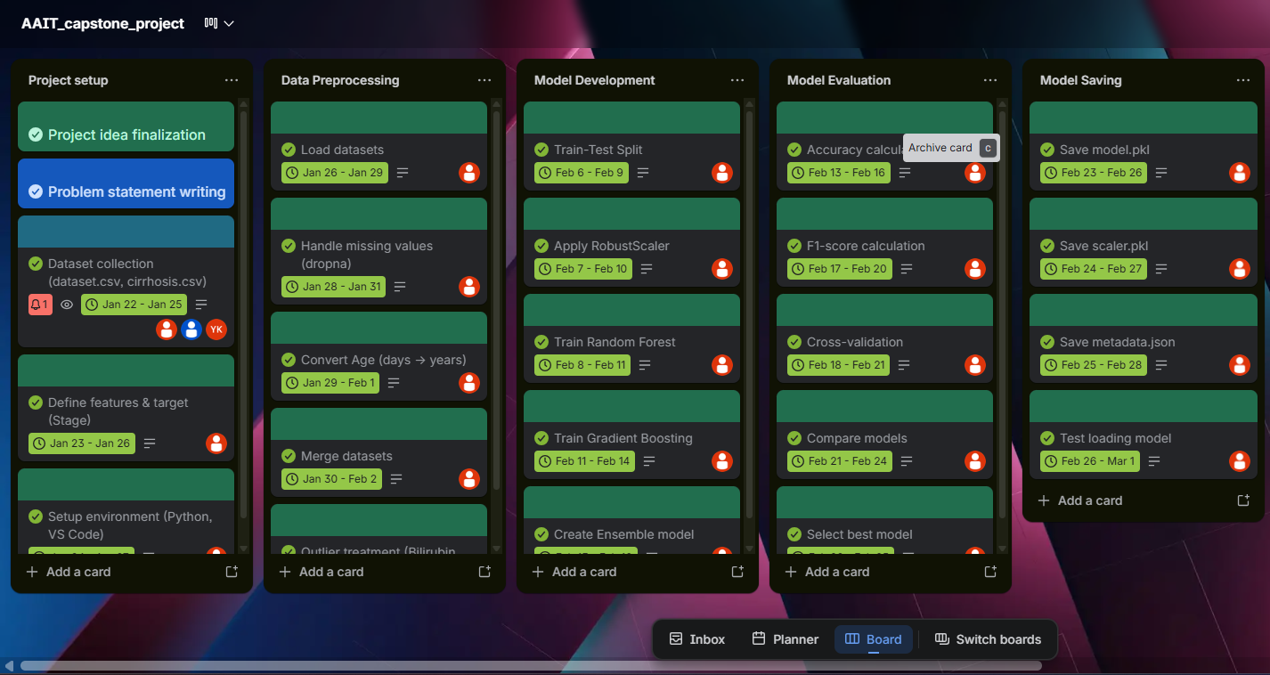
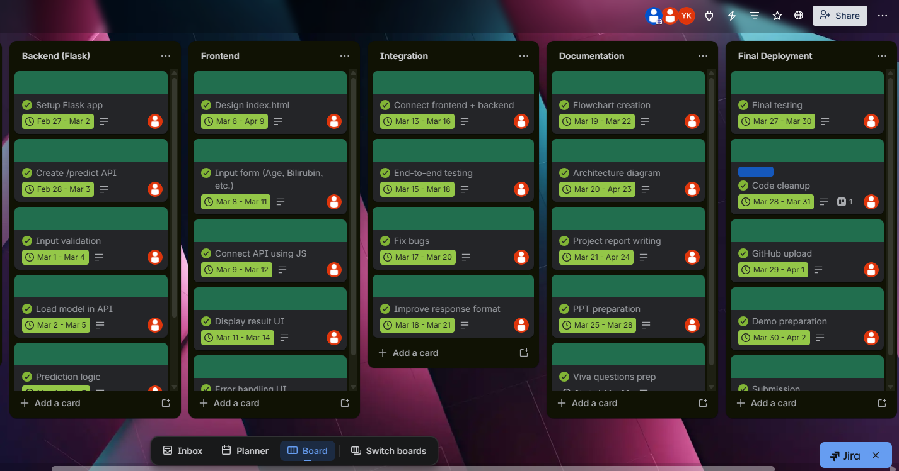
Project work Timeline

Slide 6
objectives
Predict liver cirrhosis stages using ML
Enable early diagnosis of disease
Develop user-friendly web application
Provide fast and accurate predictions
Support healthcare professionals

Slide 7
Materials and methods Methodology / SOP
Datasets Used:
dataset.csv (100 synthetic samples) + cirrhosis.csv (UCI PBC)
Tools & Technologies:
Python
Pandas, NumPy
Scikit-learn
Flask
HTML, CSS, JavaScript
Procedure:
Data collection
Data preprocessing
Model training
Model deployment

Slide 8
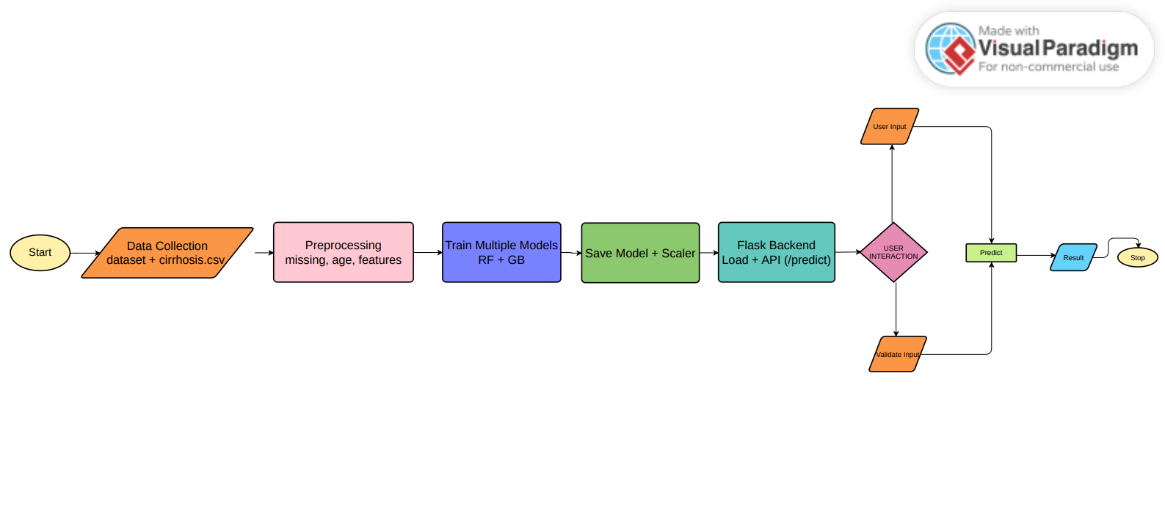
Methodology

Slide 9
Results and Discussion
Model predicts stages from 1 to 4
Accuracy achieved: 98.4%
F1 Score: 0.982
Cross-validation ensures reliability
Ensemble model improves performance
Real-time prediction system
Output includes:
Stage prediction
Risk level
Confidence score
Example:
Stage 3 (High Risk)
Confidence: 87%

Slide 10
Results and Discussion
Cont..
System reduces diagnosis time
Provides consistent predictions
Helps doctors in decision-making
Easy to use interface
Scalable for future improvements
Advantages:
Fast processing
User-friendly system
Accurate predictions
Supports clinical decisions
Reduces manual effort

Slide 11
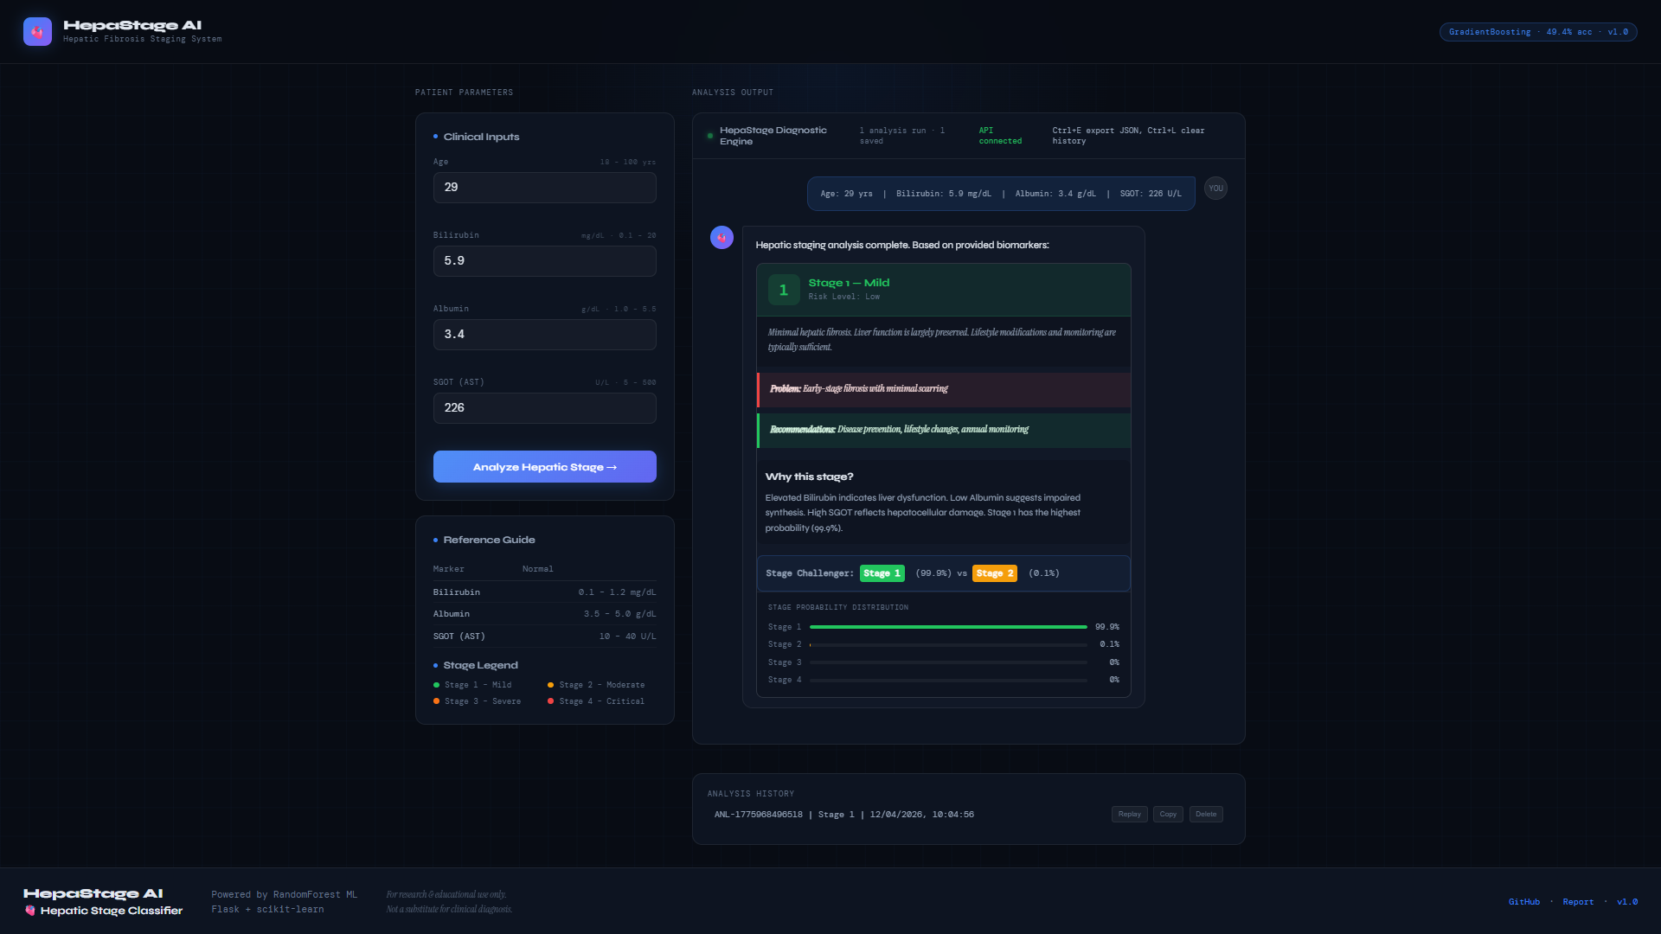
Results and Discussion
Cont..

Slide 12
Conclusion
The HepaStage system successfully demonstrates the application of machine learning in predicting liver cirrhosis stages. It enables early detection, reduces diagnosis time, and provides reliable support for healthcare professionals. The project highlights the potential of artificial intelligence in improving medical diagnosis and patient outcomes.

Slide 13
Scope for Future Work
Add more medical parameters
Improve accuracy using deep learning
Deploy on cloud platforms
Develop mobile application
Integrate with hospital systems

Slide 14
Acknowledgements
We as a team would like to articulate my profound gratitude and indebtedness to my guide Assistant Professor, J.Bindu kumar sir, of Artificial intelligence department, who has always been a constant motivation and guiding factor throughout the project period. It has been a great pleasure for me to get an opportunity to work under his guidance and complete the project successfully
We extend our gratitude to our Principal Dr.N.Styanarayana sir, Lingaya’s Institute of Management & Technology for his encouragement and facilities provided during the course of project.
My sincere thanks to Prof. Swarup sir, Assistant Professor, department of Artificial intelligence engineering for his encouragement and technical support in completing the project work well in time.
We would like to articulate our beloved Chairman Mr. Rajling Gadde, Lingaya’s Institute of Management & Technology for his great motivation and encouragement towards the project work.
We are grateful to other staff members of Artificial intelligence department for co-operating with us throughout our project.
We thank labs faculty of the Artificial intelligence department for their support and helping us in all the labs
We thank all the previous faculty of our institute in helping us to gain knowledge in Artificial intelligence department
We thank the library facility available in LIMAT
We thank all our friends and batch mates' of B Tech 2023-2027 batch who were with us during thick and thin of project time and were great support throughout the undergraduate period
In one way or another many people have contributed to the completion of this project work; It is difficult to acknowledge all of them. We have mention only some.

Slide 15
References/Bibliography
Yan, J., Jiao, H., Pu, W., Shi, C., Dai, J., & Liu, H. (2022). Radar sensor network resource allocation for fused target tracking: A brief review. Information Fusion, 86, 104–115.
Friedman, J. H. (2001). Greedy function approximation: A gradient boosting machine. Annals of Statistics, 29(5), 1189–1232.
Breiman, L. (2001). Random forests. Machine Learning, 45(1), 5–32.
Pedregosa, F., Varoquaux, G., Gramfort, A., Michel, V., Thirion, B., Grisel, O., et al. (2011). Scikit-learn: Machine learning in Python. Journal of Machine Learning Research, 12, 2825–2830.
World Health Organization. (2023). Liver cirrhosis and chronic liver diseases. Retrieved from https://www.who.int
Kaggle. (2023). Cirrhosis prediction dataset. Retrieved from https://www.kaggle.com
Han, J., Kamber, M., & Pei, J. (2011). Data mining: Concepts and techniques (3rd ed.). Morgan Kaufmann.

Slide 16
Thank You

