Slide 1
Text Summarizer Using NLP
Infosys Springboard Internship 2024
Mentor : Narendra Kumar sir
Avanigadda Sivayya [GROUP-1]

Slide 2
Introduction
Overview of the Internship Project:
This project, developed as part of the Infosys Springboard internship, focuses on creating a Text Summarizer using Natural Language Processing (NLP) techniques. The summarizer aims to reduce the length of documents while preserving key information and meaning, making it easier for users to quickly understand the content of large texts.

Slide 3
Objectives
Project Goals:
Develop an automatic text summarization tool using both Extractive and Abstractive methods.
Ensure the summarizer maintains the original meaning and key points of the text.
Create an user friendly interface for easy interaction with the summarizer.

Slide 4
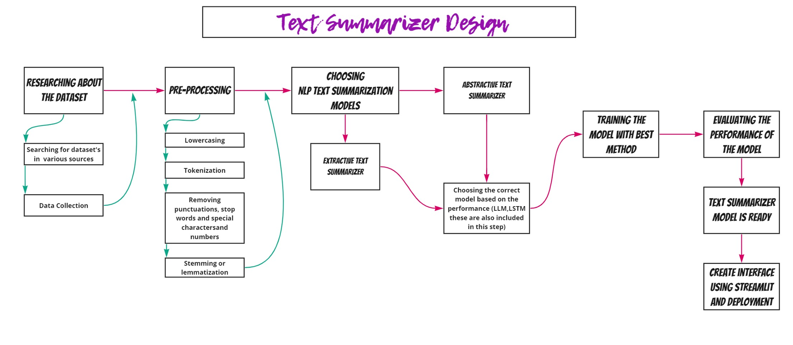
Initial Design

Slide 5
Datasets
Data Collection:
CNN/Daily Mail Dataset: This dataset consists of news articles and their corresponding summaries, making it ideal for training and evaluating text summarization models.
Samsum Dataset: This dataset is specifically used for abstractive summarization.
Which consists of dialogue and their respective summaries.

Slide 6
Extractive Summarization
Overview:
Extractive summarization involves selecting key sentences from the original text that best represent the main points of the document.
Pre-processing:
Text Cleaning: Remove newline characters, content within square brackets, extra spaces, and quotation marks.
Tokenization: Spliting text into sentences using the ‘nltk.sent_tokenize’ function.
Lemmatization and stop words removal: using the ‘spacy’ library to extract lemmatized words and non-alphabetic tokens.

Slide 7
TF-IDF (Term Frequency-Inverse Document Frequency)
Sentence Scoring :
TF-IDF (Term Frequency-Inverse Document Frequency):
This technique calculates the importance of words in each sentence. The ‘TfidfVectorizer’ from ‘sklearn’ is utilized to convert the preprocessed sentences into a TF-IDF matrix. Each row in the matrix represents a sentence, and each column represents a unique term in the corpus.
Sentence Sum Scores:
The sum of TF-IDF scores for each sentence is calculated, representing the importance of the sentence within the document.

Slide 8
TF-IDF Example Calculation
Example Calculation of TF-IDF:
"Siva is a skilled programmer who enjoys solving complex problems."
Term: Siva
TF: 1/9 = 0.1111
IDF (log(1/1) = 0): 0
TF-IDF: 0
Implementation:
Implemented code in the file ‘Extractive_Text_Summarization.ipynb’

Slide 9
Extractive Summarization Results
Summary Generation:
Concatenate the selected sentences to form the final summary.
Rouge Scores for Extractive Model:
ROUGE-1: Precision: 0.5614, Recall: 0.5333, F1-Score: 0.5470
ROUGE-2: Precision: 0.3894, Recall: 0.3697, F1-Score: 0.3793
ROUGE-L: Precision: 0.4211, Recall: 0.4000, F1-Score: 0.4103

Slide 10
Abstractive Summarization
Overview: Abstractive summarization generates new sentences that convey the same meaning as the original text.
Initial Setup:
Import necessary libraries from Hugging Face transformers library and load the Samsum dataset.
After loading the dataset we displayed the structure of the dataset and also 1st dialogue and their respective summary.

Slide 11
Pre-processing
Tokenization of Inputs: Convert the prepared input texts into tokenized representations suitable for model input.
Parameters: max length = 512
Tokenization of Summaries: Tokenize the summary texts to prepare them as model targets (labels).
Parameters: max length = 150
Formatting Model Inputs: Store the tokenized inputs and labels in a dictionary (model_inputs).

Slide 12
Model and Training
Load Pre-trained T5 Model:
Model: T5ForConditionalGeneration [T5- Text-Text Transfer Transformer]
Weights: Pre-trained t5-small weights
Training the Model:
Training Setup: Uses the Trainer class from Hugging Face's transformers library.
After training 5 epochs
Epoch | Training Loss | Validation Loss
1 | 0.3803 | 0.3441
2 | 0.3716 | 0.3369
3 | 0.3636 | 0.3329
4 | 0.3592 | 0.3323
5 | 0.3607 | 0.3310

Slide 13
Abstractive Summarization Results
Evaluation of the Model:
Rouge Scores for Abstractive Model:
ROUGE-1: Precision: 0.8457, Recall: 0.3345, F1-Score: 0.4422
ROUGE-2: Precision: 0.5563, Recall: 0.2222, F1-Score: 0.2880
ROUGE-L: Precision: 0.7565, Recall: 0.3064, F1-Score: 0.3966
ROUGE-Lsum: Precision: 0.8323, Recall: 0.3468, F1-Score: 0.4502

Slide 14
Interface
Application Interface:
Built using Streamlit.
Deployed in Streamlit Cloud.
The Application URL: Stream Application

Slide 15
Thank You

