Slide 1
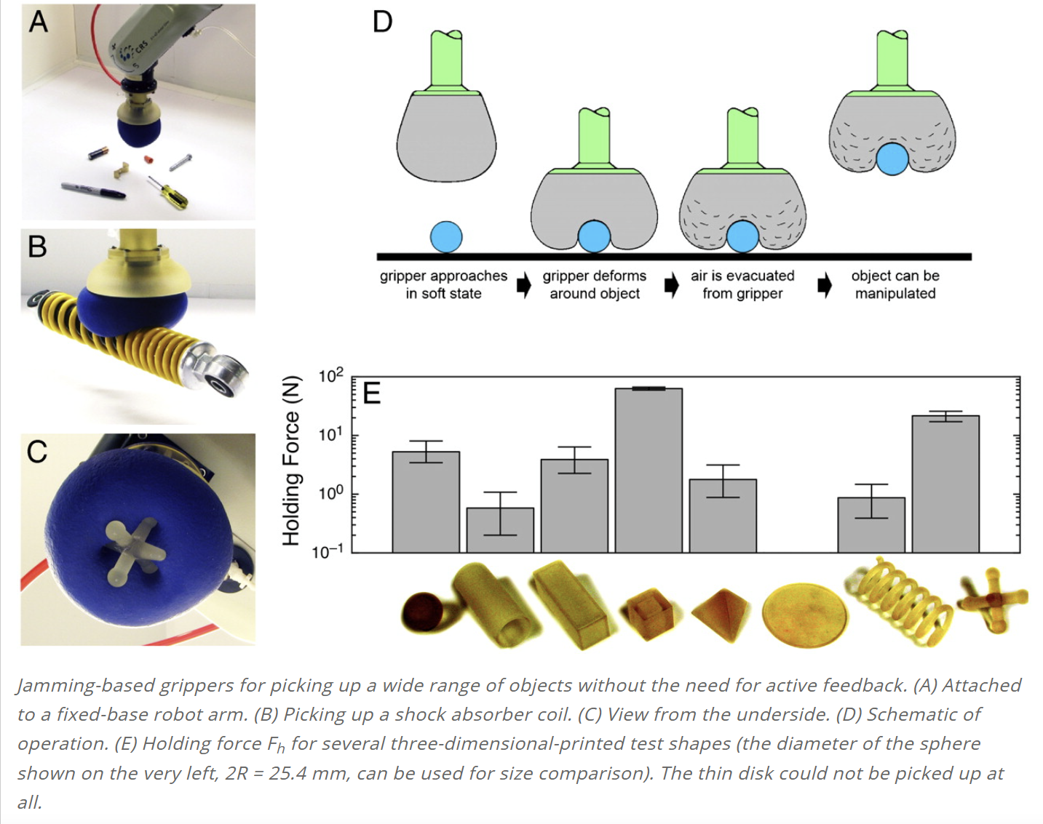
DEM Co‑Design of a Jamming‑Augmented Soft Robotic Segment
Soft Core (BDEM)
Kelvin‑Voigt bonds
Soft Core (BDEM)
Kelvin‑Voigt bonds
Jamming Sleeve
(unbonded beads + membrane)
Jamming Sleeve
(unbonded beads + membrane)
Actuation
(cables / pneumatics)
We use the Discrete Element Method (DEM) to co‑design a soft robotic segment with a bonded‑particle core and a granular‑jamming sleeve.
The unified particle model predicts stiffness‑on‑demand, contact, and manipulation performance and guides micro‑to‑macro design choices (bond stiffness, bead size, packing, vacuum level).
Goals: lower tip error, higher grasp robustness, and energy‑efficient actuation.

