Slide 1



Salary Prediction Using Linear Regression
Presented by: URSHASHI MAJUMDER
Techno India University
Guided by: HIMANSHU SOUDA
Notes:
1

Slide 2




Introduction to Salary Prediction
This project aims to predict employee salaries using machine learning techniques, focusing on the powerful yet interpretable Multiple Linear Regression model. We delve into key features influencing salary, from age and education to years of experience, providing a comprehensive workflow from data preprocessing to model deployment.
Age & Gender
Education Level
Demographic factors
Academic background
Job Title
Years of Experience
Professional role
Professional tenure
Our workflow encompassed data preprocessing, exploratory data analysis (EDA), model development, and prediction, all executed using a robust suite of Python tools.
Notes:
2

Slide 3

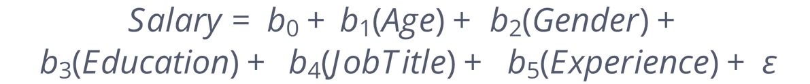
The Power of Linear Regression
Linear Regression is a fundamental statistical method that models the linear relationship between input features and a continuous output variable, in this case, salary. It helps us understand how each contributing factor influences the predicted salary.
Here, b₀ represents the intercept, and b₁ through b₅ are the coefficients indicating the weight and direction of each feature's influence on salary. The ε term accounts for the irreducible error.
Notes:
3

Slide 4






Tools & Technologies Utilized
The successful execution of this project relied on a robust stack of Python libraries and development tools, enabling efficient data manipulation, visualization, model building, and persistence.
Python
Pandas & NumPy
Matplotlib & Seaborn
Scikit-learn
The core programming language for data science.
Essential for data handling and numerical operations.
For comprehensive data visualization and EDA.
The primary library for machine learning models.
Jupyter Notebook
Joblib
For interactive development and documentation.
For efficient serialization and model saving.
Notes:
9

Slide 5
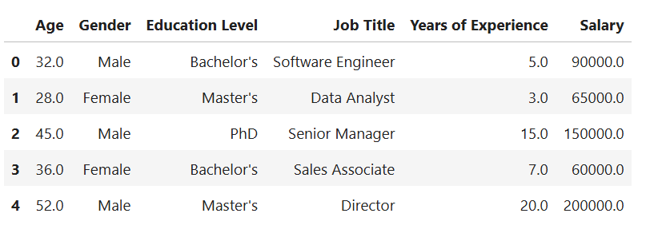
Dataset & Preprocessing Pipeline
Our dataset comprised essential employee attributes, crucial for building an accurate prediction model. Rigorous preprocessing steps ensured the data was clean and ready for machine learning.
Preprocessing Steps:
Key Data Columns:
Age
Handle Missing Values
Gender
Ensuring data completeness and integrity.
Education Level
Job Title
Encode Categorical Features
Years of Experience
Transforming qualitative data into numerical format.
Salary
Prepare Clean Data
Finalizing the dataset for model training.
Notes:
4

Slide 6
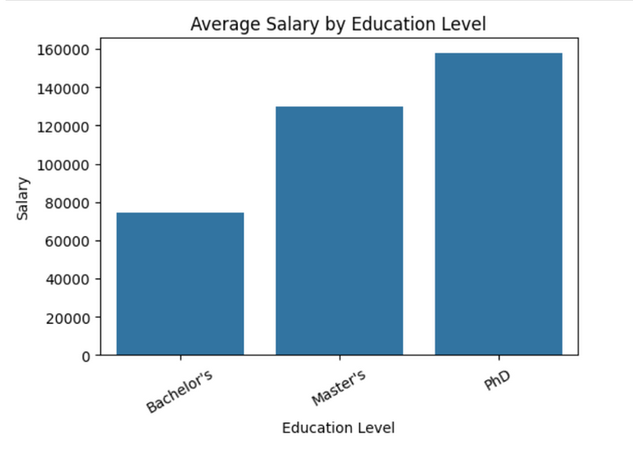
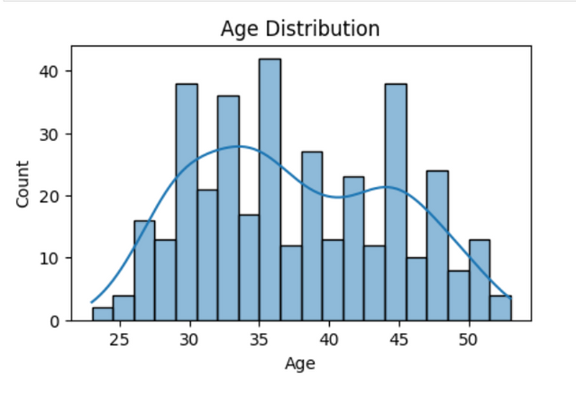
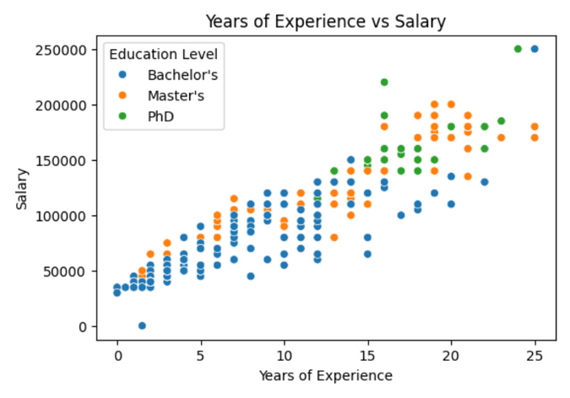
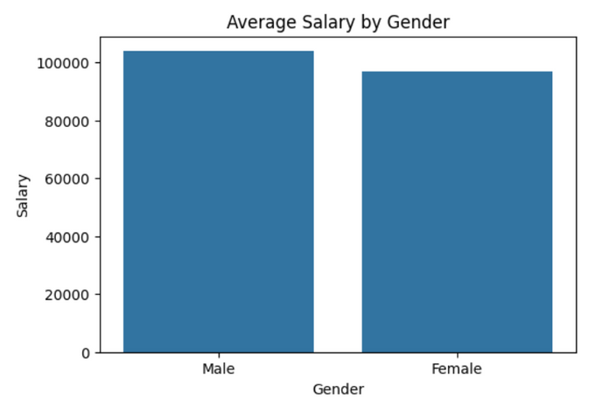
Exploratory Data Analysis (EDA)
EDA was pivotal in uncovering underlying patterns and relationships within the data, providing insights into which features were most influential in salary determination.
Visualizations revealed clear trends, such as the positive correlation between years of experience and salary, and disparities across education levels and genders, guiding our feature engineering and model selection.
Notes:
5

Slide 7




Models Employed for Prediction
To ensure robustness and optimize prediction accuracy, we explored a range of regression models, each offering unique strengths. Our evaluation focused on key metrics to determine the best fit for our salary prediction task.
Decision Tree Regressor
Linear Regression
The baseline model, providing interpretable coefficients.
Captures non-linear relationships and interactions.
Random Forest Regressor
Voting Regressor
An ensemble method for improved accuracy and stability.
Combines predictions from multiple models for enhanced performance.
We assessed each model's performance using R² Score (coefficient of determination) and Mean Absolute Error (MAE), crucial metrics for understanding model accuracy and prediction deviation.
Notes:
6

Slide 8
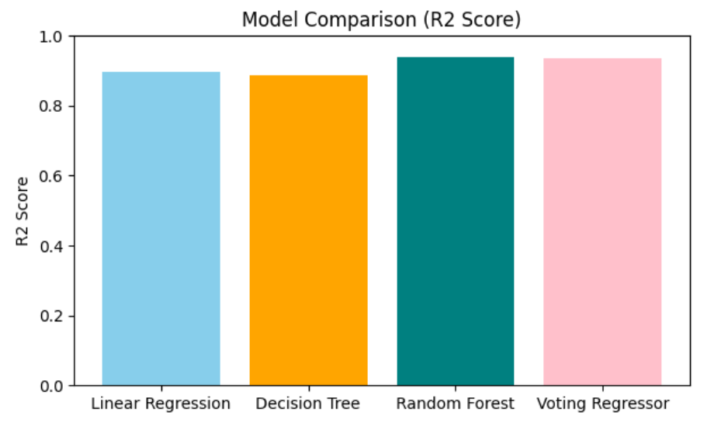
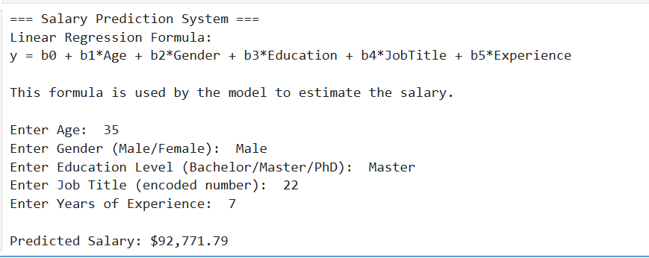
Model Comparison & Results
After rigorous evaluation, the Random Forest Regressor demonstrated superior performance across key metrics. However, for its interpretability and robust deployment capabilities, the Linear Regression model was selected for final deployment and saved for real-world application.
Random Forest
Linear Regression
Achieved the highest R² score and lowest MAE, indicating its strong predictive power.
Chosen for its clarity and ease of interpretation, the model was saved as salary_prediction.pkl for future use.
The saved model is capable of taking user inputs to predict salaries, offering a practical solution for various applications.
Notes:
7

Slide 9



Applications & Future Scope
Our salary prediction model offers diverse applications and a clear path for future enhancements, addressing current challenges and expanding its utility.
Key Applications
Challenges & Solutions
Future Enhancements
HR salary planning
Categorical Encoding
Web App Deployment
Resolved using LabelEncoder.
Integrate for broader accessibility.
Hiring & talent management
Model Selection
Feature Expansion
Addressed through comprehensive performance comparison.
Incorporate location, skills, and industry data.
Industry salary insights
Model Persistence
Advanced Models
Budget forecasting
Managed with joblib for saving/loading.
Explore deep learning for greater complexity.
Interactive Dashboard
Develop for dynamic insights.
Notes:
8

Slide 10

Project Conclusion
This project successfully demonstrates the application of machine learning for salary prediction. While Multiple Linear Regression served as our interpretable foundation, the Random Forest Regressor showcased superior accuracy, guiding our understanding of feature importance. The deployed model provides a reliable tool for forecasting and strategic planning.
"Data is the new oil, and machine learning is the refinery."
Our model transforms raw data into actionable insights, providing a valuable resource for various stakeholders.
Notes:
10

