Slide 1

Visvesvaraya National Institute of Technology (VNIT), Nagpur
Department of Electronics and Communication Engineering
M.Tech. Applied AI, Semester 3 Session: Summer 2025
NLP Chatbot For Jira Data
Submitted To: Dr. Saugata Sinha
Submitted by: (Group13)
Mr. Abhinav Srivastava Mr. Sanjeev Pandey Mr. Sanjay Joshi
Enroll No. MT23AAI008 MT23AAI001 MT23AAI038

Slide 2
Problem Statement
To develop a Chatbot which can answer user queries based on JIRA(Apache -Spark) issue data:
JIRA is widely used for tracking software issues and project tasks, but its interface and
search capabilities can be overwhelming when handling large-scale data.
The goal of this project is to create an NLP-powered chatbot interface that enables
semantic querying of Apache JIRA issue data (specifically the SPARK project) using natural language.
The chatbot is powered by a locally deployed Llama 2 7B language model using `llama_cpp`,
supported by fine-tuned SentenceTransformer embeddings for efficient semantic search.

Slide 3
Dataset Overview
Data Source:
Apache JIRA REST API: Contains issues (bugs, feature requests, tasks, etc.) tracked in Apache's JIRA system.
Each issue in the dataset corresponds to a JIRA issue (a bug report, feature request, task, etc.) from Apache’s projects.
A typical issue record contains:
Metadata about the issue (ID, key, project)
Key fields: key, issuetype, summary, description, reporter, status, priority, reporter, assignee, created, updated, full_text, output and timestamps.
The data size for SPARK is 35,000+ issues and overall the data set contains 2M+ issues
We are using 5000 issues from Apache Spark Jira dataset.
URL https://issues.apache.org/jira/rest/api/2/search
Data Source

Slide 4
Dataset Overview
We have selected following fields for our chatbot:
issue_id: Identifier for the issue (e.g., ISSUE-0).
type (or issuetype):: Type of the issue (e.g., Task
summary: A brief summary of the issue (can be empty)
status: Status of the issue (e.g., Unknown)
priority: Priority level (e.g., Medium)
Description: Additional description of the issue (can be empty).
full_text: the constructed input text used for embedding and semantic search
input: A formatted input string describing the issue
output – a generated summary response or formatted version of the issue
URL https://issues.apache.org/jira/rest/api/2/search
Data Source

Slide 5
Training* Pipeline
[JSON File Upload]
↓
[process_jason_data()] → Extract: ID, type, summary, status, priority, description
[json_to_pickle()]
↓
[create_chunks_from_pickle()] → Chunk Size equal to
one Jira issue
↓
[build_embeddings()] → SentenceTransformer BGE encoding
[build_embeddings()] → SentenceTransformer BGE encoding
↓
[FAISS Index Creation] → IndexFlatIP for similarity search
↓
[optimize_search_parameters()] → Auto-tune thresholds
↓
[Model Loading] → Initialize Llama 2 7B
↓
[READY STATE] → System ready for queries
*Preparing data so that the pre-trained LLaMA model and FAISS can be used for question-answering.
We are training the system pipeline, not the model itself

Slide 6
Query Processing Pipeline
[handle_fast_queries()] → Statistical queries (counts, distributions)
↓ (if not statistical)
[semantic_search_enhanced()] → Multi-tier search:
• Exact match (issue IDs)
• Vector similarity (BGE embeddings)
• Keyword fallback
↓
[Context Assembly] → Top-K relevant issues
↓
[generate_response_advanced()] → Llama 2 with context
[User Query]
[Natural Language Response] → User-friendly answer

Slide 7
Tech Stack and Libraries
Core ML/AI
Llama 2 7B (Quantized)
Llama- cpp- python
SentenceTransformers
FAISS (Vector Search)
Web Interface
Gradio
Python Threading
Process Tracking
File Upload
Data Processing
NumPy
Pandas
Pickle
JSON
Utilities
Requests (Model Download)
TQDM (Progress Bars)
Collections (Statistics)
Treading (Concurrency)

Slide 8
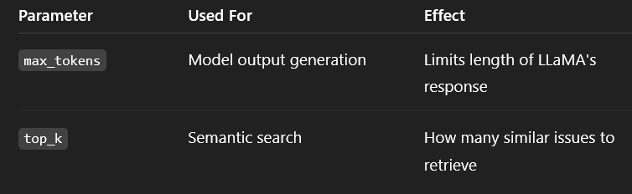
Model Details and Parameters
Llama 2 7B quantized model
n_ctx= 4096, Context window
n_batch=512, Batch processing
Embedding size: 768-dimensional vectors
FAISS vector index for similarity search
Max_tokens: 1024
Top_k: How many similar issues to retrieve(3 to 5)
Multi-tier search strategy:
1. Exact match (issue IDs)
2. Semantic similarity (vector search)
3. Keyword fallback (text matching)

Slide 9
Citations
#1 https://arxiv.org/html/2406.02290v1, A Study of Optimizations for Fine-tuning Large Language Models, Microsoft Arjun Singh , Nikhil Pandey² , Anup Shirgaonkar, Pavan Manoj, Vijay Aski
#2 https://ollama.com/library/llama2
#3 https://huggingface.co/docs/peft

Slide 10
Appendix

Slide 11
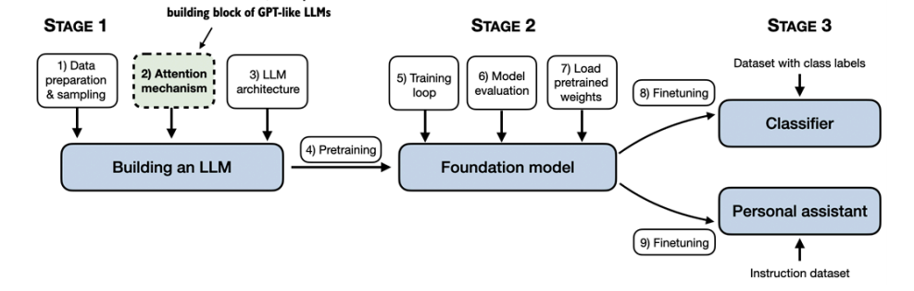
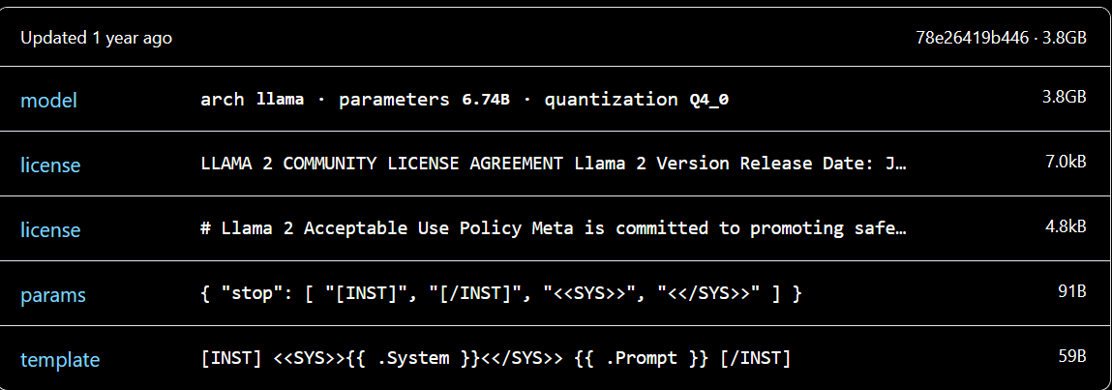
Methodology
Tokenization:
Vector Embedding
Positional encoding
Input data to GPT in batches
Context length
Attention Mechanism
#Source:Raschka, Sebastian. Build A Large Language Model (From Scratch). Manning, 2024. ISBN: 978-1633437166.

Slide 12
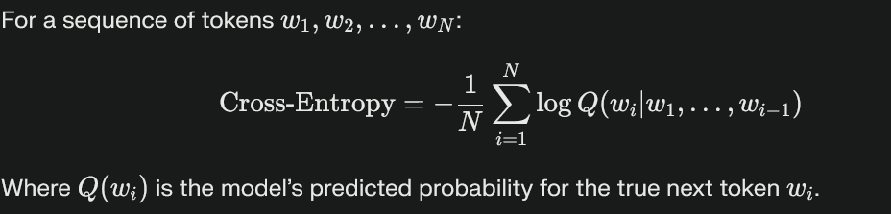
Model Evaluation
Metrics:
Cross entropy:
Accuracy: Task-specific correctness (e.g., question answering). Correct Predictions/Total Predictions

