Slide 1
Neural Network Implementation for Iris Flower Classification
Author :Sanjeev Kumar Pandey
MTech. In Applied AI, VNIT, Nagpur
A brief overview of the program's purpose and outcomes.

Slide 2
Objective
Goal of the Program:
Train a neural network to classify Iris flowers into three species:
Iris-setosa
Iris-versicolor
Iris-virginica
Dataset Used:
Iris Dataset with 150 samples and four features:
Sepal Length
Sepal Width
Petal Length
Petal Width

Slide 3
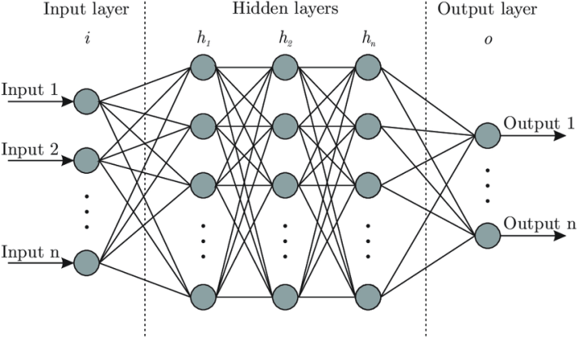
Model Architecture
Model Design:
Input Features: 4 (flower measurements)
Hidden Layers:
Layer 1: 8 neurons
Layer 2: 9 neurons
Output Layer: 3 neurons
(one per flower class)
Activation Function:
ReLU (Rectified Linear Unit) for hidden layers.
ReLU(x)=max(0,x)
Final layer directly outputs class scores.

Slide 4
Data Preprocessing
Steps Performed:
Loaded the Iris dataset using pandas.
Encoded species labels as numeric values:
Iris-setosa → 0.0
Iris-versicolor → 1.0
Iris-virginica → 2.0
Split dataset into training and testing sets using an 80:20 ratio.
Converted features and labels into PyTorch tensors:
Features: FloatTensor
Labels: LongTensor
Features: Use FloatTensor because:
Continuous numerical values require floating-point precision.
Neural network computations rely on floating-point operations.
Labels: Use LongTensor because:
Labels represent discrete class indices.
Loss functions in classification tasks expect integer-based labels.

Slide 5
Training Process
Key Details:
Loss Function: CrossEntropyLoss (handles multi-class classification).
Optimizer: Adam Optimizer with a learning rate of 0.01.
Epochs: 100 iterations over the training dataset.
Training Workflow:
Forward pass to predict labels.
Calculate loss between predictions and ground truth labels.
Backward pass to compute gradients.
Update model parameters using gradients.

Slide 6
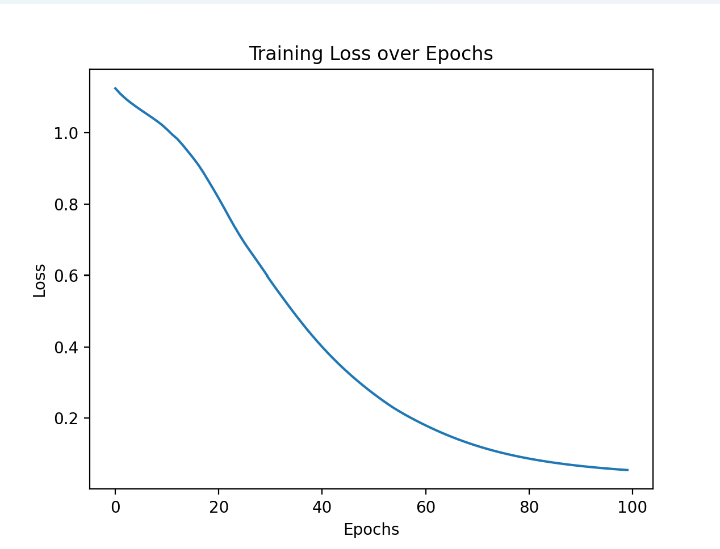
Training Loss Visualization
Graph: Loss vs. Epochs
Highlights a decreasing
loss trend, indicating
successful training of
the model.

Slide 7
Model Evaluation
Testing Workflow:
Evaluation Mode: Disabled gradient computation.
Predicted the class of each test sample.
Compared predictions with ground truth labels to compute accuracy.
Accuracy Achieved:
Test Accuracy: 93.33%

Slide 8
Key Learnings
Neural networks effectively classify small datasets like Iris when well-structured.
CrossEntropyLoss is suitable for multi-class classification problems.
Proper preprocessing and training data splits are critical for robust evaluation.

Slide 9
Code Insights
Highlights:
Modular and reusable model architecture using PyTorch's nn.Module.
Clean and structured preprocessing with pandas.
Effective visualization of training performance.

Slide 10
Future Work
Experiment with different architectures (e.g., more hidden layers or neurons).
Optimize hyperparameters like learning rate and number of epochs.
Test model robustness on noisy or imbalanced data.
Research work for predicting Air Pollution desnsity in near future.

Slide 11
Acknowledgments
Tools: PyTorch, pandas, Matplotlib, scikit-learn.
Dataset Source: UCI Machine Learning Repository.

