Slide 1
PM2.5 Concentration Analysis
Presented by: Sanjeev Kumar Pandey
Enrolment No: MT23AAI001
Project Guide: Dr. Amit Agrawal
For VNIT MTECH in AAI Mini Project
In collaboration with WITS University, South Africa

Slide 2
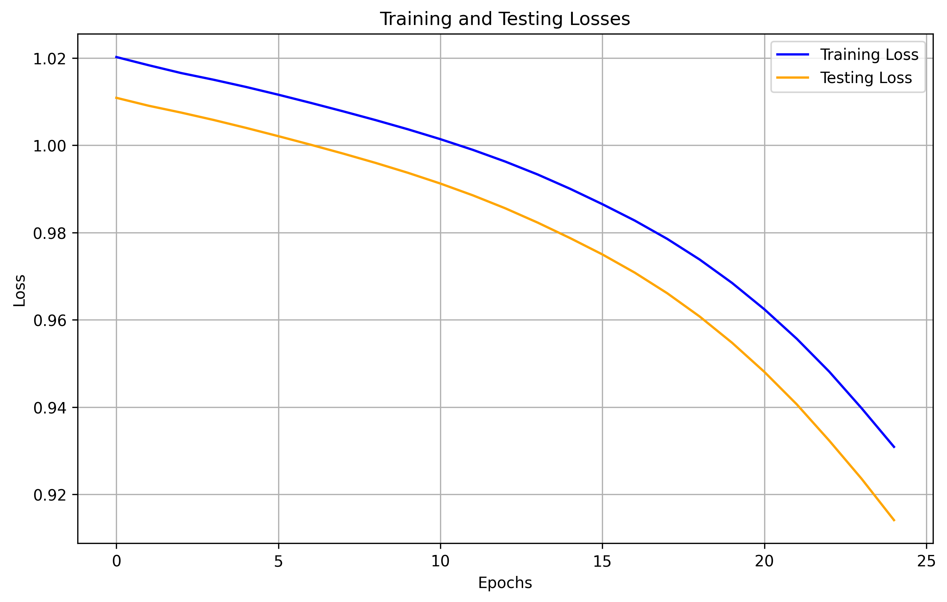
Dataset Shape : [(91488, 17)]

Slide 3
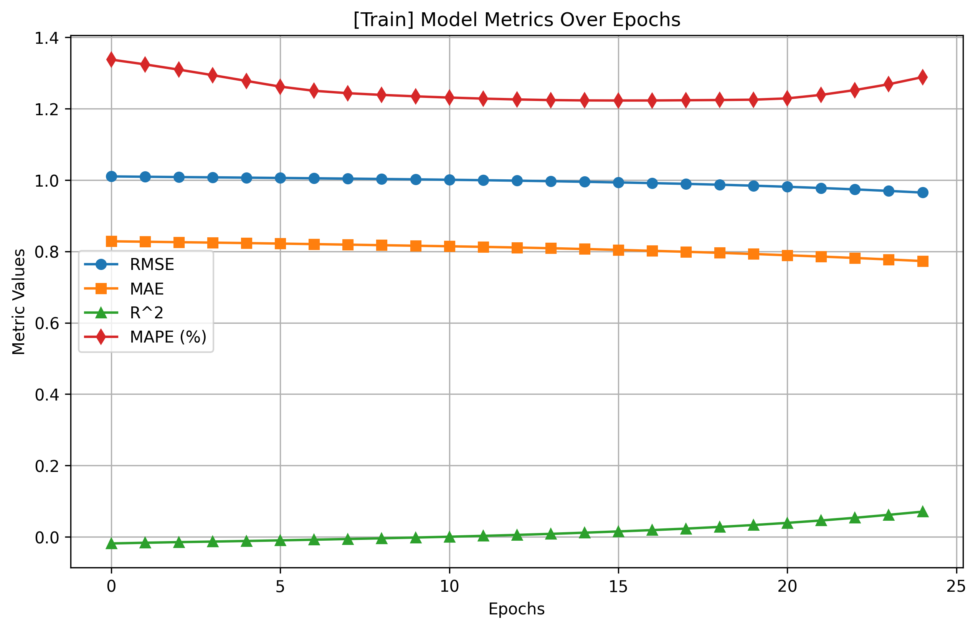

Slide 4
