Slide 1


PM2.5 Concentration Prediction
Presented by: Sanjeev Kumar Pandey
Enrolment No: MT23AAI001
Project Guide: Dr. Amit Agrawal
In collaboration with WITS University, South Africa

Slide 2
Problem Statement
Develop an advanced prediction model for PM2.5 concentration.
Utilize Spatio-Temporal Graph Neural Networks (ST-GNNs) for modeling spatial and temporal dependencies.
Integrate remote-sensing hyperspectral indices to enhance prediction accuracy.
Incorporate meteorological variables such as temperature, humidity, wind speed, and direction.
Leverage pollutant concentration data as key input features.

Slide 3
Background
The project is based on prior work conducted at WITS University, South Africa, using Spatio-Temporal Graph Neural Networks (ST-GNNs) for PM2.5 concentration forecasting.
Leaders:
Bruce Mellado [ bruce.mellado@wits.ac.za ]
Mukesh Kumar [ Mukesh.kumar@wits.ac.za ]
My Contribution
Future Work: Building on this foundation for expanded datasets and advanced methods.
Collaborate with WITS University as part of MTech mini-project for Study Areas
Switzerland (9 stations, 2016–2021).
Gauteng, South Africa (8 stations, 2016–2022).

Slide 4
Data and Methodology …
Prior Work (WITS University):
Data Sources
Meteorological data: Temperature, humidity, wind speed, wind direction.
Air quality data: PM2.5 concentrations.
Remote-sensing data: Hyperspectral indices (NDVI, AFRI2100, GARI).
Model Architecture: PM2.5-GNN:
Graph Neural Network (GNN): Models spatial interactions among monitoring stations.
Gated Recurrent Unit (GRU): Captures temporal dependencies for sequential data.

Slide 5
Data and Methodology
Planned Future Work:
Extend datasets to include diverse geographical regions and additional features (e.g., terrain, boundary layer height).
Incorporate advanced techniques like Reinforcement Learning (RL) for adaptive interventions and LSTMs for long-term temporal dependency modelling.

Slide 6
Results from Prior Work
Performance Metrics (WITS University):
Switzerland:
RMSE (Root Mean Square Error) improved from 1.4660 to 1.4591 with hyperspectral indices.
MAE (Mean Absolute Error ) reduced from 1.1147 to 1.1053
CSI (Critical Success Index) and POD (Probability of Detection) improved, FAR decreased.
Gauteng:
RMSE reduced from 6.3486 to 6.2319
MAE improved from 4.4891 to 4.4066
CSI and POD increased, slight rise in FAR.
Key Findings
Spectral indices improved prediction accuracy, especially for forecasts beyond 2 days.
Error stabilized over longer periods (e.g., Switzerland datasets).

Slide 7
My Contribution and Future Work
Role in Future Work:
Collaborate with WITS University to expand and enhance the existing methodology.
Use the existing findings as a baseline to explore new techniques.
Tentative Additions:
Integrate Reinforcement Learning for dynamic air quality interventions.
Incorporate LSTMs (Long Short-Term Memory) for advanced temporal pattern analysis.
Develop Models using datasets covering new regions (e.g., USA, Brazil, India) for robust testing.
Address limitations like missing terrain and environmental variables.

Slide 8
Architecture Overview
LSTM Module: Processes sequential time-series data (e.g., hourly air pollution levels, meteorological variables).
CNN Module: Captures spatial patterns from data like grid-based pollutant concentration maps or satellite imagery.
Reinforcement Learning Agent: Makes decisions or predictions based on outputs from the hybrid model, optimizing a reward function.
PyTorch or TensorFlow will be used to implement Deep Learning Frameworks, i.e. Fusion of LSTM and CNN Module.

Slide 9
Workflow
Preprocessing:
Temporal Data: Time Series data, such as time series like PM2.5 concentration over time, should be nnormalized and organized sequences suitable for LSTM.
Spatial Data: Convert grids/images to tensors for CNN for processing spatial features.
Environment: Set up an RL environment where the hybrid model predicts and improves iteratively.
Model Training:
Train the CNN-LSTM hybrid model on spatial-temporal data first.
Integrate the trained model with the RL agent.
Fine-tune with reward feedback to improve decision-making.
Evaluation:
Use metrics like MAE, RMSE for the hybrid model's predictions.
Evaluate RL performance using cumulative reward or convergence rate.

Slide 10
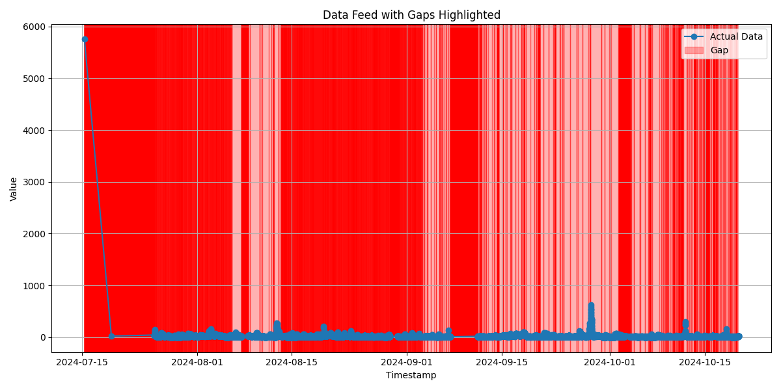

Slide 12
Scope Covered
Data Loading:
Used 120 Days of Sensor data from 13 stations.
Combined Dataset Shape : [(519748, 17)]
Data Preprocessing:
Columns used for prediction : [sensor_id, temperature, humidity, longitude, latitude, timestamp, pm2p5]
Timestamp column split to [hour, minute, day_of_week] and appended in the Copy of dataset with above columns.
Sequence of Data created using above features to use the capabilities of LSTM
Sequential Data is split into Test and Train
Model Training:
A Hybrid of below Algos are used to create the Model
Graph Neural Networks (GNNs) to capture spatial relationships between nodes in a graph.
LSTM for temporal dynamics of node features across time.
Attention Mechanisms for enhanced feature importance weighting in temporal sequences.
Prediction Head for generating a single output value (e.g., predicting pm2p5).
Used 250 Epochs to train the model
Evaluation:
Evaluated the model using matrices: RMSE, MAE, R^2, MAPE.
Plots:
Created plots to compare the behaviour of Model with Test and Train Data

Slide 13
Future Developments
Forecasting:
Forecasting of PM2.5 Concentrations for next 7-30 days
User Interface:
Display Forecast data date and station wise.
Challenges Faced
Train vs Test Prediction Accuracy:
The losses were not consistent when the data of multiple sensors were merged and processed with the Model. LSTM Code was changed to fix the behaviour
User Interface:
Display Forecast data date and station wise.

Slide 14
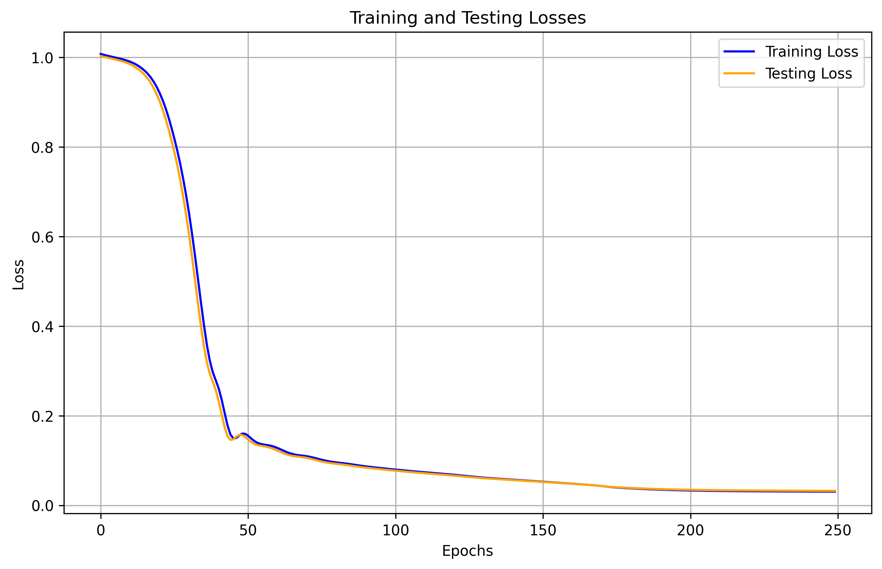

Slide 15
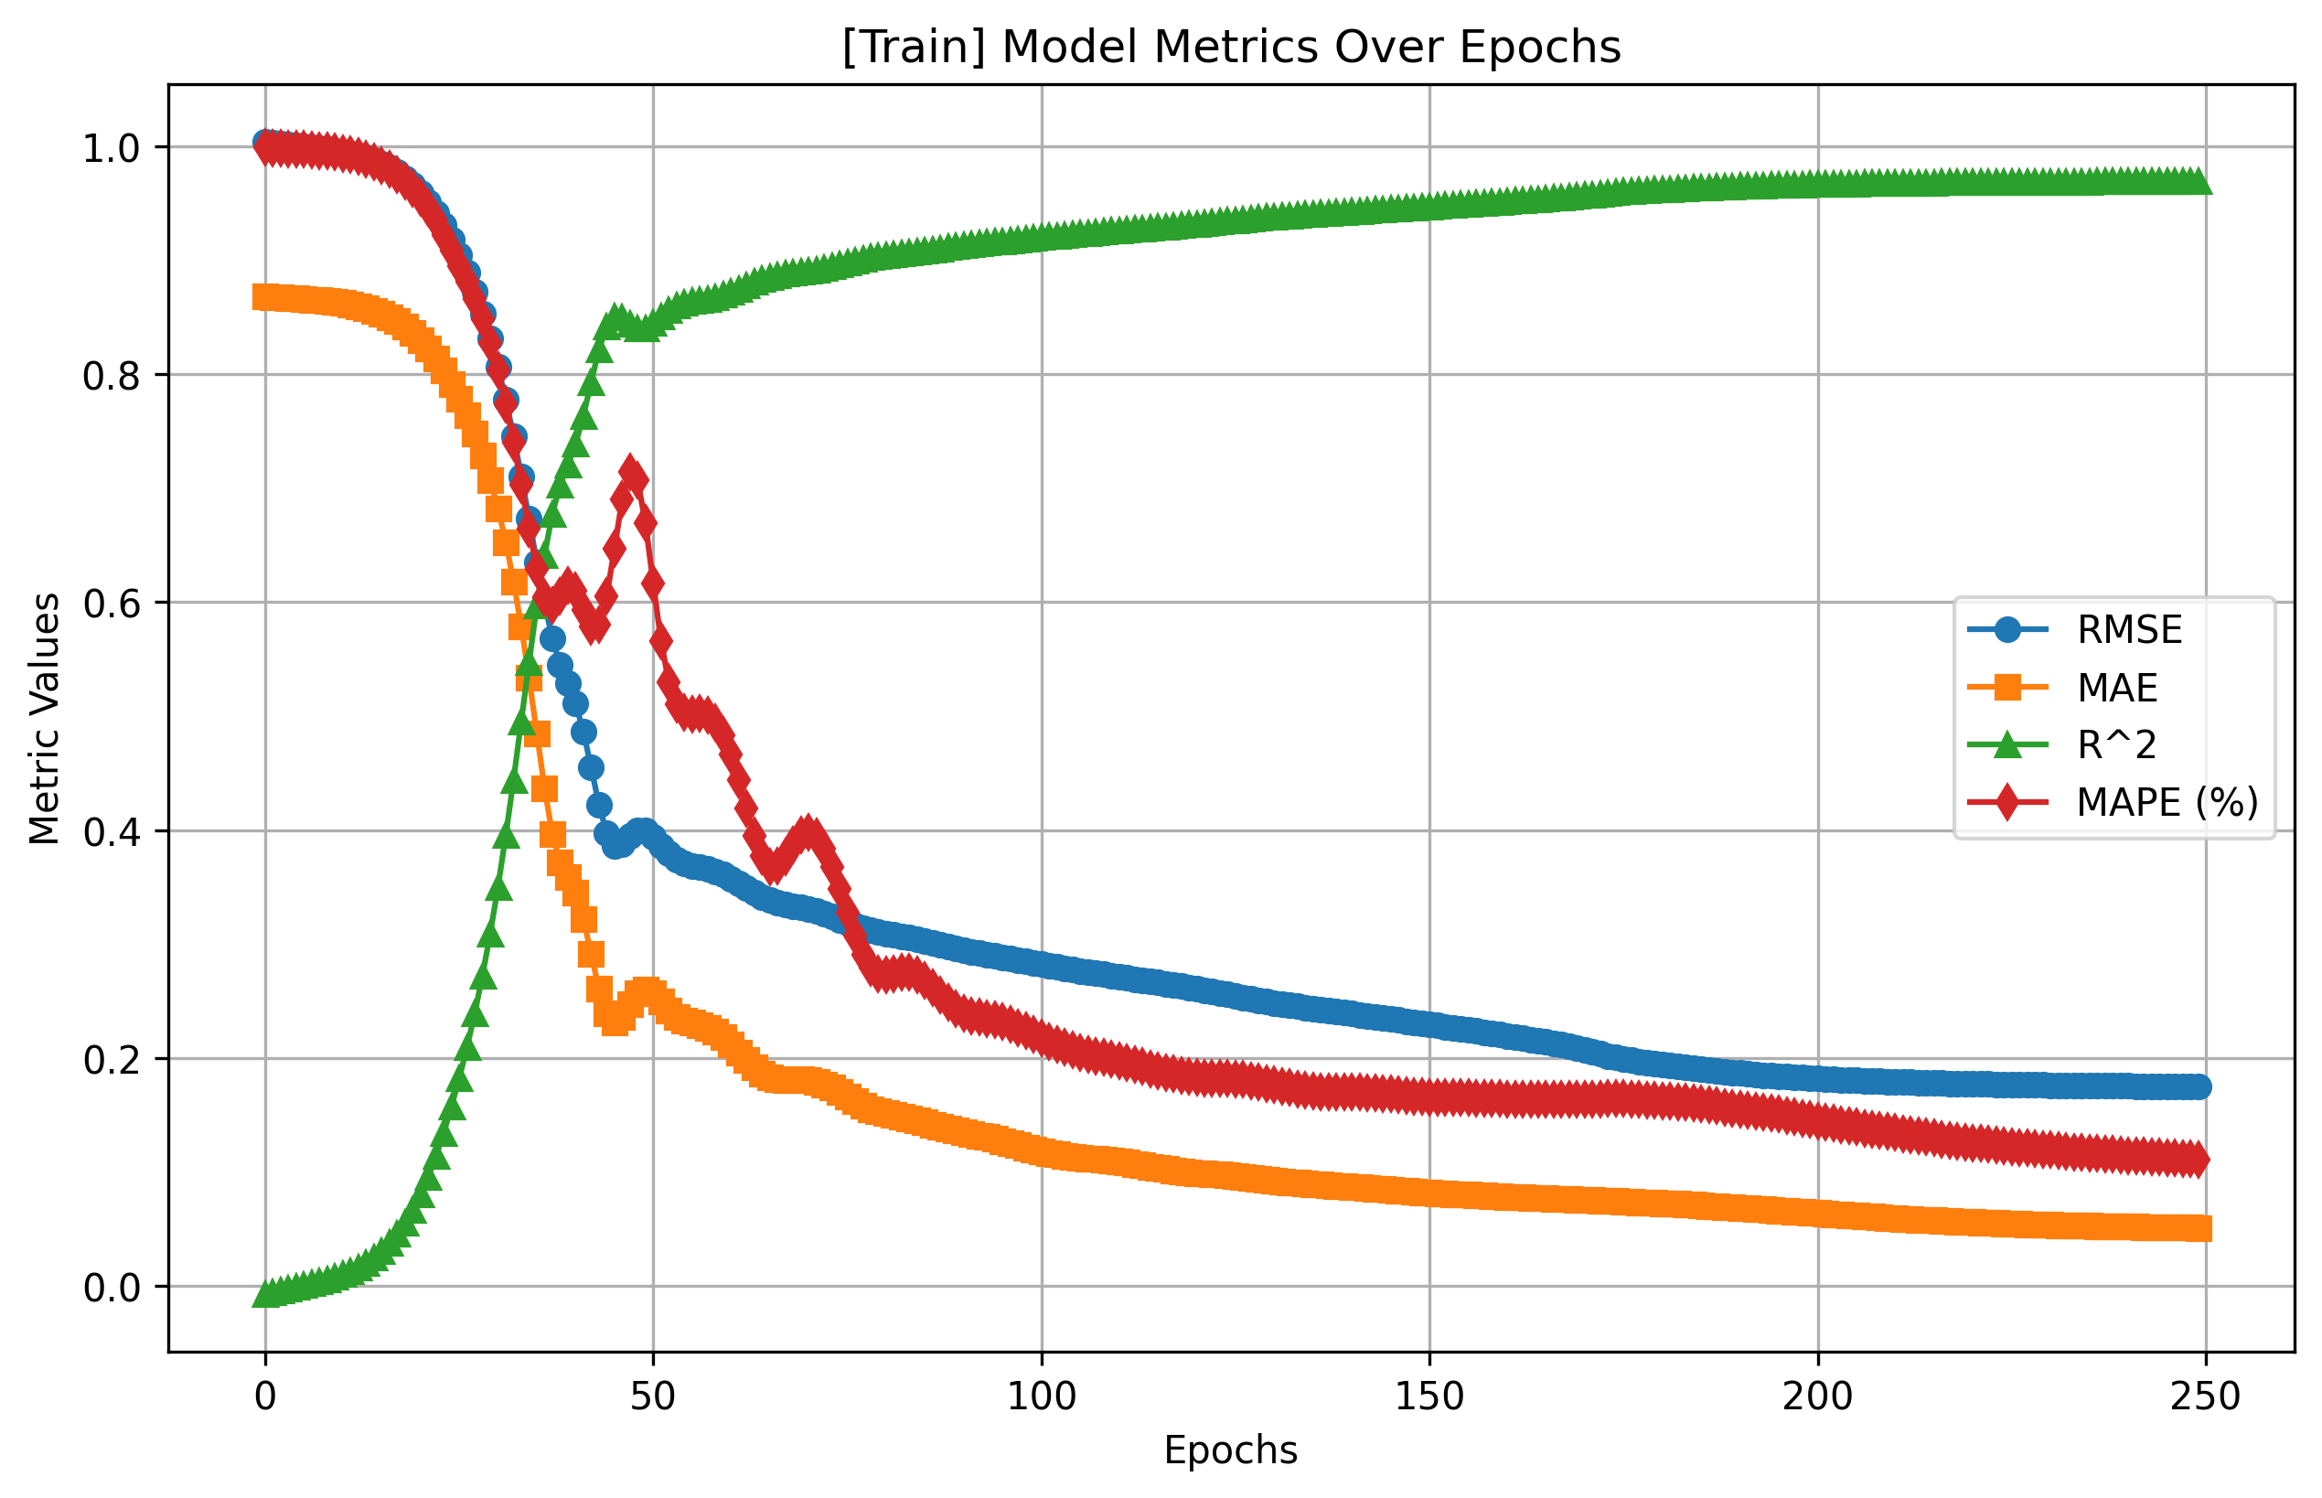

Slide 16


Slide 17
Observations
Model Generalization:
The small difference between training and test metrics indicates strong generalization.
Improved Predictions:
Metrics such as R^2 improve drastically from negative values to near-perfect (~0.97).
Effectiveness of Training:
A steady decrease in loss and error metrics without spikes suggests consistent training.
Convergence and Performance
The model converges well, as seen from the smooth decline in loss values and improvement in metrics.
The gap between training and testing metrics remains minimal, showing no significant overfitting.

Slide 18
Technical and Delivery Expertise in Payment Solutions & Application Support
Key Roles Held
Service Delivery / Technical Manager for LMS-S IDFC (since Feb 2024)
Sr Analyst for Cash Management & Payments (MAN Investments) (Jan 2018 – Jan 2024)
Technical Delivery Manager for Payments Hub (Santander) (Apr 2008 – Dec 2017, Top Role: Technical Delivery Manager; Started as Project Lead)
Developer for CitiCards (Sep 2006 – Apr 2008)
Team Lead for Sanctions Check AML (Citi) (Sep 2004 – Aug 2006)
Education
M.Tech, Applied AI – VNIT Nagpur (Pursuing, 2026)
MCA – Indira Gandhi National Open University (2009)
BCA – Indira Gandhi National Open University (2002)
PGDCA – C-DAC, ACTS Hyderabad
Skills and Tools
Programming: Java (up to Java 17), Angular, J2EE, Python (Pandas/Numpy)
Integration: Microservices, Kafka, Active MQ, IBM MQ
Cloud Platforms: AWS, Kubernetes
Build & Deployment : Jenkin / Git / Build Pipeline / Ruby
Database & Server Administration: Oracle Database, AIX, WebSphere, Kubernetes
Standard Payment Formats: SWIFT, ISO 20022, EDIFACT, CNAB240
Project Management: SLA compliance, AMC/TnM Contract Execution, Disaster Recovery
Notable Projects
Liquidity Management System (LMS)
Client: IDFC First Bank
Duration: Since February 2024
Key Contributions:
Designed and implemented cutting-edge microservices architecture.
Leveraged Kubernetes for deployment and orchestration.
Integrated Kafka, Active MQ, and JMS for seamless communication.
Delivered scalable and high-performing solutions to manage real-time liquidity needs.
Santander Payment Hub Implementation
Client: Banco Santander, Spain
Duration: Apr 2008 – Dec 2017
Key Contributions:
Led a 12-member team across development and testing.
Delivered real-time payment status reporting with high availability.
Optimized systems for processing international payment formats having files of 100k Payment Instructions.

