Slide 1
Timestamp Gap Analysis
Presented by: Sanjeev Kumar Pandey
Enrolment No: MT23AAI001
Project Guide: Dr. Amit Agrawal
For VNIT MTECH in AAI Mini Project
In collaboration with WITS University, South Africa

Slide 2
About Dataset and corresponding analysis
Analysed data of 22 Stations having records ranging from 500 to 67000
All of the datasets have reported the gaps ranging from misses of one reading to 3 readings on the average. Note : 1 reading is sent on every 5 minutes.
Outliers, mean, average – etc statistics will be presented in the next meeting.
All the datasets are processed and time gap reports and plots are created.

Slide 3
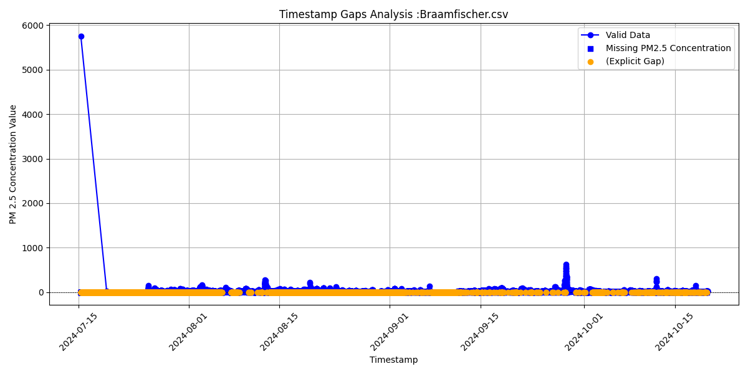

Slide 4
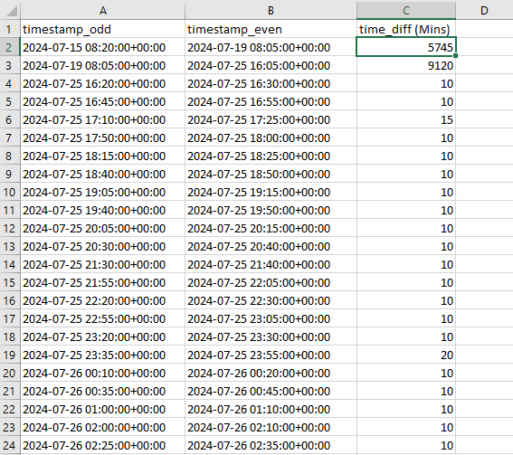
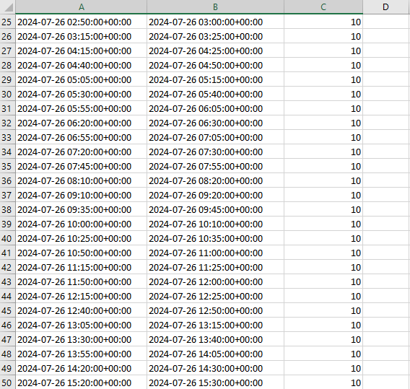
Time Gap Analysis Report

