Slide 1
CONTENTS OF THE PROJECT
Objective
Literature Survey- Min 10 papers
Existing System and Drawbacks
Problem statement
Proposed System Diagram
List of Modules
Expected Outcome
References

Slide 2
OBJECTIVE
concept to analyse women safety using social networking messages and by applying machine learning algorithms on it. Now-a-days almost all peoples are using social networking sites to express their feelings and if any women feel unsafe in any area then she will express negative words in her post/tweets/messages and by analysing those messages we can detect which area is more unsafe for women’s.

Slide 3
LITERATURE SURVEY
S.NO | TITLE OF THE PROJECT | AUTHOR NAME | JOURNAL | METHOD AND DESCRIPTION | DRAWBACKS | YEAR
1. | Contextual phrase-level polarity analysis using lexical affect scoring and syntactic n-grams | Apoorv Agarwal Fadi Biadsy Kathleen R. Mckeown | International Horticultural Congress | We present a classifier to predict contextual polarity of subjective phrases in a sentence. Our approach features lexical scoring derived from the Dictionary of Affect in Language (DAL) and extended through WordNet, | We compute polarity for each syntactic constituent in the input phrase using lexical affect scores for its words and extract n-grams over these constituents | 2009
2. | Robust sentiment detection on twitter from biased and noisy data | Luciano Barbosa , Junlan Feng | International Symposium on Models for Plant Growth and Control in Greenhouses | we propose an approach to automatically detect sentiments on Twitter messages (tweets) that explores some characteristics of how tweets are written and meta-information of the words that compose these messages | They have only initialized the problem. | 2010

Slide 4
EXISTING SYSTEM
concept to analyse women safety using social networking messages and by applying machine learning algorithms on it. Now-a-days almost all peoples are using social networking sites to express their feelings and if any women feel unsafe in any area then she will express negative words in her post/tweets/messages and by analysing those messages we can detect which area is more unsafe for women’s.

Slide 5
Drawback of the Existing System
But women feel that they are unsafe in places like malls, shopping malls on their way to their job location because of the several unknown Eyes body shaming and harassing these women point

Slide 6
PROBLEM DEFINITION
Women, Safety, Sexual Harassment, Hash tag,
Sentimental Analysis

Slide 7
PROPOSED SYSTEM
In propose work author using TWEEPY package from python to download tweets from twitter but every time INTERNET will not available to download tweets online so we downloaded MEETOO tweets on women safety and safe inside dataset folder. Application will read this tweets to detect women’s sentiments.
Author using NLTK (natural language tool kit) to remove special symbols and stop words from tweets and to make them clean.
Author using TEXTBLOB corpora package and dictionary to count positive, negative and neutral polarity and the tweets which has polarity value less than 0 will consider as negative as and greater than 0 and less than 0.5 will consider as neutral and polarity greater than 0.5 will consider as positive.

Slide 8
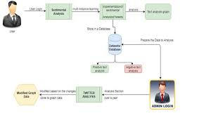
ARCHITECTURE DIAGRAM

Slide 9
LIST OF MODULES
upload dataset: using this module we will upload FICUS plant dataset
Dataset cleaning: using this module we will find out empty values in the dataset and replace with mean or 0 values.
Train & Test Split: Using this module we will split dataset into two parts called and training and testing. All machine learning algorithms take 80% dataset to train classifier and 20% dataset is used to test classifier prediction accuracy. If classifier prediction accuracy high then Mean Square Error, Root Mean Square Error and Mean Absolute Error will be dropped.
Run SVR Classifier: Using this module we will train SVR classifier with splitted 80% data and used 20% data to calculate it performance
Run Random Forest Classifier: Using this module we will train Random Forest classifier with splitted 80% data and used 20% data to calculate it performance
Run LSTM Classifier: Using this module we will train LSTM classifier with splitted 80% data and used 20% data to calculate it performance
Predict Plant & Yield Growth: Using this module we will upload test data and then apply LSTM classifier to predict it growth value

Slide 10
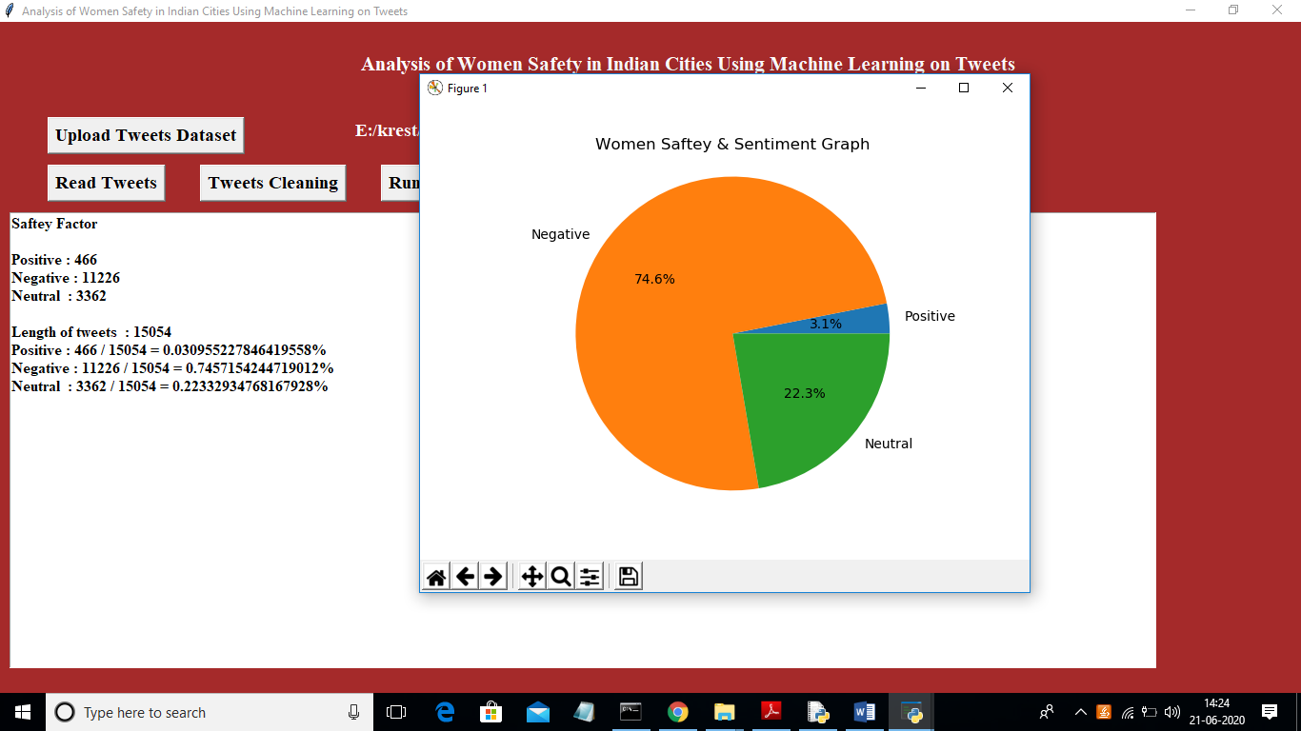
Expected Outcome/Result

Slide 11
REFERENCES
[1] Agarwal, Apoorv, Fadi Biadsy, and Kathleen R. Mckeown.
"Contextual phrase-level polarity analysis using lexical affect
scoring and syntactic n-grams." Proceedings of the 12th
Conference of the European Chapter of the Association for
Computational Linguistics. Association for Computational
Linguistics, 2009.
[2] Barbosa, Luciano, and Junlan Feng. "Robust sentiment
detection on twitter from biased and noisy data." Proceedings of
the 23rd international conference on computational linguistics:
posters. Association for Computational Linguistics, 2010.
[3] Bermingham, Adam, and Alan F. Smeaton. "Classifying
sentiment in microblogs: is brevity an advantage?." Proceedings
of the 19th ACM international conference on Information and
knowledge management. ACM, 2010.

Slide 12
THANK YOU

