Slide 1
Comprehensive indicators
M
F
D
G
Adaptability
Flexibility
Flow ability
Distribution of contribution
Tempo

Slide 2
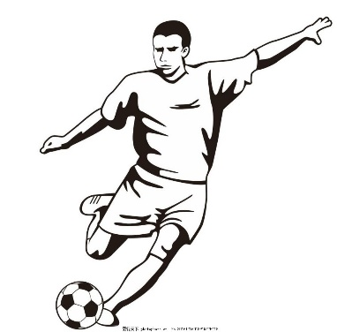
Comprehensive indicators
M
F
D
G
Adaptability
Flexibility
Flow ability
Distribution of contribution
Tempo
Performance
in different role
The indicators of teamwork
Indicators of G
Save attempt
Pass
Indicators of M, D, F, G
Smart pass
Acceleration
Shot
Touch
Duel
Clearance

Slide 3
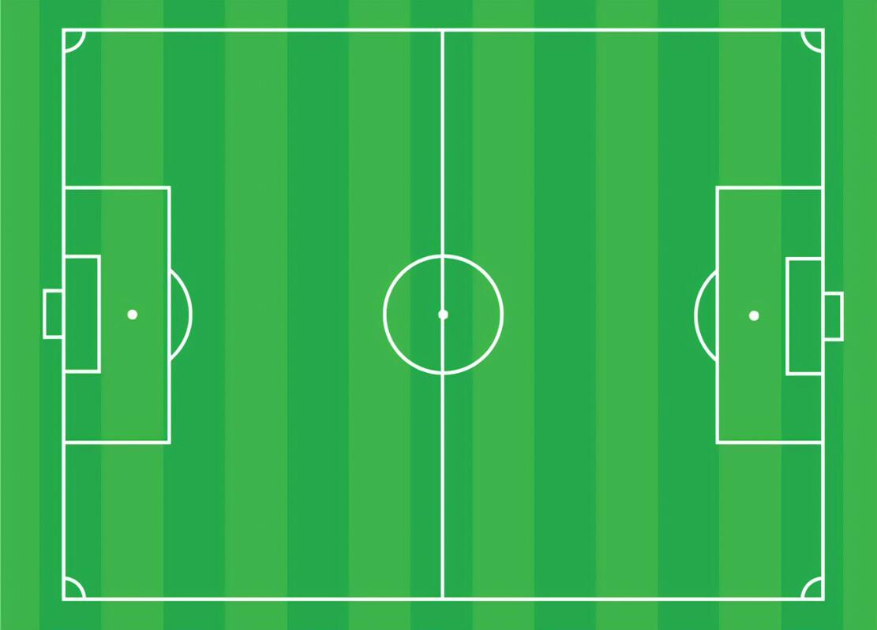
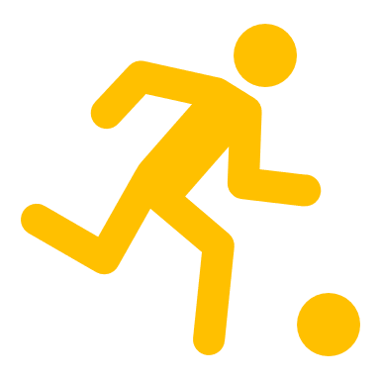

midfield
进攻方向
Defensive zone
Shot zone
Attack zone
Save zone
Hot zone
(Frequent pass and duel of Huskies)
y
X=10
X=90
x

Slide 4
Dynamic analysis
5 passes or 50s
Sliding window
Static Analysis
50 passes or 200 s
Step=20 passes or 50s
Match Time or total passes

Slide 5
Player1 current position
Player2 current position
Player1 previous position
Player2 previous position
Pass
Motif1: trapezoid pass
Motif2: triangle pass
Motif3: straight line pass
Moving direction

Slide 6
“passevents.csv”
“fullevents.csv”
“matches.csv”
The Football Passing Network Model
The Comprehensive Hierarchy of Teamwork Model
The Strategic Analysis Model
The Generalized Teamwork Model
Depend on opponents’ strategy
The Construction of the Network
Structural Indicators and Network Properties
Evaluate the Player’s Performance
Evaluate teamwork
Use heatmap to zone the football field
design more effective teams from these aspects
Directed weighted graph
Macro
Micro
Establish the evaluation indicators and weight of four types of player
Quantify six indicators to evaluate teamwork
design structural strategies
Centrality
Network patterns
Distribution of contribution
Connectivity
Clustering coefficient
Sliding window method
Use logistic regression classifier to get feature importance and estimate weight coefficients
capture important pass motifs
A competent leader
Spatial
Network Centroid
Use AHP to calculate weight coefficients
Universally effective
appropriate topological structure
Advance ratio
Use M-W hypothesis test to capture indicator difference between us and our opponents
Cohesion
Use weighted average to get comprehensive indicator
Diversity in people and strategy
Analyze minute-to-minute and average in every match, analyze time series in match season
Propose improvement plan

