Slide 1
“passevents.csv”
“fullevents.csv”
“matches.csv”
The Football Passing Network Model
The Comprehensive Hierarchy of Teamwork Model
The Strategic Analysis Model
The Generalized Teamwork Model
Depend on opponents’ strategy
The Construction of the Network
Structural Indicators and Network Properties
Evaluate the Player’s Performance
Evaluate teamwork
Use heatmap to zone the football field
design more effective teams from these aspects
Directed weighted graph
Macro
Micro
Establish the evaluation indicators and weight of four types of player
Quantify six indicators to evaluate teamwork
design structural strategies
Centrality
Network patterns
Distribution of contribution
Connectivity
Clustering coefficient
Sliding window method
Use logistic regression classifier to get feature importance and estimate weight coefficients
capture important pass motifs
A competent leader
Spatial
Network Centroid
Use AHP to calculate weight coefficients
Universally effective
appropriate topological structure
Advance ratio
Use M-W hypothesis test to capture indicator difference between us and our opponents
Cohesion
Use weighted average to get comprehensive indicator
Diversity in people and strategy
Analyze minute-to-minute and average in every match, analyze time series in match season
Propose improvement plan

Slide 2
“passevents.csv”
The Football Passing Network Model
The Comprehensive Hierarchy of Teamwork Model
The Construction of the Network
Structural Indicators and Network Properties
Evaluate the Player’s Performance
Evaluate teamwork
应用
检验
灵敏度分析
Directed weighted graph
Macro
Micro
Establish the evaluation indicators and weight of four types of player
Quantify six indicators to evaluate teamwork
Centrality
Network patterns
Connectivity
Clustering coefficient
Use logistic regression classifier to get feature importance and estimate weight coefficients
Spatial
Network Centroid
Use AHP to calculate weight coefficients
Advance ratio
Use weighted average to get comprehensive indicator
Analyze minute-to-minute and average in every match, analyze time series in match season

Slide 3
“BCHAIN-MKPRU.csv”
“LBMA-GOLD.csv”
Model construction
Use our model to solve problem 1
Price Trends Prediction Model
Trading Strategy Model
$1000->$48534624
Data Pre-processing and Analysis
Trading indicators
Test our model and prove our strategy is the best
Missing Value Processing
Train LSTM
The Maximum Rate of Return
Noise Reduction
Use four-quadrant Strategy
Turn hyperparameter
The Trading Risk
Normalization
Make a trading plan
Analyze sensitivity to transaction costs
Influence strategy through the frequency of transactions
Predict on testing set
Comprehensive Trading Indicator
Feature Extraction
Dataset Partitioning
Sliding Window
Task 2

Slide 4






Slide 5
Sliding window
Tarin step length(LEN_tra )
Sliding steps
Prediction step length (LEN_pre)
The day of trade making
The entire price time series
2020 9.12-2021.9.11
Training Set
Cross-validation Set
Testing set
2016 9.11-2019.9.11
2019 9.12-2020.9.11

Slide 6
Prediction step length (LEN_pre)
Sliding steps
Train step length(LEN_tra )
The day of trade making
The entire price time series

Slide 7




If μ2/ μ1>THcomp
Let HG’/HB’->Wgold/Wbitcoin
HG
△G
HG’
αgold
△B
HB
αbitcoin
HB’
Sell
Buy

Slide 8
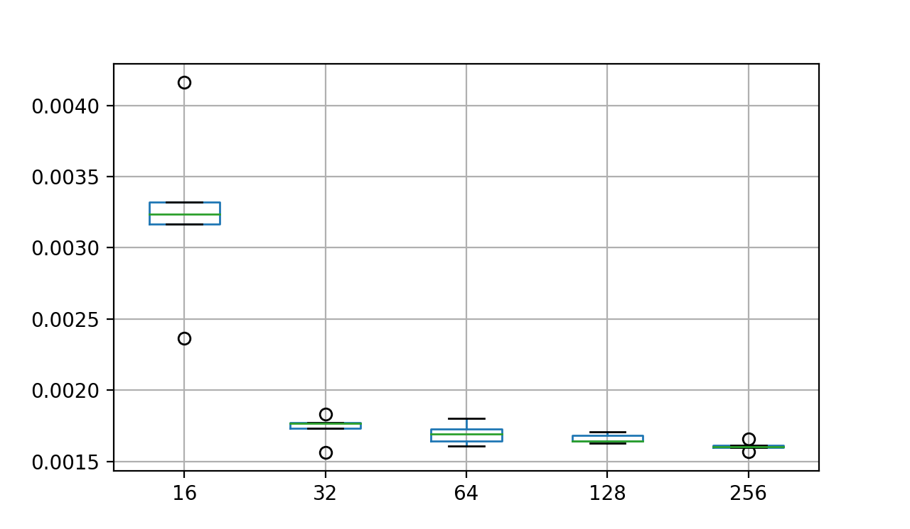
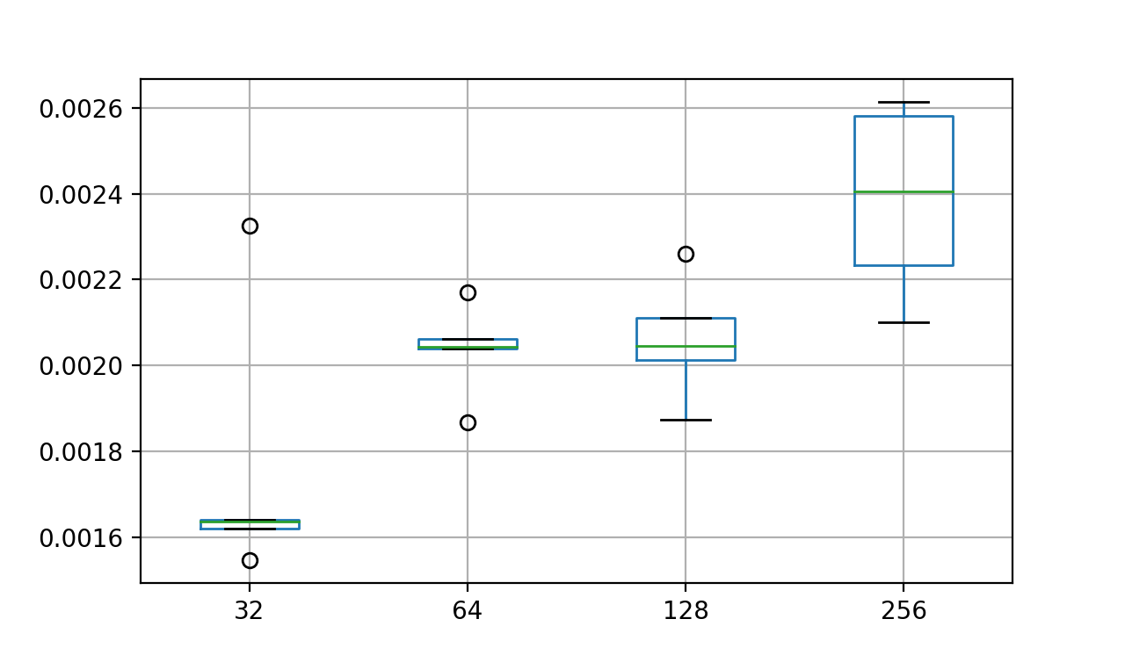
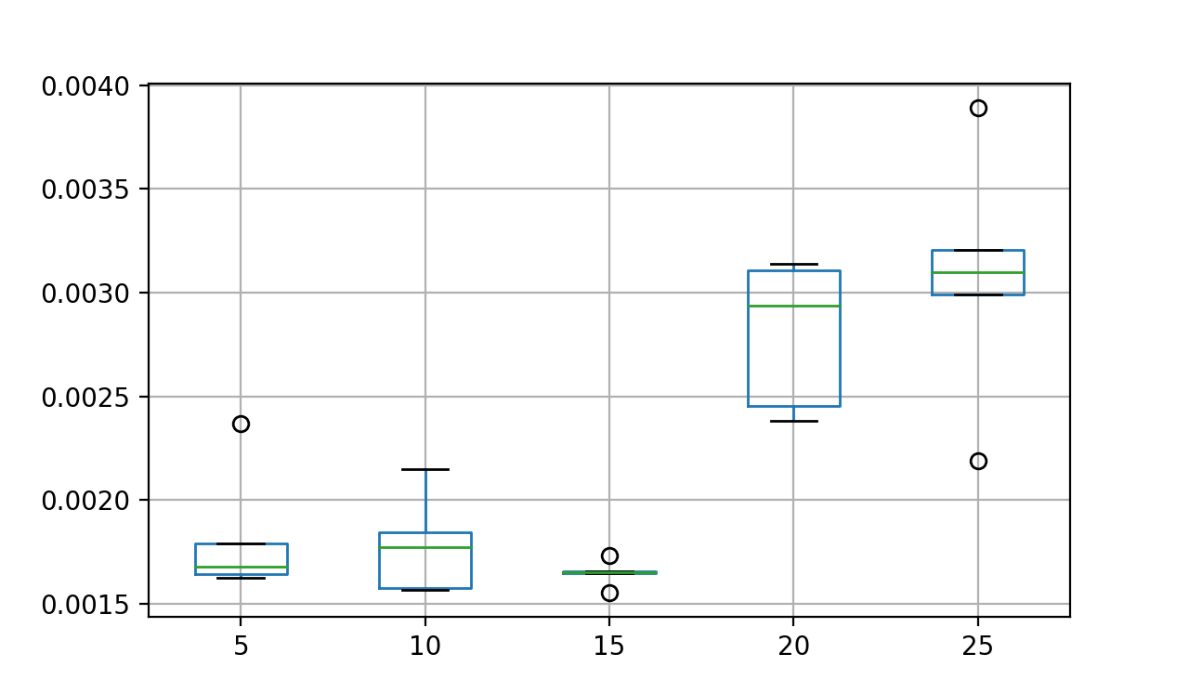
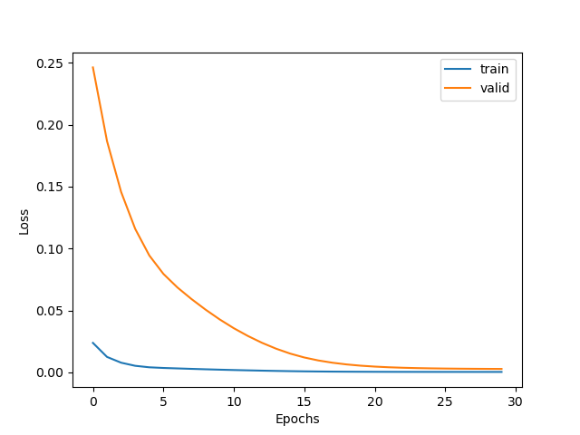
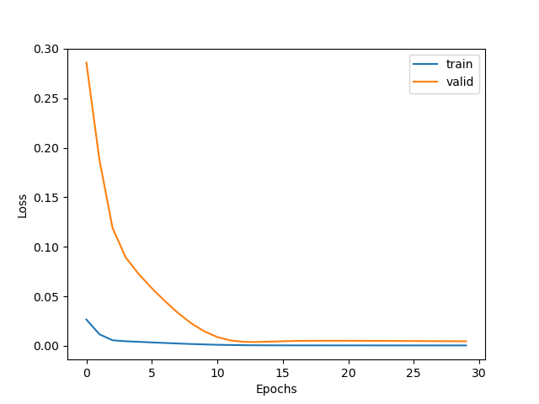
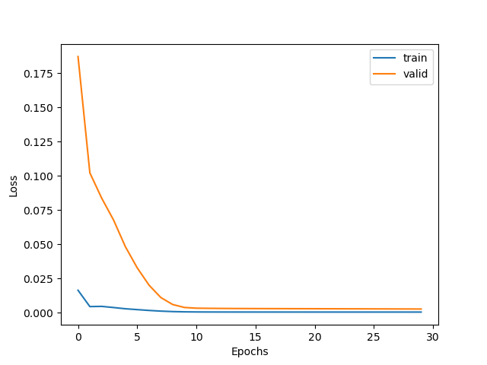
Loss(MSE)
Loss(MSE)
Loss(MSE)
The length of the training window (LEN_tra)
The number of memory cells in LSTM
Batch size
Figure a) Box diagram of parameter tuning
The number of memory cells in LSTM = 16
The number of memory cells in LSTM = 64
The number of memory cells in LSTM = 128
Figure b) The loss during learning epoches

Slide 9
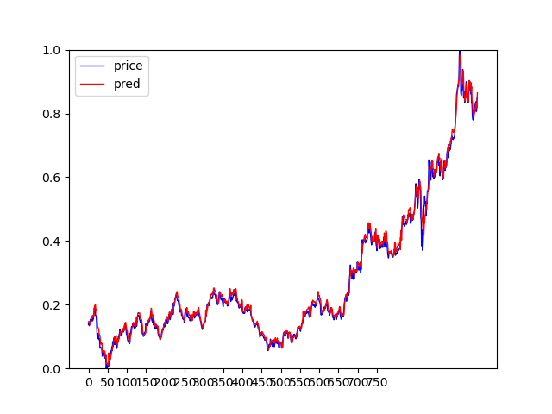
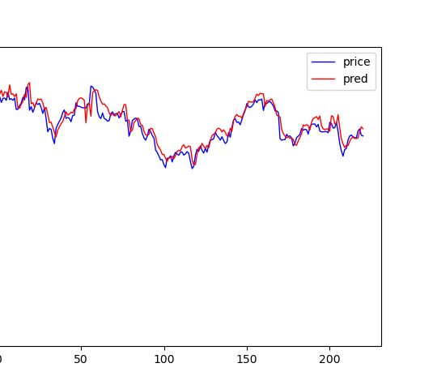
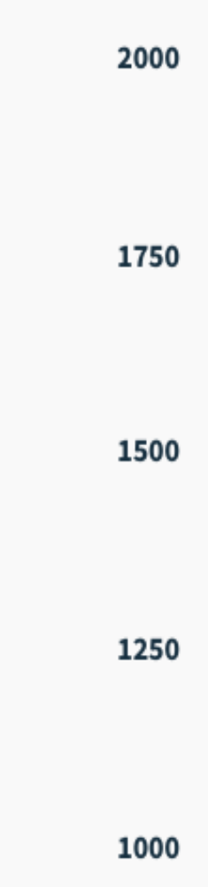
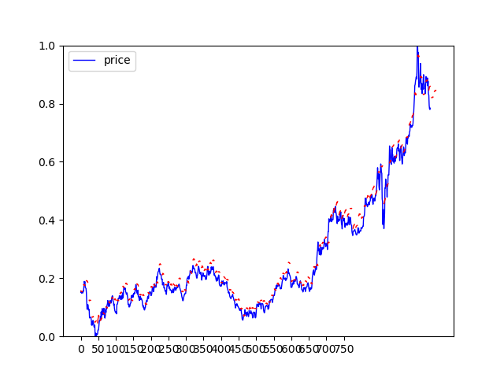
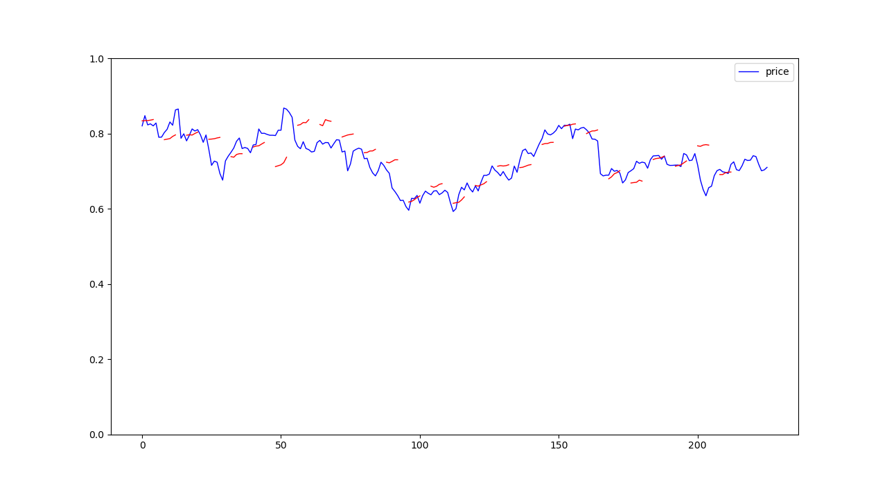
True price
Predict price
Training set
Testing set
Figure a) Gold price daily prediction
True price
Predict price
Training set
Testing set
Figure b) Gold price ten-day prediction

Slide 10
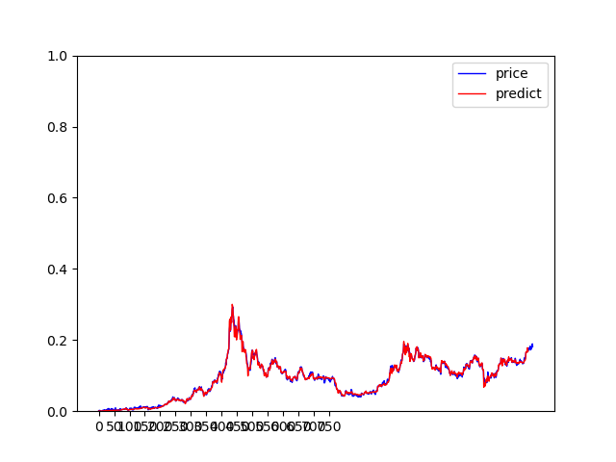
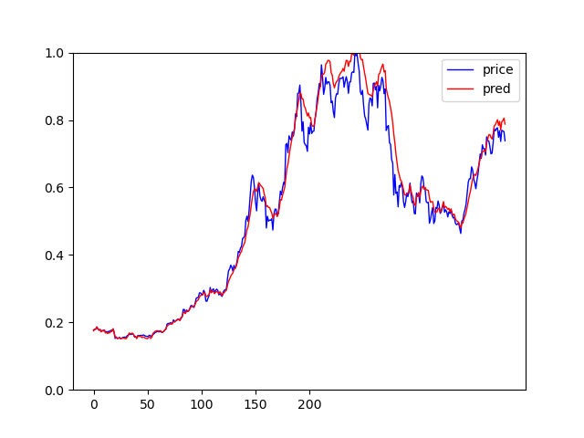
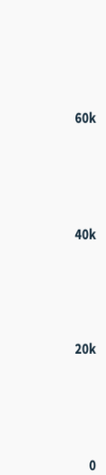
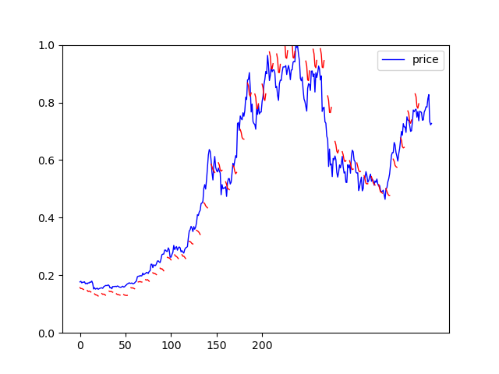
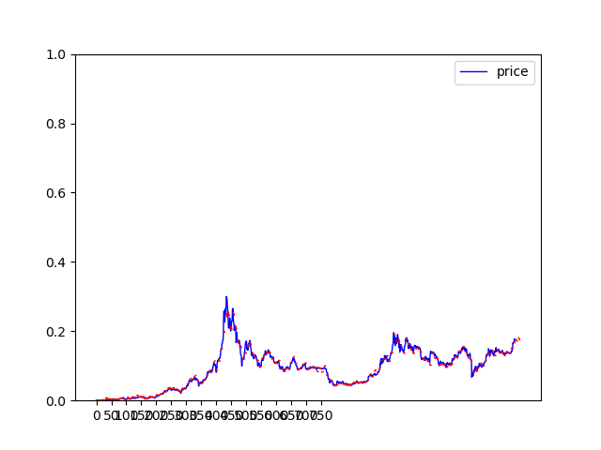
True price
Predict price
Training set
Testing set
Figure a) Bitcoin price daily prediction
True price
Predict price
Training set
Testing set
Figure b) Bitcoin price five-day prediction

Slide 11
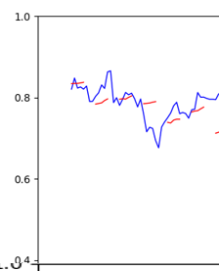
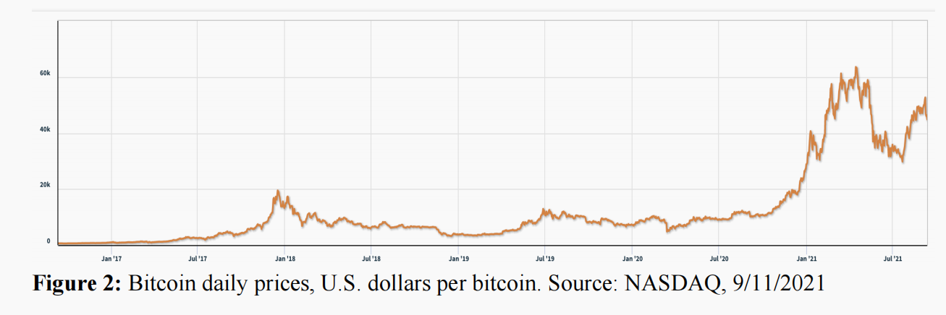

Slide 12
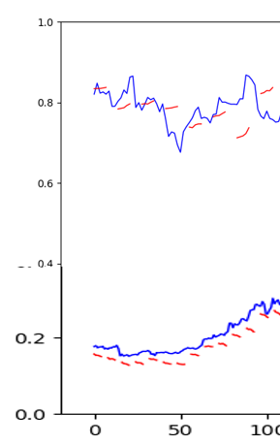

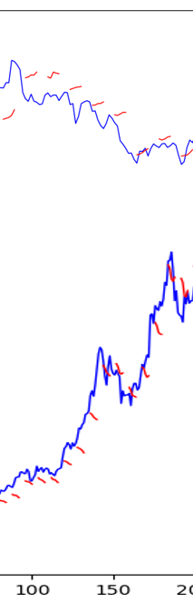
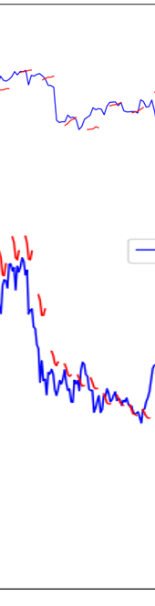





Gold
Bitcoin
Step. 20
Dec. 20
Dec. 20
Feb. 21
May. 21
Jul. 21
Figure a)
Figure b)
Figure c)

Slide 15
Buy
Hold
Yes
No
high profit & low risk?
Is the loss significant?
Yes
Sell
Optimize assets portfolio for purchase
Profit
Buy according to the best portfolio
µ1 = 0 µ2 > 0
µ1 > 0 µ2 > 0
Loss
Profit
µ1 = 0 µ2 = 0
µ1 > 0 µ2 = 0
&
Sell
Yes
Sell
Is the loss significant?
high profit & low risk?
Is the loss significant?
Loss
Yes
No
No
Hold
Yes
Hold
Buy
Profit: μ>0
Loss: μ=0
μ1 is maximum rate of return for gold.
μ2 is maximum rate of return for bitcoin.
Buy: gold or bitcoin it with all the cash you have.
Sell: Sell all the held gold or bitcoin.

Slide 16
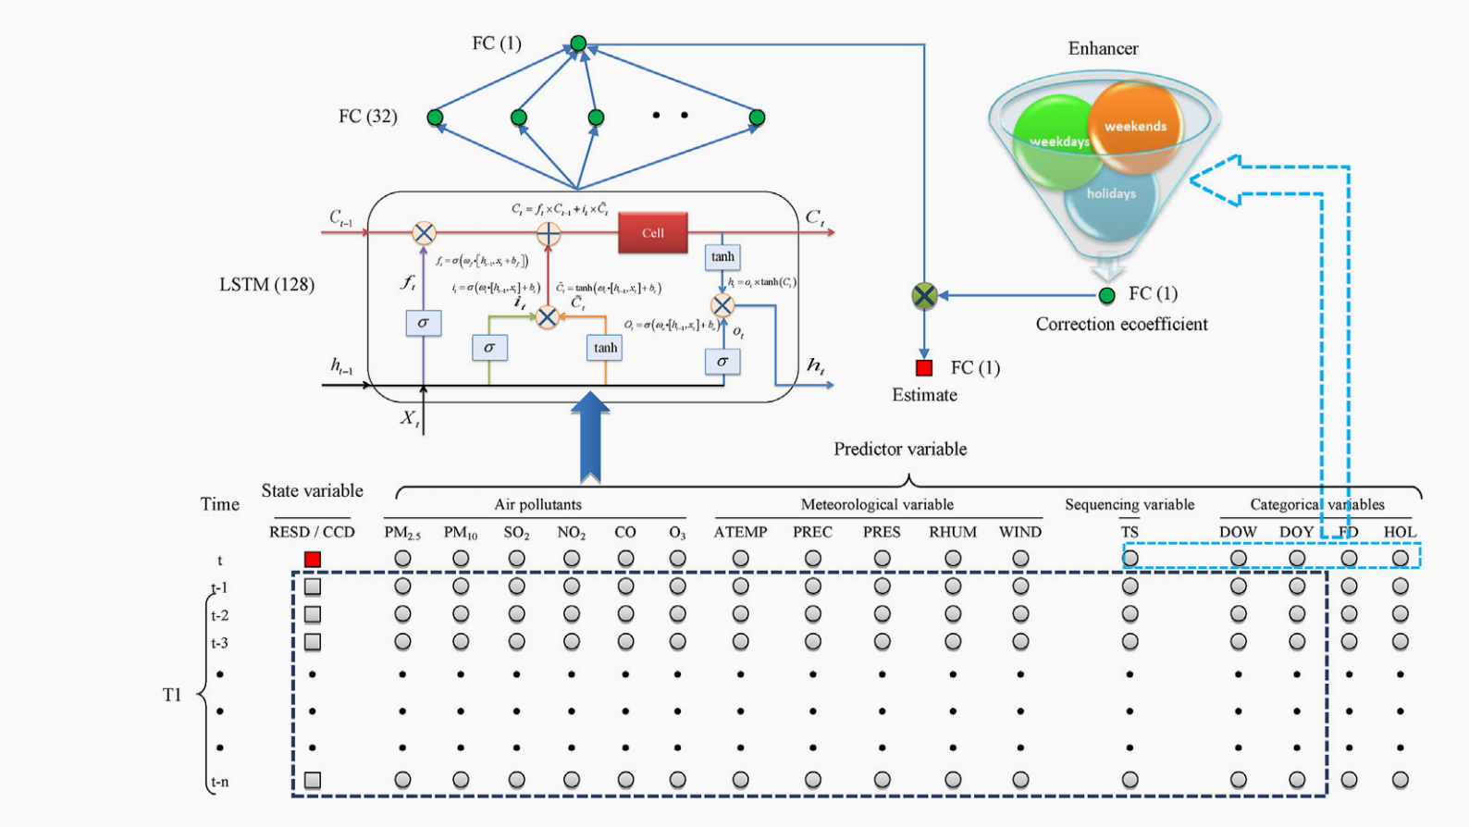

Slide 17
