Slide 1
Dem
Dem
Player Past Market
Sentiment Features
(n = 6)
Player Demographic Features
(n = 8)
Dem
Decay-Time Weighted
Player Past-Performance Features
(n = 329)
Strength of Schedule-Adjusted
Decay-Time Weighted
Dem
Strength of Schedule-Adjusted
Dem
Tourney Conditions Adjusted
Tournament Conditions
Features
(n = 21)
Player Conditioning Features
(n = 10)
Decay-Time Weighted
N = 374 predictive features
Notes:
Fig. 1

Slide 2
PREDICTED MATCH
(TARGET FEATURE: % TOTAL POINTS PLAYED WON PER PLAYER)
0
SHORT-TERM PAST PERFORMANCE FEATURES ACCRUED
(Prior 10 Matches)
Post Decay Time-Weighting Adjustments, Per
Predictive Feature
-10
LONG-TERM PAST PERFORMANCE
FEATURES ACCRUED
(Prior 60 Matches)
Adjustment
For Court Conditions
Adjustment
For Strength
of Schedule
Increasing
Weight
# Match Prior to Predicted Match
Player Value – Opponent Value
(Players in Predicted Match)
Final “Differential” Feature
-60
Notes:
Fig. 2

Slide 3
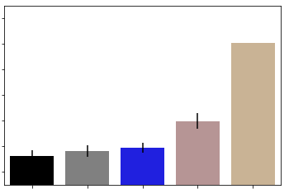
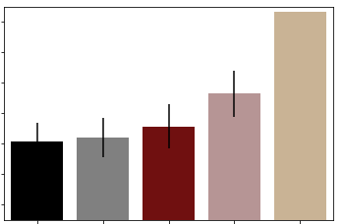
Hard Court Model
Clay Court Model
6.4
6.4
6.2
6.2
6.0
6.0
5.8
5.8
Training Error % (RMSE)
5.6
5.6
5.4
5.4
5.2
5.2
Closing IWPs
Opening IWPs
Full Set
(No IWPs)
Rankings
Dummy
Closing IWPs
Opening IWPs
Full Set
(No IWPs)
Rankings
Dummy
Feature Set Included in Model Prediction
* This model iteration included data from 2015-2019 (data from 2009-2014 were also used to accrue predictive stats and features prior to modeling stage). A minimum threshold for previous matches (20) played by both players in a given match being predicted (specific to surface predicted match is on) was also applied. These filters will be discussed later in the presentation.
Notes:
Fig. 3

Slide 4
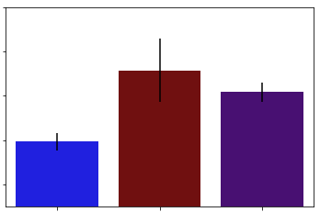
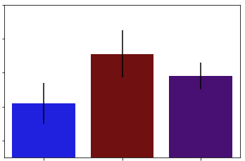
Full Sample Per Surface
Equal Samples Per Surface
6.0
6.0
5.8
5.8
5.6
5.6
Training Error % (RMSE)
5.4
5.4
5.2
5.2
Match N
Hard
Clay
Hard + Clay
Hard
Clay
Hard + Clay
(5494)
(2265)
(7759)
(2265)
(2265)
(4530)
Surface(s) Included in Model Prediction
* For the equal samples analysis “Hard” and “Hard + Clay” court models, 25 modeling iterations with different random subsets of Hard Court rows were averaged.
Notes:
Fig. 4

Slide 5
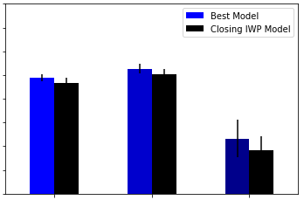
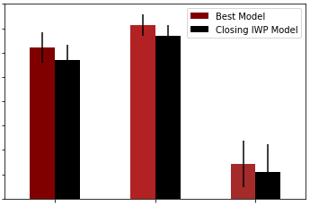
Hard Court Model
Clay Court Model
6.25
6.25
6.0
6.0
5.75
5.75
5.5
5.5
5.25
5.25
Training Error % (RMSE)
5.0
5.0
4.75
4.75
4.5
4.5
4.25
4.25
Match N
All Matches
Best of 3 (non-GS)
Best of 5 (GS)
All Matches
Best of 3 (non-GS)
Best of 5 (GS)
(9710)
(8143)
(1567)
(3952)
(3329)
(623)
% Matches
(100)
(83.9)
(16.1)
(100)
(84.2)
(15.8)
Matches Included in Model Prediction
Notes:
Fig. 5

Slide 6
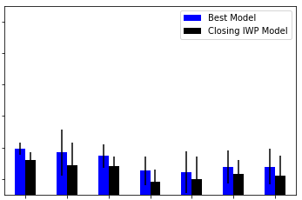
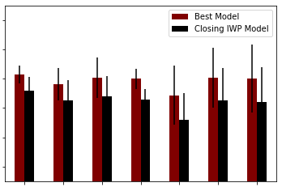
Hard Court Model
Clay Court Model
6.2
6.2
6.0
6.0
5.8
5.8
Training Error % (RMSE)
5.6
5.6
5.4
5.4
5.2
5.2
None
<7.5%
<5%
<4%
<3%
<2.5%
<2%
None
<7.5%
<5%
<4%
<3%
<2.5%
<2%
Match N
(5494)
(5048)
(4301)
(3718)
(3023)
(2610)
(2123)
(3607)
(3258)
(2723)
(2374)
(1931)
(1695)
(1386)
% Matches
(100)
(91.9)
(78.3)
(67.7)
(55.0)
(47.5)
(38.6)
(100)
(90.3)
(75.5)
(65.8)
(53.5)
(47.0)
(38.4)
Inclusion Cutoff For Opening to Closing IWP Movement
Notes:
Fig. 6

Slide 7
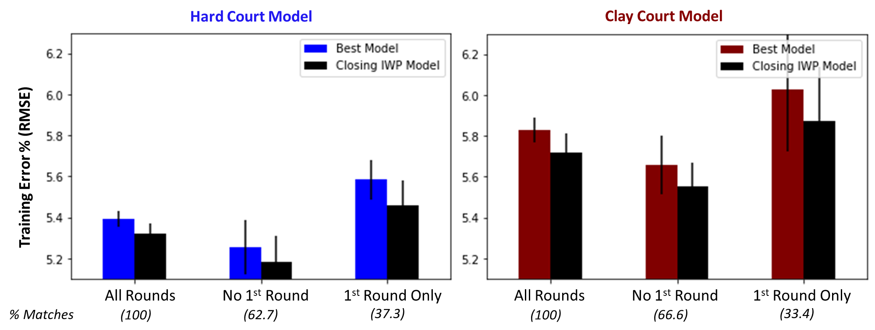
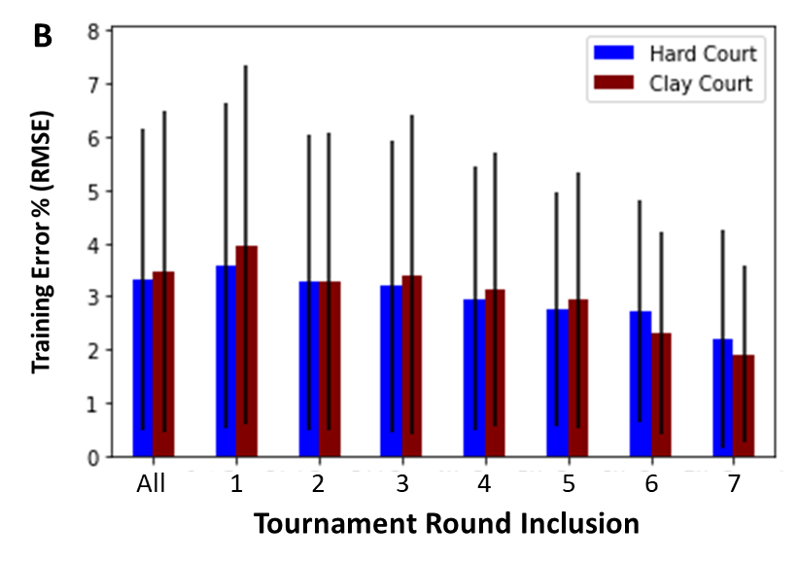
A
B
IWP Δ (%)
% Matches - Hard
(100)
(37.2)
(30.2)
(17.2)
(9.1)
(4.7)
(1.2)
(0.4)
% Matches - Clay
(100)
(33.3)
(30.5)
(18.8)
(10.1)
(5.7)
(1.4)
(0.2)
Tournament Round Inclusion
Notes:
Fig. 7

Slide 8
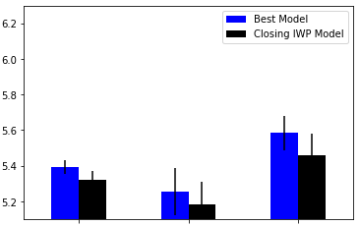
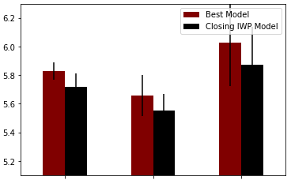
Hard Court Model
Clay Court Model
Training Error % (RMSE)
All Rounds
No 1st Round
1st Round Only
All Rounds
No 1st Round
1st Round Only
% Matches
(100)
(62.7)
(37.3)
(100)
(66.6)
(33.4)
Tournament Round Inclusion
Notes:
Fig.7

Slide 9
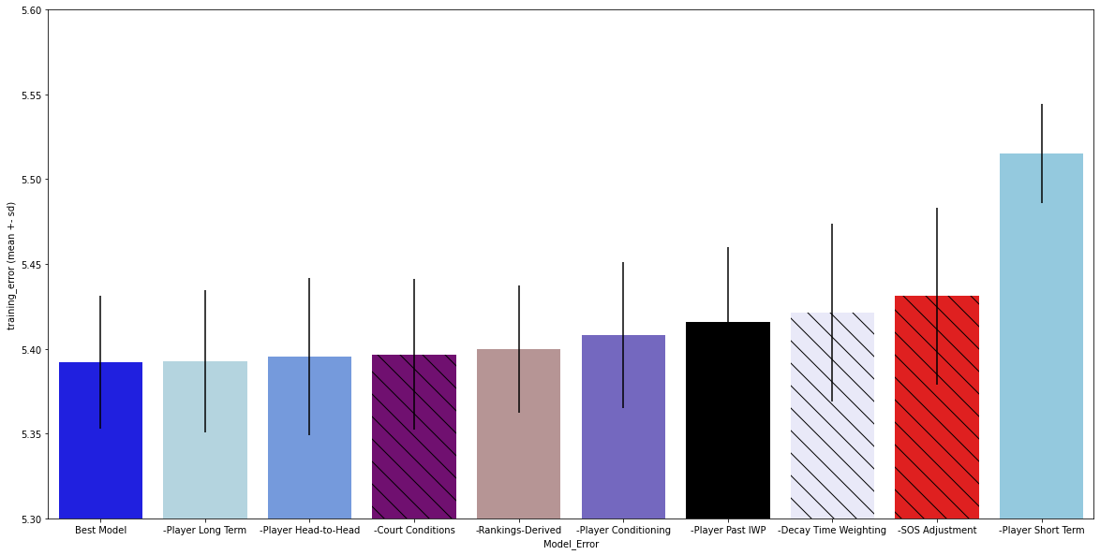
5.6
5.55
5.5
5.45
Training Error % (RMSE)
5.4
5.35
5.3
Decay-Time Weighting
SOS Adjustment
Player Short Term
Full Best Model
Player Long Term
Player H2H
Court
Conditions
Rankings
Derived
Player
Conditioning
Player
Past IWP
Subtracted Feature Class or Adjustment Type
Notes:
Fig. 8

Slide 10
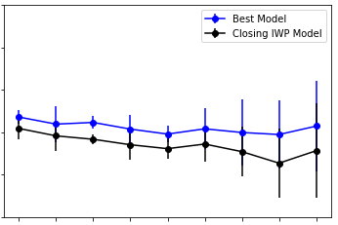
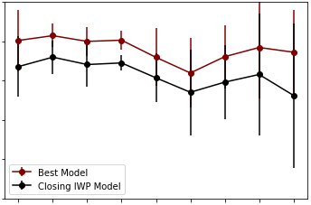
Hard Court Model
Clay Court Model
6.0
6.0
5.8
5.8
5.6
5.6
Training Error % (RMSE)
5.4
5.4
5.2
5.2
5.0
5.0
2011
2012
2013
2014
2015
2016
2017
2018
2019
2016
2017
2018
2019
Match N
2011
2012
2013
2014
2015
(9710)
(8731)
(7696)
(6555)
(5494)
(4347)
(3241)
(2145)
(1072)
(3952)
(3607)
(3224)
(2736)
(2265)
(1787)
(1329)
(846)
(428)
First Year Included in Modeling Stage
Notes:
Supp. Fig. 1

Slide 11
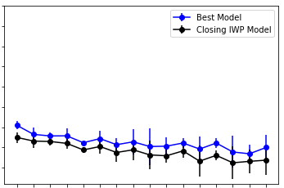
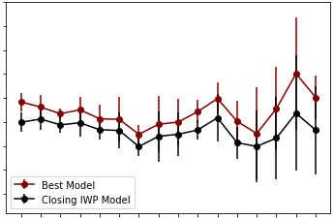
Hard Court Model
Clay Court Model
7.0
7.0
6.75
6.75
6.50
6.50
6.25
6.25
6.0
6.0
Training Error % (RMSE)
5.75
5.75
5.50
5.50
5.25
5.25
5.0
5.0
Match N
0
20
40
60
80
100
120
140
0
20
40
60
80
100
120
140
(7432)
(5494)
(4422)
(3584)
(2814)
(2189)
(1679)
(1337)
(6364)
(3607)
(2232)
(1431)
(873)
(494)
(262)
(133)
Minimum Previous Matches Played Threshold (Both Players in Predicted Match)
Notes:
Supp. Fig. 2

Slide 12
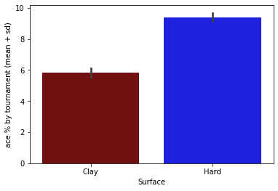
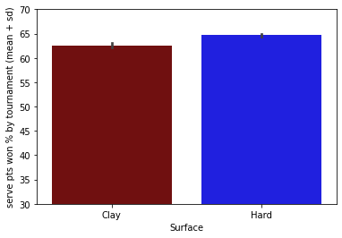
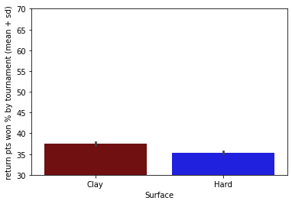
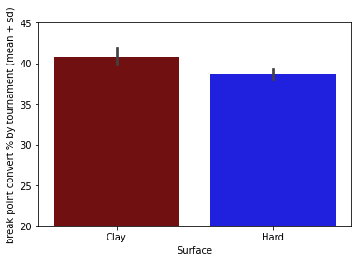
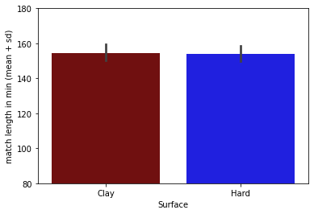
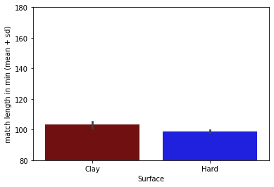
A
Ace %
B
Serve Pts Won %
C
Return Pts Won %
D
E
F
Break Point Convert %
GS Match Length (min)
Non-GS Match Length (min)
Notes:
Supp. Fig. 3

Slide 13
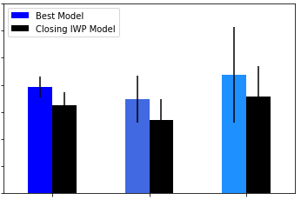
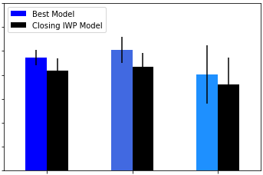
Hard Court (2015-2019)
Hard Court (2011-2019)
5.7
5.7
5.6
5.6
5.5
5.5
5.4
5.4
Training Error % (RMSE)
5.3
5.3
5.2
5.2
5.1
5.1
5.0
5.0
Match N
All Matches
Outdoor
Indoor
All Matches
Outdoor
Indoor
(5494)
(4067)
(1427)
(9710)
(7087)
(2623)
Matches Included in Model Prediction
Notes:
Supp. Fig. 4

Slide 14
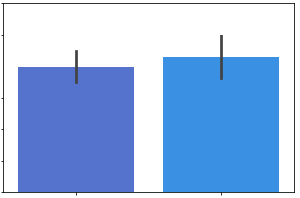
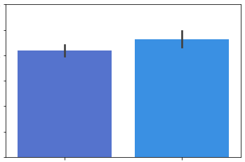
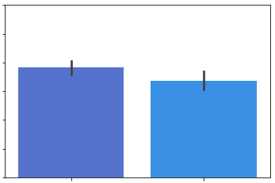
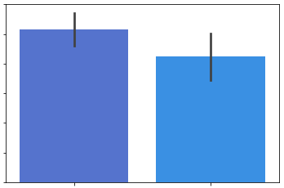
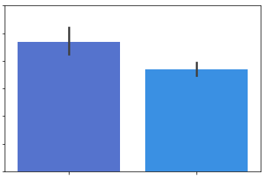
A
Ace %
B
Serve Pts Won %
C
Return Pts Won %
10.0
66.0
38.0
9.5
65.0
37.0
9.0
64.0
36.0
8.5
63.0
35.0
8.0
62.0
34.0
7.5
61.0
33.0
7.0
Indoor
60.0
Outdoor
Indoor
32.0
Indoor
Outdoor
Outdoor
D
Break Point Convert %
E
Non-GS Match Length (min)
39.0
110.0
38.0
105.0
38.0
100.0
37.0
95.0
36.0
90.0
35.0
85.0
34.0
Outdoor
Indoor
80.0
Outdoor
Indoor
Notes:
Supp. Fig. 5

