Slide 1
What Factors are Key to Successfully Predicting Match Outcomes in Top Level Men’s Professional Tennis?
Jon Raksin
10/06/2022

Slide 2
Introduction and Business Case Scenario*
Our consultancy has been approached by LV Sports Consultants (LVSC), a group providing recommendations on wagering lines and betting limits to a number of Las Vegas sports books
LVSC requests us to build a quantitative model of the outcomes of tennis matches, and provide a semi-technical summary report on aspects of the model useful in generating accurate predictions
We decided to focus on the top level of men’s professional singles tennis, the Association of Tennis Professionals main tour, and have obtained a large amount of raw match outcomes data going back over a decade from the Github site of a well-regarded tennis statistician
Using this data archive (~35,000 matches from 2008-2019) and our knowledge of the game, we built a large set (~150) of individual player performance, player demographic, and match conditions-derived features to predict the outcomes of individual matches at the level of percent points won per player [0-100%]
Utmost care was taken to ensure that all information used to predict the outcome of a given match was available prior to that match being played
We built two models (one per court surface) as the final stage of the initial project, and presently share the main findings and proposed next steps with the LVSC team
*Note that this is a purely hypothetical scenario for narrative and “real world relevance” purposes. I, Jon Raksin, did all of the work on this project.

Slide 3
Methodology: Summary of Predictive Feature Generation
Feature Class (n/140) | Examples in Class | Time-Sensitive Adjustments
Match: Conditions (9) | Locale, Court Speed, Altitude | N/A
Player: Non-Adjusted Demographic & Past Performance (47) | Ranking, Height, Handedness, Home Court Advantage, Head-to-Head Past Performance vs Current Opponent, Height, Age | N/A
Player: Adjusted Past Performance (64) | Past % Serve Pts Won, Past % Return Pts Won, Past Ace%, Past Break Pt% (Short and Long-term forms of each) | Short (previous 10 matches on surface) or Long (last 60 matches on surface) term stats time-decay weighted (more recent = more weight) Time-weighted stats adjusted by average strength of opponents over measurement interval on same stat (“SOS Adjustment”)
Player: Adjusted Fatigue & Stamina (20) | Fatigue (within tourney): Total Time on Court, Total Pts Played; Stamina (full sample): # Past Matches Played | Fatigue metrics across all previous matches in same tournament as match being predicted on are time-decay weighted “Body Battery” integrates time-weighted fatigue metrics with stamina metrics (longer past = “bigger battery”)
Target feature (TF): % of total points played [0-100] won by a given player in a given match
TF predicted by 140 features in 4 classes, derived from data available prior to match being predicted on:
Notes:
Key Points
This table summarizes the key aspects of predictive feature generation for the two surface-specific models used to predict the target feature, which was % of total points played [0-100] won by a given player in a given match.
Two of these feature classes (Match: Conditions and Player: Non-Adjusted Demographic & Past Performance) did not involve aggregation of stats from a rolling window of matches prior to the one being predicted. These classes comprise tournament and match metadata (e.g., surface, locale, altitude) and non-statistically derived player attributes (e.g., height, handedness, age, ranking).
In contrast, features in the other two classes (Player: Adjusted Past Performance and Player: Adjusted Fatigue & Stamina) were generated by statistics aggregation from a rolling window (of empirically-derived size looking backward in time) from matches for a given player on a given surface prior to the match being predicted. The term “Adjusted” in describing these two classes refers to the fact that empirically-derived time decay weighting and/or factoring by the quality of opponents faced over the aggregation window (ie, “strength of schedule adjustment”) was applied to each feature after the initial windowed aggregation.
As a final key methodology note, all player-level predictive features (comprising features in all but the Match: Conditions class) were generated in both “Raw” and “Differential” forms. Using height as an example, the Raw form of the feature would be the height itself (e.g., 180 cm) and the Differential form would be 180 minus the height of the opponent in the match being predicted on (e.g., 180-170 = 10). In the opponent’s record for the same match, the Raw and Differentials values would be 170 and -10, respectively.

Slide 4
Key Finding #1: Hard Court Tennis Match Outcomes Were Modeled More Accurately Than Those on Clay Courts

Slide 5
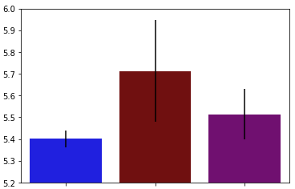

Best Model Prediction Quality Was For Hard Court Tennis Alone, Even When Sample Size Was Made Equivalent For The Surfaces
Full Sample Per Surface*
Equal Samples Per Surface*
Training Set Sample Ns
~3.2K
~3.2K
~6.4K
~11.2K
Training Error % (RMSE)
~8K
~3.2K
Hard
Clay
Hard + Clay
Hard
Clay
Hard + Clay
Surface(s) Included in Model Prediction
* This model iteration included data from 2015-2019 (data from 2012-2014 were also used to accrue predictive stats and features prior to modeling stage). A minimum threshold for previous matches (20) played by both players in a given match being predicted (specific to surface predicted match is on) was also applied. These filters will be discussed later in the presentation.
Notes:
Key Points
Hard court match outcomes were modeled more accurately than those on clay courts, even when adjusting for sample size differences across the two surfaces (mean training set error for TF: 5.42% [+-0.04%] for hard courts vs 5.71% [+-0.23%] for clay courts [RMSE])
Note that there are approximately 3x as many matches on hard courts than on clay courts in the sample (left panel). For the equal samples analysis, an identical number of records as were included in the full clay court sample were sampled randomly from the full hard court sample, following the application of other filters for both the clay and hard court samples (see footnote).
For broader perspective on model quality, the best hard court and clay court models were substantially more accurate than "Dummy" models where TF for each record was guessed using the mean TF in the overall surface sample (Hard
Court: 6.16%; Clay Court: 6.65% [training set cross-validation errors]) (not shown)

Slide 6
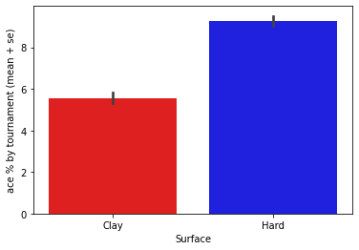
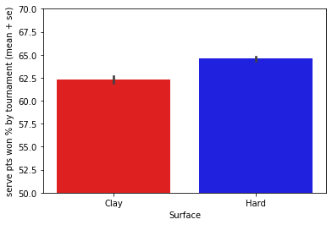
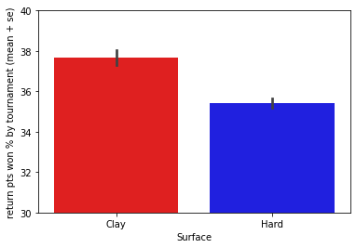
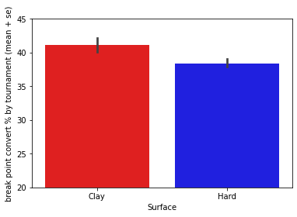
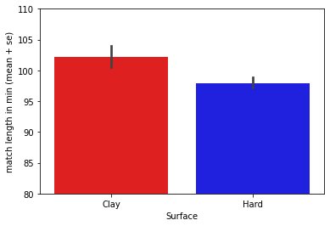
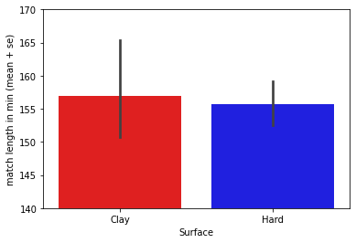
Hard Court and Clay Court Tennis Are Different Animals I
A
Ace %
B
Serve Pts Won %
C
Return Pts Won %
D
E
F
Break Point Convert %
Non-GS Match Length (min)
GS Match Length (min)
Notes:
Key Points
Additional analyses of underlying data suggest that hard court tennis should in principle be more predictable than clay court tennis
On average, matches in the sample on hard courts were substantially more dominated by the serve (A-D) and were of longer duration than matches on clay (E-F). Longer matches and less dominance by the serve may lead to reduced predictability of outcome on clay, and hence lower prediction quality.

Slide 7
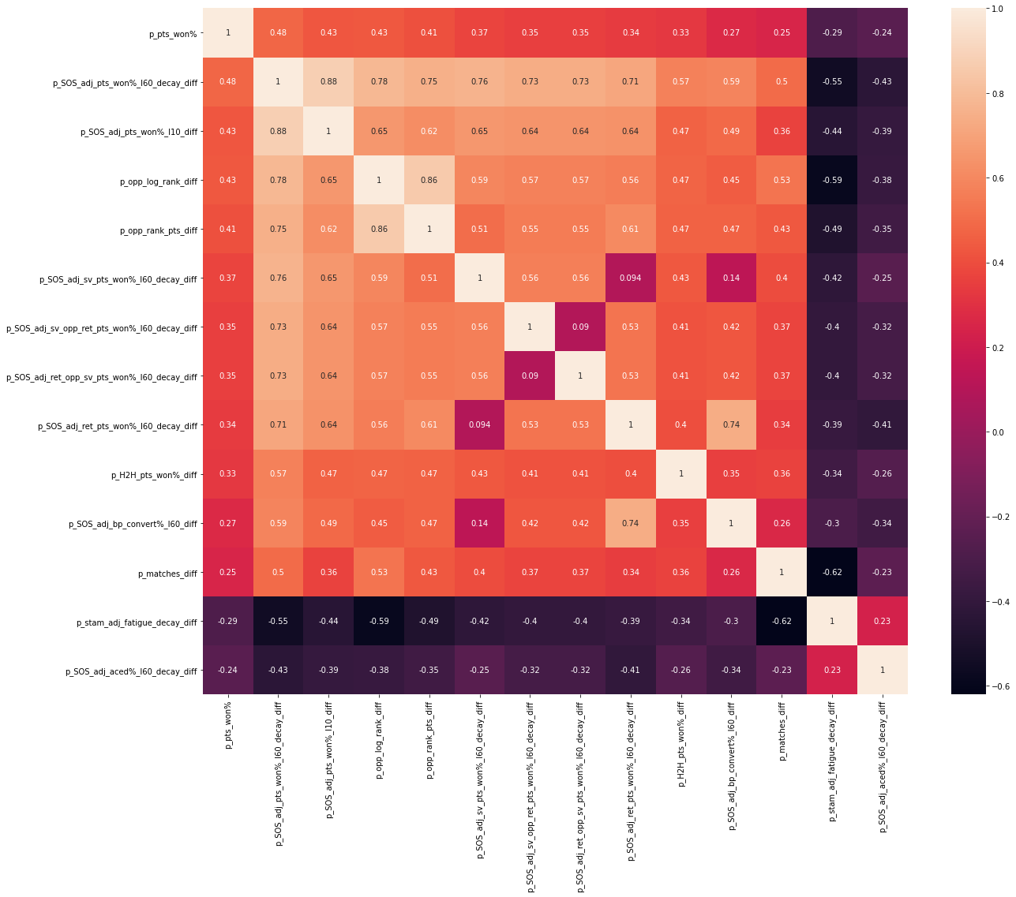
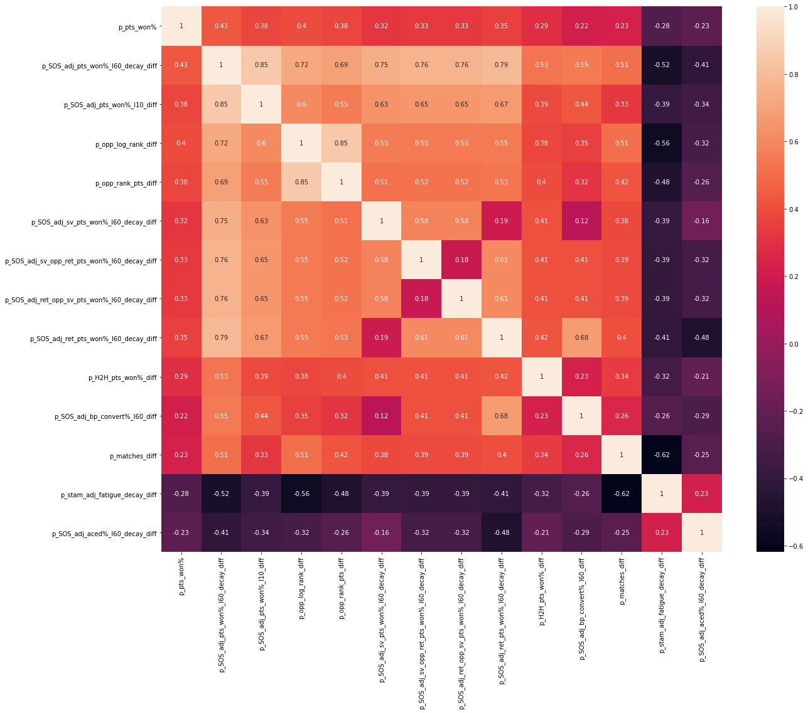
Hard Court and Clay Court Tennis Are Different Animals II
Features with High Correlations to % Pts Won in “Current Match” (Target) on Hard Courts
All are for Differential Features (Player Raw Feature Value - Opponent Raw Feature Value)
Player Pts
Won% in
“Current
Match”
(Target)
Adjusted
Past Pts
Won % (Long Term)
Adjusted
Past Pts
Won % (Short Term)
Log of
Ranking
Ranking
Points
Adjusted
Past Serve Pts
Won % (Long Term)
Adjusted
Past Serve Pts
Won % vs Opponent Return Pts Won % (Long Term)
Adjusted
Past Return Pts
Won % vs Opponent Serve Pts Won % (Long Term)
Adjusted
Past Return Pts
Won % (Long Term)
Head to Head Past
Performance vs Current Opponent
(% Pts Won
Adjusted
Past Break Point Conversion% (Long Term)
Total Matches
Played
Stamina
Adjusted
Fatigue
Adjusted
Past Aced % (Long Term)
Correlations for Same Set of Features on Clay Courts
Notes:
Key Points
Overall, correlation strengths were lower on clay vs hard courts, which supports the idea that clay court tennis outcomes are harder to predict.
Of note, the hierarchy of correlation strengths is quite different for the two surfaces. This suggests that the underlying functions for prediction of outcomes on the two surfaces are different, and provides strong rationale for not pursuing a combined model for the two surfaces.

Slide 8
Key Finding #2: Models including “Differential” predictive features had substantially superior prediction quality relative to those including only “Raw” features
Key Finding #3: Models including ranking alone (an derivatives thereof) as measures of past player performance yielded substantially poorer predictions than those including predictive features derived from past match stats

Slide 9
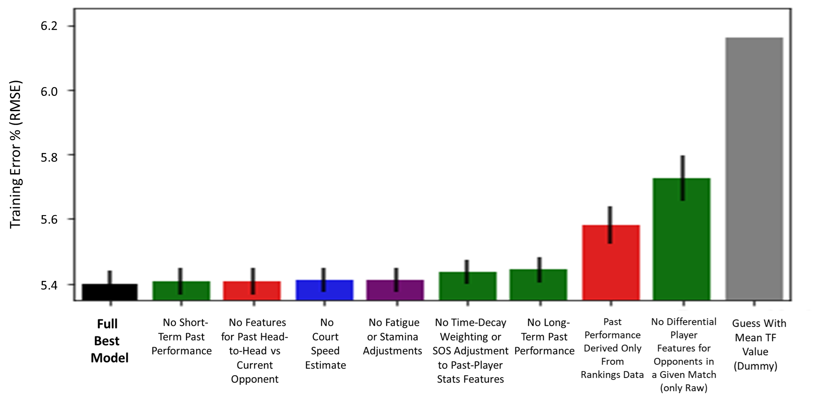
Prediction Quality Depended on Many Features, But Several Were Critical
Feature Subtraction Analysis on Hard Court Model
Impact of Individual (Non-Cumulative) Subtractions on Model Prediction Quality
Notes:
Key Points
With regard to key finding #2, mean hardcourt training set error for TF: 5.42% [+-0.04%] with Differential Features (black bar at left) vs 5.72% [+-0.07%] without Differential Features (green bar at second right [RMSE])
With regard to key finding #3, mean hardcourt training set error for TF: 5.42% [+-0.04%] with past match stats-derived predictive features (black bar at left) vs 5.58% [+-0.06%] rankings features only for past performance (red bar third from right [RMSE])
This comparison can be seen as a true benchmark for the entire modeling approach, as rankings depend on past performance, but are generated without factoring playing surface or quality of opponents among many other situational variables
The tour uses rankings for seeding and tournament entry cutoff purposes, so an improvement over this approach would actually increase fairness
The grey bar at right represents prediction quality for a "Dummy" model, in which the TF for each record was guessed to be the average TF in the entire surface sample. For reference to other model variants, mean error for the full hard court
sample Dummy model was Train: 6.16% Train; Test: 6.18%. For clay courts, mean error for the full sample Dummy model was Train: 6.65%; Test: 6.54%.
Thus, even subtraction variant models performing substantially less accurately than the full best model (for either surface) performed substantially better than random guessing off of the TF mean.

Slide 10
Key Finding #4: Inclusion of more data did not necessarily lead to improved match outcome prediction quality

Slide 11
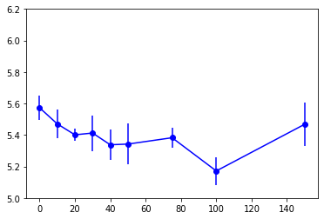
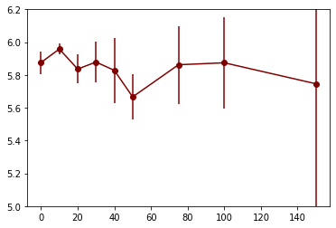
Prediction Quality Did Improved With Increasing Previous Matches Played Threshold for Modeling Inclusion, Provided Minimum Data Availability
Hard Court Model
Clay Court Model
~1K
~7K
~4K
~3.5K
~1.5K
~10K
~5.5K
Training Set Sample Ns Per Threshold
~2.5K
~100
~11K
~9K
~1K
Training Error % (RMSE)
~7K
~8K
~6K
~5K
~4K
~2K
Inclusion Threshold for Modeling Stage: Minimum Matches Played By Each Player Prior to Match Being Predicted
Notes:
Key Points
Best prediction quality occurred at a fairly high threshold of past matches played for both players in a given match being predicted (e.g., 100 matches for each player on Hard Courts; left panel).
On hard courts (left panel), this was true despite the fact that the overall amount of data included in model training at best threshold was ~20% of the total amount of data available in the overall modeling sample.
This threshold yields high prediction quality because it filters out matches between one or more players with low amounts of prior match data from which to construct predictive features to predict the TF for a given match. As we saw earlier, match stats-derived features are very important to model prediction quality, so inclusion of noisy features due to low n will yield noisy predictions.
Nonetheless, there is a clear tradeoff of the above with setting the minimum threshold of past matches too high. A relatively high % of matches are played between players without a lot of experience at the top level of the ATP tour, and a model trained only on players with a large amount of previous data may be overfitted to matches played between more experienced players and will not perform well on the many matches between less experienced players it will “see” later. To counter the risk of overfitting the model to matches between only highly experienced opponents, a threshold of 20 previous matches for both players in a given match to be predicted on was applied for finding the best model.

Slide 12
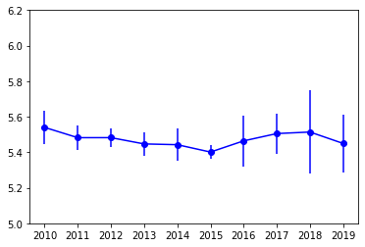
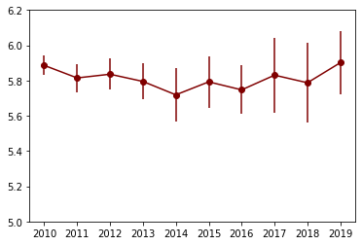
However, More Data Only Improves Prediction if It’s “Recent” Data
Hard Court Model
Clay Court Model
Training Set Ns Per Earliest Year Included
~600
~2K
~1.2K
~7K
~5.5K
~5K
~3.5K
~6K
~4K
~2.5K
~3K
~16K
~6.5K
~5K
~1.5K
Training Error % (RMSE)
~15K
~13K
~11K
~10K
~8K
Earliest Year Included in Modeling Stage (all Include Earliest Year Through 2019)
* The above was generated using a minimum threshold of 20 previous surface-specific matches for BOTH players in a given match being predicted (see previous slide)
Notes:
Key Points
Best prediction quality for hard (left panel) and clay (right panel) courts, respectively, was with 5 (2015-2019) or 6 (2014-2019) years of data inclusion. Expanding the modeling stage inclusion range further back in time (back as far as 2010) led to gradually decreased prediction quality despite increased N from addition of data from these earlier years
The most likely explanation for this result is that the underlying functions modeling tennis performance optimally change over time. It should be noted that data availability did begin to matter for prediction quality with too small a sample (<~2K samples), so there was a data “relevance” vs quantity tradeoff to some degree.

Slide 13
Key Finding #4: Inclusion of player implied win probabilities as a predictive feature resulted in small improvements in target feature prediction for best model on each surface

Slide 14
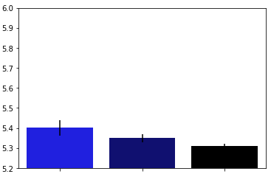
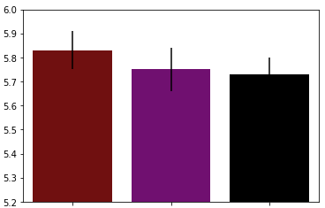
Inclusion of Player Implied Win Probabilities as a Predictive Feature Resulted in Small Improvements in Target Feature Prediction for Best Model on Each Surface
Hard Court Model
Clay Court Model
Training Error % (RMSE)
Full Set
Full Set +
Implied Probabilities
Implied Probabilities Only Player Feature
Full Set
Full Set +
Implied Probabilities
Implied Probabilities Only Player Feature
Feature Set Included in Model Prediction
Notes:
Key Points
Implied Win Probabilities of matches, per player, were derived from historical wagering lines. Derivation of these probabilities is possible with well-established formulas (https://www.gamblingsites.org/blog/how-to-remove-vig-sports-betting/#:~:text=You%20will%20need%20to%20convert,odds%20and%20eliminate%20the%20vig.).
Part of this process is removal of the vig incorporated directly into the wagering lines, which is a charge that betting sites apply to the betting markets they offer. For this project, the historical wagering lines used represented the average closing lines of 5 or more (depending on the year and specfic tournament) sports books. These averaged closing lines are theoretically highly efficient, as they both sample across different information networks and include the "wisdom of the market" at a time very close to the event itself.
Inclusion of player implied win probabilities as a predictive feature resulted in small improvements in TF prediction for best model on each surface
Hard Court no Implied Probabilities: 5.40% [+-0.04%] vs Hard Court with Implied Probabilities: 5.35% [+-0.02]
Clay Court no Implied Probabilities: 5.83% [+-0.08%] vs Clay Court with Implied Probabilities: 5.75% [+-0.09]
Per-surface models where implied probabilities was the only Player-level feature also slightly outperformed full models with or without implied probabilities

Slide 15
Client Recommendations Based on Key Findings I
Maintain the separation of hard court and clay court models moving forward, and continue to strike a balance for data inclusion between maximal sample size and maximal relevance
Hard court tennis was modeled more accurately, and with less variability, even when the sample size of matches was reduced to that of clay court matches
Whether or not hard court tennis will be more profitable to invest in will depend on the accuracy of the respective surface models relative to the market. This will require comparison of model predictions to those derived from historical pre-match wagering. Preliminary evidence in this regard suggests that the market, in the aggregate, is less accurate in prediction of clay court vs hard court outcomes roughly proportionally to the dichotomy seen between my own best surface models.
We also recommend to continue to limit the time range of modeling data inclusion to ~5 years (slightly more with the lower clay courts) and to exclude matches between players with very limited previous experience (<20 matches on the same surface)
This will ensure modeled data remain relevant to the current game, and that the model will not be overly influenced by either extremely experienced players or by players with too little previous data to accurately estimate performance features

Slide 16
Client Recommendations Based on Key Findings II
Obtain and integrate “micro-conditions” data into current model
Current model lacks data-wise in match specific conditions that would be known only in the immediate lead-up to a given match to be predicted (“micro-conditions” data)
These data would include weather variables (e.g., humidity, temperature, wind), court speed and ball bounce height estimation derived from “on the ground” sources (the current, obviously non-ideal, proxies are derived from outcomes data from the previous year at the same tournament), and real-time injury/other personal information on individual players as a tournament evolves

Slide 17
Client Recommendations Based on Key Findings II
Build a model more directly aimed at the wagering market, and run simulations to test its theoretical profitability
It is encouraging that the present models were only slightly improved with incorporation of the collective wisdom of the markets (closing lines)
We should build models that directly estimate win probability per player/match, and then evaluate performance on fresh data at a given threshold theoretical advantage over the market (e.g., bet players with >2% edge on closing line)
Incorporation of implied win probabilities from opening lines will be critical to evaluating and improving the models as well.
As these lines are available well ahead of matches, they can actually be incorporated into model training as a way of regressing the model to the market
Also, models can potentially be improved by filtering out matches with large line movement from opening to close from the training set. These matches were likely influenced by unique events that will weaken estimate of stats-based models.

Slide 18
Thank You!

