Slide 1
Toward Hospital Readmission Rate Reduction: Executive Presentation for Community Medical Center
Jon Raksin
6/1/22

Slide 2
Situational Overview Review
In 2012, the Centers for Medicare and Medicaid Services (CMS) began reducing Medicare payments for subsection(d) hospitals with excess readmissions within 30 days of discharge, under the Hospital Readmission Reduction Program (HRRP)
CMS has proprietary formula with which divide total readmissions in cases of heart attack, heart failure, pneumonia, chronic obstructive pulmonary disease, hip/knee replacement, and coronary artery bypass graft surgery by an expected RR.
CMC leadership approached us when told by CMS this year that 1% reduction is RR is needed in the next year, from the current 17%, to avoid Medicare payment reduction
We were asked to help CMC conduct their own analysis of factors most related to RR, and potentially assist them in coming up with a data-driven plan to avoid a quality of care-reducing penalty

Slide 3
Problem Statement Review
How can Community Medical Center lower its 30-day Readmission Rate by 1% within the next year, to avoid reduction in Medicare payments and associated impacts on quality of care?

Slide 4



Methodology
Is what happens in hospital during patient stay
useful in predicting 30-day readmission rate?
Inpatient and Outpatient Outcomes
Data
~2700 US hospitals with >= 200 inpatient cases/year
Exploratory Data Analysis, Predictive Modeling and
Recommendations
County-Level Demographic and Socioeconomic
Data
Is the broader context in which a hospital, and those likely to visit it, exists useful in predicting 30-day readmission rate ?
Notes:
Notes:
Inpatient and Outpatient Outcomes Data
Source: CMS
Includes data on:
Proportions of initial admissions due to different reasons, including those in CMS’ own formula (heart failure, COPD, hip-knee replacement, heart attack, pneumonia, COPD, coronary artery bypass graft surgery)
Infections of different type rates during inpatient stay
CMS Patient Safety and Adverse Events-Rates during inpatient stay
HCAHPS-Related Features (Patient Survey Star Ratings from inpatient stay)
Various other measures from other aspects of hospital care (e.g., emergency department efficiency metrics and hospital worker vaccination rates)
County-Level Demographic and Socioeconomic Data
Source: Bureau of Economic Analysis (BEA) socioeconomic data
Source: US Census Bureau demographic data
Data on things like median age, median income, density of hospitals relative to density of people

Slide 5
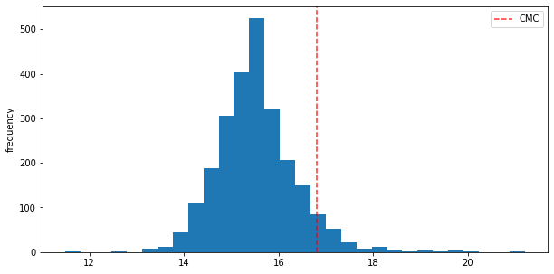
Key Finding #1: CMC Has A Relatively High Readmission Rate, But Is Predicted by the Model to Be Lower
CMC’s most recent actual RR was 16.8% (dashed red line), but model predicted RR is 15.5% (+-0.7%) (dashed green line), which is nearly identical to both the mean and median for the entire sample
Frequency
30-Day Inpatient Readmission Rate (%)

Slide 6
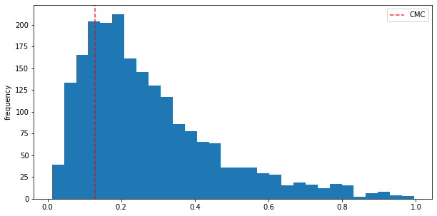
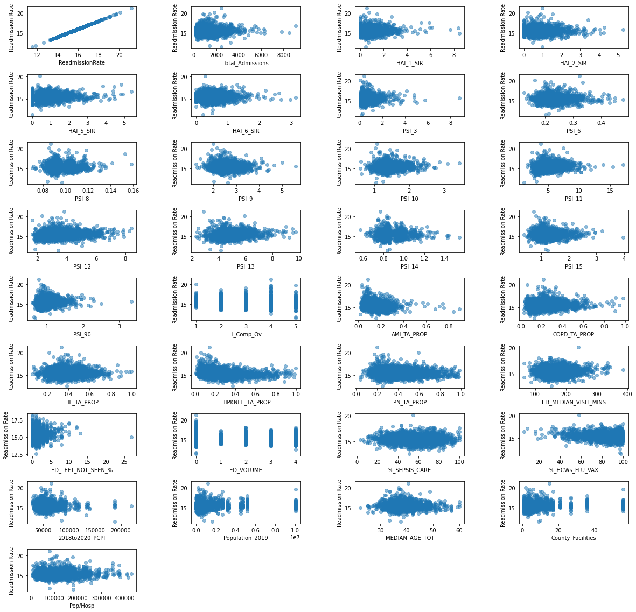
Key Finding #2: CMC Has Relatively Few Initial Inpatient Admissions For Hip-Knee Replacement
Only 13% of CMC’s (dashed red line) initial admissions have Hip-Knee Replacement as a reason. This puts CMC in the lower quartile of the sample. (Top)
Increasing proportion of admission due to Hip-Knee Replacement is associated with lower RR. This was the strongest correlation to RR of any single “feature” (variable) in the data set. (Bottom)
Frequency
Proportion of Initial Admissions With Hip-Knee Replacement as a Reason
Readmission Rate
Hip-Knee Replacement

Slide 7
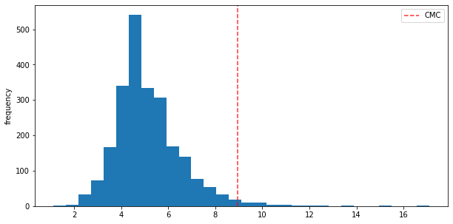
Key Finding #3a: CMC Has Relatively High Proportion of Inpatients With Breathing Problems – Postoperative Respiratory Failure
9% of CMC’s (dashed red line) inpatient surgical patients had postoperative respiratory failure (Postop RF). This puts CMC in the top few percent of the sample. (Top)
Increasing proportion of Postop RF is associated with higher RR. (Bottom)
Frequency
Postop RF (%)
Readmission Rate (%)
Postop RF (%)

Slide 8
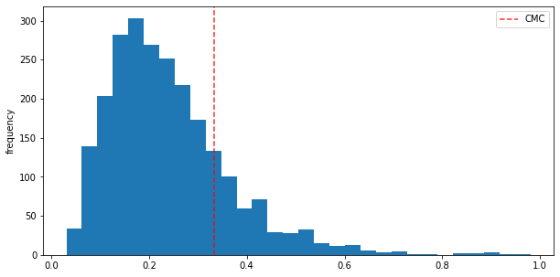
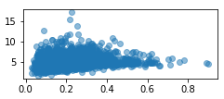
Key Finding #3b: CMC Has Relatively High Proportion of Inpatients With Breathing Problems - COPD at Admission
33% of CMC’s (dashed red line) initial admissions have COPD as a reason. This puts CMC in the upper-third of the sample.(Top)
Increasing proportion of admission due to COPD is associated with higher RR. (Bottom Left).
Higher proportion of admissions due to COPD is associated with higher postop respiratory failure rate across the hospital sample (Bottom Right)
Frequency
Proportion of Initial Admissions With COPD as a Reason
Readmission Rate (%)
Postop RF (%)
COPD at Admission
COPD at Admission

Slide 9
Client Recommendation 1: Modeling Supports “Watch and Wait” As a Viable Strategy
Model predicted RR (green line) is over 1% lower than most recent actual RR for CMC (red line)
Even considering the error margin of the model prediction (slightly more than half a percent), it is reasonable to expect regression to both the predicted RR and the overall sample mean with “status quo”
Frequency
30-Day Inpatient Readmission Rate (%)

Slide 10
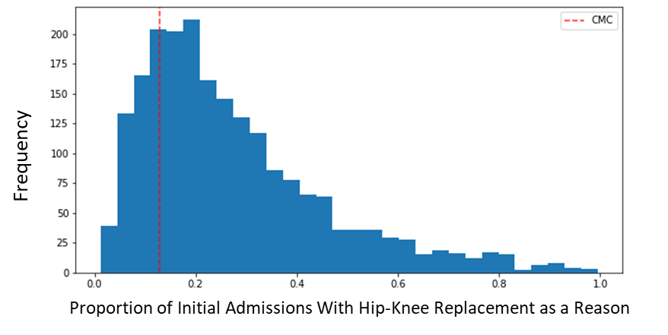
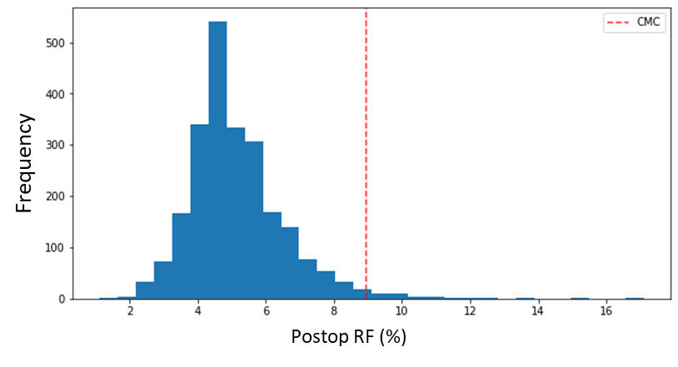
Client Recommendation #2: If Active Strategy is Desired, Focus on Boosting Hip-Knee Replacements in the Case Mix and Monitoring Patients With Breathing Problems
Model scenario in which CMC’s current proportion of initial admissions for Hip-Knee Replacement (Top; red line) increases to sample median (green line), and current Postop RF rate (Bottom; red line) decreases to median (green line) results in predicted RR decrease of 32% of goal reduction (0.32%).
COPD patients, higher levels of which we have seen to be associated with higher Postop RF rate, can be tracked and potentially focused on for new postoperative respiratory failure-prevention measures.

Slide 11
Future Directions
We have treated a very heterogenous sample of ~2,700 hospitals as one group for the sake of our present modeling exercise, but we can explore using unsupervised learning methods (e.g., PCA) to identify hospitals with similar properties and then model RR for each cluster separately
Currently, human and inpatient facilities resourcing per hospitals is measured indirectly using a combination of features derived from county-level demographic data (e.g., people in a county per inpatient facility) and various non-inpatient proxies at the hospital level (e.g., how long emergency department patients have to wait before being seen)
To obtain direct inpatient resources data per hospital, we will need to seek out data not available in the CMS trove, possibly from each hospital directly
Direct resourcing data per hospital is likely to improve model prediction of RR

Slide 12
Thank you!

