Slide 2
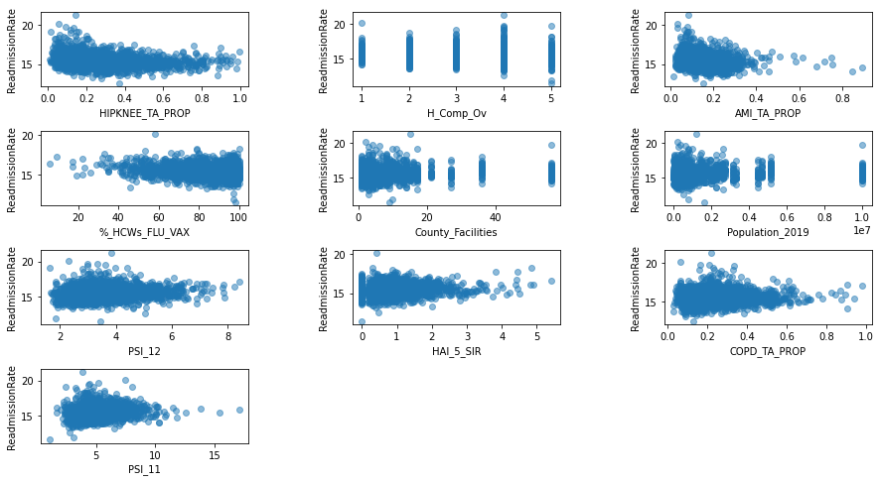
A
B
C
r = -.22
r = -.18
RR
r = -.19
Hip-Knee Replacement
Overall Hospital Rating
Acute Myocardial Infarction
D
E
F
r = -.18
r = .09
r = .10
RR
Healthcare Workers Vaccinated
COPD
Postop RF

Slide 3
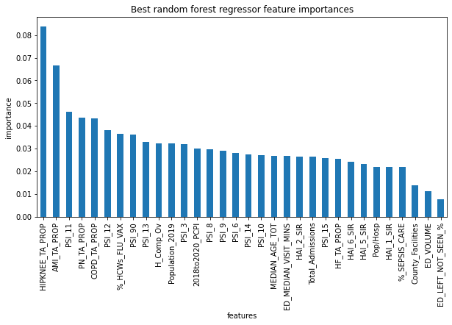
Model Importance Per Feature
AMI
COPD
Postop RF
Postop Pneumonia
Hip-Knee Replacement

Slide 4
