Slide 1
What Factors are Key to Successfully Predicting Match Outcomes in Top Level Men’s Professional Tennis?
Jon Raksin
06/09/2022
Notes:
Explanation and Importance of Findings Presented On Slide Face:

Slide 2
Introduction and Business Case Scenario
Our consultancy has been approached by LV Sports Consultants (LVSC), a group providing recommendations on wagering lines and limits to a number of Las Vegas sports books
LVSC requests us to build a quantitative model of the outcomes of tennis matches, and provide a semi-technical summary report on aspects of the model useful in generating accurate predictions
We decided to focus on the top level of men’s professional singles tennis, the Association of Tennis Professionals main tour, and have obtained a large amount of raw match outcomes data going back over a decade from the Github site of a well-regarded tennis statistician
Using this data archive (~35,000 matches from 2008-2019) and our knowledge of the game, we built a large set (~150) of individual player performance, player demographic, and match conditions-derived features to predict the outcomes of individual matches at the level of percent points won per player [0-100%]
Great care was taken in this rolling-window, time-series analysis to ensure that all information used to predict the outcome of a given match was available prior to that match being played
We built a machine learning model as the final stage of the project, and presently share the main findings and proposed next steps with the LVSC team

Slide 3
Methodology: Summary of Predictive Feature Generation
Target feature (TF): % of total points played [0-100] won by a given player in a given match
TF predicted by ~150 features in 4 classes, derived from data available prior to match being predicted on:
Feature Class | Examples in Class | Time-Sensitive Adjustments
Match: Conditions | Locale, Court Speed, Altitude | N/A
Player: Non-Adjusted Demographic and Past Performance | Ranking, Height, Handedness, Home Court Advantage, Head-to-Head Past Performance vs Current Opponent, Height, Age | N/A
Player: Adjusted Past Performance | Past % Serve Pts Won, Past % Return Pts Won, Past Ace%, Past Break Pt% (Short and Long-term forms of each) | Short (previous 10 matches on surface) or Long (last 60 matches on surface) term stats time-decay weighted (more recent = more weight) Time-weighted stats adjusted by average strength of opponents over measurement interval on same stat (“SOS Adjustment”)
Player: Adjusted Fatigue & Stamina | Fatigue (within tourney): Total Time on Court, Total Pts Played; Stamina (full sample): # Past Matches Played | Fatigue metrics across all previous matches in same tournament as match being predicted on are time-decay weighted “Body Battery” integrates time-weighted fatigue metrics with stamina metrics (longer past = “bigger battery”)
All Player Target Features were generated both in Raw and Differential forms
Eg, for height a player’s Raw feature is the height itself (say, 180) and the Differential feature is 180 minus the height of the opponent in the match being predicted on (say, 180-170 = 10)

Slide 4
Key Finding #1: Hard Court Tennis Match Outcomes Were Modeled More Successfully Than Those on Clay Courts
Notes:
Explanation and Importance of Findings Presented On Slide Face:

Slide 5
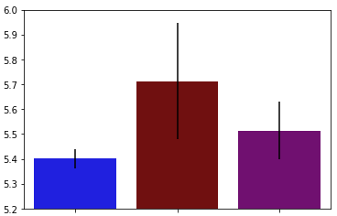

Best Model Prediction Quality Was For Hard Court Tennis Alone, Even When Sample Size Was Made Equivalent For The Surfaces
Full Sample Per Surface*
Equal Samples Per Surface*
Training Set Sample Ns
~3.2K
~3.2K
~6.4K
~11.2K
Training Error % (RMSE)
~8K
~3.2K
Hard
Clay
Hard + Clay
Hard
Clay
Hard + Clay
Surface(s) Included in Model Prediction
* This model iteration included data from 2015-2019 (data from 2012-2014 were also used to accrue predictive stats and features prior to modeling stage). A minimum threshold for previous matches (20) played by both players in a given match being predicted (specific to surface predicted match is on) was also applied. These filters will be discussed later in the presentation.
Notes:
For the equal samples analysis, an identical number of records as were included in the full clay court sample were sampled randomly from the full hard court sample, following the application of other filters for both the clay and hard court samples (see footnote on slide face).

Slide 6
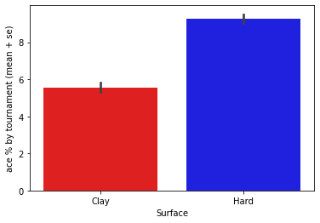
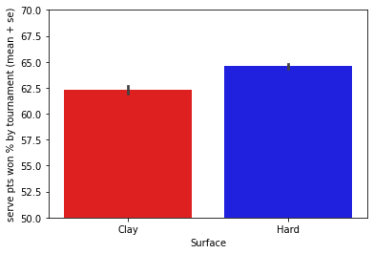
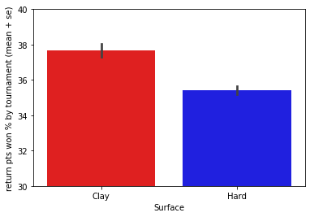
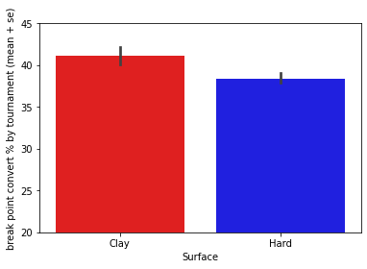
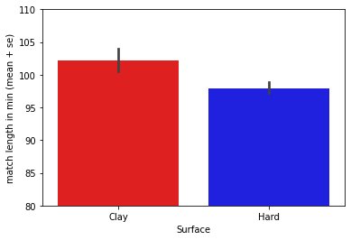
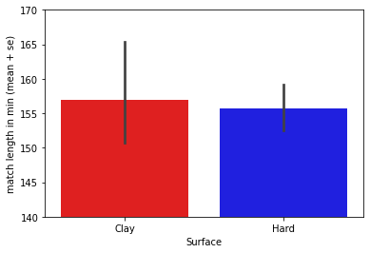
Hard Court and Clay Court Tennis Are Different Animals I
A
Ace %
B
Serve Pts Won %
C
Return Pts Won %
D
E
F
Break Point Convert %
Non-GS Match Length (min)
GS Match Length (min)
Notes:
On average, matches on hard courts are substantially more dominated by the serve and take longer than matches on clay. Longer matches and less dominance by the serve may lead to less predictability of outcome on clay, and hence lower prediction quality.
Furthermore, indoor matches are much more common on hard courts than on clay. Reduced impact of weather conditions, as well as less air resistance (leading to more aces), may lead to more predictable outcomes overall, which would directly translate to more accurate predictions on hard courts.

Slide 7
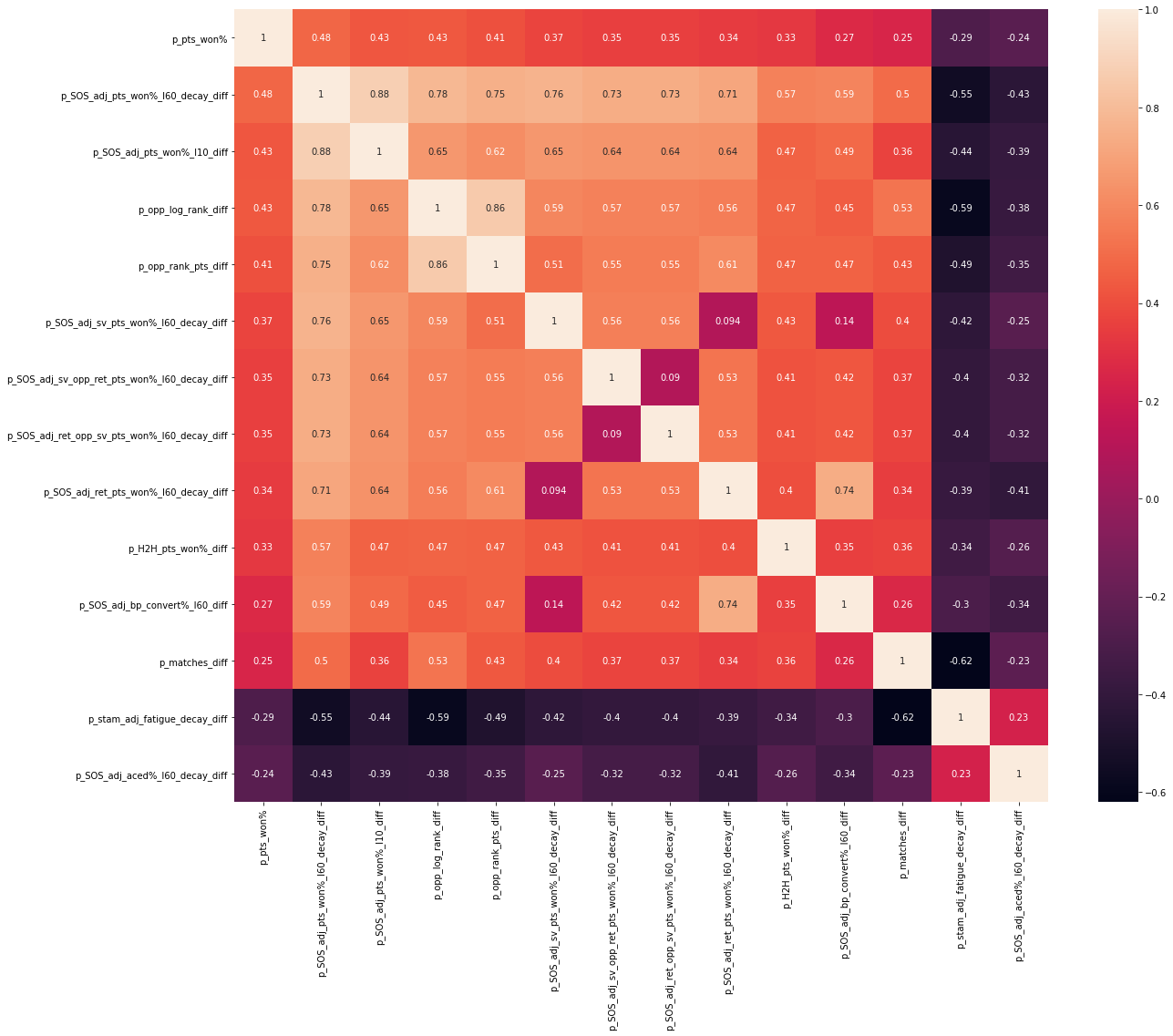
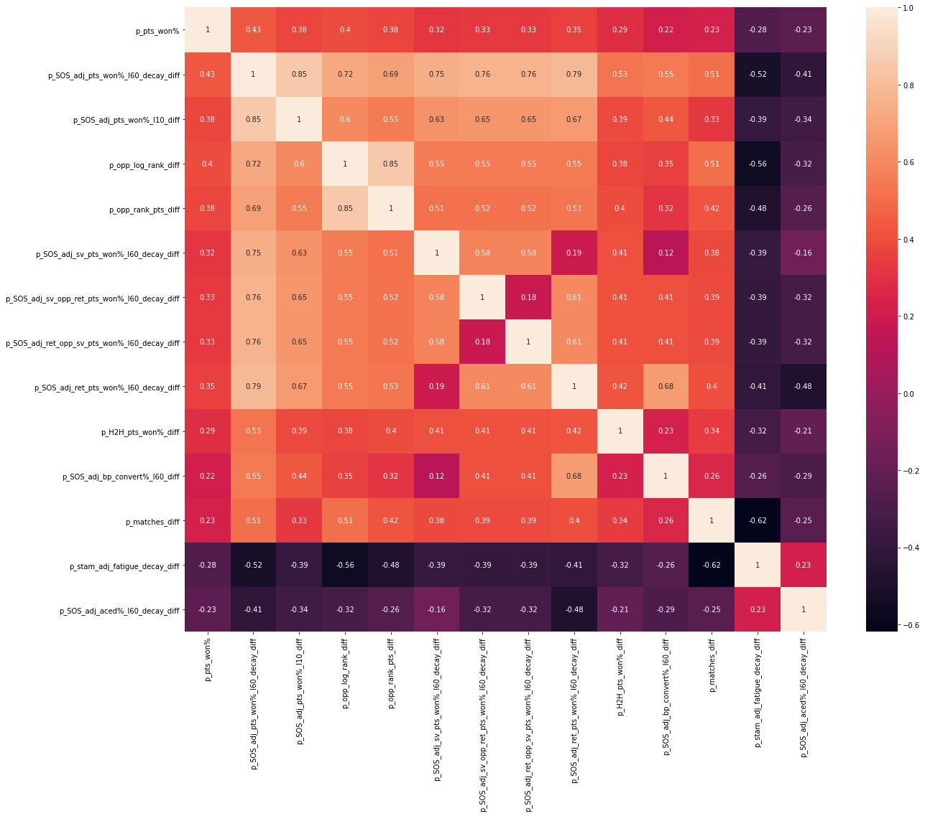
Hard Court and Clay Court Tennis Are Different Animals II
Features with High Correlations to % Pts Won in “Current Match” (Target) on Hard Courts
All are for Differential Features (Player Raw Feature Value - Opponent Raw Feature Value)
Player Pts
Won% in
“Current
Match”
(Target)
Adjusted
Past Pts
Won % (Long Term)
Adjusted
Past Pts
Won % (Short Term)
Log of
Ranking
Ranking
Points
Adjusted
Past Serve Pts
Won % (Long Term)
Adjusted
Past Serve Pts
Won % vs Opponent Return Pts Won % (Long Term)
Adjusted
Past Return Pts
Won % vs Opponent Serve Pts Won % (Long Term)
Adjusted
Past Return Pts
Won % (Long Term)
Head to Head Past
Performance vs Current Opponent
(% Pts Won
Adjusted
Past Break Point Conversion% (Long Term)
Total Matches
Played
Stamina
Adjusted
Fatigue
Adjusted
Past Aced % (Long Term)
Correlations for Same Set of Features on Clay Courts
Notes:
Note that overall correlation strengths are lower on clay (only past return performance bucks this trend), which supports the idea that clay court tennis is harder to predict
The sequence of correlation strengths is quite different as well for the two surfaces, which may present a challenge when modeling both surfaces together
Note: For this presentation, data from 2012-2019 inclusive are used for both surfaces. The year range is slightly different in the EDA for hard courts in notebook 3. This results in a few very slight correlation numerical differences between the two sources (ie, a few .01 differences between the two separate analysis variants) that don’t affect the qualitative conclusions here.

Slide 8
Key Finding #2: After Playing Surface, What Matters Most to Prediction Quality is Direct Comparison of Opponents in the Match Being Predicted. Especially Important is to Include Features Derived Directly From Past Match Statistics.

Slide 9
Methodology: Summary of Predictive Feature Generation
Target feature (TF): % of total points played [0-100] won by a given player in a given match
TF predicted by ~150 features in 4 classes, derived from data available prior to match being predicted on:
Feature Class | Examples in Class | Time-Sensitive Adjustments
Match: Conditions | Locale, Court Speed, Altitude | N/A
Player: Non-Adjusted Demographic and Past Performance | Ranking, Height, Handedness, Home Court Advantage, Head-to-Head Past Performance vs Current Opponent, Height, Age | N/A
Player: Adjusted Past Performance | Past % Serve Pts Won, Past % Return Pts Won, Past Ace%, Past Break Pt% (Short and Long-term forms of each) | Short (previous 10 matches on surface) or Long (last 60 matches on surface) term stats time-decay weighted (more recent = more weight) Time-weighted stats adjusted by average strength of opponents over measurement interval on same stat (“SOS Adjustment”)
Player: Adjusted Fatigue & Stamina | Fatigue (within tourney): Total Time on Court, Total Pts Played; Stamina (full sample): # Past Matches Played | Fatigue metrics across all previous matches in same tournament as match being predicted on are time-decay weighted “Body Battery” integrates time-weighted fatigue metrics with stamina metrics (longer past = “bigger battery”)
All Player Target Features were generated both in Raw and Differential forms
Eg, for height a player’s Raw feature is the height itself (say, 180) and the Differential feature is 180 minus the height of the opponent in the match being predicted on (say, 180-170 = 10)

Slide 10
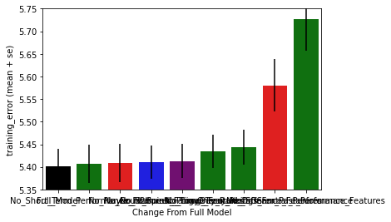
Prediction Quality Depended on Many Features, But Several Were Critical
The most important elements for best model prediction quality (two rightmost bars) were using:
Previous match stats, not just rankings and derivatives thereof, to create predictive player performance features
Differential feature values between opponents in given match that TF (% pts won by player) is being predicted
eg, Player A has 10% Past Ace% (Raw Ace%), Player B has 6% Past Ace%: Player A Differential Ace% = 10-6 = +4%
5.75
5.65
Training Error % (RMSE)
5.55
5.45
5.35
Full
Best
Model
No Short-Term Past Performance
No Features for Past Head-to-Head vs Current Opponent
No Court Speed Estimate
No Fatigue or Stamina
Adjustments
No Time-Decay Weighting or SOS Adjustment to Past-Player Stats Features
No Long-Term Past Performance
Past Performance
Derived Only From Rankings Data
No Differential Player Features for Opponents in a Given Match (only Raw)
Impact of Individual (Non-Cumulative) Subtractions on Model Prediction Quality
Notes:
This depiction was constructed from the best hard court model, but the same trends apply to the clay court model, albeit with higher prediction error across model inclusions.

Slide 11
Key Finding #3: More Data Does Not Necessarily Lead to Improved Match Outcome Prediction Quality

Slide 12
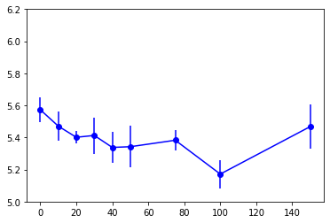
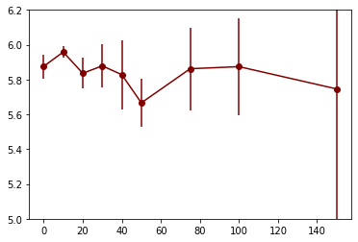
Prediction Quality Improves With Increasing Previous Matches Played Threshold for Modeling Inclusion, Provided Minimum Data Availability
Hard Court Model
Clay Court Model
~1K
~7K
~4K
~3.5K
~1.5K
~10K
~5.5K
Training Set Sample Ns Per Threshold
~2.5K
~100
~11K
~9K
~1K
Training Error % (RMSE)
~7K
~8K
~6K
~5K
~4K
~2K
Row Inclusion Threshold for Modeling Stage: Minimum Matches Played By Each Player Prior to Match Being Predicted
Notes:
Explanation and Importance of Findings Presented On Slide Face:
The best prediction quality occurs at a fairly high threshold of past matches for both players in the match being predicted on (100 for hard court; Left). This occurs despite the fact that the overall amount of data included in model training at this threshold is ~1/5 of the total amount of data in the model sample
This threshold yields high prediction quality because it filters out matches between one or more players with low amounts of prior match data from which to construct predictive features for the match to be predicted on.
However, there is a clear tradeoff with setting the minimum threshold of past matches too high. A relatively high % of matches are played between players without a lot of experience at the top level of the ATP tour, and a model trained only on players with a large amount of previous data may be overfitted to matches played between more experienced players and will not perform well on the many matches between less experienced players it will “see” later.
To counter the risk of overfitting the model to matches between only highly experienced opponents, a threshold of 20 previous matches for both players in a given match to be predicted on was applied for finding the best model.
A critical technical note: matches between players not reaching minimum threshold of prior matches in the overall sample to include in modeling were included in the earlier stages of accrual of past match stats and predictive feature creation for later matches in the sample.
Thus, for example, a match between players both in their 21st match in the sample would be predicted using stats from their previous 20 matches in the sample. This despite the fact that, at a minimum threshold of 20 previous matches, those previous 20 matches would not themselves be included in the modeling stage.

Slide 13
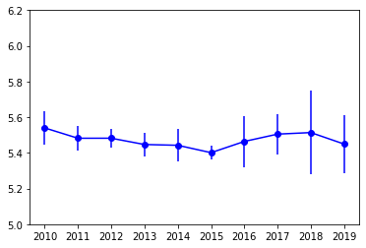
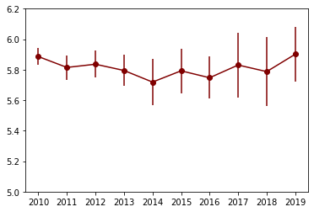
However, More Data Only Improves Prediction if It’s Recent Data
Hard Court Model
Clay Court Model
Training Set Ns Per Earliest Year Included
~600
~2K
~1.2K
~7K
~5.5K
~5K
~3.5K
~6K
~4K
~2.5K
~3K
~16K
~6.5K
~5K
~1.5K
Training Error % (RMSE)
~15K
~13K
~11K
~10K
~8K
Earliest Year Included in Modeling Stage (all Include Earliest Year Through 2019)
* The above was generated using a minimum threshold of 20 previous surface-specific matches for BOTH players in a given match being predicted (see previous slide)
Notes:
Explanation and Importance of Findings Presented on Slide Face:
Best prediction for hard court matches (left) occurred with 5 consecutive years of data included in model
This was true despite the fact that this range (2015-2019) included half as much data as the maximum range (2010-2019)
Likely explanation is that the underlying functions modelling the game optimally change over time
Data availability did begin to matter with too small a sample (less than ~2K samples), so there was a data “relevance” vs quantity tradeoff
As an important technical note, an minimum of 2 years of data was used for accrual of past match stats and predictive feature creation for later matches in the sample.
For example, when matches from 2010-2019 are included in model generation, match stats from the years 2008 and 2009 were used to generate predictive features for 2010-2019 even though the records from 2008 and 2009 were filtered out prior to the model generation stage.

Slide 14
Client Recommendations Based on Key Findings I
Maintain the separation of hard court and clay court models moving forward, and continue to strike a balance for data inclusion between maximal sample size and maximal relevance
Hard court tennis was modeled more accurately, and with less variability, even when the sample size of matches was reduced to that of clay court matches
Whether or not hard court tennis will be more profitable to invest in will depend on the accuracy of the respective surface models relative to the market. This will require comparison of model predictions to those derived from historical pre-match wagering line data
Along with continued separation of surfaces, we recommend to continue to limit the time range of modeling data inclusion to ~5 years and to exclude matches between players with very limited previous experience (<20 matches on the same surface)
This will ensure modeled data remain relevant to the current game, and that the model will not be overly influenced by either extremely experienced players or by players with too little previous data to accurately estimate ability

Slide 15
Client Recommendations Based on Key Findings II
Obtain historical pre-match wagering data and evaluate effects of adding to current model
Can be added to existing model as one or more new predictive features
If these features improve prediction quality (almost certainly they will), logical next step is to look closely at features of matches for which prediction quality improved most
Match Features for which market improves model most will become primary focus for new data acquisition and integration for inclusion in the present model

Slide 16
Client Recommendations Based on Key Findings III
Obtain and integrate “micro-conditions” data into current model
Current model lacks data-wise in match specific conditions that would be known only in the immediate lead-up to a given match to be predicted (“micro-conditions” data)
These data would include weather variables (e.g., humidity, temperature, wind speed and direction), court speed and ball bounce height estimation derived from “on the ground” sources (currently the proxy from this comes from data from the previous year at the same tournament), and real-time injury information on individual players as a tournament evolves
This approach synergizes with the second recommendation in that the market wisdom insights will refine which of these micro-conditions to prioritize for data acquisition and model integration.

Slide 17
Future Directions Summary: Integrate Micro-conditions and Market Wisdom Data
Micro-Conditions Data
Weather variables known before given match (temp, humidity, wind, precipitation etc.)
Flag known injuries prior to given match
Independent assessments of court speed and ball bounce height prior to given (can be within tournament update)
Market Wisdom
Create features from available closing pre-match betting line data per match (lines carry implied win probability, per player)
Key Question
Does adding micro-conditions data improve model quality?
Will look to guidance from unsupervised learning (e.g., clustering) related to improvements brought on by adding Market Wisdom features.
The properties of matches for which prediction improves the most with Market Wisdom addition will inform what types of new data to chase down
Present Model
Key Question
Does adding market wisdom features improve model quality?
If so, what are the features of matches for which prediction quality is most improved?
Some lessons may be actionable (e.g., by adding weather data to model), while others may reflect less actionable “insider information” (e.g., occult injuries not publicly known prior to a match that “the market” knew about)
Improved Model

Slide 18
Thank You!

Slide 19
Summary of Findings
Even when controlling for sample size differences (hard court ~70% of matches) selected modeling approach was more successful predicting hard court than clay court outcomes
Match outcome model prediction quality was improved incrementally by many of the ~150 features generated to capture match conditions and player past performance
The two most important aspects to model prediction quality were using past player performance stats (long-term especially) to generate features, and framing player features as differentials between the two opponents in a match being predicted
Model prediction quality improves with higher threshold for number of previous matches played by each of the two opponents, but setting this threshold too high risks overfitting the model to predict outcomes involving only highly experienced players
Prediction quality was best when a 5 year data window was used in the modeling stage, despite the fact that 2x as much data was available going back just 5 more years

