Slide 1
Trends in Top-Level Men’s Pro Tennis: 1995-2019
Jon Raksin
5/22/22

Slide 2
Presentation Goal
Goal: To identify and visually describe several major biodemographic trends in top level men’s professional tennis over the past quarter century, and conduct cursory exploration of correlates in player performance

Slide 3
Methodology
Raw player demographic and match performance data from 1996-2019 were obtained from the ATP website and Jeff Sackmann’s Github, and cleaned, updated, and processed in Python using Pandas
Data filtered down to top 200 players at any given time step (start of week) in sample. All main tour matches on either hard (~68% of total) or clay court (~28%) included for exploratory analysis (grass court, Davis Cup, Olympics removed)
For some analyses, players are filtered into 1 of 4 Ranking Tiers at each time step
Tier 1= Top 25 (elite players), Tier 2 = 26-50 (~upper limit [UL] for direct entry to top-level tour events), Tier 3= 51-125 (~UL for Grand Slam direct entry), Tier 4 = 126-200 (“minor leaguers” sometimes qualifying for main tour events via play-in tournaments)

Slide 4
Trends in Player Height
Have player height distribution characteristics changed over the last 25 years? If so, in what way(s)?
what are the performance correlates of any systematic height changes?

Slide 5
Trends in Player Height I
Have player height distribution characteristics changed over the last 25 years? If so, in what way(s)?
what are the performance correlates of any systemtic height changes?

Slide 6
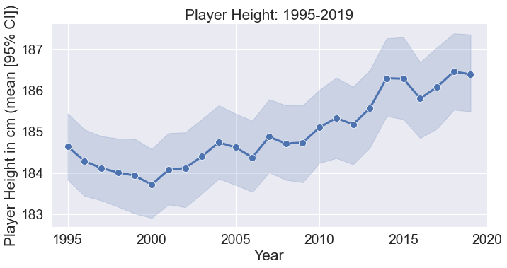
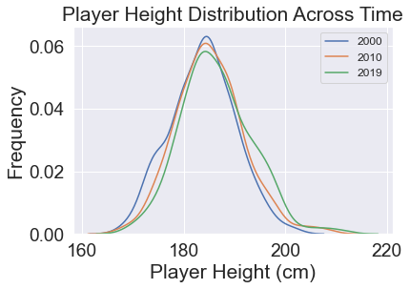
Player Height in Has Steadily Increased Over the Past 25 Years
Notes:
LEFT: Mean player height has steadily increased in the top 200 on the ATP Tour over the last quarter century (1995-2019)
RIGHT: This mean increase has been accomplished with a loss of players under ~175 cm and the introduction of a number of players above 190 cm (green arrow). The center of mass or mode of the distribution has remained essentially unchanged, at right around 6 ft.

Slide 7
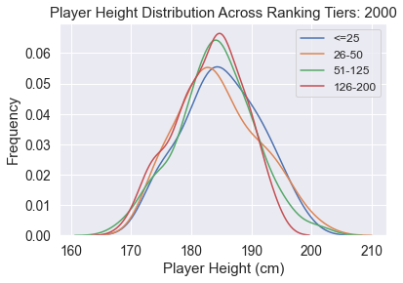
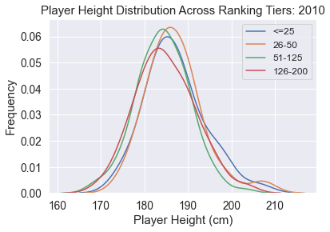
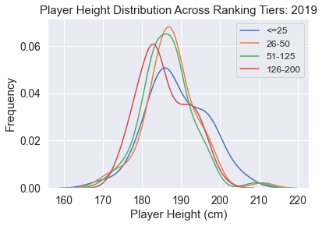
Taller Players Have Become Overrepresented in the Top Tier Over Time
Notes:
As we saw on the last slide, mean height within the top 200 players has steadily increased over the study period.
This height increase has not been uniform across ranking tiers, however.
The tallest players are now overrepresented in the top ranking tier relative to other ranking tiers (see blue arrow on rightmost graph. Also note that the center of mass/mode for players in the Top 3 tiers has shifted to the right (taller) in 2019 relative to the other time points. The center of mass for the Fourth Tier, interestingly, remains largely unchanged, though there is clearly some bimodality (the rightward hump may represent taller players on their way up the rankings).

Slide 8
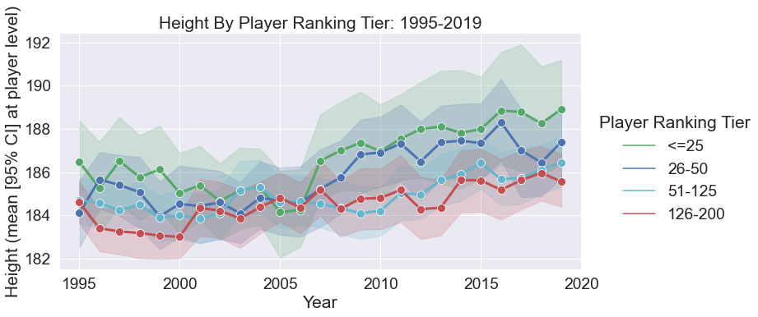
Taller Players Have Become Overrepresented in the Top Tier Over Time
Notes:
As we saw on the last slide, mean height within the top 200 players has steadily increased over the last quarter century
This height increase has not been uniform across ranking tiers, however
The tallest players are now overrepresented in the top ranking tier relative to other ranking tiers. This is another way of visualizing what is shown on the previous slide.

Slide 9
Trends in Player Height II
Have player height distribution characteristics changed over the last 25 years? If so, in what way(s)?,
what are the performance correlates of any systematic height changes?

Slide 10
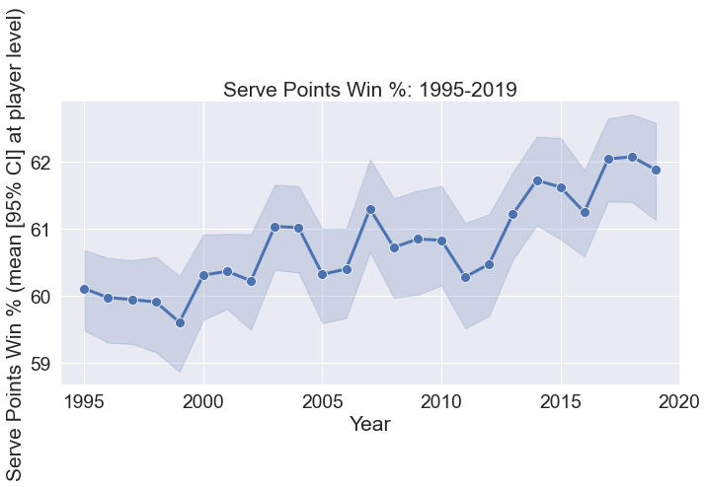
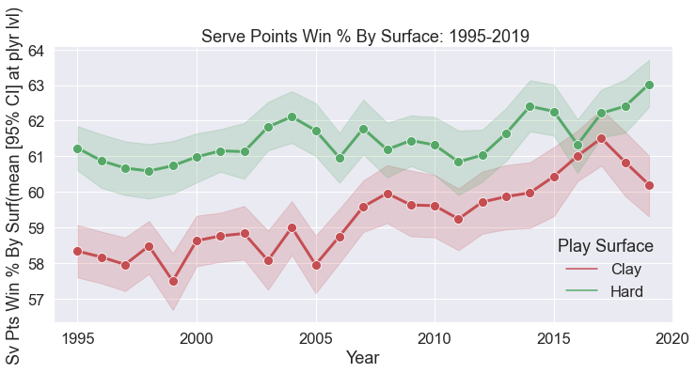
Serve Performance Has Improved Over Time Along Along With Height
Notes:
LEFT: Serving performance has steadily increased in the top 200 on the ATP Tour over the last quarter century (1995-2019)
RIGHT: Performance has improved on both major surfaces, but perhaps more on clay courts over the past ~10 years
Approximately 70% of tour level matches are played on hard courts and 30% played on clay courts (not including the few grass court tournaments). Most of the analysis moving forward will focus on hard court performance, as it constitutes the lion’s share of tour action.

Slide 11
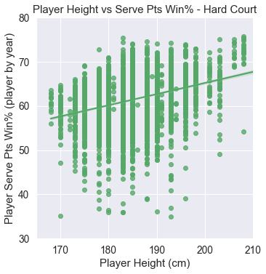
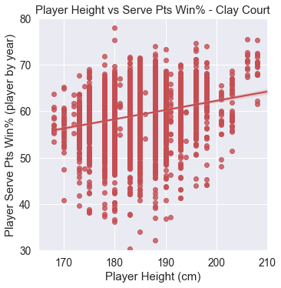
Height and Serve Performance Are Indeed Positively Correlated
Notes:
LEFT: Mean player serve points won per match percentage is positively correlated to player height. Each data point represents one player’s mean performance for a given year on hard courts. This correlation appears to be moderately stronger on hard courts than on clay courts.
RIGHT: Mean player serve points won per match percentage is positively correlated to player height. Each data point represents one player’s mean performance for a given year on clay courts. This correlation appears to be moderately stronger on hard courts than on clay courts.
Approximately 70% of tour level matches are played on hard courts and 30% played on clay courts (not including the few grass court tournaments).

Slide 12
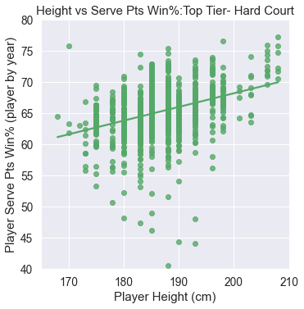
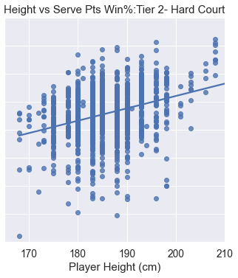
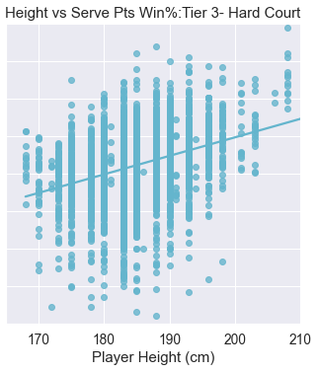
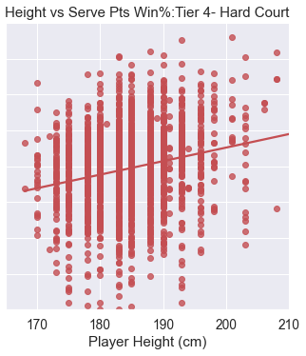
Height and Serve Performance Relationship is Pronounced Across Ranking Tiers: All Data
Notes:
LEFT: Mean player serve points won per match percentage is positively correlated to player height. Each data point represents one player’s mean performance for a given year on hard courts. This correlation appears to be moderately stronger on hard courts than on clay courts.
RIGHT: Mean player serve points won per match percentage is positively correlated to player height. Each data point represents one player’s mean performance for a given year on clay courts. This correlation appears to be moderately stronger on hard courts than on clay courts.
Approximately 70% of tour level matches are played on hard courts and 30% played on clay courts (not including the few grass court tournaments).

Slide 13
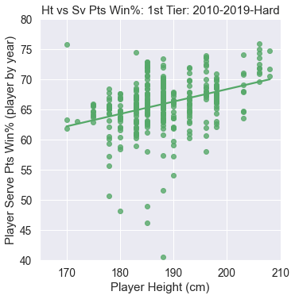
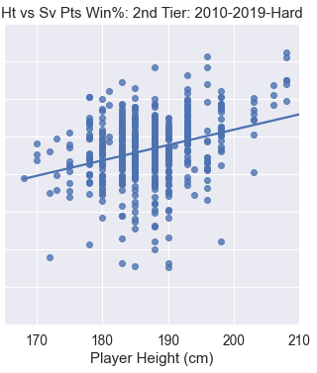
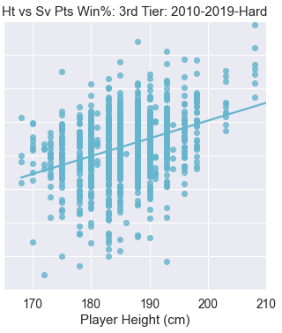
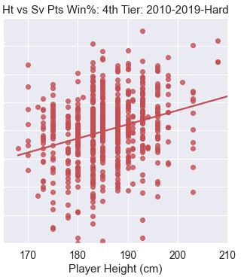
Height and Serve Performance Relationship is Pronounced Across Ranking Tiers: 2010-2019
Notes:
LEFT: Mean player serve points won per match percentage is positively correlated to player height. Each data point represents one player’s mean performance for a given year on hard courts. This correlation appears to be moderately stronger on hard courts than on clay courts.
RIGHT: Mean player serve points won per match percentage is positively correlated to player height. Each data point represents one player’s mean performance for a given year on clay courts. This correlation appears to be moderately stronger on hard courts than on clay courts.
Approximately 70% of tour level matches are played on hard courts and 30% played on clay courts (not including the few grass court tournaments).

Slide 14
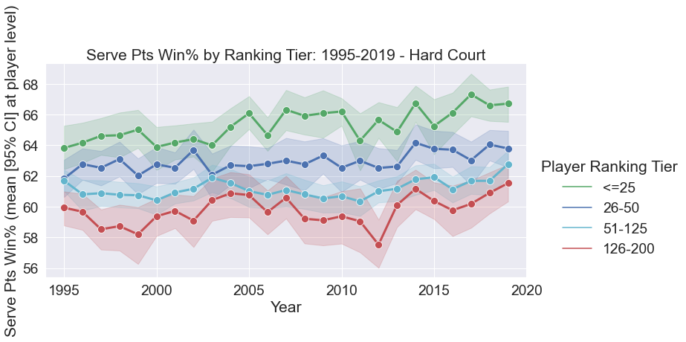
However, As Top Tier Has Gotten Taller, It May Also Be Outpacing Other Tiers On Serve Performance Gains
Notes:
All ranking tiers have trended toward greater success on serve over the past 25 years, though the top tier of players may have improved relatively much compared to the other tiers of players.
Recent separation (see green arrow) is indicated
This runs in parallel to the fact that top tier players have also been getting taller relative to the lower tiers.

Slide 15
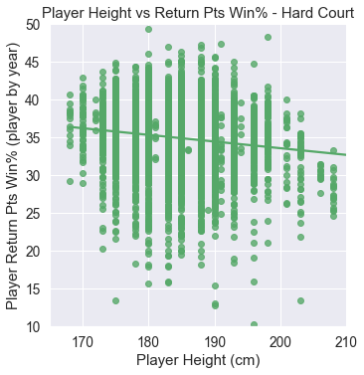
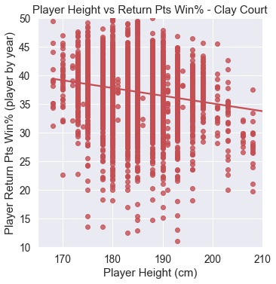
There Is A Tradeoff With Increasing Height However: Return Performance Suffers

Slide 16
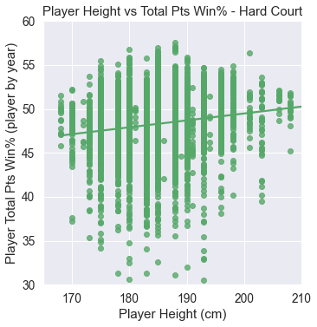
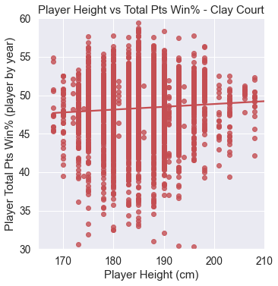
Gains in Serve Performance With Height Outpace Losses in Return Performance: Height Is A Net Positive

Slide 17
Gains in Serve Performance With Height Outpace Losses in Return Performance: Height Is A “Net” Positive

Slide 18
Height Analysis Summary
Mean player height in the Top 200 gradually increased from 1995-2019
Tier 1, the most elite players, has taken on taller players disproportionately
Serve Performance has improved as mean height has increased, and this improvement can be seen across Ranking Tiers (and surfaces)
However, Tier 1 may have achieved disproportionate improvement over the past 5-10 years, as it has also become disproportionately taller
Increased height is associated with reduction in Return Performance
However, this reduction is more then offset by Serve Performance gains in terms of Overall Performance (ie, height is a “net” positive)

Slide 19
Trends in Player Age
Have player AGE distribution characteristics changed over the last 25 years? If so, in what way(s)?
what are the performance correlates of any systematic AGE distribution changes?

Slide 20
Trends in Player Age I
Have player AGE distribution characteristics changed over the last 25 years? If so, in what way(s)?
what are the performance correlates of any systematic AGE distribution changes?

Slide 21
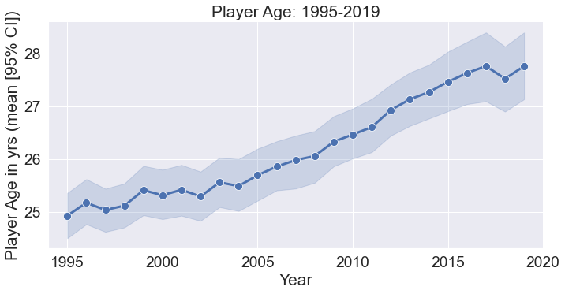
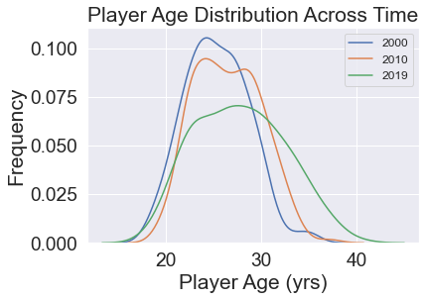
Pro Men’s Tennis Is Getting Older
Notes:
LEFT: Mean player age has steadily increased in the top 200 on the ATP Tour over the last quarter century (1995-2019)
RIGHT: In contrast to the case with height, the overall age distribution has shifted to the right

Slide 22
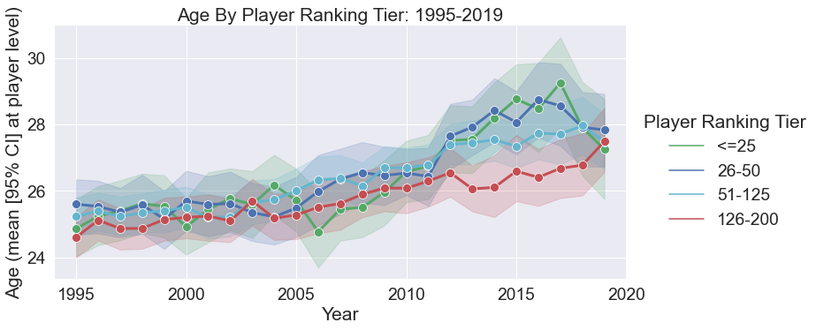
Top Tier Players Have Trended Older Over Time Relative to Lower Tier Players
Notes:
FIGURE: All ranking tiers have trended older over the past 25 years, though there appears to be a differentiation over the past 10 or so years between players in the top two tiers (see green and dark blue arrows) and everyone else. 2019 is an interesting data point running counter to this trend, however.

Slide 23
Trends in Player Age II
Have player AGE distribution characteristics changed over the last 25 years? If so, in what way(s)?
what are the performance correlates of any systematic AGE distribution changes?

Slide 24
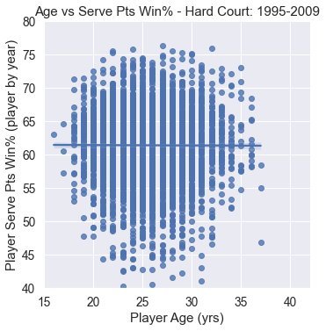
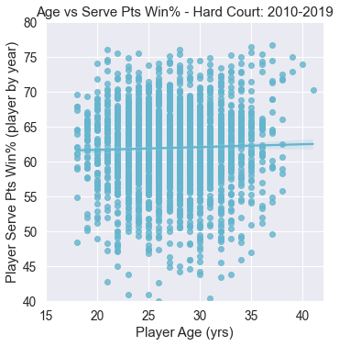
Player Serve Performance With Increasing Age Has Improved In The Past Decade
Notes:
LEFT: Mean player serve points won per match percentage is weakly negatively correlated to player age in the early part of the sample (1995-2009). Each data point represents one player’s mean performance for a given year on hard courts.
RIGHT: In contrast, player serve points won per match percentage is positively correlated to player age in the second part of the sample (2010-2019). Each data point represents one player’s mean performance for a given year on hard courts.
Approximately 70% of tour level matches are played on hard courts and 30% played on clay courts (not including the few grass court tournaments).

Slide 25
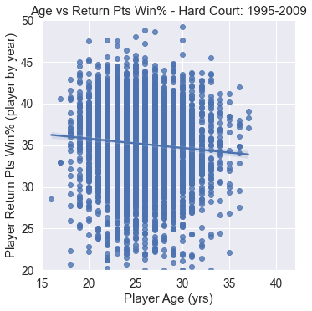
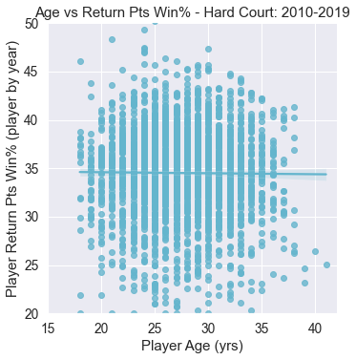
Player Return Performance Decline With Age Has Been Reduced
Notes:
LEFT: Mean player return points won per match percentage noticeably decline with player age in the early part of the sample (1995-2009). Each data point represents one player’s mean performance for a given year on hard courts.
RIGHT: In contrast, mean player return points won per match percentage is only weakly correlated to player age in the second part of the sample (2010-2019). Each data point represents one player’s mean performance for a given year on hard courts.
Approximately 70% of tour level matches are played on hard courts and 30% played on clay courts (not including the few grass court tournaments).

Slide 26
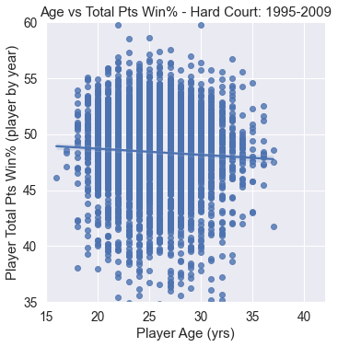
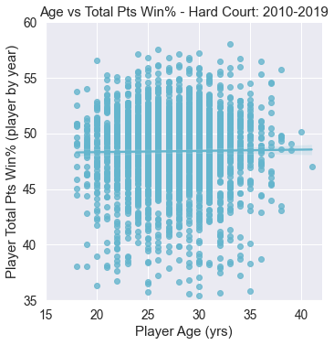
Across Serve and Return Performance, Players Overall No Longer Decline With Age
Notes:
LEFT: Mean total points won per match percentage noticeably decline with player age in the early part of the sample (1995-2009). Each data point represents one player’s mean performance for a given year on hard courts.
RIGHT: In contrast, mean player total points won per match percentage is weakly POSITIVELY correlated to player age in the second part of the sample (2010-2019). Each data point represents one player’s mean performance for a given year on hard courts.
Approximately 70% of tour level matches are played on hard courts and 30% played on clay courts (not including the few grass court tournaments).

Slide 27
Age Analysis Summary
Mean player age in the Top 200 gradually increased from 1995-2019
Tier 1, the most elite players, has taken on older players disproportionately
Serve Performance declined slightly with increasing age 1995-2010. However, it slightly IMPROVED across age range over past decade
Return Performance declined sharply with increasing age 1995-2010. However, it declined only very slightly across age range over past decade
Overall performance has reversed from negative to positive across age range from the first 15 years of the sample to the past 10

Slide 28
Synthesis
So are the increasing height and increasing age ends related? Do they correlate, taken together, to a performance advantage?

Slide 29
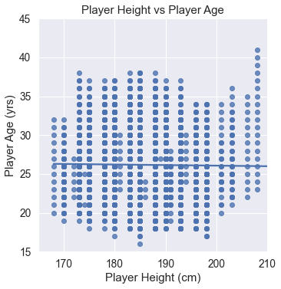
No Clear Aggregate Relationship Between Height and Longevity, But Trends At Extremes
Shortest players don’t
go deep into 30s
Tallest players can go deep into 30s (even 40s!)
“not tall enough?”
Notes:
Each dot represent a year within the Top 200 in the world for a given player at a given age and height (though height never changes for a given player across the sample)
There is overall, perhaps, a very slight negative correlation between increasing height and longevity (heights are static for a given player throughout career), or no statistically significant relationship
However, it is notable that there are no years beyond the early 30s for the shortest players on tour (below 175 cm; green callout)
In contrast, there are multiple years beyond 37 for the tallest players in the sample and none for any shorter players (purple callout).
Given what I’ve already shown about the relationship between height and serve advantage, it is likely that extreme serve advantage can extend careers and extreme serve disadvantage can cut careers short. There may also be a valley where being tall but not tall enough to have an extreme serve advantage is associated with career shortening (orange callout).

Slide 30
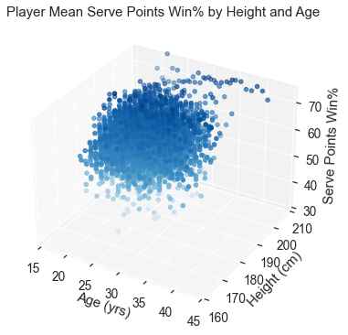
The Tallest Players May Stay Around Because They Are Outlier Servers
Shortest players don’t
go deep into 30s
Tallest players can go deep into 30s (even 40s!)
The oldest player years are for very tall player(s), and they have outlier success on serve
“not tall enough?”
Notes:
The 3-D plot on the right supports the idea that tall players are “hanging on” to an advanced age by being unusually strong on serve (purple callout)

Slide 31
Height and Age Synthesis Summary
There is no clear sample-wide relationship between height and age
However, at the extremes several possible trends emerge
The shortest players in the sample tend to not last past early 30s in Top 200
The tallest players last the longest, in at least a few cases into their early 40s
Curious dip between 190-200 cm where players also don’t last as long as most players in the sample
Player years at the very top of the age range clearly belong to the very best servers.
Perhaps players in the “curious dip” have age-related problems associated with being very tall but aren’t tall enough to get away with jut having a massive serve as they slow down?

Slide 32
Conclusion and Future Directions
Players in the Top 200 have gotten both taller and older on average in the study period (1995-2020), with the most elite players (Tier 1) becoming disproportionately tall and old
Improved Serve Performance with height and age, outpacing any declines in Return, may be the primary success driver in “tall” and “old” players
Quantitative follow-up of the visual trends seen here is warranted, as is a careful dissection of how these trends play out on clay vs hard surface
One obvious set of questions surrounds why the game is more welcoming to “tall” and “old” players now. Is it primarily technology-driven (racquet, strings, balls)? Nutrition and training-driven? Court conditions generally favoring big servers? Wealth/resource disparity between elite and everyone else making it harder to “break through” for younger players no matter how talented?

Slide 33
Thank You!

