Slide 1

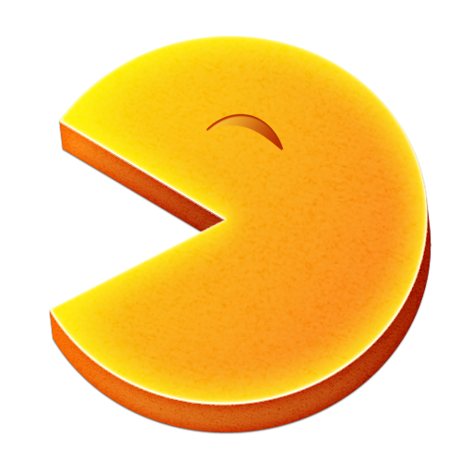
PACMAN GAME

Slide 2
At the beginning, we were four…
Balosache Alexandru 342C2
Bottea Alexandru 342C2
Codreanu Andrei 342C2
Popescu Ovidiu 342C2
But we added them:
Chelcea Adelina 342C1
Stamate Stefan 342C4
Ursu Vlad-Andrei 342C4
Voica Robert 342C4
And we ended as a team with eight persons.
Have we managed to do a good job???

Slide 3
What each member worked on:
Let’s begin with Andrei:
- implemented networking, synchronize all players movement
- static map generation
- implemented player movement and wall collision
- player animations and models
- bug fixing
And continue with Stefan:
implemented the game mechanics, more specifically the monster killing another player when it catches him and the increase of its score
the respawning of a player after dying
selection of a new monster from among the living players after a fixed time.

Slide 4
Vlad’s contribution:
completed the random scene generation (on each game a new scene
is created, which will be the same for all players);
- created the github project and worked on moving it from bitbucket to github;
- minor modification to the graphical interface and small refactorizations of code
Ovidiu’s work:
- Implemented the score board
- dummy start scene replaced by Robert’s start menu
- added backgroud sound
Robert :
implemented the start game scene
synchronized the start game scene for all players

Slide 5
Adelina’s contribution:
random players generation
coding style document
PowerPoint presentation
And we cannot forget about our testers:
Alex Balosache:
tested the game and solved bugs in the movement of the player
wrote the user documentation (how to play)
Alex Bottea:
tested the game
created the diagram
wrote the technical documentation

Slide 6
And of course, don’t forget about the fact that everyone started with unity tutorials in order to understand how the program works!

Slide 7
What we have learnt:
to work with the Unity game engine
how to configure git on our own computers
we have found out about Trello which seems to be a good project
management application
working in a team, synchronization with colleagues
to split tasks so that everybody has something to do
taking decisions and analyse the possible solutions for some functionalities

Slide 8
What we disliked:
the number of people implicated in the project was too great for its complexity and it made task distribution more difficult and somewhat unbalanced
the development period was too short considering the fact that everybody has other homeworks and labs. Not to mention the fact that some of us also have a job

Slide 9
But we liked that:
the project had a different topic comparing to the others made during university classes
We had the freedom to choose what technology to use in order to implement the game
the emphasis was put on the way we managed to communicate and interact
and not on how well the code was written or how well the game turned out.
- we managed to work in a team and everybody has shown involvement
“When I decided to take this subject, I had no idea what it was about, but now that I do, I’m glad I chose it.” – Alex Bottea

Slide 10
What can be changed:
Only one more complex project with a bigger implementation period would be more appropriate; in this way, the distribution of the tasks can be well done and it would be easier to work with github

Slide 11
As a team, we managed to organize ourselves, to distribute the tasks as well as we could and synchronize one with each other.
We haven’t used Trello so much because Facebook turned out to be more efficient in this case. We were able to communicate faster and solve the problems we had at that moment.
We started with BitBucket, but we had to move to GitHub because of the limited number of persons who can access the repository.

Slide 12
Conclusion
It was an overall pleasant team collaboration experience.

