Slide 1

Intro to Python
© QuantSprout

Slide 2
Introductions
Otto Stegmaier
Undergrad in Econ @ Harvard
USMC Infantry Officer
General Assembly Student for Data Science
Assistant instructor for GA Data Science & Analytics Courses
Data Scientist at Fitbit

Slide 3
Why I’m teaching this?
- Python opened a ton of doors for me
- Enabled my transition from the USMC
- Exciting career in tech
…All started with an intro to python course

Slide 4
Objectives for Class
Build strong foundation of Python
Remove barriers/frustration
Enable you to approach more advanced topics
Data Analytics
Web Development
Machine Learning
HAVE FUN!

Slide 5
Class Introductions
Name
Expectations for this course
How do you plan to apply skills your Python skills?
Fun Fact

Slide 6
Course Structure
Lectures on topics
Interaction is good
Feel free to ask questions
If there’s not enough time to cover questions, we’ll put it in a parking lot for after class
Hands on exercises
Pair programming
Mix up partners

Slide 7
Schedule
Time | Topic
10:00 – 10:30 | Overview of Python
10:30 – 12:30 | Python Fundamentals
12:30 – 1:30 | Lunch
1:30 – 2:30 | If Statements
2:30 – 3:00 | Lists, Tuples and Dictionaries
3:00 – 3:15 | Break
3:15 – 4:00 | For Loops
4:00 – 4:30 | Importing Packages
4:30 – 5:00 | Additional Resources

Slide 8
Why Python?
Readability
Flexibility
Dynamic typing
Supports multiple programming paradigm (Object oriented, Functional, Procedural)
Entire ecosystem for interacting with web
Libraries of Tools for Data Analysis

Slide 9
What is Anaconda?
Distribution of Python and commonly used libraries of tools
Easier than individually installing many libraries
Ensures the versions of each library are compatible with each other

Slide 10
How to Interact with Python
There are several ways to interact with python
Python Command Line
Operating System Command Line
iPython
iPython Notebook
** Sometimes called jupyter
We’ll be using iPython Notebooks

Slide 11
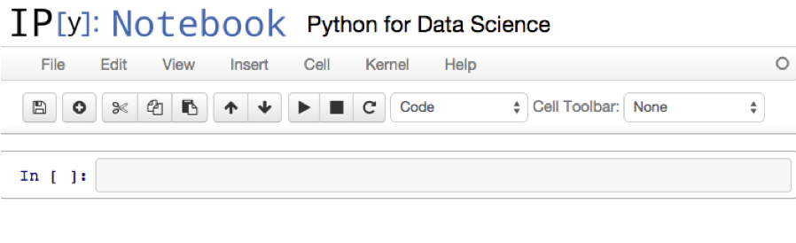
iPython Notebook Basics
Enter code here

Slide 12
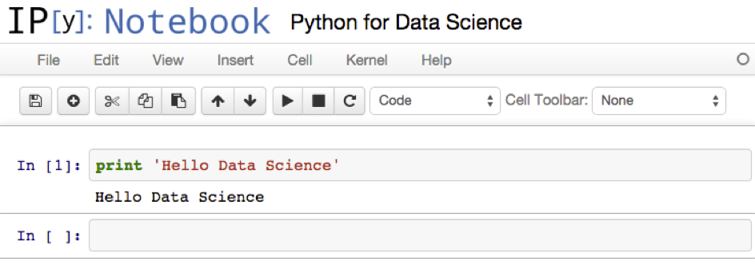
iPython Notebook Basics
Shift + Enter runs code
and returns results

Slide 13
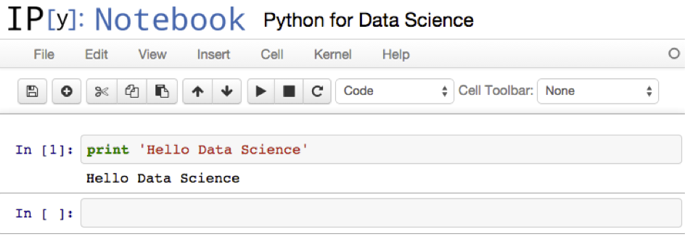
iPython Notebook Basics
Add more code blocks
Re-order code blocks

Slide 14
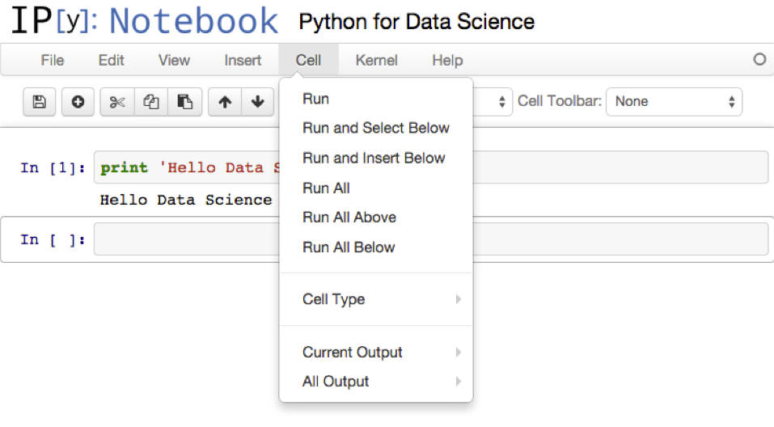
iPython Notebook Basics
Run multiple
code
blocks

Slide 15
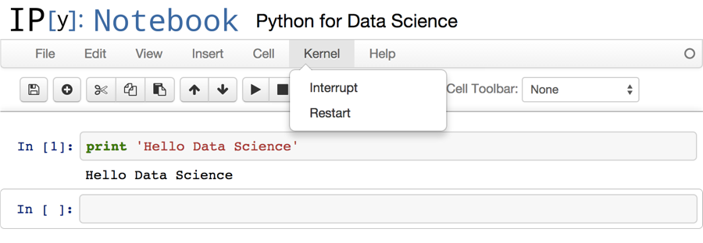
iPython Notebook Basics
Restart
Notebook to
Clear Memory

Slide 16
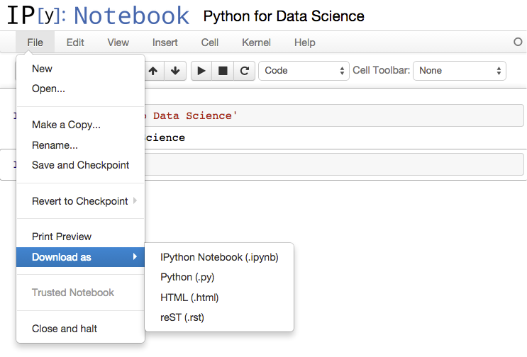
iPython Notebook Basics
Save or
Download File

Slide 17
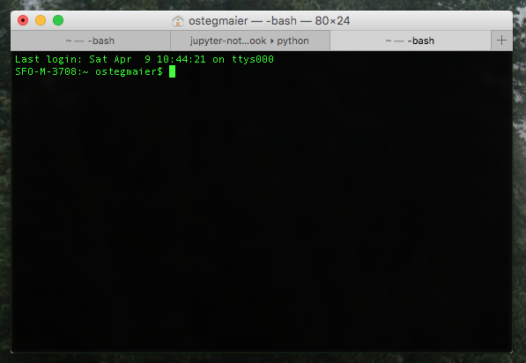
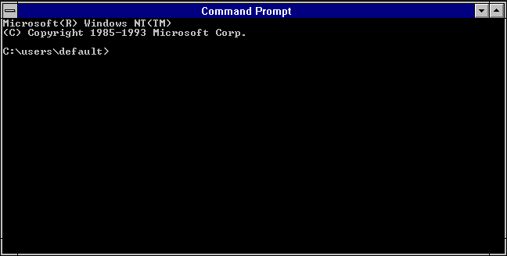
Set Up for iPython Notebooks
Download the dropbox folder to your desktop
Open your terminal/command prompt and launch ipython notebook

Slide 18
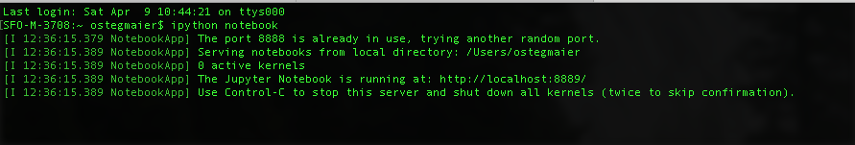
Set Up for iPython Notebooks
launch ipython notebook by typing
“ipython notebook”

Slide 19
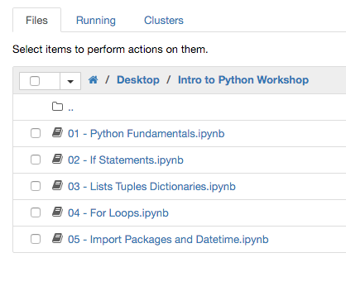
Set Up for iPython Notebooks
This will launch a web browser
Navigate to your desktop in the browser window
Open the Python Fundamentals.ipynb File

Slide 20
Write Your First Python Code
Type in the first code block:
print “Hello Data Science”
Press Shift + Enter

Slide 21
Data Types
Numeric Types
Integer (whole numbers)
Float (includes decimals)
Boolean (True/False)
Strings
Text
Must be in single or double quotes
Python has a function to return data type:
type(<value>)

Slide 22
Try Data Types
type(1)
type(2.5)
type(True)
type(‘string’)

Slide 23
String Insertion Syntax
Text in quotes
Placeholder for insertion
Command for
string insertion
“Bunch of text {}”.format(<value>)
Value in
parentheses

Slide 24
Try Basic String Insertion
“My name is {}”.format(‘Craig’)
name = “Waldo”
“Where in the world is {}”.format(name)

Slide 25
Multiple Insertions
Multiple insertions: helpful to put values in the brackets
place = “SF”
“{0} is in {1}”.format(name, place)
What happens when you change the
order of the variables?

Slide 26
Basic Math
Some operators are pretty obvious
5 + 5
3 * 7

Slide 27
Basic Math
Some are less intuitive
print “Hello ” + “World”
10 % 4 # modulo
10 ** 2 # exponent
1E3 + 1E-3 # exponent base 10

Slide 28
Variables
Variables are objects that hold values
Name variable using letters, numbers and underscore
Special characters can’t be used for naming variables (e.g., [ ,*,@)
Python commands can’t also be used as variable names
Assign values to variables using single =
You can re-assign values to variables

Slide 29
Assign Values to Variables
Create a few variables
x = 10
y = 5
z = 4
Try math with variables
x - y
x * y

Slide 30
Data Types in Math
Try dividing two integers
x / z
Now try using one float
x / 4.0

Slide 31
Functions
Reusable snippets of code
Define the function once
Call the function to execute your code as many times as you like
Can receive inputs and return results

Slide 32
Function Syntax
start with
define
name you assign to function
Parentheses
def <function> ():
<code line 1>
<code line 2>
Colon
Code to Execute
(can be multiple lines
if also indented)
4 space
indent

Slide 33
Create a simple function
Write a function
def simplestFunction():
print “I made a function”
Call the function
simplestFunction()

Slide 34
Function with Input
Write a function that requires an input
def square(x):
return x ** 2
Call the function
square(5)

Slide 35
Line Continuation
Sometimes code gets too long to write on one line
Python automatically recognizes line continuation in specific cases like commas
Backslashes ( \ ) can be used to continue line of code

Slide 36
Line Continuation
Line continuation with commas
numbers = [1, 2, 3,
4, 5, 6,
7, 8, 9]
print numbers
Backslash for line continuation
long_string = 'This is a really, really, really ' \
+ 'long sentence’
print long_string

Slide 37
Instructions for Exercises
Pair programming
Using only one computer
Take turns typing
Collaborate on solutions
Save Examples for Future Reference
Add notes using # Comments
Error Tracking
Create a text file to keep notes on your errors
Trouble-shooting References
Online documentation
Stackoverflow / Google

Slide 38
Exercise
Create a function that converts Celsius to Fahrenheit. Results should be accurate to at least one decimal point.
Update your function to return a sentence (string type) with the Celsius and Fahrenheit values inserted into the string.

Slide 39
Schedule
Time | Topic
10:00 – 10:30 | Overview of Python
10:30 – 12:30 | Python Fundamentals
12:30 – 1:30 | Lunch
1:30 – 2:30 | If Statements
2:30 – 3:00 | Lists, Tuples and Dictionaries
3:00 – 3:15 | Break
3:15 – 4:00 | For Loops
4:00 – 4:30 | Importing Packages
4:30 – 5:00 | Additional Resources

Slide 40
If Statements
Used to execute commands when defined conditions are met
Contains a conditional statement that has a True/False value
If statement is True then a series of commands will be executed
If the statement is False then commands are skipped

Slide 41
If Statements Syntax
Must be
lower case
Conditional
statement
if <condition>:
<code 1>
<code 2>
Colon
Code to Execute
(can be multiple lines
if also indented)
4 space
indent

Slide 42
Conditional Statements
a == b | Equal
a != b | Not Equal
a > b | Greater Than
a >= b | Greater Than or Equal
a <= b | Less Than or Equal

Slide 43
Multiple Conditions
True and True | = True
True & False | = False
True or False | = True
False | False | = False
and, & are
interchangeable
or, | are
interchangeable

Slide 44
If Statement
Write a simple if statement
x = 3
if x > 0:
print x

Slide 45
Else and Else If
Allow additional conditions and actions
IF Statement
Code
Block 1
True
Executes First
True Statement
False
Else If Statement
Code
Block 2
True
False
Else
Code
Block 3
Else is catch all and
must be at the end

Slide 46
Else If Statement
If statement with Else If
x = 3
if x > 0:
print “{} is a positive number”.format(x)
elif x < 0:
print “{} is a negative number”.format(x)
else:
print “x equals 0”

Slide 47
Exercise
Create a function that checks the type of an input and returns True if the input is numeric (float or integer) or a False if it is another data type.
Update your temperature function from the Python Fundamentals exercise to return an error message if a string is entered instead of a number

Slide 48
Schedule
Time | Topic
10:00 – 10:30 | Overview of Python
10:30 – 12:30 | Python Fundamentals
12:30 – 1:30 | Lunch
1:30 – 2:30 | If Statements
2:30 – 3:00 | Lists, Tuples and Dictionaries
3:00 – 3:15 | Break
3:15 – 4:00 | For Loops
4:00 – 4:30 | Importing Packages
4:30 – 5:00 | Additional Resources

Slide 49
Lists, Tuples and Dictionaries
Python has built-in objects that can hold multiple values
Can be assigned to variables
Has built-in methods
Methods are functions for object
object.method
car.drive
dog.bark

Slide 50
Lists
Lists are ordered data containers
Lists are defined with square brackets [ ]
They can contain any type of objects
Mix of data types (e.g., integer, string, float)
Lists can even contain other lists
List are mutable (you can edit them)
Uses index to reference items in lists
Lists can be empty
Very important to understand as they feed directly into data analysis (image excel as a bunch of lists of data)

Slide 51
List Basics
Use brackets to define list
x = [1, ‘b’, True]
Use index position to reference items
print x[2]
Reassign values in a list
x[1] = ‘a’
print x

Slide 52
Indexing Lists
Create list of lists
a = [[1,2,3], 4, 5]
Use multiple indexes for lists within lists
print a[0][1]
Index from the end of the list
print a[-1]

Slide 53
Appending and Indexing
Append an item to a list
a.append(‘one more item’)
print a
Reference multiple items in a list
print a[2:4]
Open ended indexes go to the ends of lists
print a[:3]

Slide 54
Tuples
Tuples are similar to lists
Tuples are defined using parentheses ( )
Only difference is that tuples are immutable (you can’t change them)
Tuples with single value must have a comma (1,)

Slide 55
Tuple Basics
Use parentheses to define tuple
y = (1, ‘a’, 2.5)
print y
Use index position to reference items
print y[0]
Try reassigning values in a tuple
y[0] = 2

Slide 56
Dictionaries
Dictionaries are collections of key-value pairs
Dictionaries are indicated by curly braces { }
Values are looked up by key
Dictionaries are unordered

Slide 57
Dictionary Basics
Create a dictionary
info = {'name': 'Bob', 'age': 54, 'kids': ['Henry', ‘Phil’]}
print info
Use key to reference a value
print info[‘name’]
Change the value for a key-pair
info[‘age’] = 55
print info

Slide 58
Dictionary Methods
View all keys
info.keys()
View all values
info.values()
Check if a key exists
info.has_key(‘age’)

Slide 59
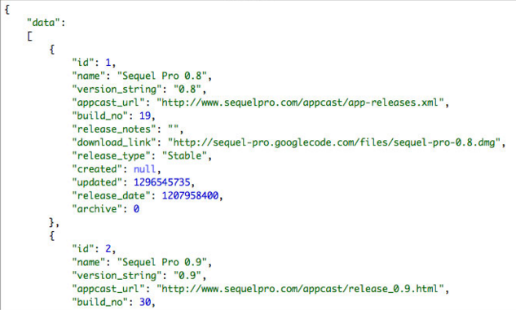
JSON!
Understanding dictionaries is important because most web data is transferred in JSON format which works like a dictionary in python

Slide 60
Schedule
Time | Topic
10:00 – 10:30 | Overview of Python
10:30 – 12:30 | Python Fundamentals
12:30 – 1:30 | Lunch
1:30 – 2:30 | If Statements
2:30 – 3:00 | Lists, Tuples and Dictionaries
3:00 – 3:15 | Break
3:15 – 4:00 | For Loops
4:00 – 4:30 | Importing Packages
4:30 – 5:00 | Additional Resources

Slide 61
For Loops
Iterates through multiple values
Commonly used to process values in a list
Loop of code is executed for each item

Slide 62
For Loop Syntax
Variable in List
Name of list
Starts with for
for <variable> in <list>:
<code 1>
<code 2>
colon
4 space
indent
Block of code
executed for each loop

Slide 63
Functions Used with For
range(<integer>)
Creates list of integers
Starts with zero and each subsequent value is incremented by 1
Returns list with length = input integer
Last item in list is input -1 since list starts with zero

Slide 64
Functions Used with For
len(<object>)
Checks the length of your object
Useful as an input to your range() function
For example, with a list:
range(len(mylist))
Or with a dictionary:
range(len(mydict.keys())

Slide 65
Basic For Loops
Create basic for loop
for x in [1,2,3]:
print x
Create a for loop with range
for x in range(10):
print x

Slide 66
For Loop with Multiple Values
Create for loop with multiple values
for x, y in [[1, 4], [2, 5], [3, 6]]:
print x * y

Slide 67
For Loops with Empty List
Capture the all the results of a for loop
results = []
for x in [1,2,3]:
squared = x ** 2
results.append(squared)
print results

Slide 68
Exercise
Create a function that receives a list of numbers as an input, adds 1 to each number and returns the results as a list
Update your temperature conversion function from the Python Fundamentals exercise to accept a list of Celsius temperatures and return a list of Fahrenheit temperatures
Bonus:
Add error handling to your temperature conversion function.

Slide 69
Schedule
Time | Topic
10:00 – 10:30 | Overview of Python
10:30 – 12:30 | Python Fundamentals
12:30 – 1:30 | Lunch
1:30 – 2:30 | If Statements
2:30 – 3:00 | Lists, Tuples and Dictionaries
3:00 – 3:15 | Break
3:15 – 4:00 | For Loops
4:00 – 4:30 | Importing Packages
4:30 – 5:00 | Additional Resources

Slide 70
Python Packages
Data analytics packages are what make python so powerful
Packages are just files/folders of python code
Importing packages allow you to use the functions from these files
Most packages have online documentation and code examples

Slide 71
Common Packages for Data Science
Package | Usage
numpy | Scientific computing
pandas | Data slicing and manipulation
datetime | Manage date and time formats
matplotlib | Creating charts and graphs
scikit-learn | Machine learning
statsmodels | Statistics

Slide 72
Importing Packages
Plain import statement: import <package name>
Use a nickname: import <package name> as <nickname>
Import a subset of the package: from <package> import <function>
Avoid this technique, because it can create name-space conflicts from <package> import *

Slide 73
Import Packages
Let's import a package
import datetime as dt
Type datetime. and press tab. Highlight time and press enter. Hit shift-tab
dt.
Use a function from the datetime package
print dt.time(1)

Slide 74
Datetime Package
Use the now function to get the current datetime stamp.
ts_now = dt.datetime.now()
print ts_now
Extract the day from the timestamp
print ts_now.day

Slide 75
Datetime Package
Extract some other datetime elements
print ts_now.year
print ts_now.month
print ts_now.minute
print ts_now.second
Create a timestamp for Christmas
ts_xmas = dt.datetime(2016,12,25)
print ts_xmas

Slide 76
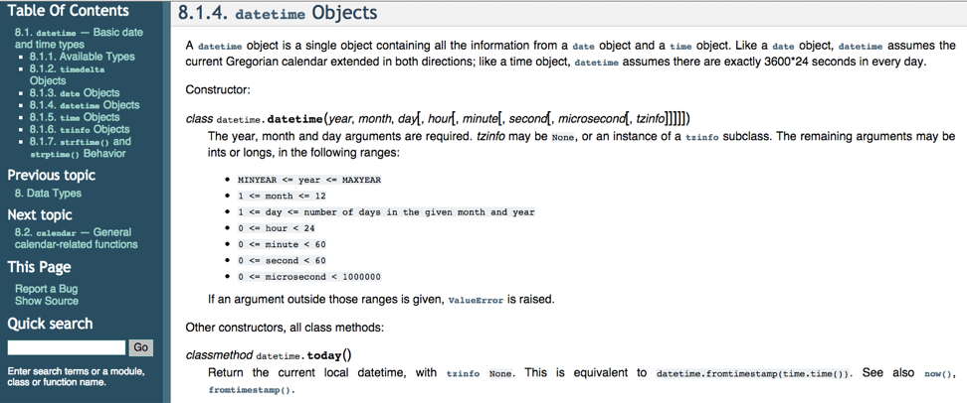
Datetime Documentation

Slide 77
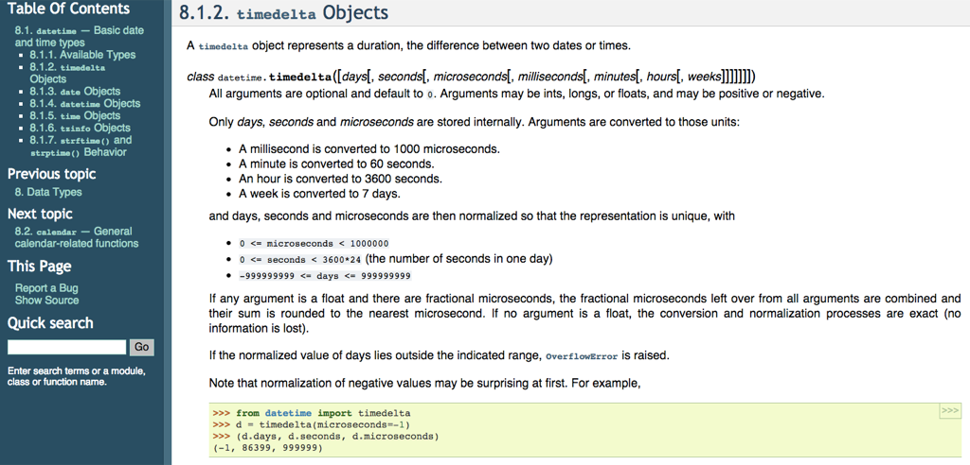
Timedelta Documentation

Slide 78
Timedeltas
Do math with the timestamps
ts_diff = ts_xmas - ts_now
print ts_diff
print type(ts_diff)
print ts_diff.days
print type(ts_diff.days)

Slide 79
Strptime Function
Converts string to datetime
String to be converted
Starts with function
dt.datetime.strptime( <string> , <format> )
Format of string in quotes
(e.g., “%Y-%m-%d”)
Format Examples:
%Y Year
%m Month
%d Day

Slide 80
Strptime Function
Converts string to datetime
String to be converted
Starts with function
dt.datetime.strptime( <string> , <format> )
Format of string in quotes
(e.g., “%Y-%m-%d”)
Format Examples:
%Y Year
%m Month
%d Day

Slide 81
Strptime Format Codes
Convert a string to datetime format
date_str = "01-10-2015"
date_ts = dt.datetime.strptime(date_str,
"%m-%d-%Y")
print date_ts
print type(date_ts)

Slide 82
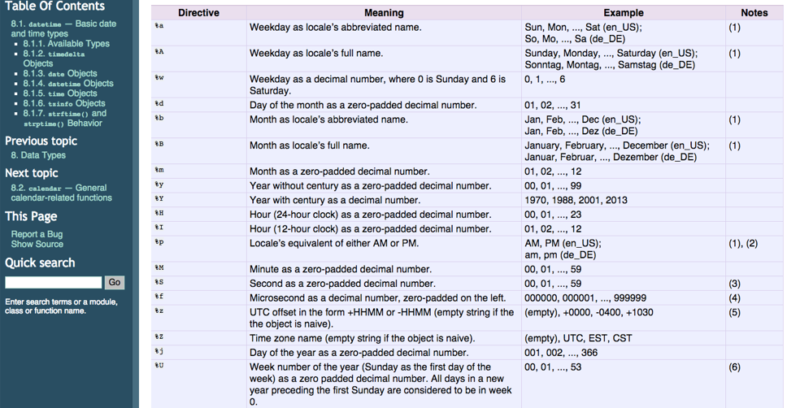
Strptime Documentation

Slide 83
Strftime Function
Convert a datetime object to a string
new_date_str = dt.datetime.strftime(
ts_now,”%H:%M:%S %m-%d-%Y")
print new_date_str

Slide 84
Exercise
Create a variable called future with a datetime value of January 15, 2017 at 5:30pm
Create a variable with a timedelta equal to the difference between future and now
Print the number of seconds from the timedelta
Bonus:
Try converting strings to datetime objects and datetime objects back to strings. What are some interesting datetime formats you can find in the documentation?

Slide 85
Schedule
Time | Topic
10:00 – 10:30 | Overview of Python
10:30 – 12:30 | Python Fundamentals
12:30 – 1:30 | Lunch
1:30 – 2:30 | If Statements
2:30 – 3:00 | Lists, Tuples and Dictionaries
3:00 – 3:15 | Break
3:15 – 4:00 | For Loops
4:00 – 4:30 | Importing Packages
4:30 – 5:00 | Additional Resources

Slide 86
Coding Best Practices
PEP-8 Style Guide
https://www.python.org/dev/peps/pep-0008/
maximum line length of 79 characters
indentation
line continuation
commenting
Hard to Use at First But Review Once a Month and You’ll Incrementally Improve

Slide 87
Debugging Tips
Test early and often
print command is your best friend
Identify common mistakes and use as checklist for debugging
Use google and stackoverflow
Check documentation
Ask for help

Slide 88
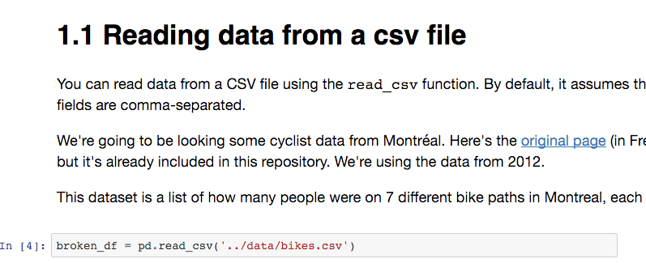
Getting Started with Pandas
Pandas Cookbook
https://github.com/jvns/pandas-cookbook
Copy of this zip file on dropbox

Slide 89
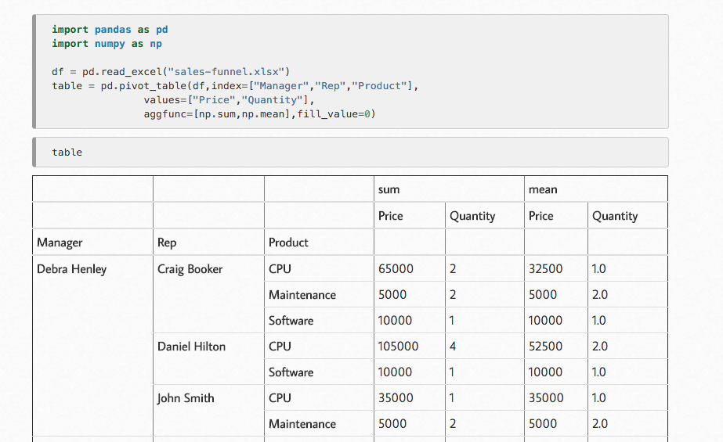
Getting Started with Pandas
“Generating Excel Reports from Pandas”:
http://pbpython.com/pandas-pivot-report.html

Slide 90
Next Steps
Practice, Practice, Practice
Find a fun project
Get a pair programming buddy
Don’t Be Afraid to Ask for Help
Join a Python Meetup
San Francisco Python
Bay Area Python Interest Group (BayPIGgies)
Keep Learning
Pycon videos on YouTube
Python for Data Science Bootcamp
Keep in Touch

Slide 91

yelp.com/biz/quantsprout-san-francisco

