Slide 1
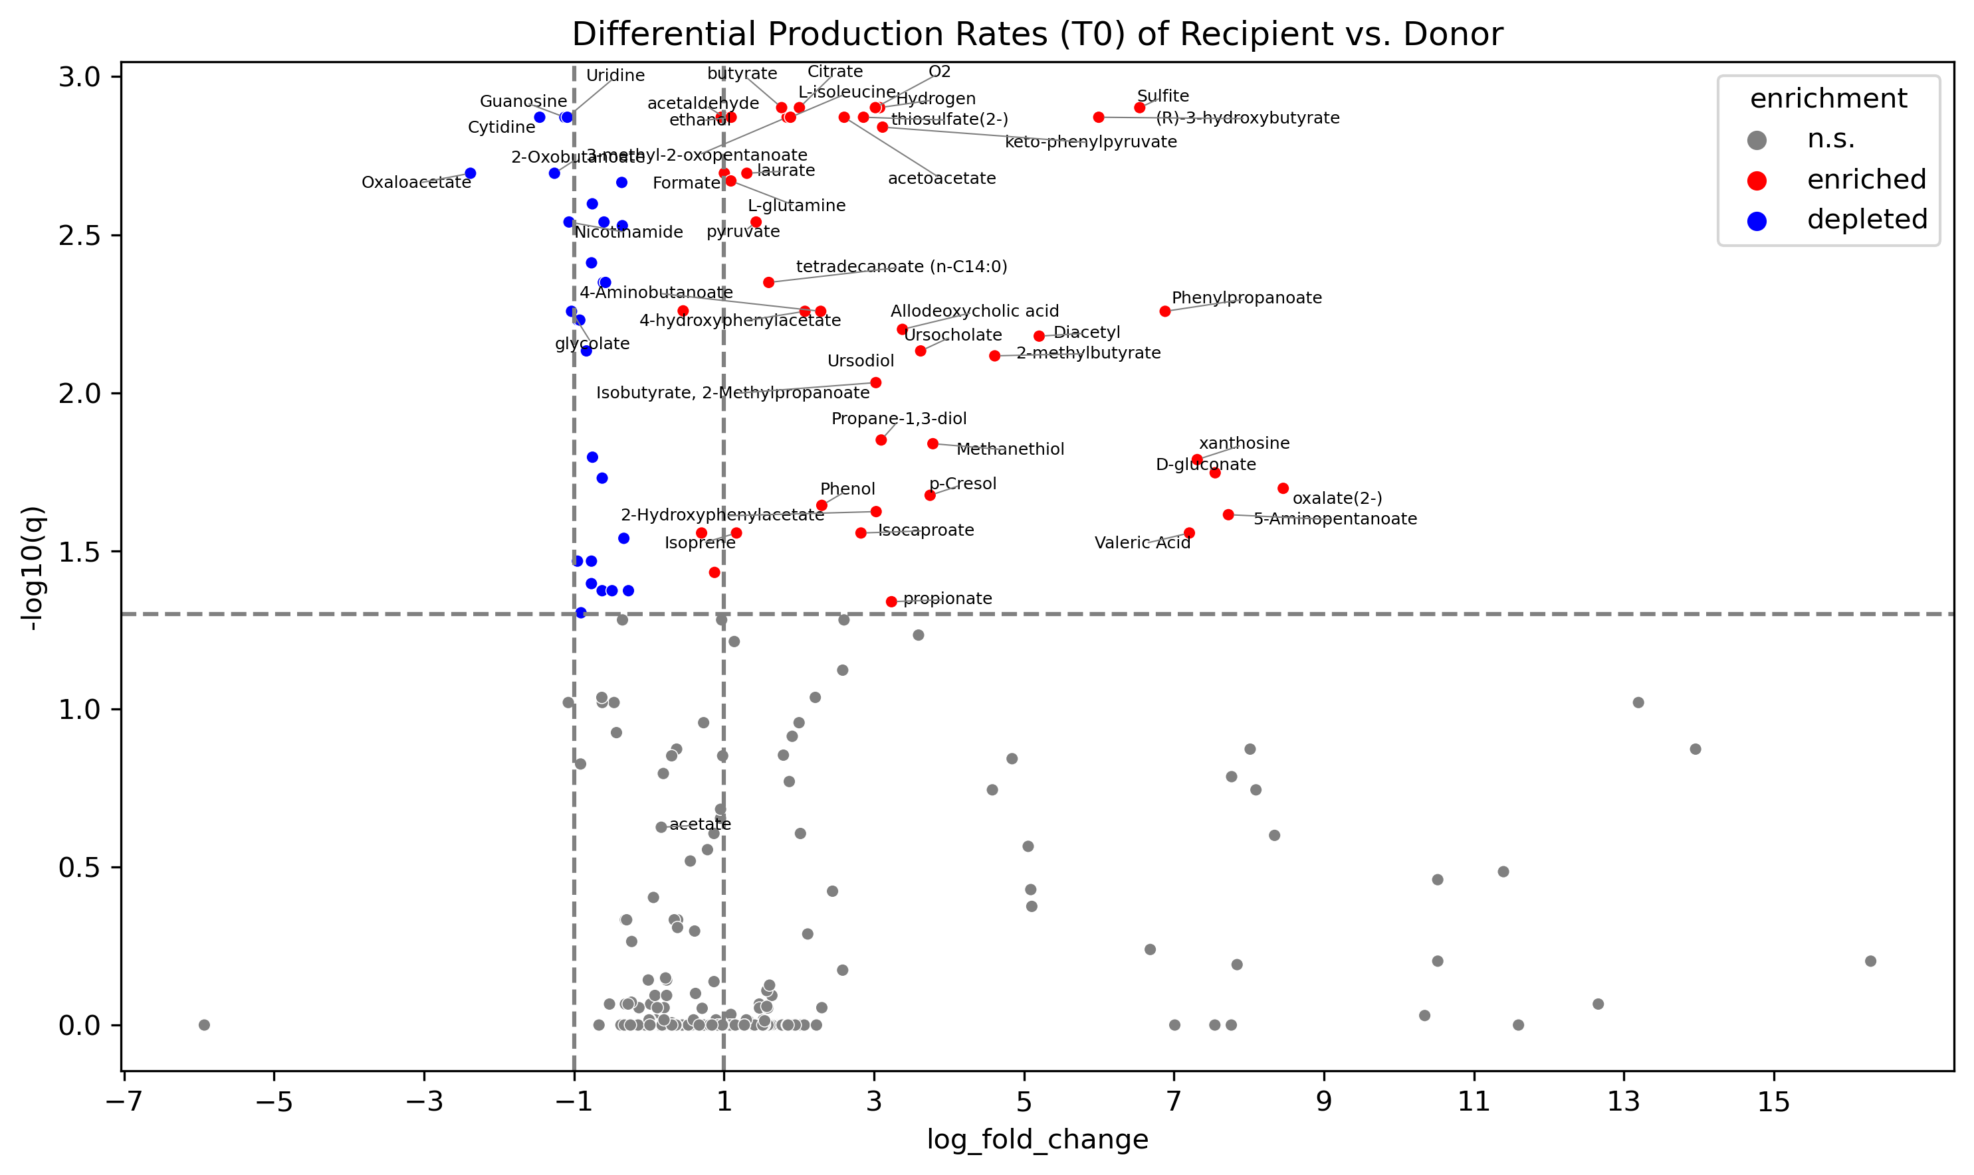
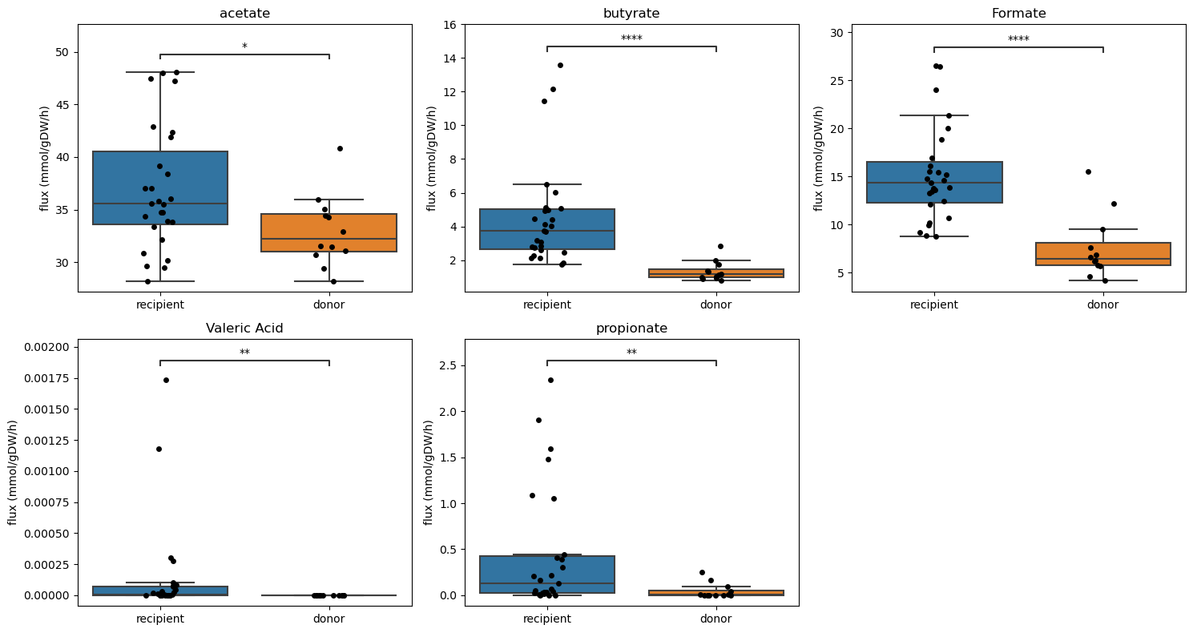
Metabolic Modeling of SCFA Production is Similar to Experimental Results
A study has shown that propionate and butyrate levels are elevated in IBS patients, while acetate level was substantially lower in IBS patients. (Ju et al., 2024).
Another study shows that acetate and propionate level was higher in IBS-D patients and higher overall SCFA production in IBS patients than control. (Jiang et al., 2022, Sun et al., 2022).
Notes:
Some samples do not have valeric acid and propionate production, these samples were added back with 0 production rate (left)
Propionate production is significant before comparison correct
Ju, X., Jiang, Z., Ma, J., & Yang, D. (2024). Changes in Fecal Short-Chain Fatty Acids in IBS Patients and Effects of Different Interventions: A Systematic Review and Meta-Analysis. Nutrients, 16(11), 1727. https://doi.org/10.3390/nu16111727
Jiang, W., Wu, J., Zhu, S., Xin, L., Yu, C., & Shen, Z. (2022). The Role of Short Chain Fatty Acids in Irritable Bowel Syndrome. Journal of neurogastroenterology and motility, 28(4), 540–548. https://doi.org/10.5056/jnm22093
Sun, Q., Jia, Q., Song, L., & Duan, L. (2019). Alterations in fecal short-chain fatty acids in patients with irritable bowel syndrome: A systematic review and meta-analysis. Medicine, 98(7), e14513. https://doi.org/10.1097/MD.0000000000014513

Slide 2
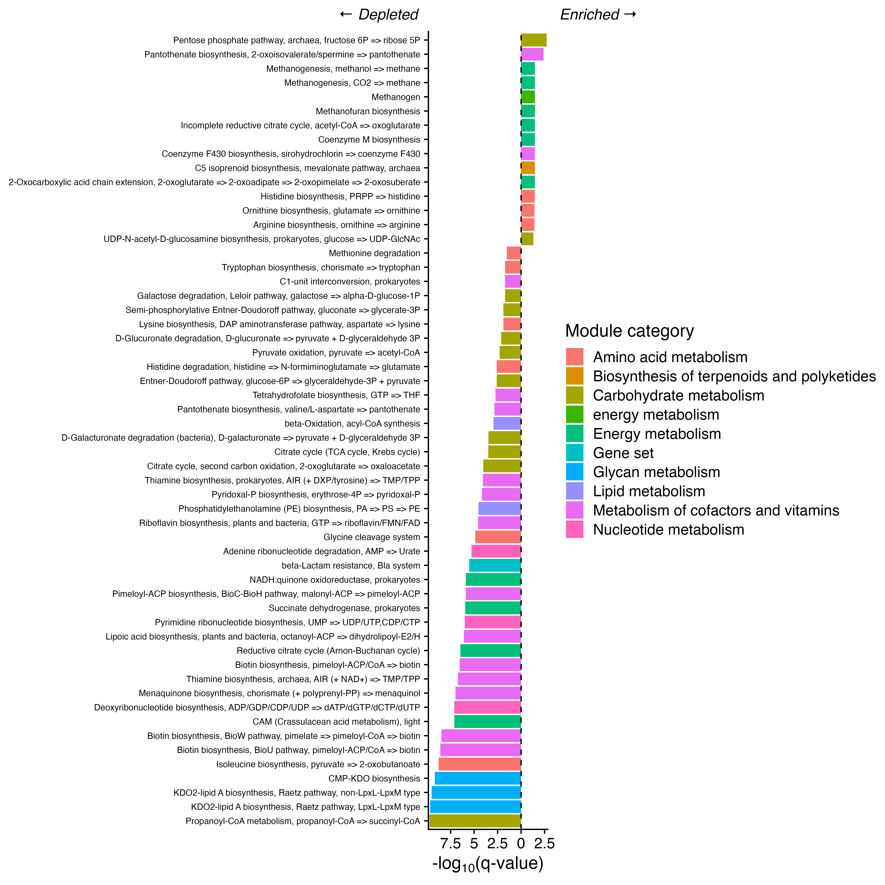
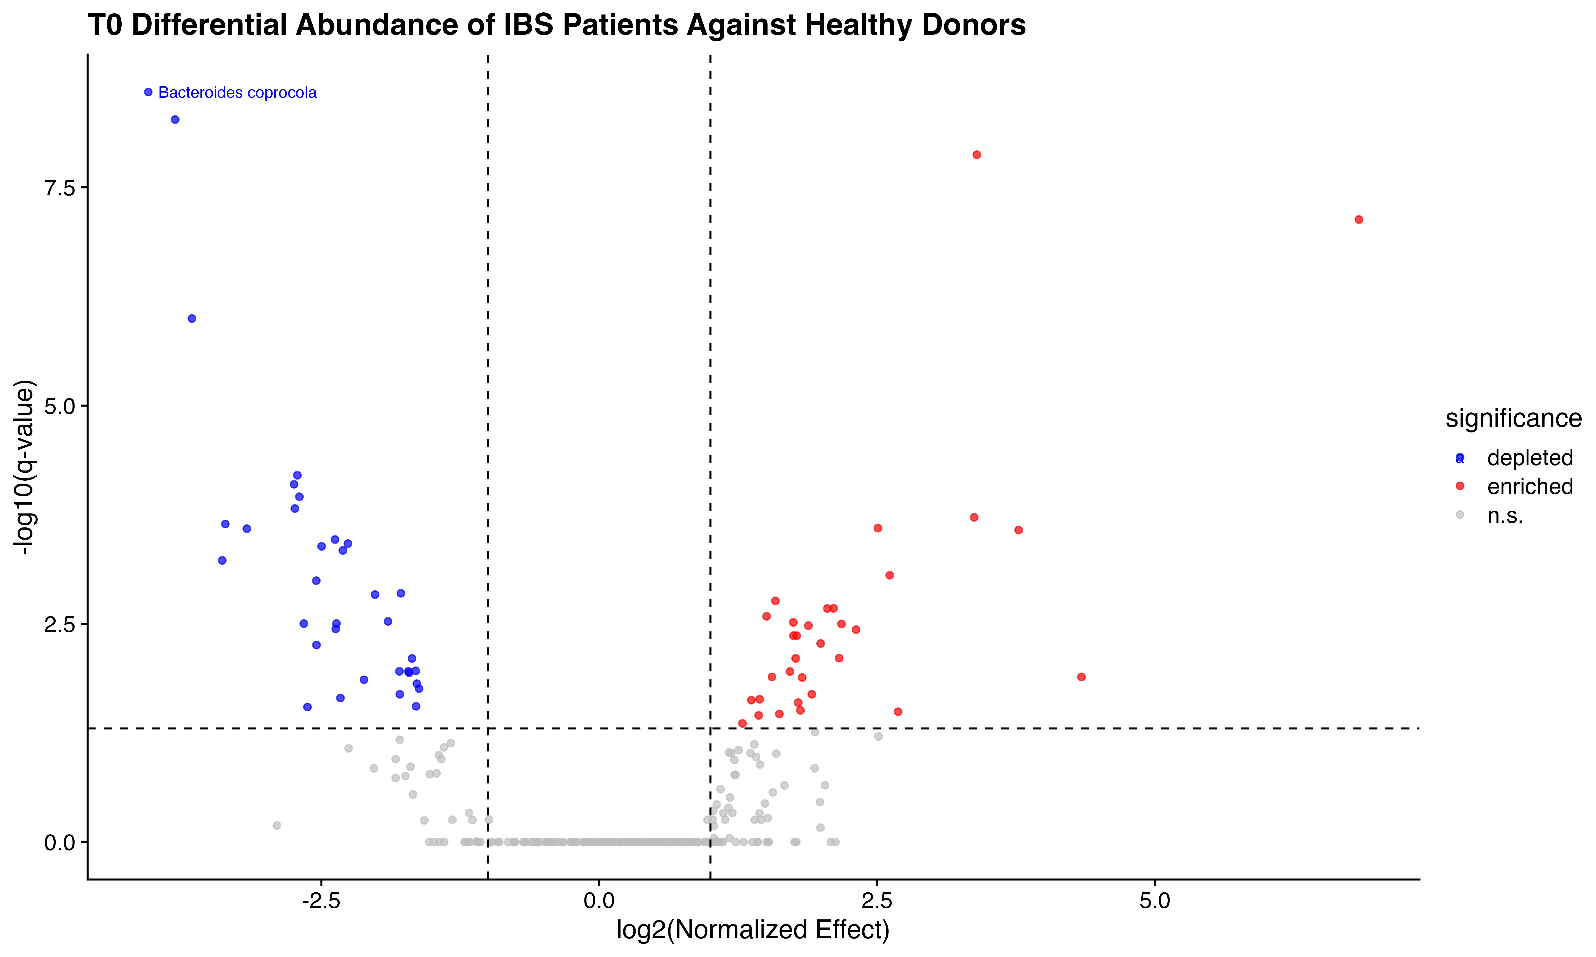
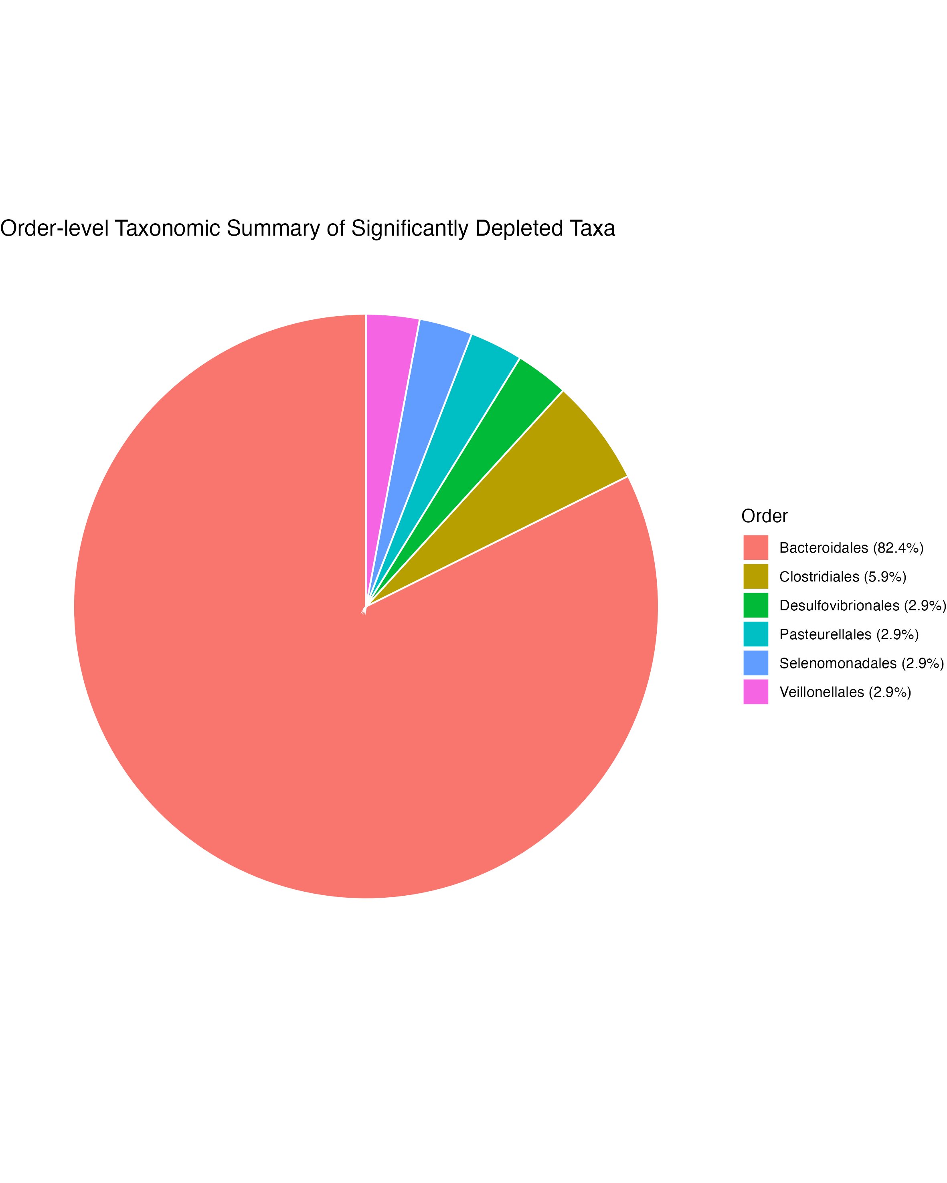
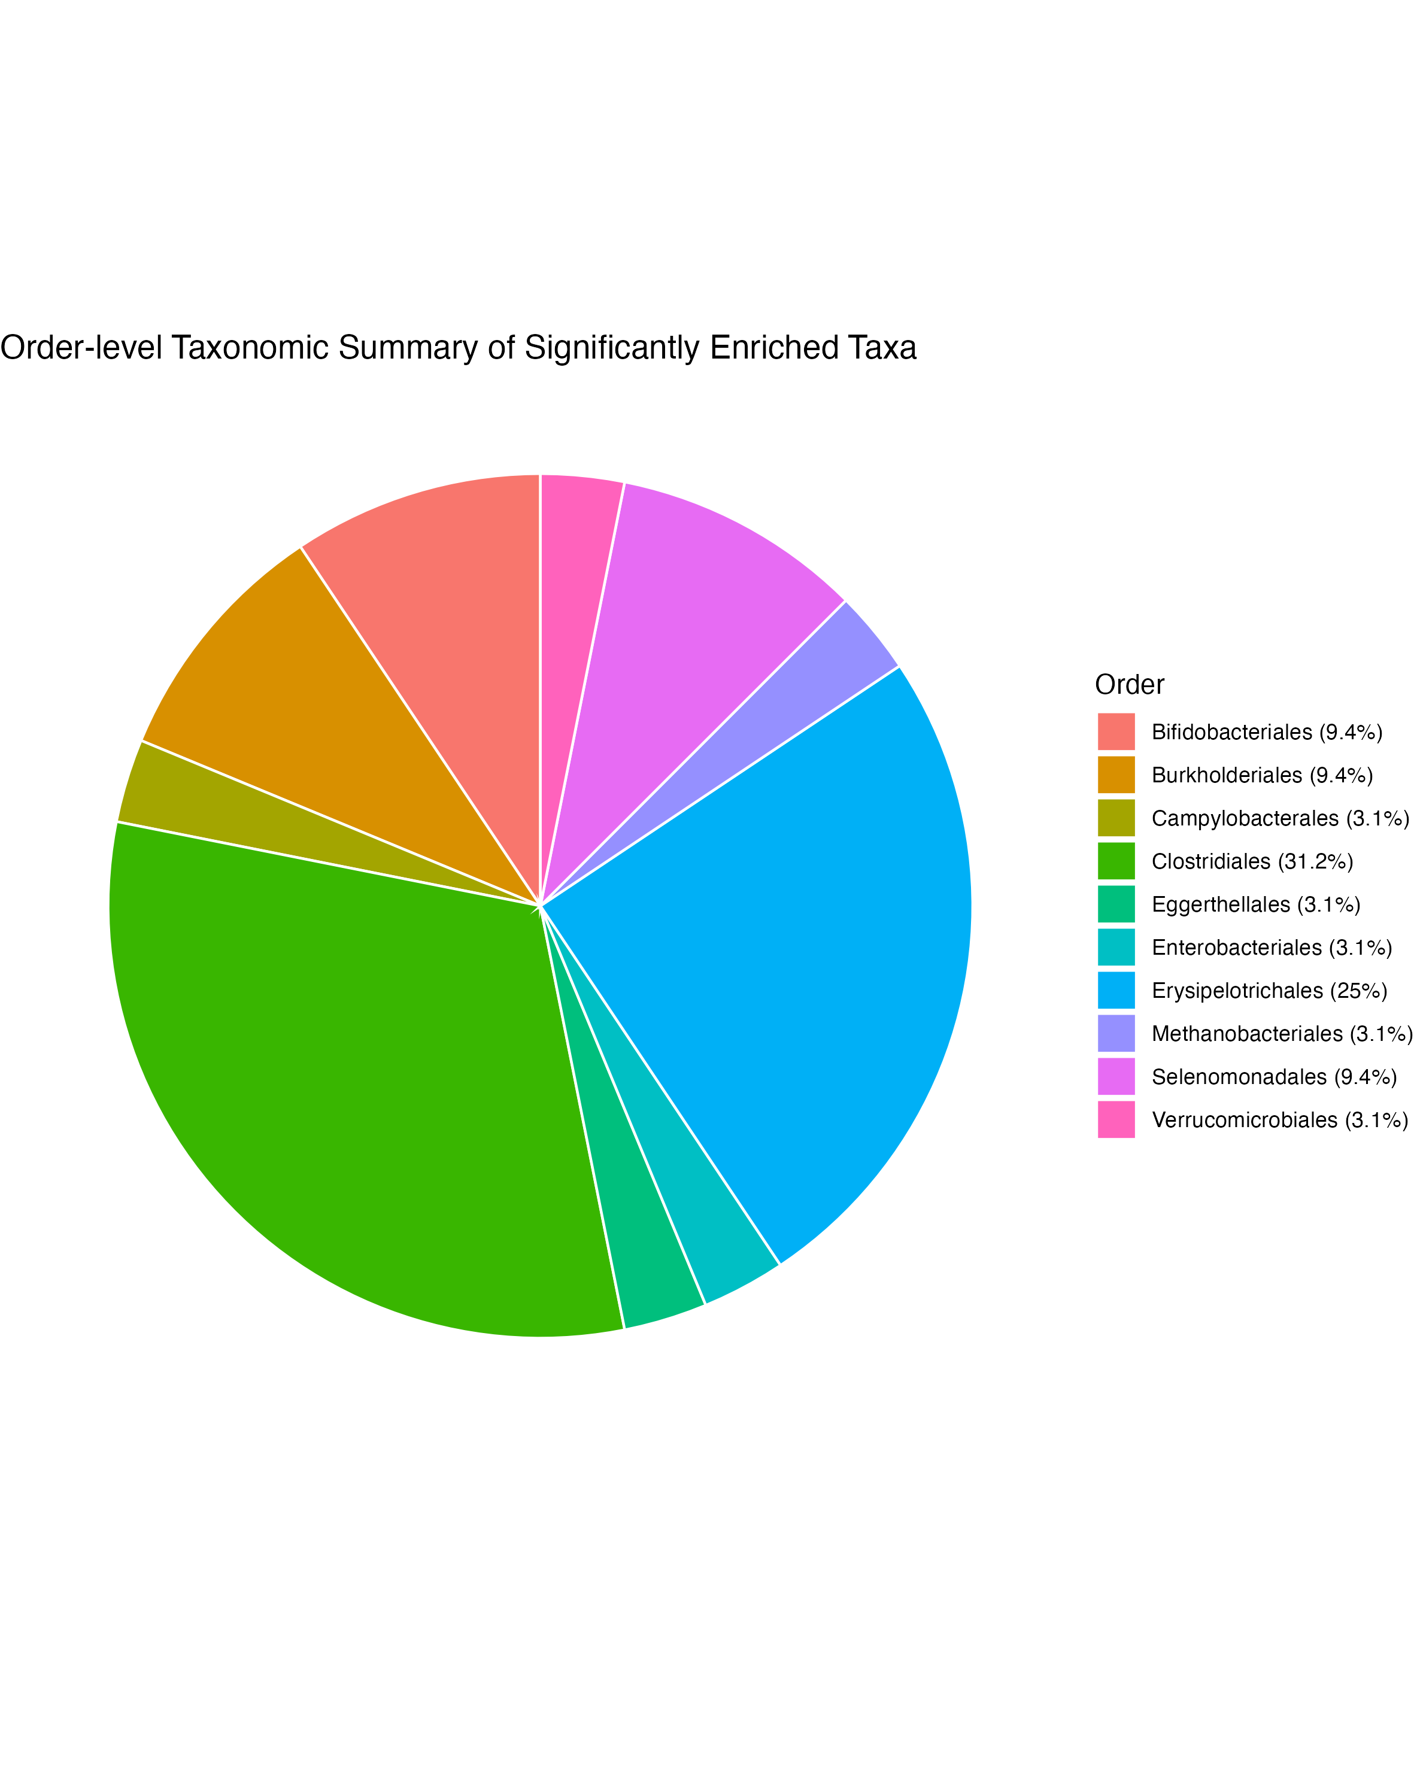

Slide 3
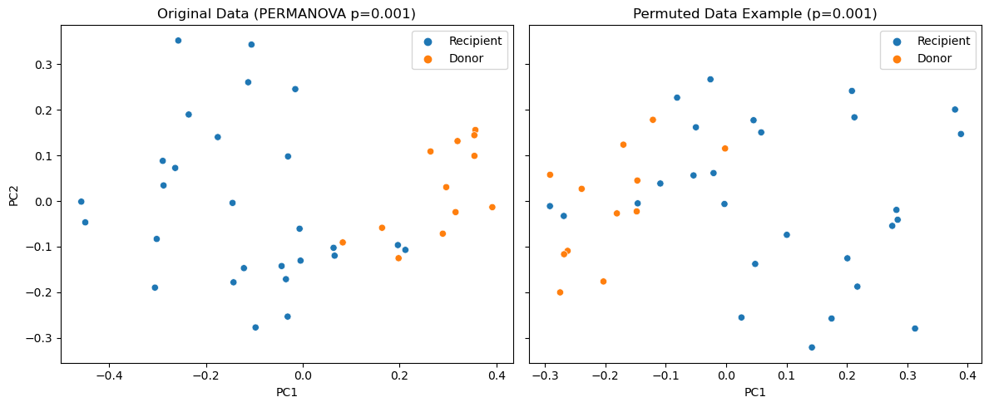
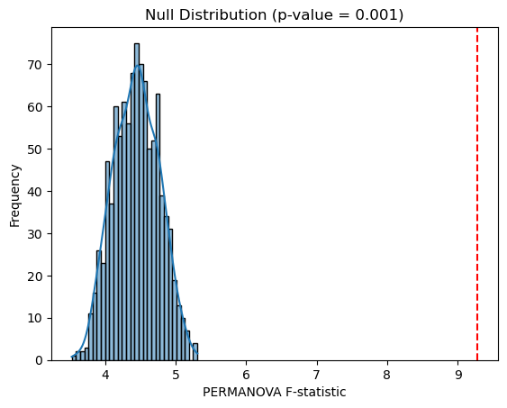
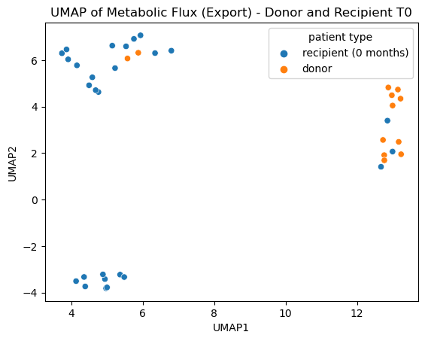
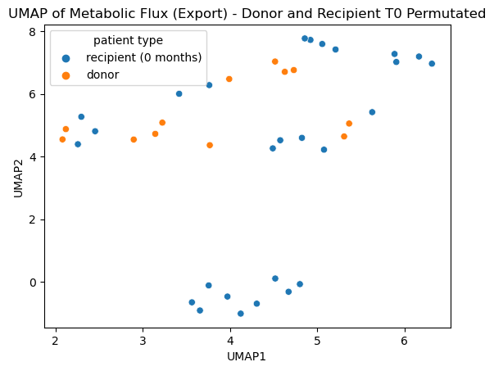
True Bray Curtis Distance Is Significantly Different From the Permuted Ones
True F-statistic
Both UMAP clustering of export metabolic flux and beta diversity shows tight cluster of donor before perturbation
Permutation with PERMANOVA strategy:
for each iteration (1- 999):
for each differentially abundant taxa:
df[taxa, donor] = random(df[taxa, recipient])
store(permanova(df, [donor, recipient]))
True F-statistic: permanova(orig_df, [donor, recipient])
p = (num permuted F-statistics > true F-statistic) / 1000

