Slide 1
Ranking models
AdaRank boosting algorithm for information retrieval
Authors:
Urtzi Sotes Senosiain
Imanol Solano Martinez

Slide 2
Summary
Introduction
AdaRank model
Analysis of the dataset
Training process
Building the dataset
Normalize and invert the rankings
Train the processed dataset
Training experiments
Conclusions

Slide 3
AdaRank model
Based on adaboost classification algorithm.
Boosting algorithm for information retrieval.
Model constructed with:
Linear combination of weak rankers.
Learning process:
Construct a ranking function (meter lo de f: X -> R).
Minimize the loss function.
Obtain best weights distribution over the queries in the training data.
Achieve best results ranking train data using best weights distribution.

Slide 4
Analysis of the dataset
All data obtained from Loinc dataset
Three different queries:
Glucose in blood.
Bilirubin in plasma.
White blood cells count.
Loinc number → Identification number.
Input features:
Long common name → Long name best represents the document.
Component → Primary part of the LOINC name.
System → Quantity being measured in the test
Property → Unit of analysis the observation was made.
Each query can be represented as an array of 67 rows x 5 columns.

Slide 5
Building the dataset
Objective: Build a model that ranks documents as optimally as possible.
Actually the features as strings → Convert them into numeric values (rankings).
How?
Apply TF-IDF model.
Based on the ranking given by TF-IDF, consider the synonyms and rank them manually.
We will get a ranking of the document based on the feature:
Long common name → Rankings from 1 to 64.
Component → Rankings from 1 to 15.
System → Rankings from 1 to 14.
Property → Rankings from 1 to 15.
Add two new columns:
qid: ID of the query (1: Glucose in blood; 2: Bilirubin in plasma; 3: White blood cells count).
label_ranking: Real output. Final rank of the documents.
Most important feature: long common name.

Slide 6
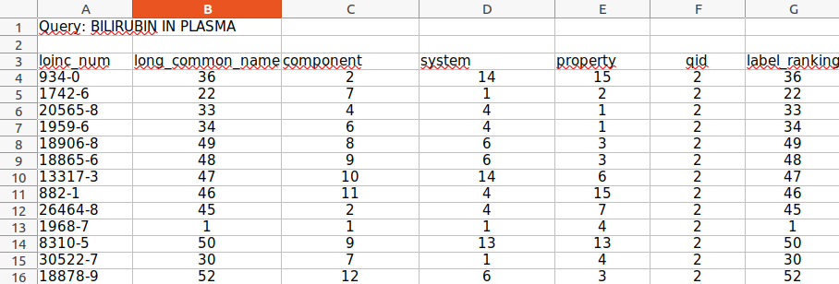

Slide 7

Normalize and Invert the Rankings
Model philosophy: The higher the value is in any of the features or in the actual output, more relevant the document will be.
Problem: In the dataset this happens in the opposite way, the lower the value is, more relevant the document will be.
Solution: Invert the values and normalize them into [0, 1] interval:
Apply the function:

Slide 8
Train the processed dataset
Input data normalized and inverted.
X = input features, y = ground truth, qid = query id.
Three different subsets from the initial dataset.
Training set for learning features.
Validation set for evaluating best weights.
Test set for testing the model for new data (not trained data).
Three different learning experiments:
Based on the division of the dataset.

Slide 9

Training Experiment 1
Divide separately depending on each query id.
Training set = validation set = 80% of the total samples.
Test set = 20% of the total samples.
Accuracy scores:
Training set = 82.65%
Test set = 64.04%

Slide 10

Training Experiment 2
Train set = 80 % of the total samples.
Test set = 20% of the total samples.
Validation set = 20 % of the training set samples.
New training set = 80 % of the old training set samples.
Accuracy scores:
Training set = 82.65%
Test set = 64.24%

Slide 11
Training Experiment 3
Train set = Validation set = Test set = Whole dataset.
Accuracy scores:
77.76%

Slide 12
Conclusions
Essential to normalize and convert values.
Best accuracy score on the Experiment 2.
Low accuracy.
Improve training process:
Use different representations to convert features into numeric values.
Get a bigger, wider and a more varied dataset.
Try different normalization functions.

