Slide 1
Analysis and Modeling of Inmate Recidivism Forecasting
Dr. Eddy Zhang
AIT580-001 (Summer 2021)
Team 9
July 2021
Ryan Vavra
Kevin Uruena
Lucien Wobembong

Slide 2
Introduction
Problem
Objective
Related Work
Recidivism “refers to a person's relapse into criminal behavior.”
There’s a high rate of recidivism among released prisoners. From those released in 2005 (401,288), there was an average of 5 arrests per prisoner (1,994,000) within a 9 year period
Forty-four percent of those released in 2005 were arrested during the first year following release
Team 9 wants to create a model that will help justice departments determine the likelihood of an inmate recidivating within 3 years
Bureau of Justice Statistics: 2018 Update on Prisoner Recidivism: A 9-Year Follow-up Period (2005-2014)
Michael D Maltz: Recidivism

Slide 3
Data Quality Assessment
Selected Dataset: The datasets were provided as part of a competition by the Office of Justice Programs. We selected this dataset based on three factors: it seemed like an interesting topic and liked the challenge, since the datasets were already cleaned and tailored, we did not have do as much cleaning and lastly, the potential prize we could win from the competition
Pre-Processing
Completeness
We decided not to trim any attributes because doing so reduced the accuracy. Furthermore, due to not having enough data, a high level of accuracy was hard to achieve
Unique
The Office of Justice Programs collects data on thousands of attributes. Our dataset contains unique attributes and values
Examined fields provided and select those that are germane to our analysis
Perform an initial cleansing of the data, replacing blanks and NULL values
Accuracy
Since the datasets were collected and made available by government agencies, we can expect a high level of accuracy
Conformity
The OJP is a combination of six different programs, each working together to ensure data accuracy
Encoded categorical fields in preparation for modeling
Analyzed with all attributes, separating between a model for binary classification, and a more specific one for multiple classification

Slide 4


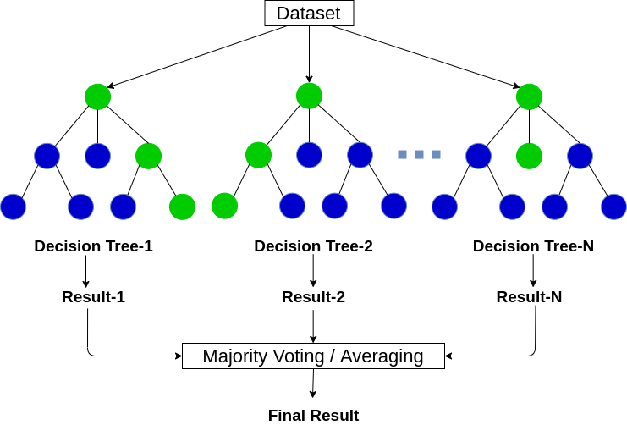
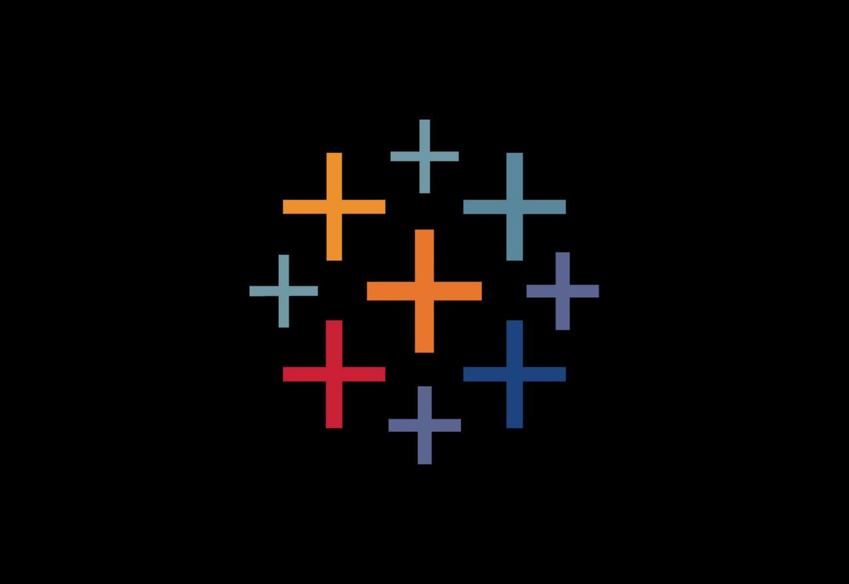

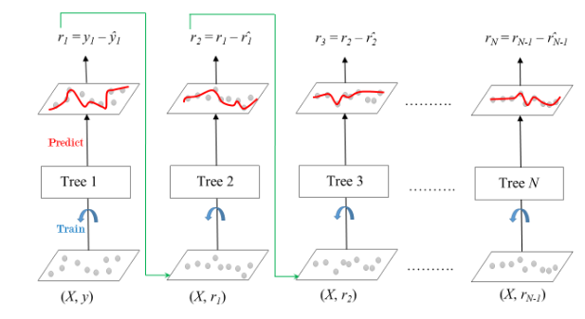
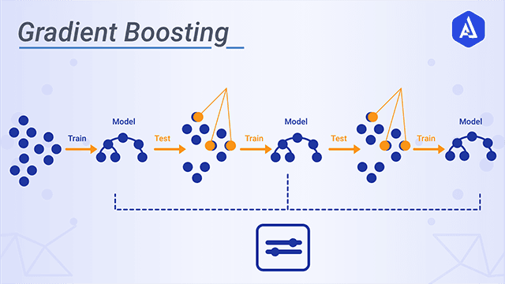

Algorithm
Architecture and Development platforms
Random Forest
Gradient Boosting

Slide 5
Data Distribution and Visualization

Slide 6
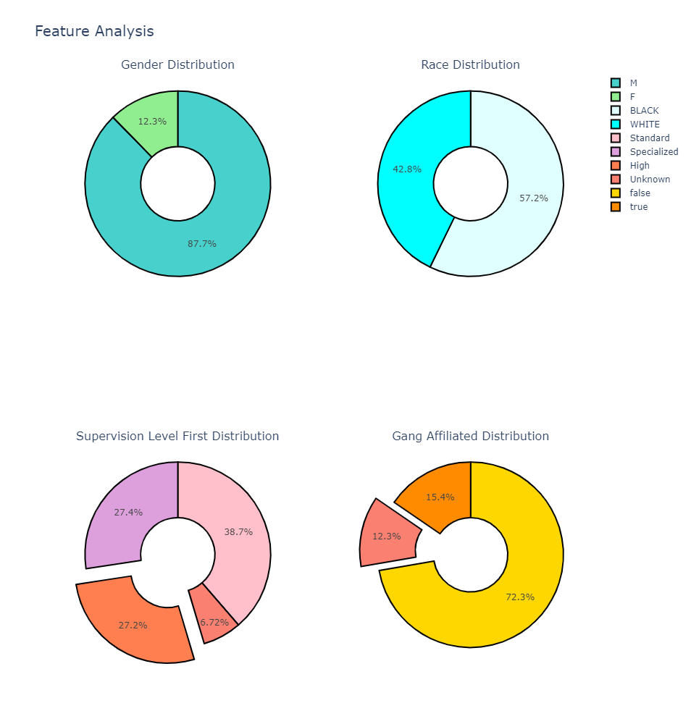
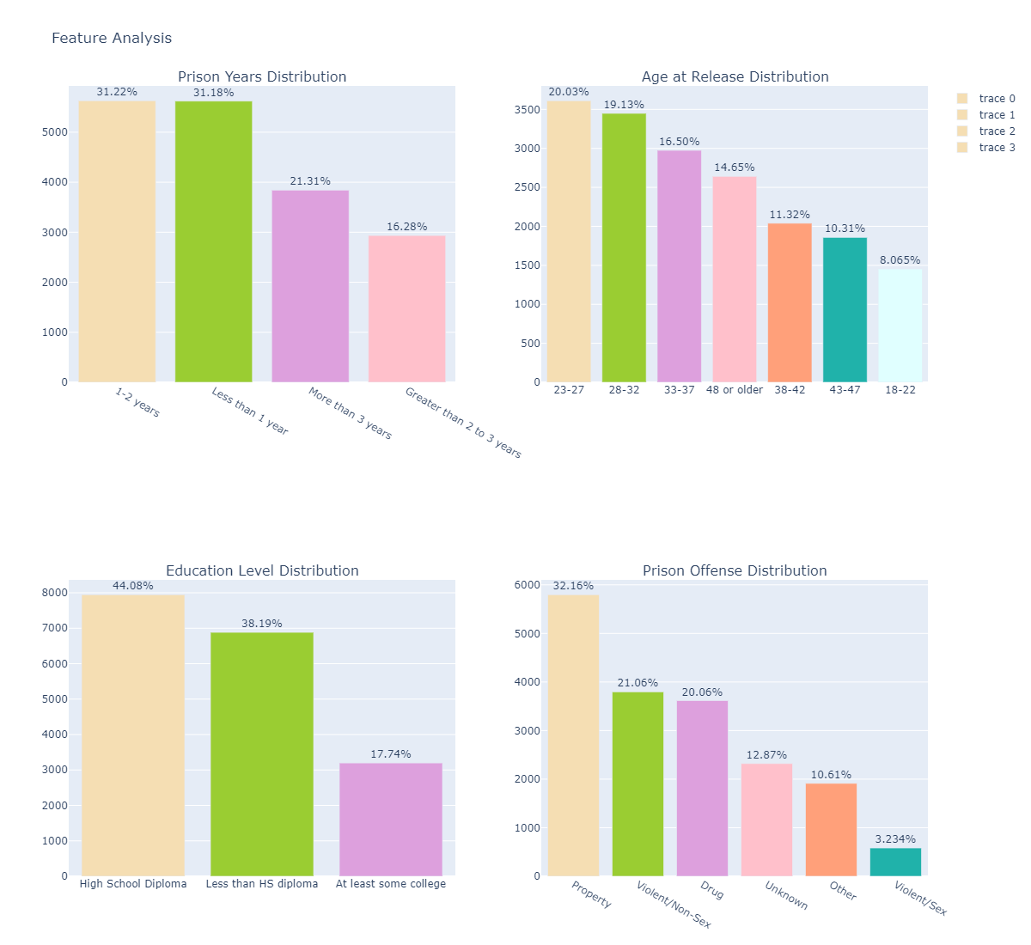
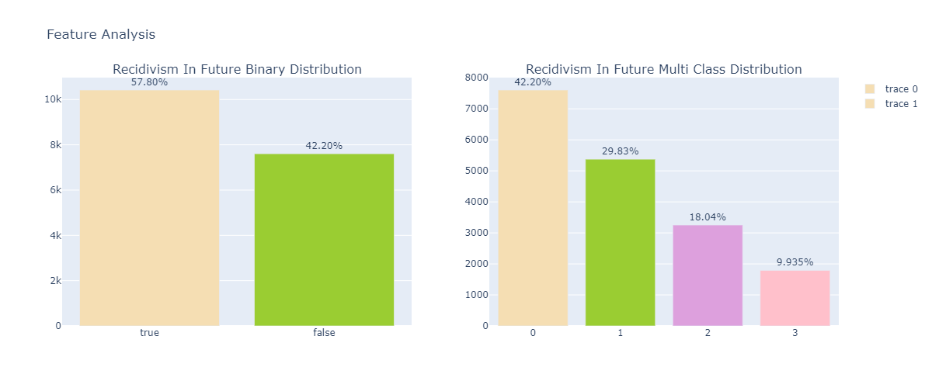
Distribution of Independent Variables

Slide 7
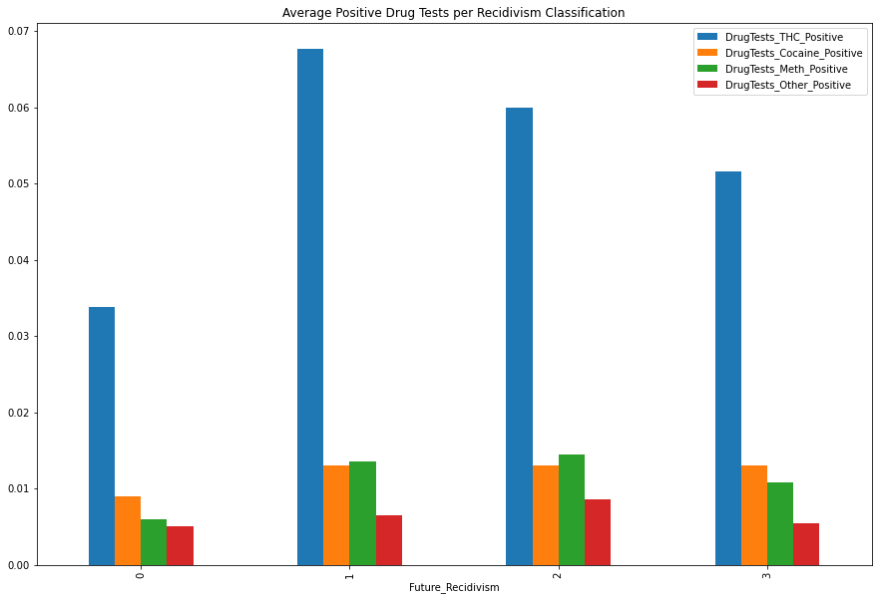
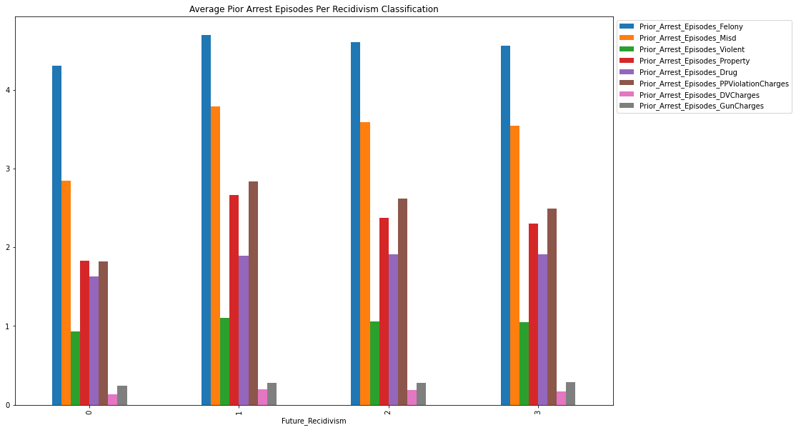
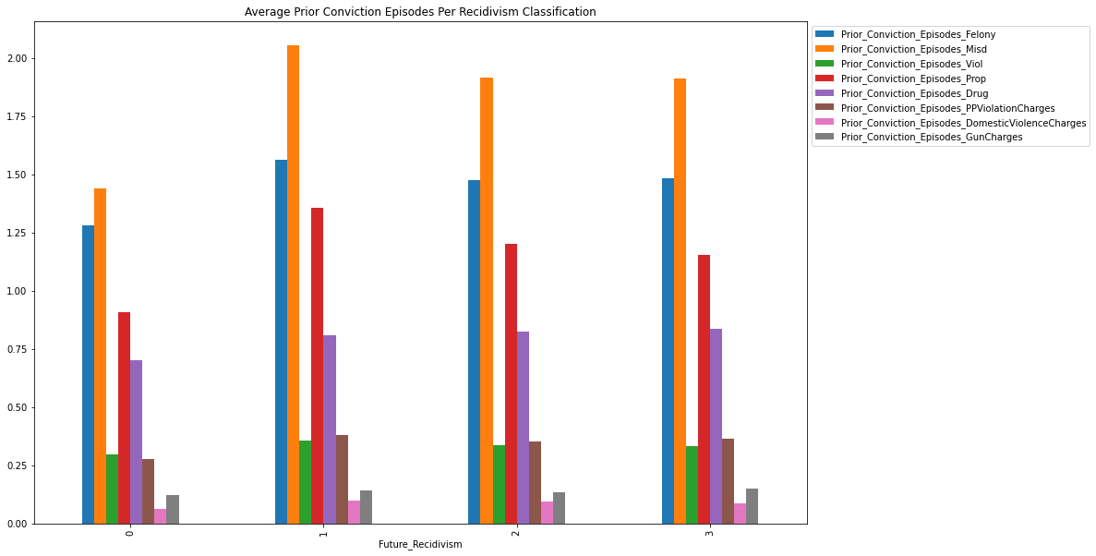
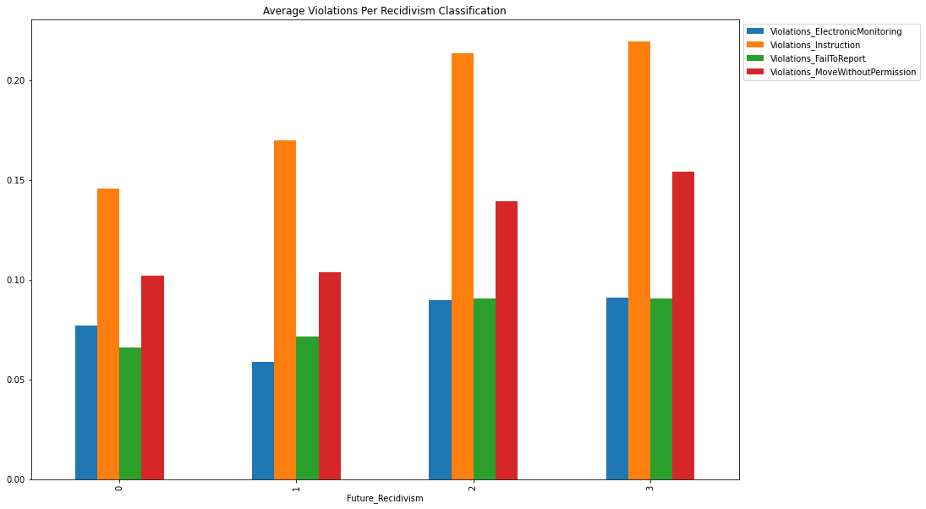
Average of Similar Predictor Variables Grouped By Year Of Recidivism
0 = No Recidivism
1 = Recidivism Year 1
2 = Recidivism Year 2
3 = Recidivism Year 3

Slide 8
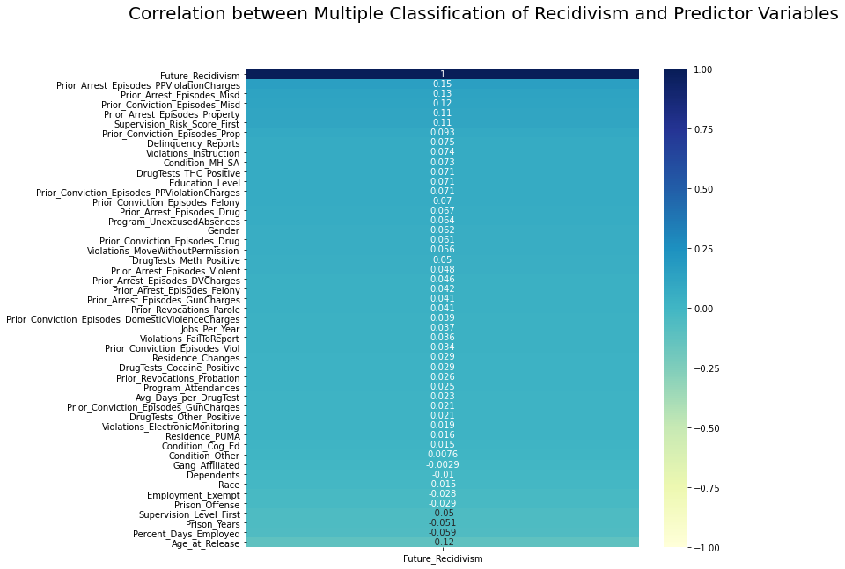
Feature Correlation

Slide 9
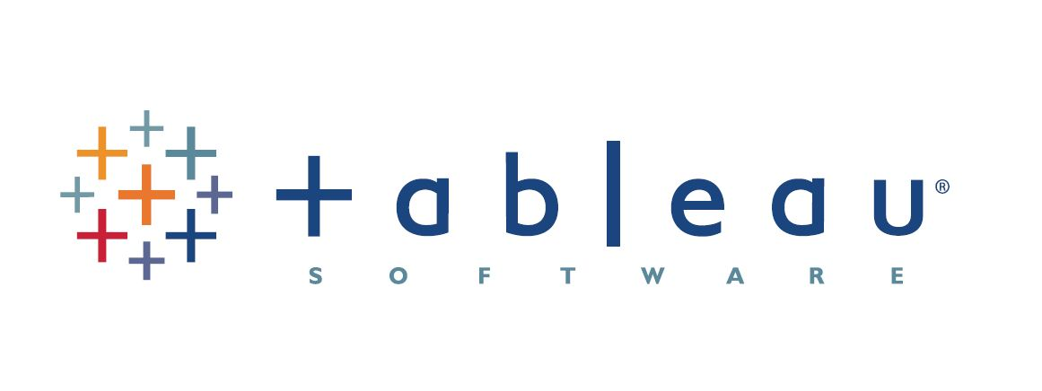
Interactive Visualization

Slide 10
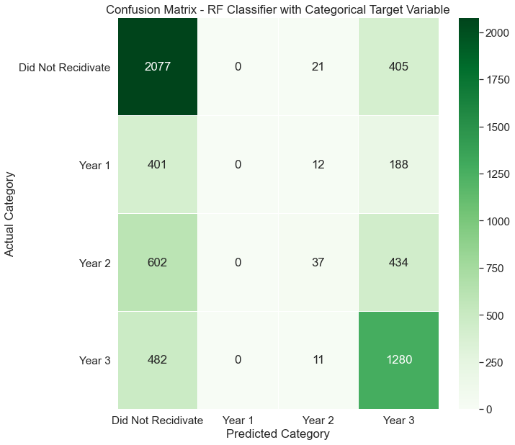
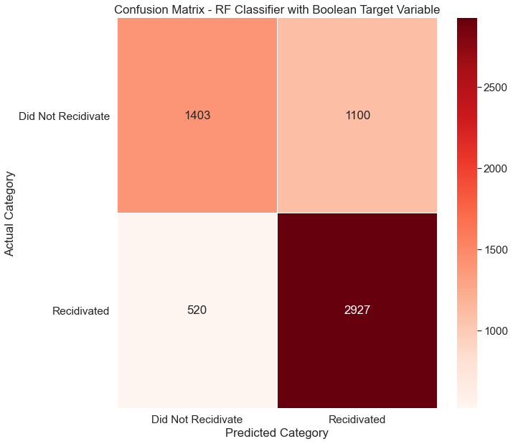
Random Forest - Classifier
Algorithms
Multi Classification
Binary Classification

Slide 11
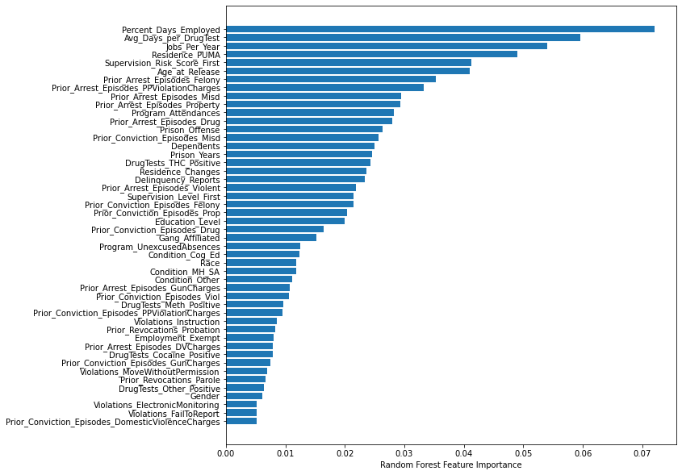
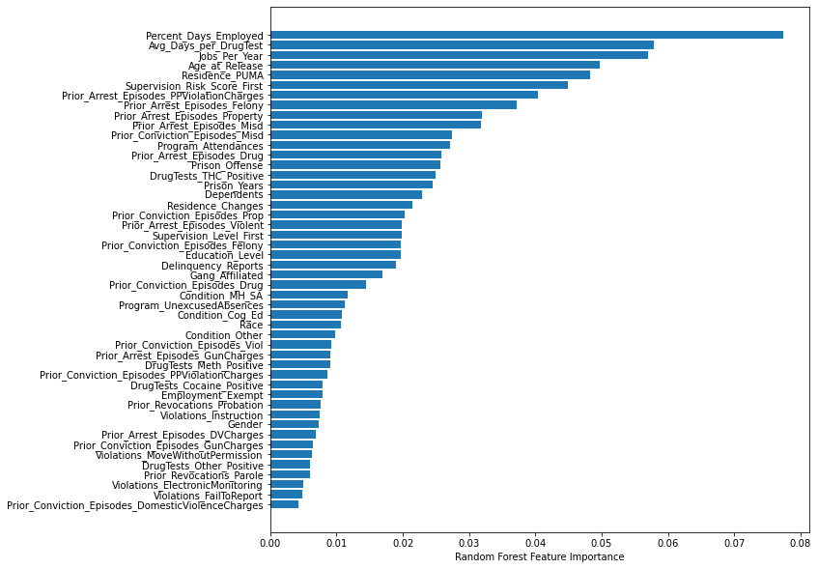
Gradient Boosting - Classifier
Multi Classification
Binary Classification

Slide 12
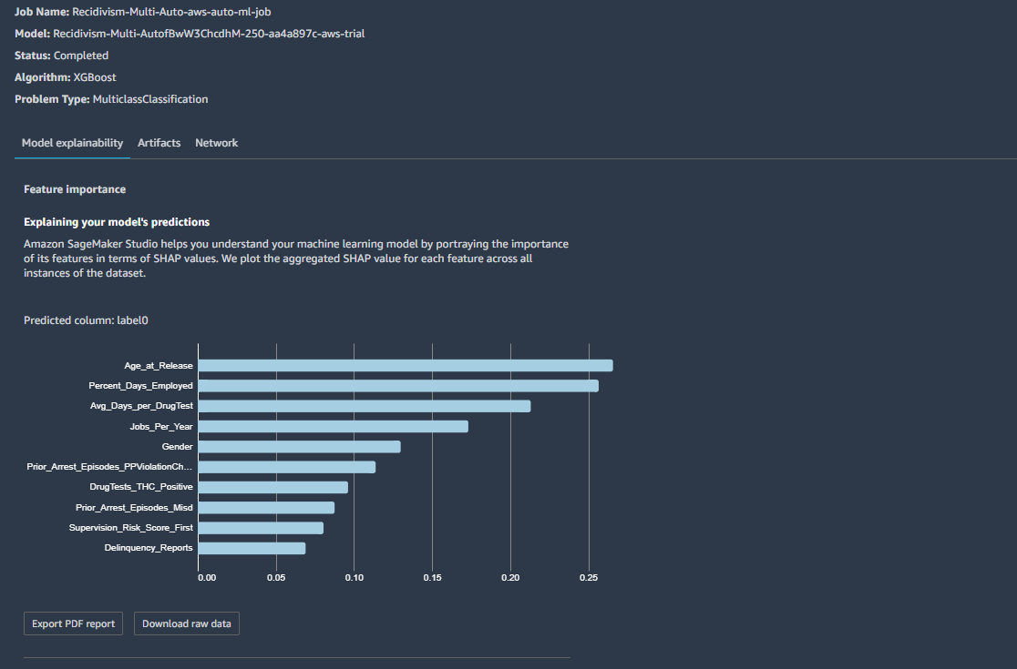
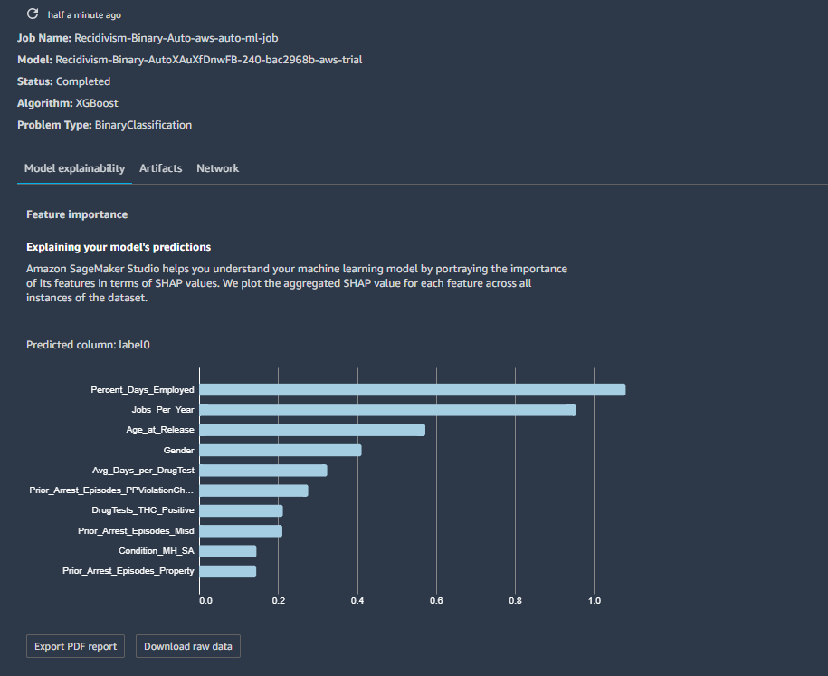
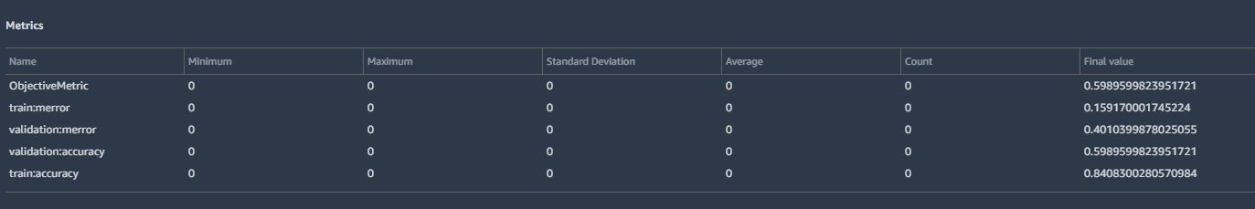
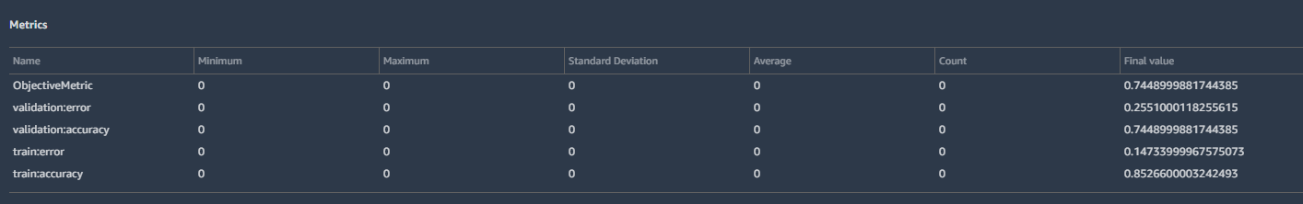
XGB Classifier – Validation With AWS SageMaker
Multi Classification
Binary Classification

Slide 13
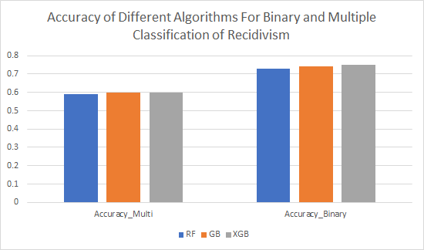
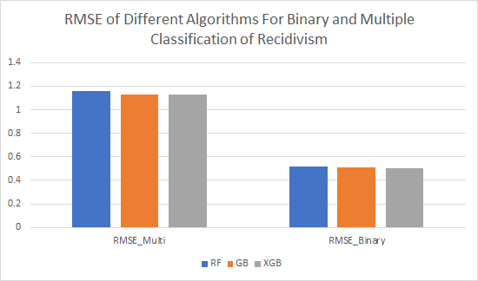
Performance Results

Slide 14
Conclusions
Difficult to predict whether an inmate will recidivate and when (human behavior, 75% vs 60%)
Jobs_Per_Year, Avg_Days_per_DrugTest, and Percent_Days_Employed are top features across models, suggesting possible items to focus on
Data seems to be from a population of inmates who committed minor violations
Ethical component (how to use results of model in real life, policing vs rehab programs)
Lessons Learned
There was very little correlation between the attributes, which could explain the low percentage in accuracy
Different methods to handle null and categorical values should be implemented accordingly to the type of problem (zero vs mean)
Further Work
More data will be needed for higher model accuracy (possible lurking variables, more uniform distribution for multiple classification problem (42% did not recidivate))
We would like more data about an inmates' time in prison
  e.g. Programs, education, etc.
We would want more data the inmates’ physical location
Try to figure out why the dataset contained so many null values
Extend to data from different states

Slide 15
References
https://nij.ojp.gov/topics/corrections/recidivism
https://nij.ojp.gov/topics/articles/measuring-recidivism#statistics
https://www.simplilearn.com/10-algorithms-machine-learning-engineers-need-to-know-article
https://www.geeksforgeeks.org/ml-one-hot-encoding-of-datasets-in-python/
https://data.ojp.usdoj.gov/stories/s/daxx-hznc
https://towardsdatascience.com/understanding-gradient-boosting-machines-9be756fe76ab
https://scikit-learn.org/stable/modules/generated/sklearn.ensemble.RandomForestClassifier.html
https://docs.aws.amazon.com/sagemaker/latest/dg/whatis.html

