Slide 1
A reversible image watermarking algorithm for tamper detection based on SIFT
Project by:
Paloju Aakash (22BCS179)
Archakam Sree Chaithanya (22BCS041)
Ashili Nishanth Kumar (22BCS046) Urugonda Vishnu (22BEC126)

Slide 2

Introduction to Digital Watermarking
What is Digital Watermarking?
Digital watermarking is the technique of embedding hidden data into a digital signal (like images) for copyright protection, authentication, and tamper detection.
About This Project
Our project focuses on reversible watermarking – enabling both tamper detection and original image recovery.
It utilizes SIFT (Scale-Invariant Feature Transform) for robust feature detection against attacks like scaling, rotation, and noise.
The watermark embeds authentication data derived from the image itself, enabling precise tamper localization.

Slide 3
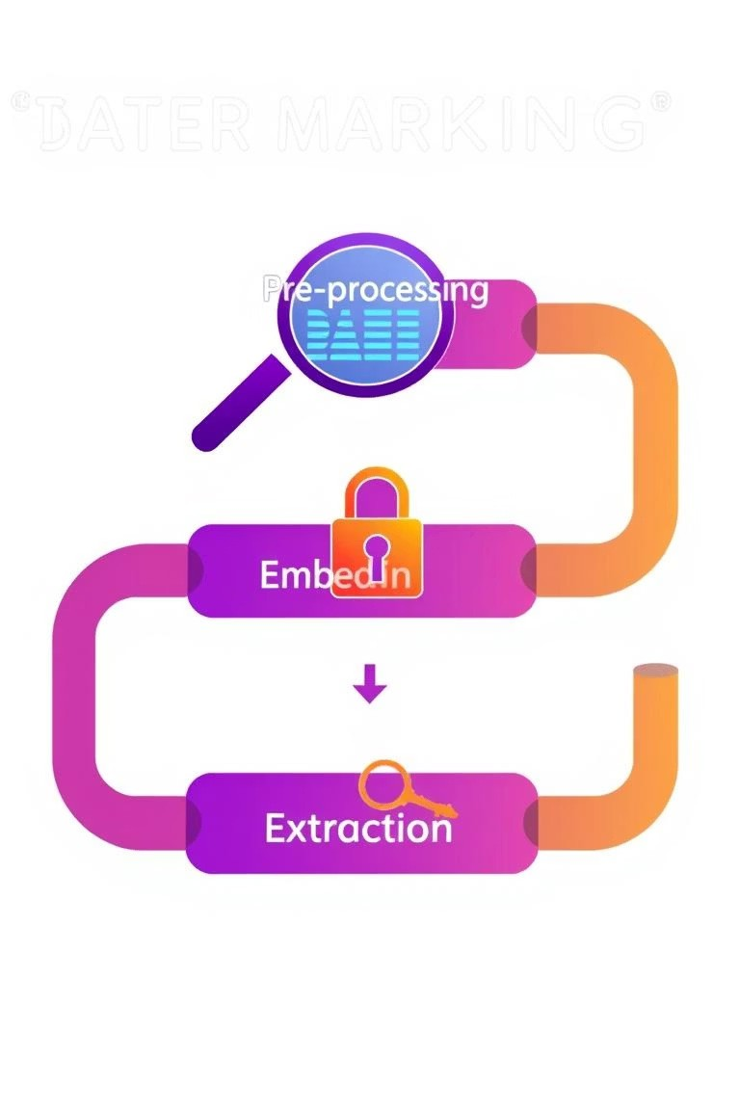
How the Project Works
Image is divided into blocks; each block's histogram data is used to generate a binary authentication watermark.
Feature points are extracted using SIFT and mapped to blocks using Logistic mapping to ensure security and spatial independence.
Reversible embedding is achieved using:
Wavelet Transform (DWT) for frequency decomposition
Singular Value Decomposition (SVD) for robust watermark embedding
The watermarked image is then subjected to tampering simulation and robustness attacks.
Extraction fi detection processes compare original vs extracted watermarks to locate tampered regions.

Slide 4
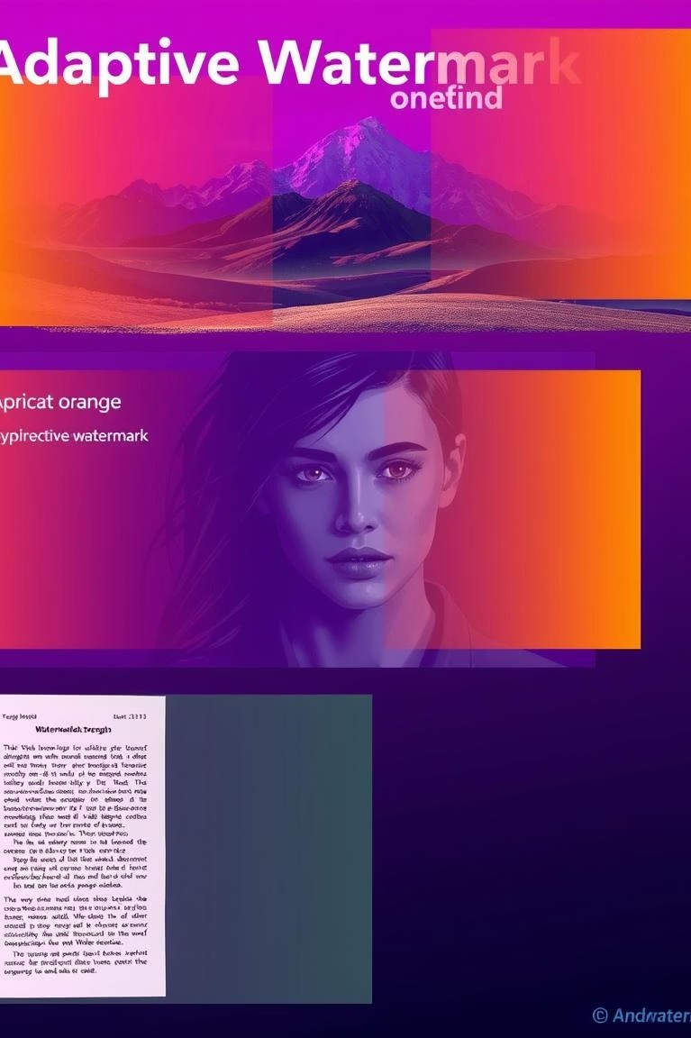
Modifications and Improvements
Implemented DWT-SVD-based reversible watermark embedding to enhance imperceptibility and robustness.
Introduced histogram-based binary watermark for simplicity and effective tamper detection.
Tamper simulation added using random block inversion.
Integrated multiple attack modes: Caussian blur, salt € pepper, JPEC compression, scaling, rotation, etc.
Achieved PSNR > 53 dB and SSIM > 0.98, showing high fidelity of the watermarked image.
Added heatmap-based tamper visualization and full image recovery via backed-up coefficients.

Slide 5
Project Results on Test Images
Values from Research Paper
Lena Image
PSNR: 55.36 dB
SSIM: 0.992
Caussian Blur: 0.966
Salt-Pepper: 0.969
JPEC20: 0.955
Baboon Image
PSNR: 53.89 dB
SSIM: 0.987
Caussian Blur: 0.959
Salt-Pepper: 0.963
JPEC20: 0.952
Plane Image
PSNR: 54.51 dB
SSIM: 0.991
Caussian Blur: 0.963
Salt-Pepper: 0.968
JPEC20: 0.955
Our Results
Lena Image
PSNR: 70.17 dB
SSIM: 1.00
Caussian Blur: 0.9991
Salt-Pepper: 0.9702
JPEC20: 0.9991
Baboon Image
PSNR: 61.72 dB
SSIM: 0.9999
Caussian Blur: 0.9909
Salt-Pepper: 0.9671
JPEC20: 0.9943
Plane Image
PSNR: 67.30 dB
SSIM: 1.00
Caussian Blur: 0.9991
Salt-Pepper: 0.9814
JPEC20: 0.9995

Slide 6
Conclusion
Our approach successfully integrates SIFT feature localization with reversible watermarking to detect and localize tampering.
Enhancements through wavelet transforms and SVD boost robustness, while histogram-based watermarking ensures simplicity.
High imperceptibility and reversible watermarking were achieved.
The project demonstrates high visual quality, accurate tamper detection, and complete image recovery 4 making it suitable for security-sensitive applications like medical or legal imaging.

