Slide 1



HTML CSS Bootcamp
By Urvshi Singla

Slide 2
Today’s Agenda
Styling and Layout with CSS
Introduction to CSS
Adding Style to Your Webpage

Slide 3
What is CSS?
CSS stands for Cascading Stylesheet.
CSS was introduced by Håkon Wium in 1994.
CSS is all about the presentation or style of the page.
It adds Styling, beauty to your Website.
Think of it as a "theme" in a word processing document, setting fonts, sizes, indentations.

Slide 4
WAYS TO ADD CSS?
Inline CSS
External CSS
Internal CSS
All the styles in a page will "cascade" into a new "virtual" style sheet by the following rules, where number one has the highest priority:
Inline style (inside an HTML element)
External and internal style sheets (in the head section)
Browser default
So, an inline style has the highest priority, and will override external and internal styles and browser defaults.

Slide 5
IMPORTANCE OF CSS?
https://stackoverflow.com/
http://www.csszengarden.com/
https://chrome.google.com/webstore/detail/web-developer/bfbameneiokkgbdmiekhjnmfkcnldhhm

Slide 6
Syntax
A CSS rule consists of a selector and a declaration block.
Syntax: selector { Declaration }
Property Value
h1 {color: black; font-size: 20px }

Slide 7
Selector
A CSS selector selects the HTML element(s) you want to style.
Ways to select
CSS Element Sector:- h1 {}
CSS id Selector:- # {}
CSS class Selector:- .{}
CSS Universal Selector:- *
CSS Grouping Selector:- h1, p {}

Slide 8
Colors
Colors are specified using predefined color names, or RGB, HEX, HSL, RGBA, HSLA values.
e.g. Backgound color, color, border color
Ways to define color values:
Color name
rgb(255, 99, 71)
#ff6347
hsl(9, 100%, 64%)
https://colorhunt.co/

Slide 9
Height/Width
The height and width properties are used to set the height and width of an element.
The height and width properties do not include padding, borders, or margins. It sets
the height/width of the area inside the padding, border, and margin of the element.

Slide 10
Borders
The CSS border properties allow you to specify the style, width, and color of an element's border.
border-color
border-style
border-width
border shorthand
border radius

Slide 11
Margin
Margins are used to create space around elements, outside of any defined borders.
margin-top
margin-right
margin-bottom
margin-left

Slide 12
Padding
Padding is used to create space around an element's content, inside of any defined borders.
padding-top
padding-right
padding-bottom
padding-left

Slide 13
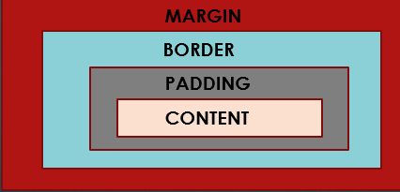
Box Model
In CSS, the term "box model" is used when talking about design and layout.
The CSS box model is essentially a box that wraps around every HTML element.
It consists of: margins, borders, padding, and the content.

Slide 14
Text
CSS has a lot of properties for formatting text.
color
text-alignment
vertical-alignment
text-decoration
text-transform
text-identation

Slide 15
Font
Choosing the right font has a huge impact on how the readers experience a website.
The right font can create a strong identity for your brand.
Using a font that is easy to read is important. The font adds value to your text. It is also important to choose the correct color and text size for the font.
Font-family
Font style
Font-weight

Slide 16
Specificity
If there are two or more conflicting CSS rules that point to the same element, the browser follows some rules to determine which one is most specific and therefore wins out.
Think of specificity as a score/rank that determines which style declarations are ultimately applied to an element.
The universal selector (*) has low specificity, while ID selectors are highly specific!
Order of specificity
Inline styles
IDs
Classes, attributes and pseudo-classes
Elements and pseudo-elements

Slide 17
Background
The CSS background properties are used to add background effects for elements.
Properties to Style Background:
background-color
background-image
background-repeat
background-attachment
background-position
background (shorthand property)

Slide 18
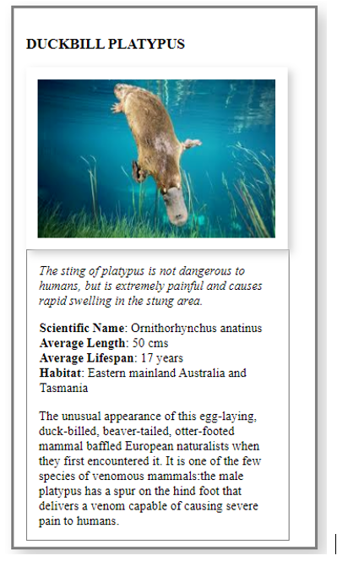
Task
Replicate below image

Slide 19

Q & A

Slide 20
Thank You

