Slide 1
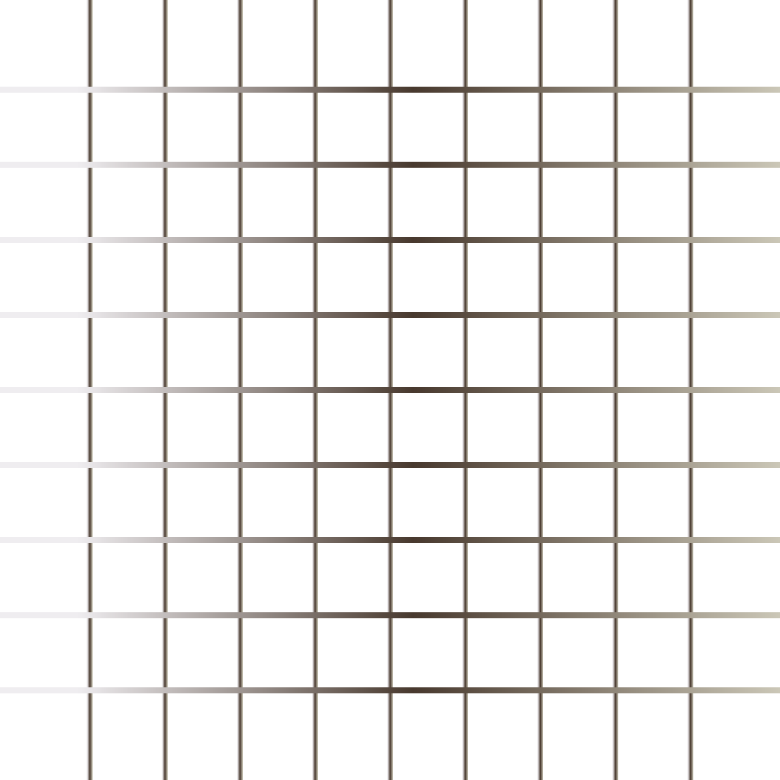


HTML CSS Bootcamp
By Urvshi Singla

Slide 2
Today’s Agenda
Getting Started with HTML & CSS
Setting Up the Environment
Basic HTML Structure

Slide 3

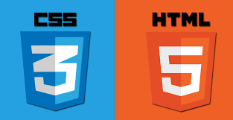

What is Web/Front Development?
Front-end web development, also known as client-side development is the practice of producing HTML, CSS and JavaScript for a website or Web Application so that a user can see and interact with them directly. Front end development manages everything that users visually see first in their browser or application. Front end developers are responsible for the look and feel, ultimately design of a website.

Slide 4
WHAT IS HTML?
HTML stands for Hyper text Markup Language.
It is used to define structure of Web Pages.
With HTML, you can create your own website.
It is a Tag based language.
e.g. <h1>add some title course</h1>

Slide 5
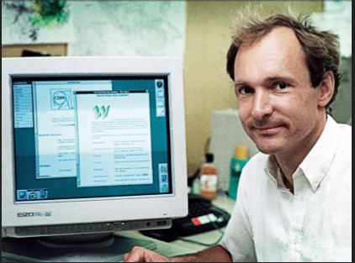
HISTORY
HTML was introduced by Sir Tim Berners-Lee.
This first web page was created by Sir Tim Berners-Lee.
First web page went live in the year 1991.

Slide 6
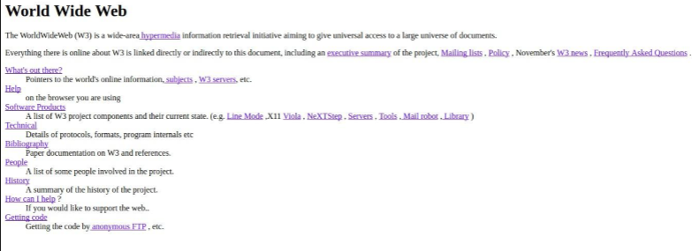
THE FIRST WEB PAGE

Slide 7
HTML Basics
Structure of HTML Document
Basic Elements: Heading, Paragraph, Image.
Create First HTML Webpage.
How to View HTML Source.

Slide 8
Head
HTML metadata is data about the HTML document. Metadata is not displayed. Metadata typically define the document title, character set, styles, script.
metaData: The html element is a container for the following elements: title, style, meta, link, script. title: Defines a title in the browser toolbar provides a title for the page when it is added to favorites displays a title for the page in search engine-results
style: The <style> element is used to define style information for a single HTML page
link: tag defines the relationship between the current document and an external resource.

Slide 9
HTML Charset
To display an HTML page correctly, a web browser must know which character set to use.
UTF-8 is identical to ASCII for the values from 0 to 127.
UTF-8 does not use the values from 128 to 159.
UTF-8 is identical to both ANSI and 8859-1 for the values from 160 to 255.
UTF-8 continues from the value 256 with more than 10 000 different characters.

Slide 10
HTML5 - Basic Elements
Tag: Types of tags: paired, unpaired/empty, self-closing tag, utility tag.
Elements & Attributes
Heading: HTML headings are titles or subtitles that you want to display on a webpage.
Paragraph: A paragraph always starts on a new line, and is usually a block of text.

Slide 11
Semantic & Non-Semantic
Semantic elements describe the meaning of the element and content. e.g.
<header>: Introductory content e.g. set of navigation links
<footer>: Define the footer section containing copyright, social media links, sitemap, etc.
<section>: Defines a section of a document.
<nav>: It define the navigation links.
Non-Semantic elements define nothing about the content. e.g.
div: tag is used to define division/section in an HTML document. It is used as a container for HTML elements. Any sort of content can be added in the div tag.
span: tag is an inline container to mark up a part of the text of document.

Slide 12
Links
HTML links are hyperlinks. You can click on a link and jump to another document.
When you move the mouse over a link, the mouse arrow will turn into a little hand. Links are found in nearly all web pages. Links allow users to click their way from page to page
Links are appear as follows in browser:
An unvisited link is underlined and blue
A visited link is underlined and purple
An active link is underlined and red

Slide 13
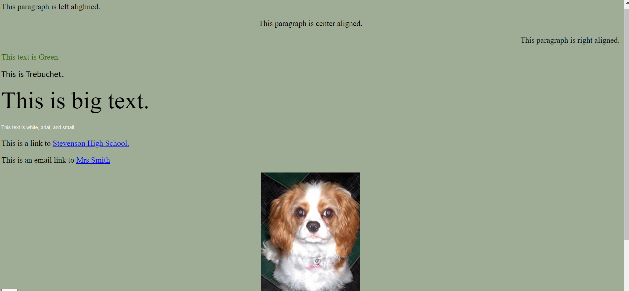
Task
Replicate below image

Slide 14

Q & A

Slide 15
Thank You

