Slide 1
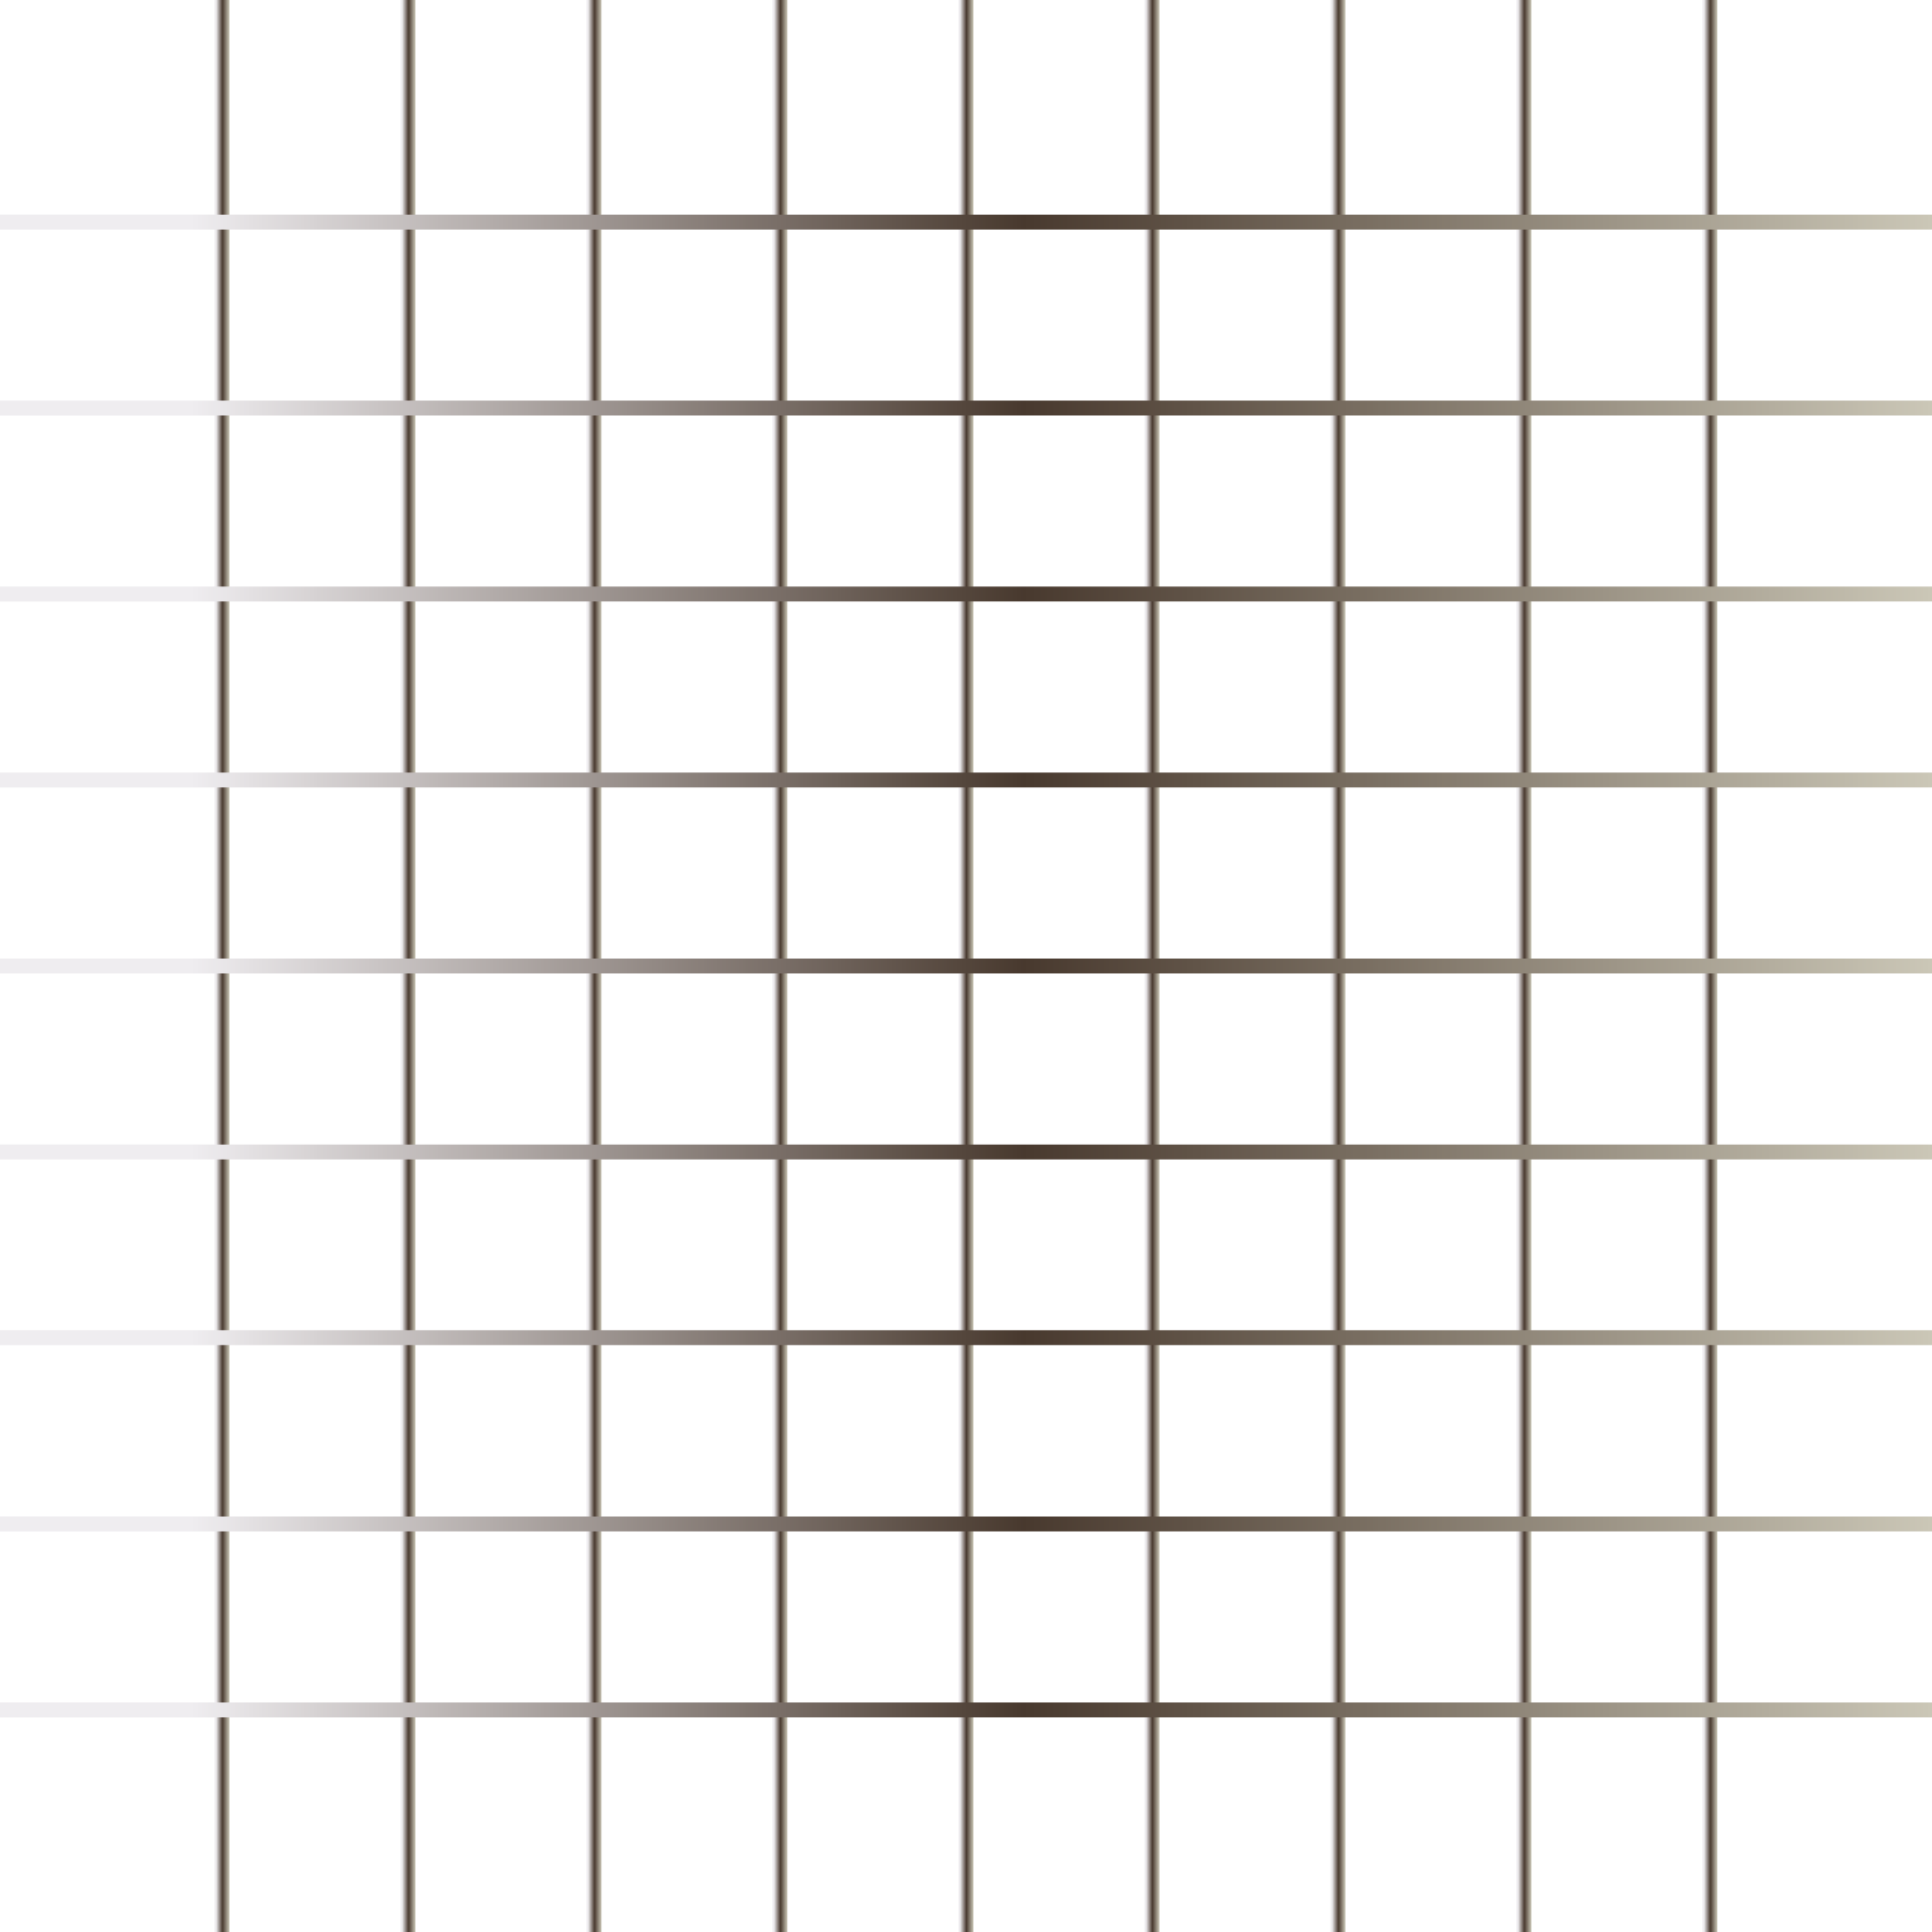


HTML CSS Bootcamp
By Urvshi Singla

Slide 2
Today’s Agenda
Advanced CSS Technique
Responsive Web Design
Project: Mini Portfolio Website

Slide 3
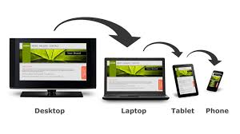
Responsive Design
What is responsive website?
Viewport
How to use media query
How to make images responsive

Slide 4
What is responsive website?
Responsive web design makes your web page look good on all devices.
Responsive web design uses only HTML and CSS.
Responsive web design is not a program or a JavaScript.
Viewport
The viewport is the user's visible area of a web page.
The viewport varies with the device, and than on a computer screen. will be smaller on a mobile phone
Before tablets and mobile phones, web pages were designed only for computer screens, and it was common for web pages to have a static design and a fixed size.

Slide 5
Transitions
CSS transitions allows you to change property values smoothly, over a given duration.
transition
transition-delay
transition-duration
transition-property
transition-timing-function

Slide 6
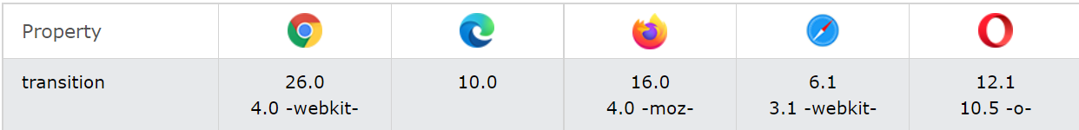
Browser Support

Slide 7
Task
See PDF

Slide 8
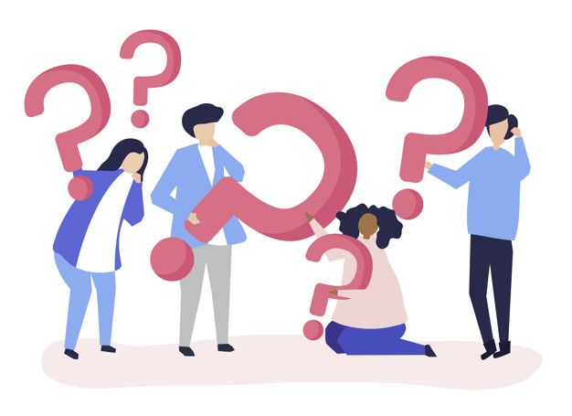
Q & A

Slide 9
Thank You

