Slide 1

Welcome to
New age upskilling platform for high growth careers
By Urvshi Singla

Slide 2
Session Agenda
Link
Lists
Tables
Form Elememts

Slide 3
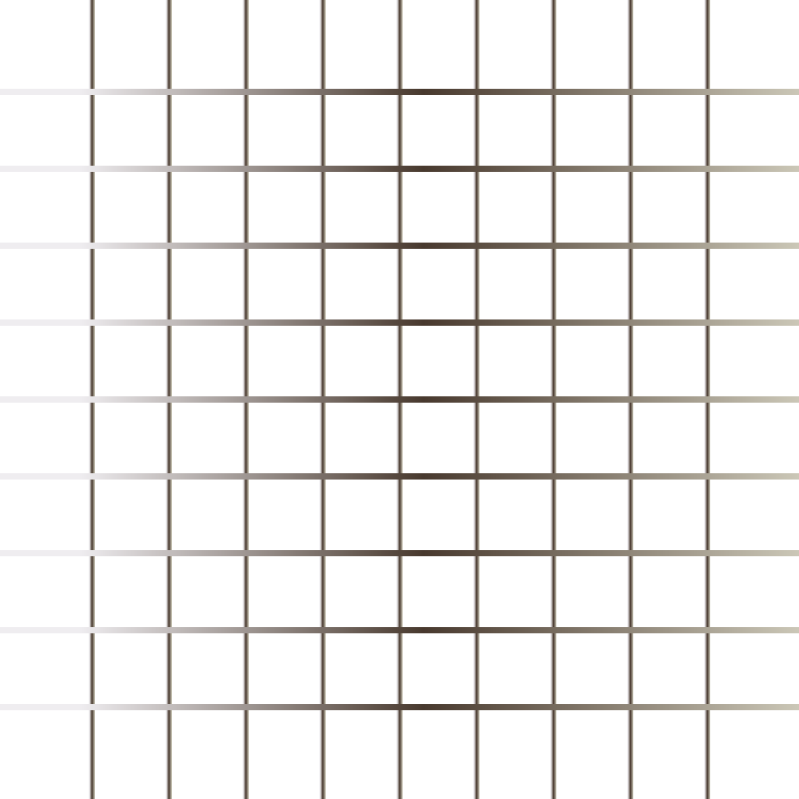
Links
HTML links are hyperlinks. You can click on a link and jump to another document.
When you move the mouse over a link, the mouse arrow will turn into a little hand. Links are found in nearly all web pages. Links allow users to click their way from page to page
Links are appear as follows in browser:
An unvisited link is underlined and blue
A visited link is underlined and purple
An active link is underlined and red

Slide 4
Lists, block & Inline
Lists
We group related data into list on web browser.
There are three types of list:
Unordered List
Ordered List
Description List
Block & Inline Elements
https://file-examples.com/index.php/sample-audio-files/

Slide 5
Tables
HTML tables allow us to organize data into rows and columns.
tr: define each row
td: define each table cell/ they are data containers
th: define the table header
caption: Use the HTML <caption> element to define a table caption

Slide 6
Forms
Forms is used to collect user input.
Form Elements: label input, select, option, textarea, button, fieldset, legend.
Form Attributes: method, target, action

Slide 7
Q & A

Slide 8
Thank You

