Slide 1

Welcome to
New age upskilling platform for high growth careers
By Urvshi Singla

Slide 2
Session Agenda
Form Elememts
Iframe

Slide 3
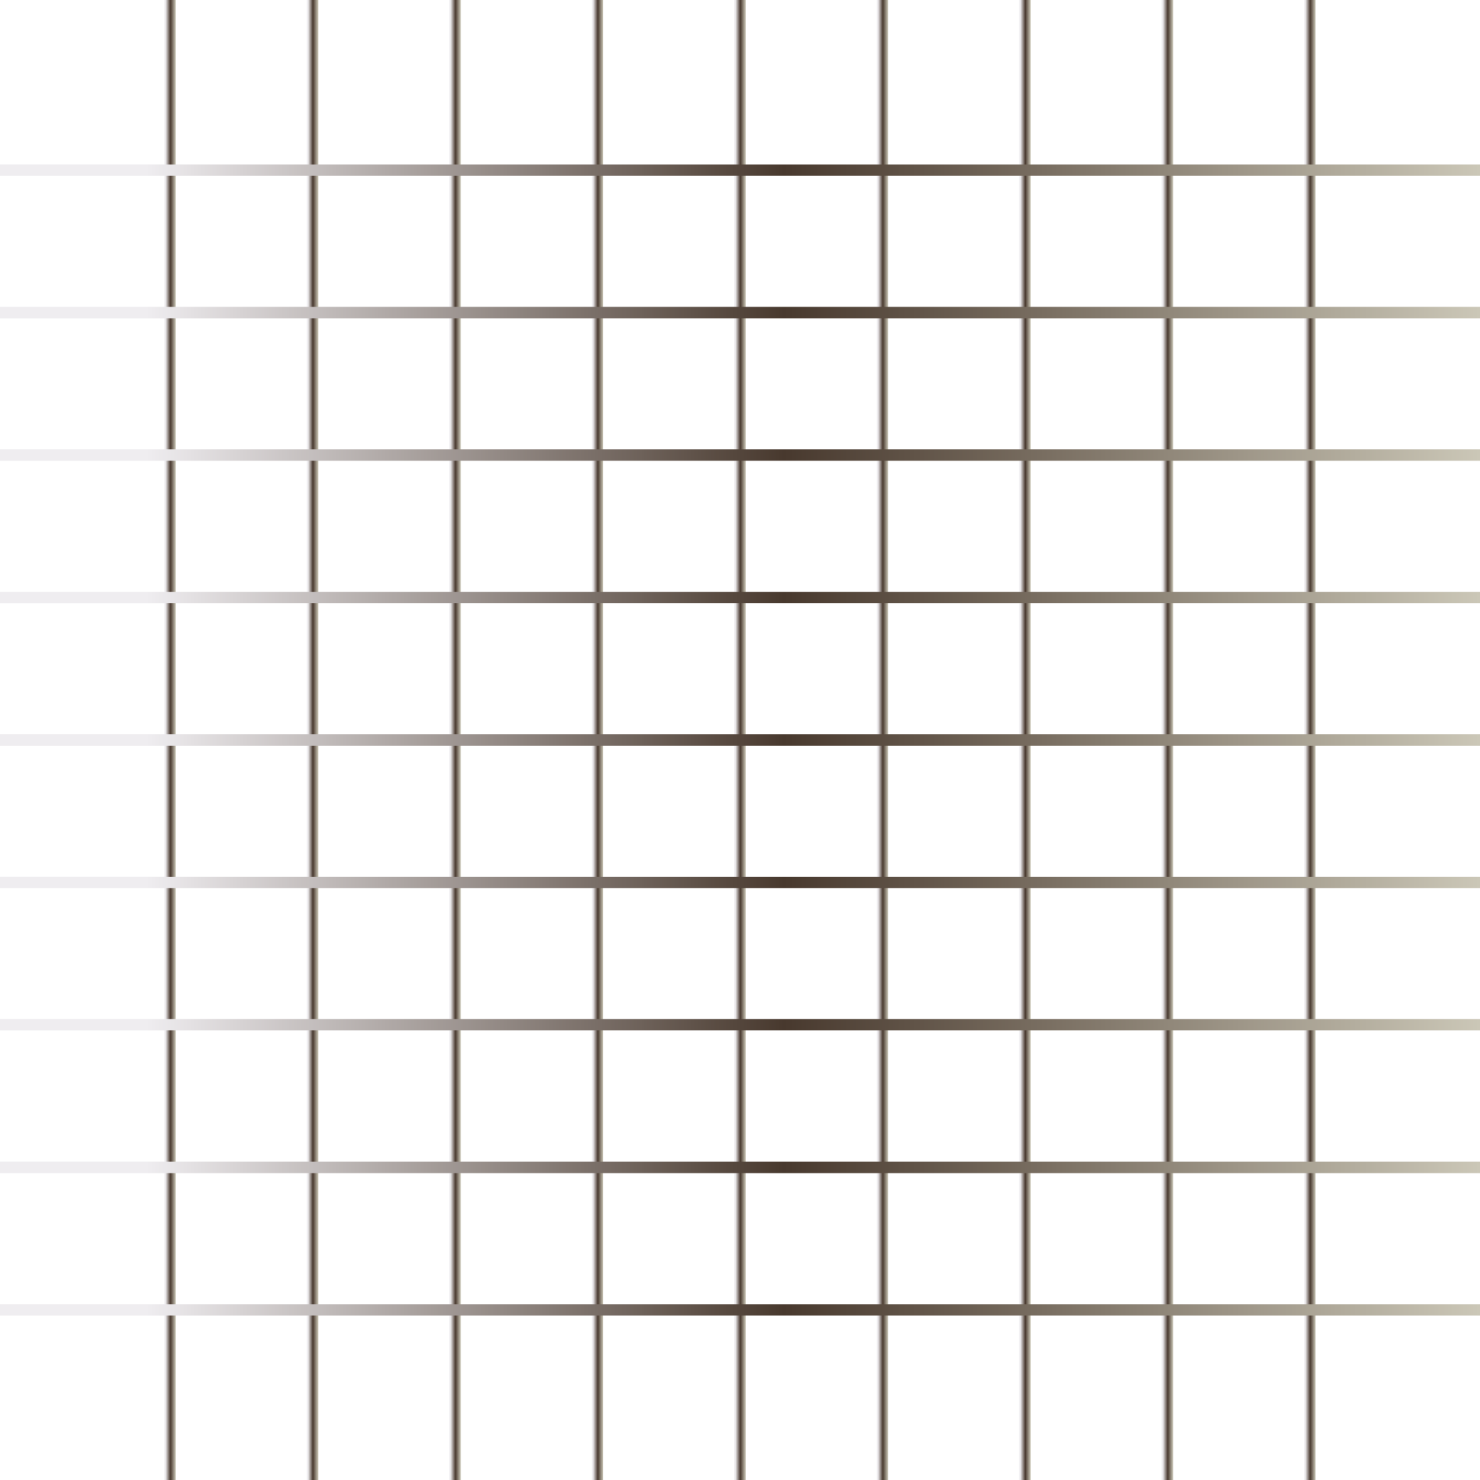
Forms
Forms is used to collect user input.
Form Elements: label input, select, option, textarea, button, fieldset, legend.
Form Attributes: method, target, action
Iframe

Slide 4
Q & A

Slide 5
Thank You

