Slide 1
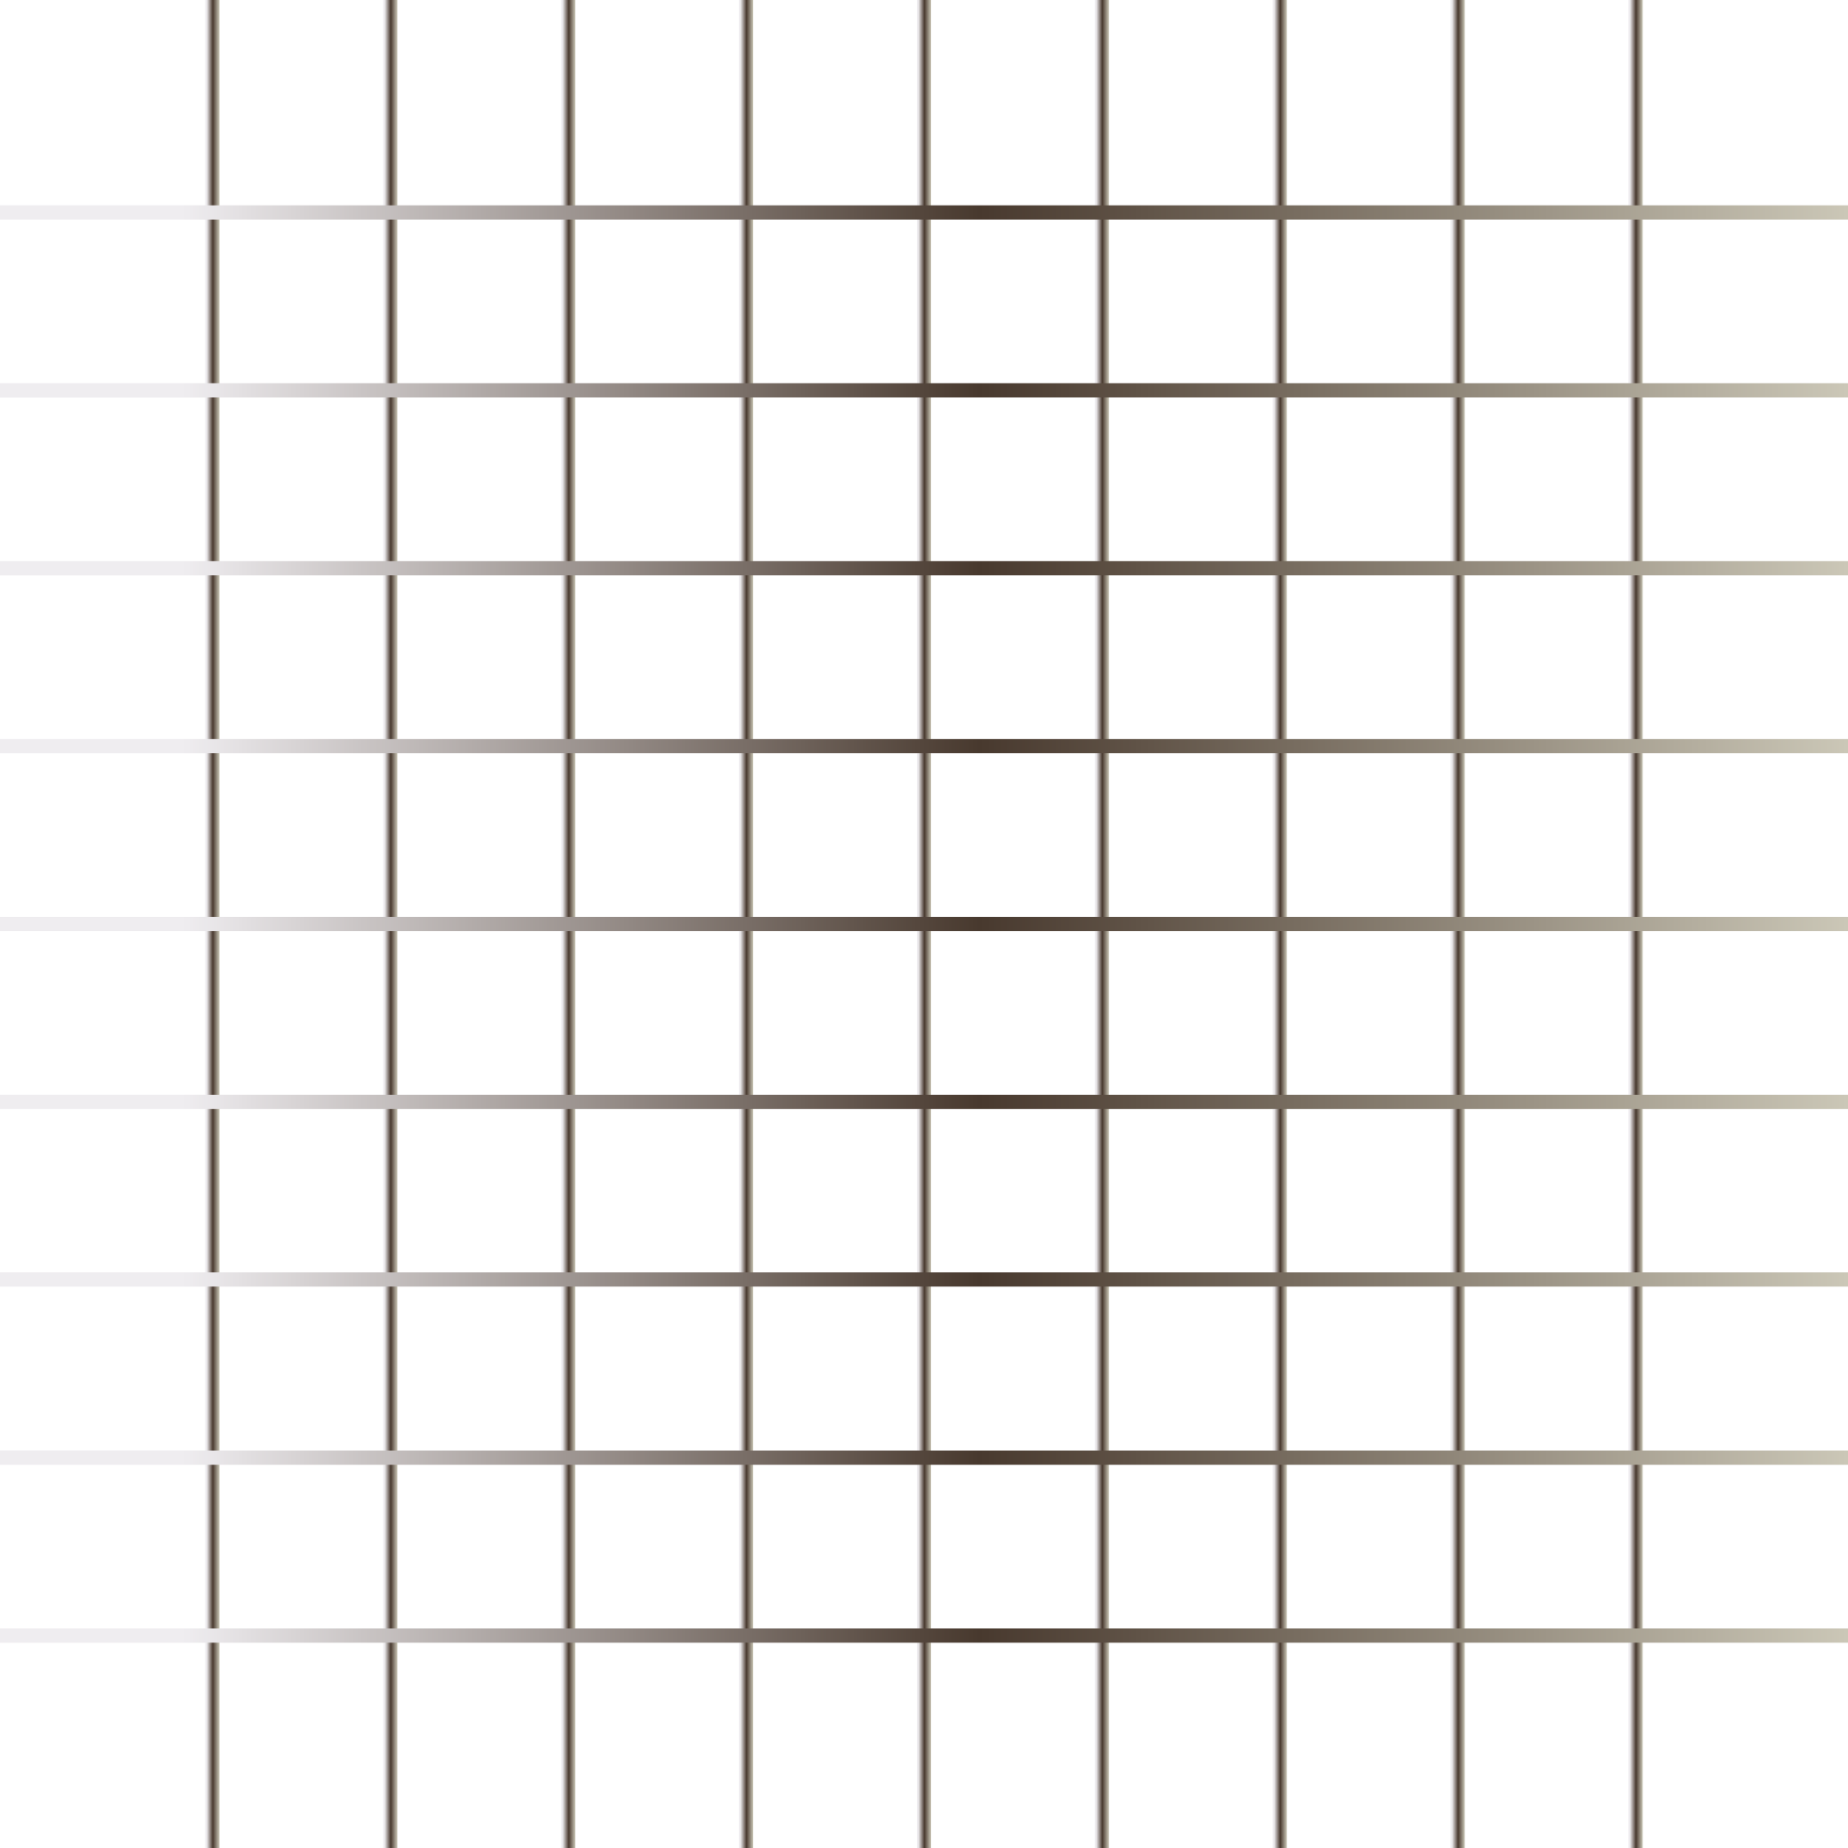


JavaSctipt
Bootcamp
“Only Programming language of the WEB”
By Urvshi Singla

Slide 2
Today’s Agenda
What, Why, History?
Datatypes
Operators
Conditional Statements
Loops
Function

Slide 3
WHAT IS JAVASCRIPT?
It is an interactive glue between html and CSS. JavaScript is the programming language of the Web.
It is used to make your website dynamic and interactive.
It is the only programming language that a browser can understand. All advance tech like Reactjs, Expressjs, Nodejs written over the top of js.
JavaScript Can Change HTML Content, HTML Attribute Values, Elements, HTML Styles.
Without javaScript there would be no games, no dynamic html forms, no interactive maps, no Gmail, no Youtube, no Netflix.

Slide 4
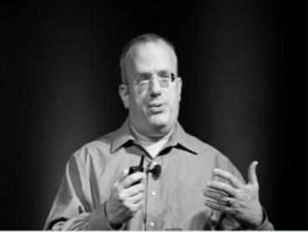
HISTORY
It was created by Brendan Eich In 1995.
Towards the end of 1996, It was standardized by Ecma as the Ecmascript.
Java or Javascript?

Slide 5
JAVASCRIPT - DATA TYPES
JavaScript variables can hold many data types: numbers, strings, objects, etc.
Js datatypes are of two types:
Primitive Non-Primitive String Function
Numbers Objects and Arrays
Boolean
Undefined
null

Slide 6
OPERATORS
Arithmetic
Assignment
String
Comparison
Logical

Slide 7
Conditions
Conditional statements are used to perform different actions based on different conditions.
Conditional Statements in JavaScript
If
else
Ternary Operator
switch

Slide 8
Loops
Loops can execute a block of code a number of times.
Types of Loops in JavaScript
for
while
do/while

Slide 9
JavaScript - Functions, Events
Function: A JavaScript function is a block of code designed to do something or perform a task. A JavaScript function is executed when it is invoked(called).
Function names can contain letters, underscores, and dollar signs (same rules as variables).

Slide 10
Tasks
Write a function to return biggest element in an array [89, 78, 56]
0-6 display day week depending upon is entering (0-> sunday)
sum of digits (123: 1 + 2 + 3 = 6) or (1234 : 1 + 2 + 3 + 4 = 10)
From 1 to 100, print "foo" if multiple of 3, "bar" if multiple of 5, if multiple of both display "hello" or else print the number e.g. 1 2 foo 4 bar foo
sum and average of array elements [1, 9, 8]

Slide 11

Q & A

Slide 12
Thank You

