Slide 1
HTML
Today’s Topics
Types of Component
Building blocks of ReactJs
React-State
Factories
Intro Webpack
List, Keys, Fragments
By Urvashi

Slide 2
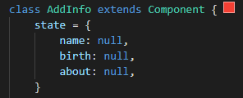
BUILDING BLOCKS OF REACTJS
Component
State
Props

Slide 3
HTML
TYPES OF COMPONENT
UI/Stateless/Function Component
Class/ Container/State Component
Doesn’t contain state
Receive data from props
Only concerned with the UI
Use Function to create
Contain state
Contain Lifecycle Methods
Not concerned with the UI
Use Class to create

Slide 4
HTML
App
Display
DisplayTwo
DisplayData

Slide 5
STATE
Collection of data that resides inside your component.
State is used so that a component can keep track of information in between any renders that it does.
States are the objects which determine components rendering and behavior.
They are mutable unlike the props and create dynamic and interactive components.
They are accessed via this.state

Slide 6
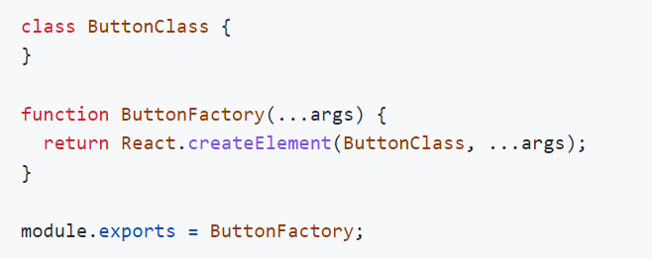


Factories
This is React 0.12.

Slide 7
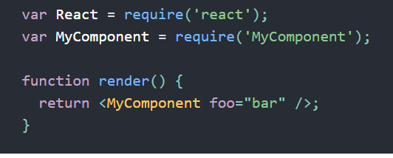
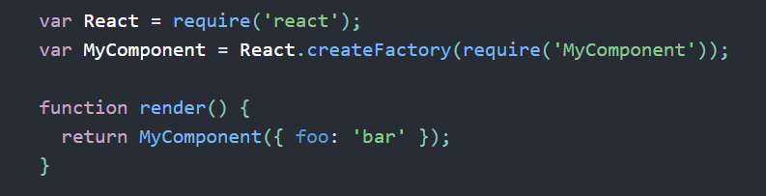
Factories
With JSX
Without JSX

Slide 8
JSX
Fundamentally, JSX just provides syntactic sugar for the React.createElement(component, props, ...children)
Using Dot Notation for JSX Type
User-Defined Components Must Be Capitalized
JSX Children
JSX Expression
Passing props

Slide 9
HTML
Why not use Create React App Tool?
Create React App comes with its disadvantages. Specifically, using Create React App makes it difficult to add custom build configurations. We could eject the application (stop hiding what is installed under the hood), but that defeats the point of Create React App. Create React App also adds a lot of abstraction and it is important to understand what is required to create/run a React application. Create React App (CRA) ships with webpack already under the hood, but usually, we would need to add more configurations as our app grows. Luckily for us, we can create a webpack. config. js file and put our webpack configurations in there

Slide 10
HTML
What is Webpack?
Webpack takes files of different types such as JavaScript and front-end asset files (HTML, CSS, images, etc.) and packages them into a group of smaller files. Webpack also creates a dependency graph to import modules that are dependent on one another in the correct order. We could use alternatives such as Browserify or Gulp but webpack is the most widely used module bundler for React.

Slide 11
Setup Webpack
Please refer wepack-setup and webpack-setup-explanation files.

Slide 12
HTML
Webpack Loaders
Loaders are what webpack uses to handle and process different file types. Loaders dictate how certain file types should be preprocessed as they are imported/loaded.
babel-loader transpiles JavaScript code, sass-loader compiles SASS files to CSS, style-loader adds CSS to the DOM using style tags, etc.
Read more on: https://dev.to/riyanegi/setting-up-webpack-5-with-react-and-babel-from-scratch-2021-271l

Slide 13
LIST, KEYS, FRAGMENTS
List:
Lists are used to display data in an ordered format.
Key:
A key is a unique identifier. In React, it is used to identify which items have changed, updated, or deleted from the Lists. It is useful when we dynamically create components or when the users alter the lists. It also helps to determine which components in a collection needs to be re-rendered instead of re-rendering the entire set of components every time.
Fragment:
Fragments allow you to group a list of children without adding extra nodes to the DOM. It makes the execution of code faster as compared to the div tag. It takes less memory. Key is the only attributes that can be passed with the Fragments.

Slide 14
HTML
Q & A

Slide 15
HTML
Thank You!

