Slide 1
HTML
Today’s Topics
How to Update State
DOM Events
Types of Component
Building blocks of ReactJs
React-State
Factories
Intro Webpack
List, Keys, Fragments
By Urvashi

Slide 2
SETUP REACT ENVIRONMENT
Step 1: Install Node visit https://nodejs.org
Step 2: NPM will install automatically with node
Step 3: By using create-react-app
npm install -g create-react-app
create-react-app my-app
To Run: cd my-app
npm start
npm install react@17 react-dom@17

Slide 3
HTML
Browser Extension and VSCode Plugin
Open VSCode, add Babel as extension.
Add React Developer Tools as Browser extension.

Slide 4
HTML
React Version
29 May 2013, First React version was released React 0.3.0
April 2016, React version was released React 15.0
On September 26, 2017, React 16.0 was released to the public.
On February 16, 2019, React 16.8 was released to the public. The release introduced React Hooks.
On August 10, 2020, React v17.0, notable as the first major release without major changes to the React developer-facing API.
On March 29, 2022, React 18 was released

Slide 5
Virtual DOM
UI Component App.js
Browser DOM
JSX
VirtualDom (New)
VirtualDom (Current)
Difference Updated

Slide 6
HTML
SPA VS MPA
SPA
A SPA is an app that works inside a browser and does not require page reloading during use.
It is just one web page that you visit which then loads all other content using JavaScript — which they heavily depend on.
SPA requests the markup and data independently and renders pages straight in the browser.
Typically it has only one reactDOM.render() call because we have one root app component which hosts other react component
Used By Gmail, Google Maps, Facebook
MPA
MPA is considered a more classical approach to app development. The multi-page design pattern requires a page reload every time the content changes.
Every Change i.e. displaying the data or submit data back to server requests rendering a new page from the server.
Before deploying a web application, you need to consider the goal of it. If you know you need multiple categories — use a multi-page site.
Used By extensive product portfolios, for example, e-commerce businesses.

Slide 7
WHY REACTJS?
Virtual DOM
SPA VS MPA
Unidirectional Data Flow
JSX
Component Based System

Slide 8
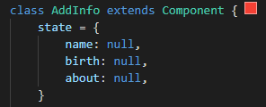
BUILDING BLOCKS OF REACTJS
Component
State
Props

Slide 9
HTML
TYPES OF COMPONENT
UI/Stateless/Function Component
Class/ Container/State Component
Doesn’t contain state
Receive data from props
Only concerned with the UI
Use Function to create
Contain state
Contain Lifecycle Methods
Not concerned with the UI
Use Class to create

Slide 10
HTML
App
Display
DisplayTwo
DisplayData

Slide 11
STATE
Collection of data that resides inside your component.
State is used so that a component can keep track of information in between any renders that it does.
States are the objects which determine components rendering and behavior.
They are mutable unlike the props and create dynamic and interactive components.
They are accessed via this.state

Slide 12
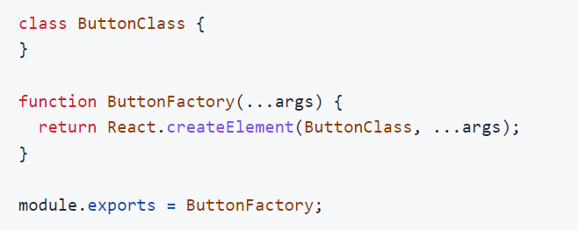


Factories
This is React 0.12.

Slide 13
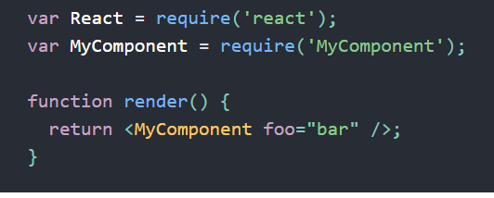
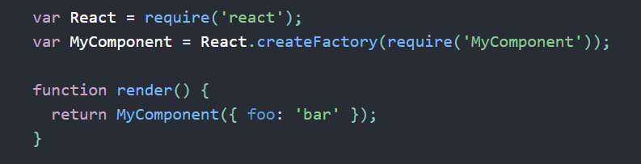
Factories
With JSX
Without JSX

Slide 14
JSX
Fundamentally, JSX just provides syntactic sugar for the React.createElement(component, props, ...children)
Using Dot Notation for JSX Type
User-Defined Components Must Be Capitalized
JSX Children
JSX Expression
Passing props

Slide 15
LIST, KEYS, FRAGMENTS
List:
Lists are used to display data in an ordered format.
Key:
A key is a unique identifier. In React, it is used to identify which items have changed, updated, or deleted from the Lists. It is useful when we dynamically create components or when the users alter the lists. It also helps to determine which components in a collection needs to be re-rendered instead of re-rendering the entire set of components every time.
Fragment:
Fragments allow you to group a list of children without adding extra nodes to the DOM. It makes the execution of code faster as compared to the div tag. It takes less memory. Key is the only attributes that can be passed with the Fragments.

Slide 16
HTML
Why not use Create React App Tool?
Create React App comes with its disadvantages. Specifically, using Create React App makes it difficult to add custom build configurations. We could eject the application (stop hiding what is installed under the hood), but that defeats the point of Create React App. Create React App also adds a lot of abstraction and it is important to understand what is required to create/run a React application. Create React App (CRA) ships with webpack already under the hood, but usually, we would need to add more configurations as our app grows. Luckily for us, we can create a webpack. config. js file and put our webpack configurations in there

Slide 17
HTML
What is Webpack?
Webpack takes files of different types such as JavaScript and front-end asset files (HTML, CSS, images, etc.) and packages them into a group of smaller files. Webpack also creates a dependency graph to import modules that are dependent on one another in the correct order. We could use alternatives such as Browserify or Gulp but webpack is the most widely used module bundler for React.

Slide 18
Setup Webpack
Please refer wepack-setup and webpack-setup-explanation files.

Slide 19
HTML
Webpack Loaders
Loaders are what webpack uses to handle and process different file types. Loaders dictate how certain file types should be preprocessed as they are imported/loaded.
babel-loader transpiles JavaScript code, sass-loader compiles SASS files to CSS, style-loader adds CSS to the DOM using style tags, etc.
Read more on: https://dev.to/riyanegi/setting-up-webpack-5-with-react-and-babel-from-scratch-2021-271l

Slide 20
HTML
Q & A

Slide 21
HTML
Thank You!

