Slide 1
HTML
Today’s Topics
REACT ROUTING
By Urvashi

Slide 2
REACT ROUTING
What is React Router DOM?
Install react-router: npm install --save react-router-dom.
How to create multiple webpages in a client-side
Link b/w Routes
Routing Parameters
How to use third party API

Slide 3
React Router DOM
React Router DOM is an npm package that enables you to implement dynamic routing in a web app. It allows you to display pages and allow users to navigate them. It is a fully-featured client and server-side routing library for React
A <BrowserRouter> stores the current location in the browser's address bar using clean URLs and navigates using the browser's built-in history stack.

Slide 4
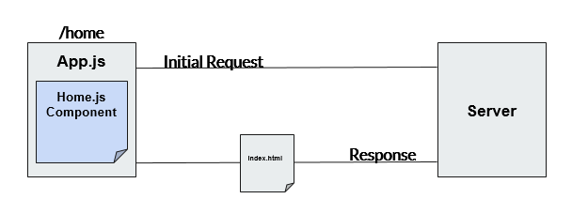
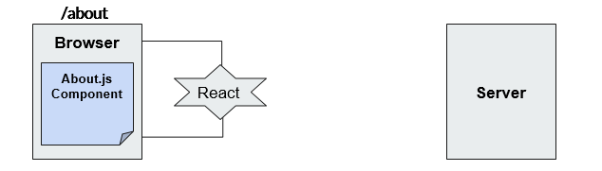
REACT ROUTER DOM
ROUTING
REACT-ROUTER DOM

Slide 5
HTML
Axios
Axios is a modern, Promise-based HTTP client library.
This means that Axios is used to send an HTTP request and handle their responses, all using JavaScript's promises.
Axios supports both Node.js and JavaScript in the browser.
npm install --save axios
API: https://rapidapi.com/hub

Slide 6
HTML
CONDITIONAL RENDERING
In React, you can create distinct components that encapsulate behavior you need. Then, you can render only some of them, depending on the state of your application.
Conditional rendering in React works the same way conditions work in JavaScript. Use JavaScript operators like if or the conditional operator to create elements representing the current state, and let React update the UI to match them.

Slide 7
HTML
HIGHER ORDERED COMPONENTS
HOC are methods that give super powers component to it.
A higher-order component (HOC) is an advanced technique in React for reusing component logic.
A higher-order component is a function that takes a component and returns a new component.
Supercharged Component
Component
HOC
About.js
About.js
ColorChanger

Slide 8
HTML
JavaScript Library Integration: Lodash
It is a superset of underscores.
It makes JavaScript easier by taking hassle out of working with arrays, numbers, strings, objects.
They are best when: Integrating, Working, Manipulating with arrays, objects, string.
Visit: https://lodash.com/
Install: npm i --save lodash
React-Export-Excel
react-image-magnify
Library: moment.js, d3.js, recharts

Slide 9
HTML
Q & A

Slide 10
HTML
Thank You!

