Slide 1
HTML
Today’s Topics
React – Hooks
Prop-Validation
Suspense
Tree-shaking
By Urvashi

Slide 2
HTML
HOOKS - useState
A Hook is a special function that lets you “hook into” React features. For example, useState is a Hook that lets you add React state to function components
If you write a function component and realize you need to add some state to it, previously you had to convert it to a class. Now you can use a Hook inside the existing function component.
What does useState do:
What does useState return:
How to display/read the State Variables:

Slide 3
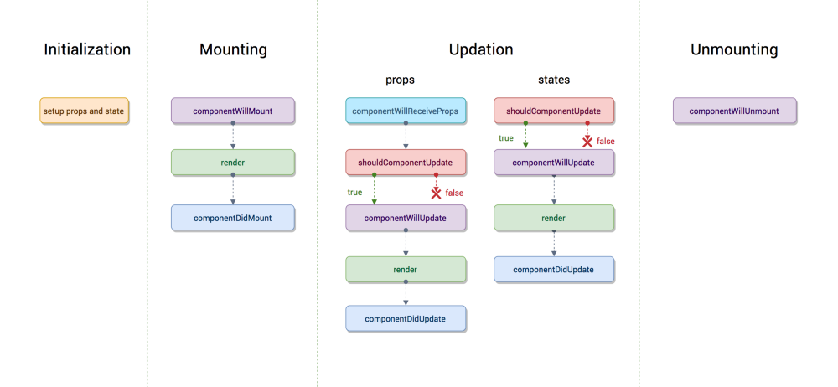
LIFECYCLE OF COMPONENT

Slide 4
Each component in React has a lifecycle which you can monitor and manipulate during its three main phases. The three phases are: Mounting, Updating, and Unmounting.
Mounting
These methods are called in the following order when an instance of a component is being created and inserted into the DOM:
constructor()
static getDerivedStateFromProps()
render()
componentDidMount()

Slide 5
Updating
An update can be caused by changes to props or state. These methods are called in the following order when a component is being re-rendered:
static getDerivedStateFromProps()
shouldComponentUpdate()
render()
getSnapshotBeforeUpdate()
componentDidUpdate()
Unmounting
This method is called when a component is being removed from the DOM:
componentWillUnmount()

Slide 6
LIFECYCLE OF COMPONENT
MOUNT
UPDATE
static getDerivedStateFromProps()
shouldComponentUpdate()
render()
getSnapshotBeforeUpdate(prevProps,
prevState)
componentDidUpdate(prevProps,
prevState,snapshot)
constructor()
static getDerivedStateFromProps(props, state)
render()
componentDidMount()

Slide 7
HTML
Uses of Lifecycle component
componentWillMount()
This is called once on the server side, if server side rendering is present, and once the client side.
You can use it to do api calls which do not have direct effect on the components, for example getting oAuth tokens
componentDidMount()
This function is mostly used for calling API's.
Components state initializations which are based on the props passed by parents.
shouldComponentUpdate(nextProps, nextState)
This method is invoked before the render happens when new props or states are received. Here we can return false if the re-render is not required.
We can see this as a performance optimisation tool. In case of frequent re-rendering of parent component this method should be used to avoid unnecessary update to current component

Slide 8
HTML
Uses of Lifecycle component
componentWillUpdate(nextProps,nextState)
this function is called every time a component is updated, it is not called when component mounts
Carry out any data processing here. For example, when a api fetch returns data, modelling the raw data into props to be passed to children
this.setState() is not allowed in this function , it is to be done in componentWillReceiveProps or componentDidUpdate
componentDidUpdate(prevProps,prevState)
Invoked right after the changes are pushed to the DOM
We can use it whenever the required data is not at the first render (waiting for api call to come through) and DOM requires to be changed based on the data received
Example, based on the age received show the user if he is eligible for application for an event
componentWillUnmount()
As the official docs mentions, any event listeners or timers used in the component to be cleaned here.

Slide 9
HTML
Uses of Lifecycle component
static getDerivedStateFromProps is a new React lifecycle method as of React 17 designed to replace componentWillReceiveProps.
Its main function is to ensure that the state and props are in sync for when it’s required.
static getDerivedStateFromProps(props, state) {
return { name: ‘alina’}
}
static getDerivedStateFromProps(props, state) {
return null;
}

Slide 10
HTML
HOOKS - useEffect
We don’t have lifecycle component in Function component. UseEffect is replacement of Lifecyle method for Function component.
useeffect means manage the side effects. Side effect is whenever you do something with state of a component.
useEffect is the replacement of ComponentDidMount, ComponentDidUpdate, ComponentWillUnmount.
Command to install axios: npm install --save axios.

Slide 11
HTML
TYPECHECKING
As your app grows, you can catch a lot of bugs with typechecking. React has some built-in typechecking abilities.
PropTypes
Default Prop Values

Slide 12
HTML
PROPS VALIDATION
It check the types of the properties that we pass to the component.
Properties validation is a useful way to force the correct usage of the components. This will help during development to avoid future bugs and problems, once the app becomes larger. It also makes the code more readable.
propTypes is used for props Validation. If some of the props aren't using the correct type that we assigned, we will get a console warning.
Install: npm install --save prop-types

Slide 13
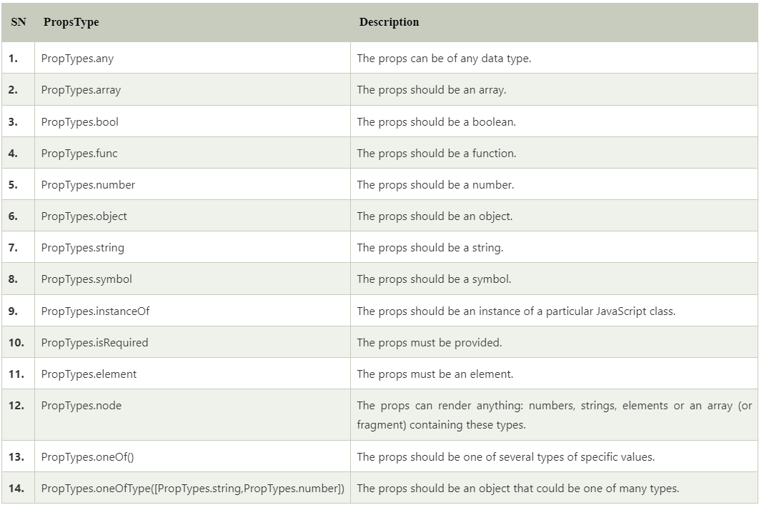
HTML
PROPS VALIDATION

Slide 14
HTML
Treeshaking (dead-code elimination)
Tree shaking, also known as dead code elimination, is the practice of removing unused code in your production build. It's important to ship as little code to your end-users as possible.
By statically analyzing our source code, we can determine what's not being used and exclude it from our final bundle. webpack supports tree-shaking.
In es5
In es6

Slide 15
HTML
Treeshaking (dead-code elimination)
• Configure webpack option to ignore transpiling modules to commonJS. • Use ES2015/ES6 module syntax (i.e. import and export). • Configure side effects property option in webpack file of the project.

Slide 16
HTML
Suspense and Data service
Suspense is a feature for managing asynchronous operations in a React app. It lets your components communicate to React that they're waiting for some data.
React.Suspense lets you specify the loading indicator in case some components in the tree below it are not yet ready to render The React Suspense feature was released as part of React 16 version.
Now, with React 18, we can use it for react-async data fetching. It is important to note that Suspense is not a data fetching library like react-async. Render-as-you-fetch.
How to fetch data from API (Data service)

Slide 17
HTML
Q & A

Slide 18
HTML
Thank You!

