Slide 1
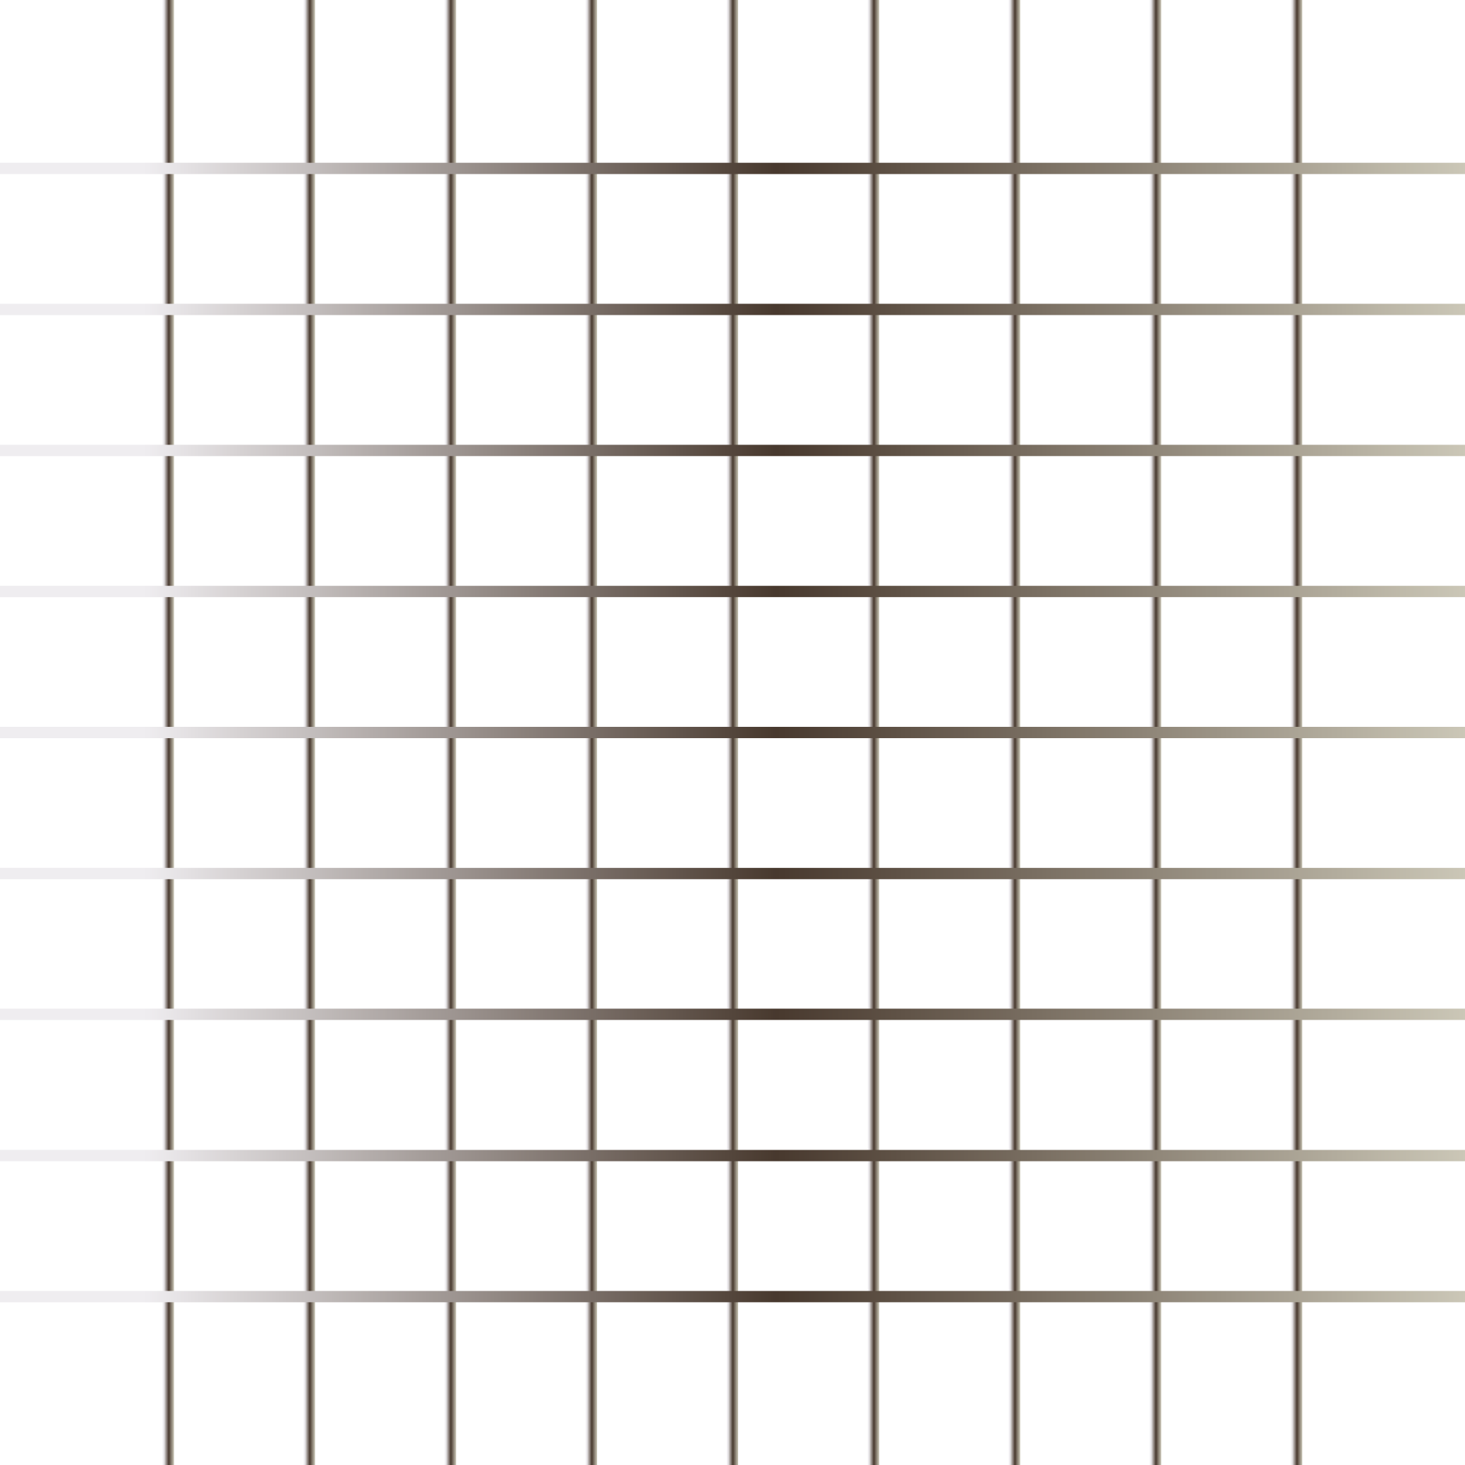
Today’s Agenda
Flexbox
Responsive Design
Units

Slide 2
Flex
Before the Flex Layout module, there were four layout modes:
Block, for sections in a webpage
Inline, for text
Table, for two-dimensional table data
Positioned, for explicit position of an element
The Flexible Box Layout Module, makes it easier to design flexible responsive layout structure without using float or positioning.

Slide 3
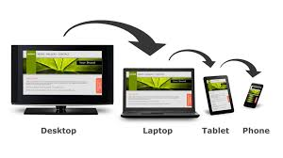
Responsive Design
What is responsive website?
Viewport
How to use media query
How to make images/videos responsive
Framework

Slide 4
What is responsive website?
Responsive web design makes your web page look good on all devices.
Responsive web design uses only HTML and CSS.
Responsive web design is not a program or a JavaScript.
Viewport
The viewport is the user's visible area of a web page.
The viewport varies with the device, and will be smaller on a mobile phone than on a computer screen.
Before tablets and mobile phones, web pages were designed only for computer screens, and it was common for web pages to have a static design and a fixed size.

Slide 5
How to use media query?
Media query is a CSS technique introduced in CSS3.
It uses the @media rule to include a block of CSS properties only if a certain condition
is true.
Mobile First means designing for mobile before designing for desktop or any other device (This will make the page display faster on smaller devices).
This means that we must make some changes in our CSS.
How to make images/videos responsive?

Slide 6
Frameworks:
There are many free CSS Frameworks that offer Responsive Design.
Materialize CSS
Bootstrap 4

Slide 7
Units
CSS has several different units for expressing a length.
For some CSS properties, negative lengths are allowed.
There are two types of length units: absolute and relative.
Absolute
The absolute length units are fixed and a length expressed in any of these will appear as exactly that size. Absolute length units are not recommended for use on screen, because screen sizes vary so much. However, they can be used if the output medium is known, such as for print layout.
Relative Lengths
Relative length units specify a length relative to another length property. Relative length units scales better between different rendering mediums.

