Slide 1
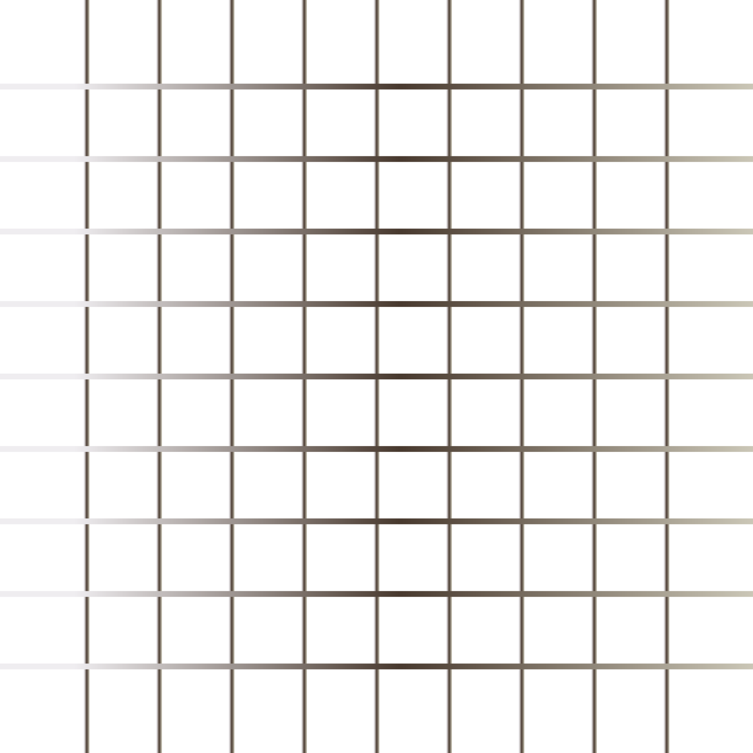
Today’s Agenda
Tables
Forms
Layout
Style Guide

Slide 2
Tables
HTML tables allow us to organize data into rows and columns.
tr: define each row
td: define each table cell/ they are data containers
th: define the table header
caption: Use the HTML <caption> element to define a table caption

Slide 3
Forms
Forms is used to collect user input.
Form Elements: label input, select, option, textarea, button, fieldset, legend.
Form Attributes: method, target, action

Slide 4
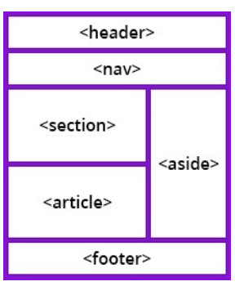
Layout
Websites often display content in multiple columns (like a magazine or a newspaper).
HTML has several semantic elements that define the different parts of a web page:
Header: Defines a header for a document or a section.
Nav: Defines a set of navigation links.
Section: Defines a section in a document.
Footer: Defines a footer for a document or a section.
Aside: Defines content aside from the content (like a sidebar).

Slide 5
Style Guide
Reusable, readable, clear Code
Always declare DOCTYPE
Use Lowercase for tag, element name.
Opening tag always has closing tag.
Always define width, height for images.
Indentation
Always define title element
Include meta tag
Filename: use Camel case

Slide 6
What is Git and GitHub?
It is a open-source solution.
Git is a version control system that lets you manage and keep track of your source code history.
GitHub is a cloud-based hosting service that lets you manage Git repositories
GitHub is a code hosting platform for version control and collaboration. It lets you and others work together on projects from anywhere. It includes GitHub essentials like repositories, branches, commits, push and pull requests.

Slide 7
Setup GitHub
Create an account on Github: https://github.com/
Install Git: https://git-scm.com/downloads
Create a repository on GitHub.
Add you local code to GitHub, using git bash (Commands are already mentioned on the page, when you create a repository).
Documentation: https://docs.github.com/en/get-started/getting-started-with-git/setting-your-username-in-git

