Slide 1
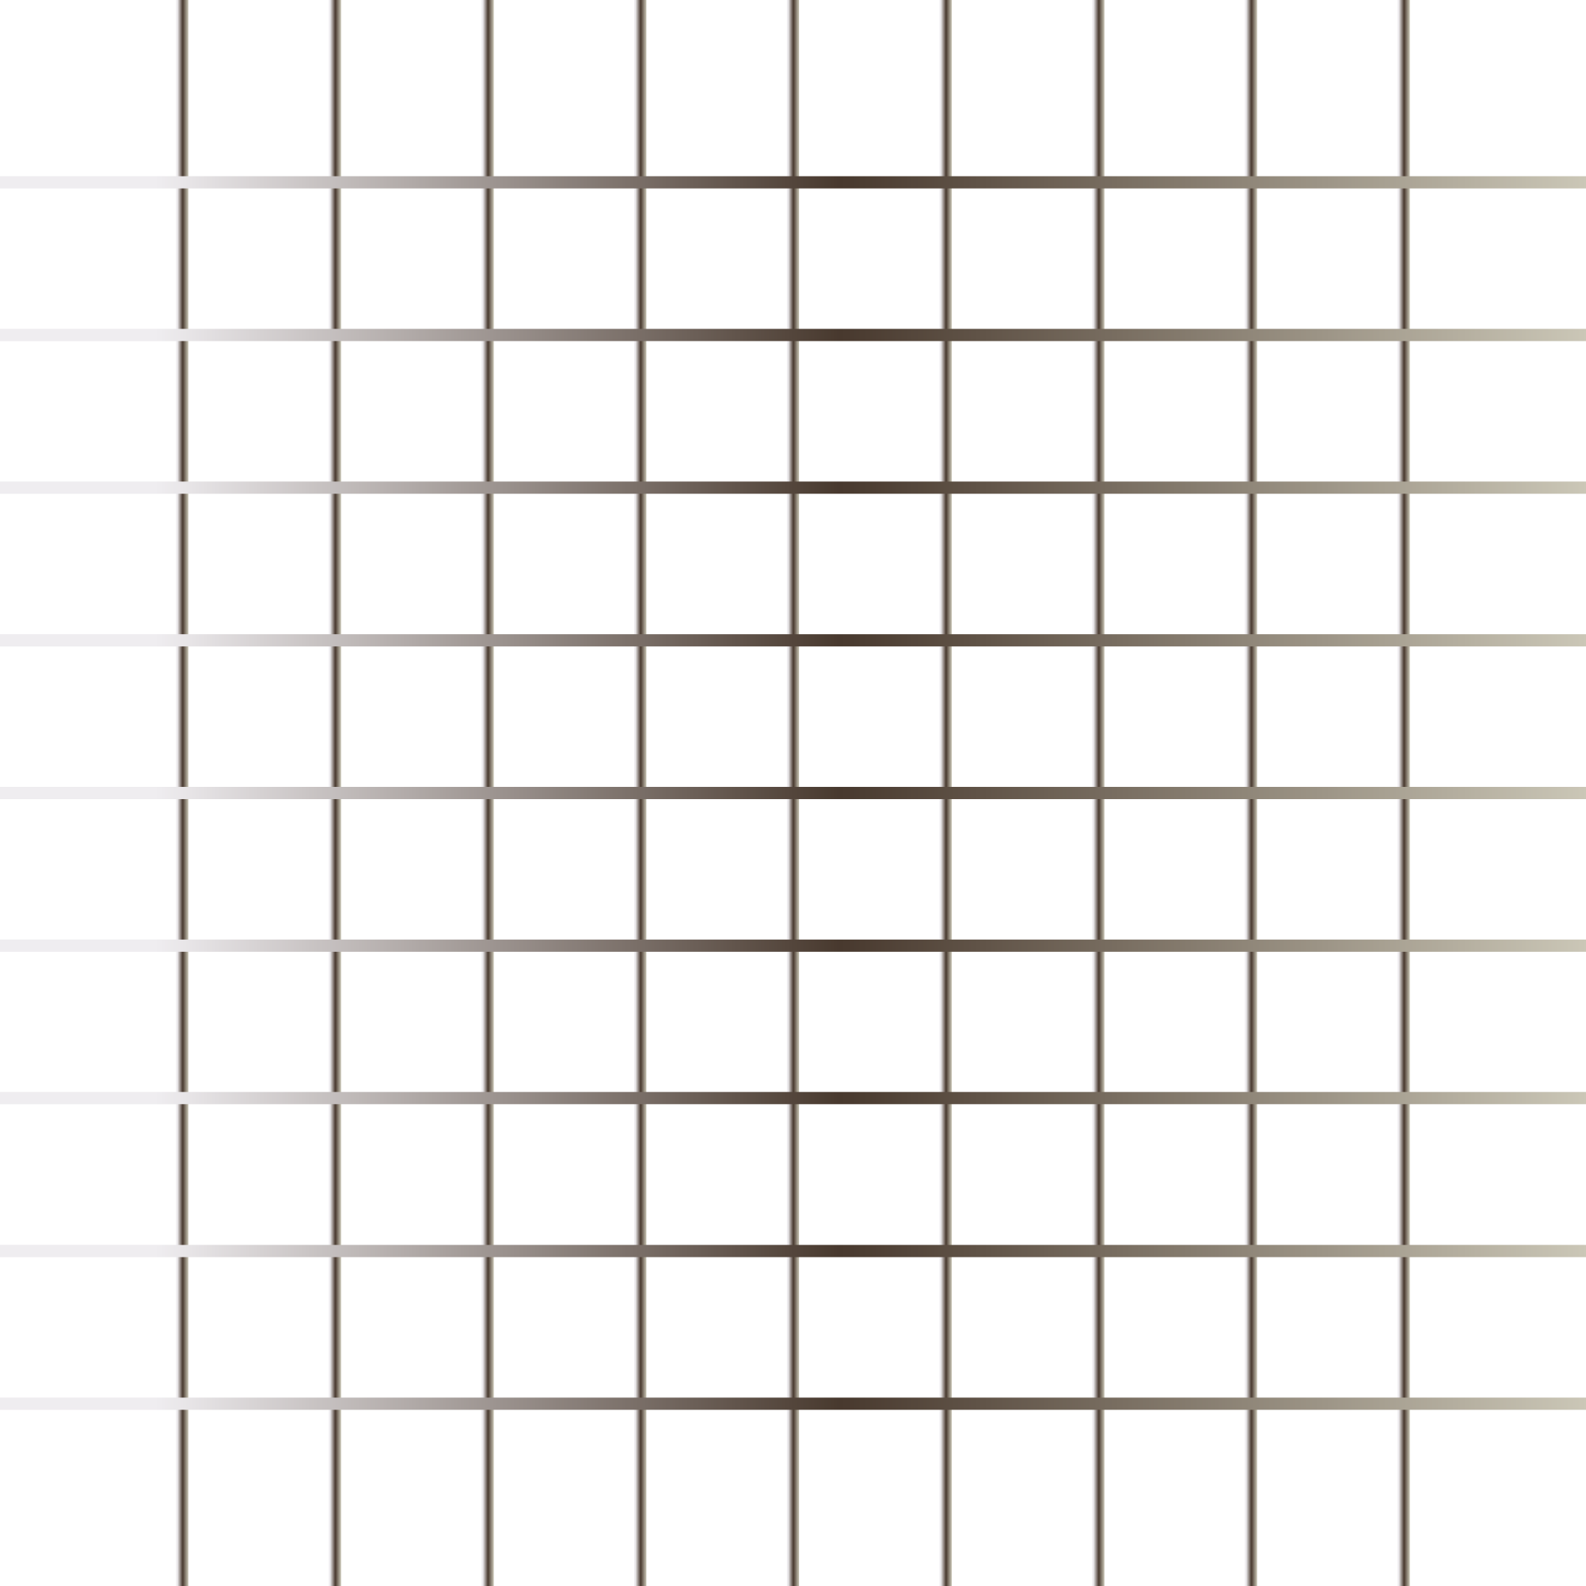
Today’s Agenda
JavaScript –Arrays
Math Object
JavaScript- Function & Events

Slide 2
ARRAYS
Arrays doesn’t support named indices.
Arrays are basically special kind of object with numbered index.
Return type of array and object is object.

Slide 3
JavaScript Math Object
Math Object: The JavaScript Math object allows you to perform mathematical tasks on numbers.
We have pre-defined methods and properties in Math objects.

Slide 4
JavaScript - Functions, Events
Function: A JavaScript function is a block of code designed to do something or perform a task. A JavaScript function is executed when it is invoked(called).
Function names can contain letters, underscores, and dollar signs (same rules as variables).

Slide 5
JavaScript - Functions, Events
Function Calling:
When an event occurs (when a user clicks a button)
When it is invoked (called) from JavaScript code
Automatically (self invoked)
Code Reusability.
You can use the same code many times with different arguments, to produce different results.

Slide 6
JavaScript - Functions, Events
An HTML event can be something the browser does, or something a user does.
Event handlers and Event Listener.
To assign events to HTML elements you can use event attributes.
Event handlers can be used to handle and verify user input, user actions, and browser actions.

