Slide 1
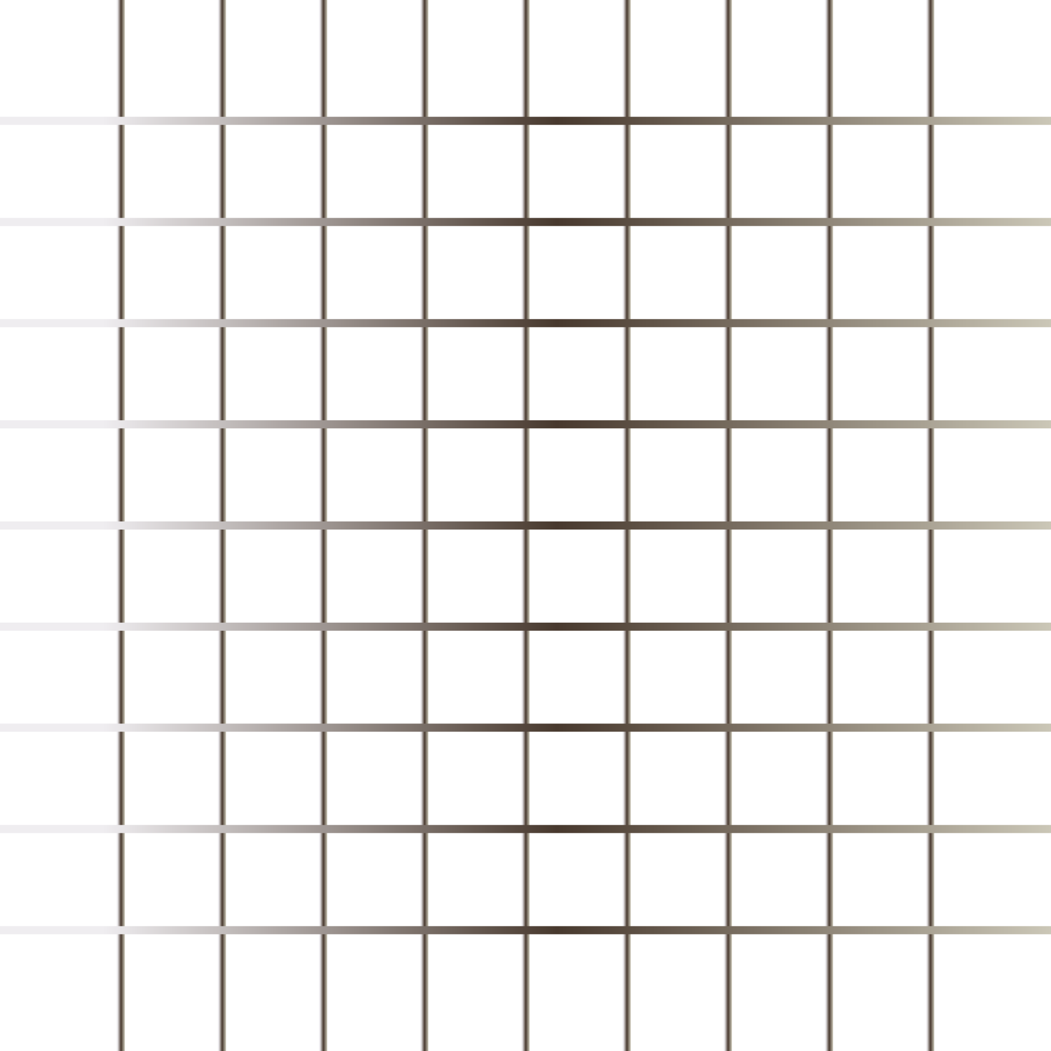
Today’s Agenda
Form & Form Validation
Regex
How to debug js code
This keyword

Slide 2
Form & Form Validation
Js uses forms to allow users to interact with the web page.
It is a set of input values, enter by the user.
It’s like user is inputting the value.
Form Validation
Front-end Validation
It checks input by the user is correct or not.
What validation need to be checked is decided by the developer/according to the application requirement.
We need events

Slide 3
Regex
A regular expression is a sequence of characters that forms a search pattern.
When you search for data in a text, you can use this search pattern to describe what you are searching for.
A regular expression can be a single character, or a more complicated pattern.
The search pattern can be used for text search and text replace operations.
Regex test : https://regex101.com/

Slide 4
How to debug js code
It is process of finding, testing and reducing bug/error in code.
Why Debugging?
Ways to debug Js code
Console.log()
Debugger
Adding break points

Slide 5
This keyword
This keyword refers to the object it belongs to.
It has different meaning depending upon where it is used.
Object: refers to the owner of the object
Alone: refers to the global object
Function: refers to the object that owns function
Strict mode: this is undefined
Event: refers to the HTML element that received event

