Slide 1

Welcome to
New age upskilling platform for high growth careers
By Urvshi Singla

Slide 2
Session Agenda
Algorithm Analysis
Introduction to Asymptotic Analysis
Analysing Time Complexity

Slide 3
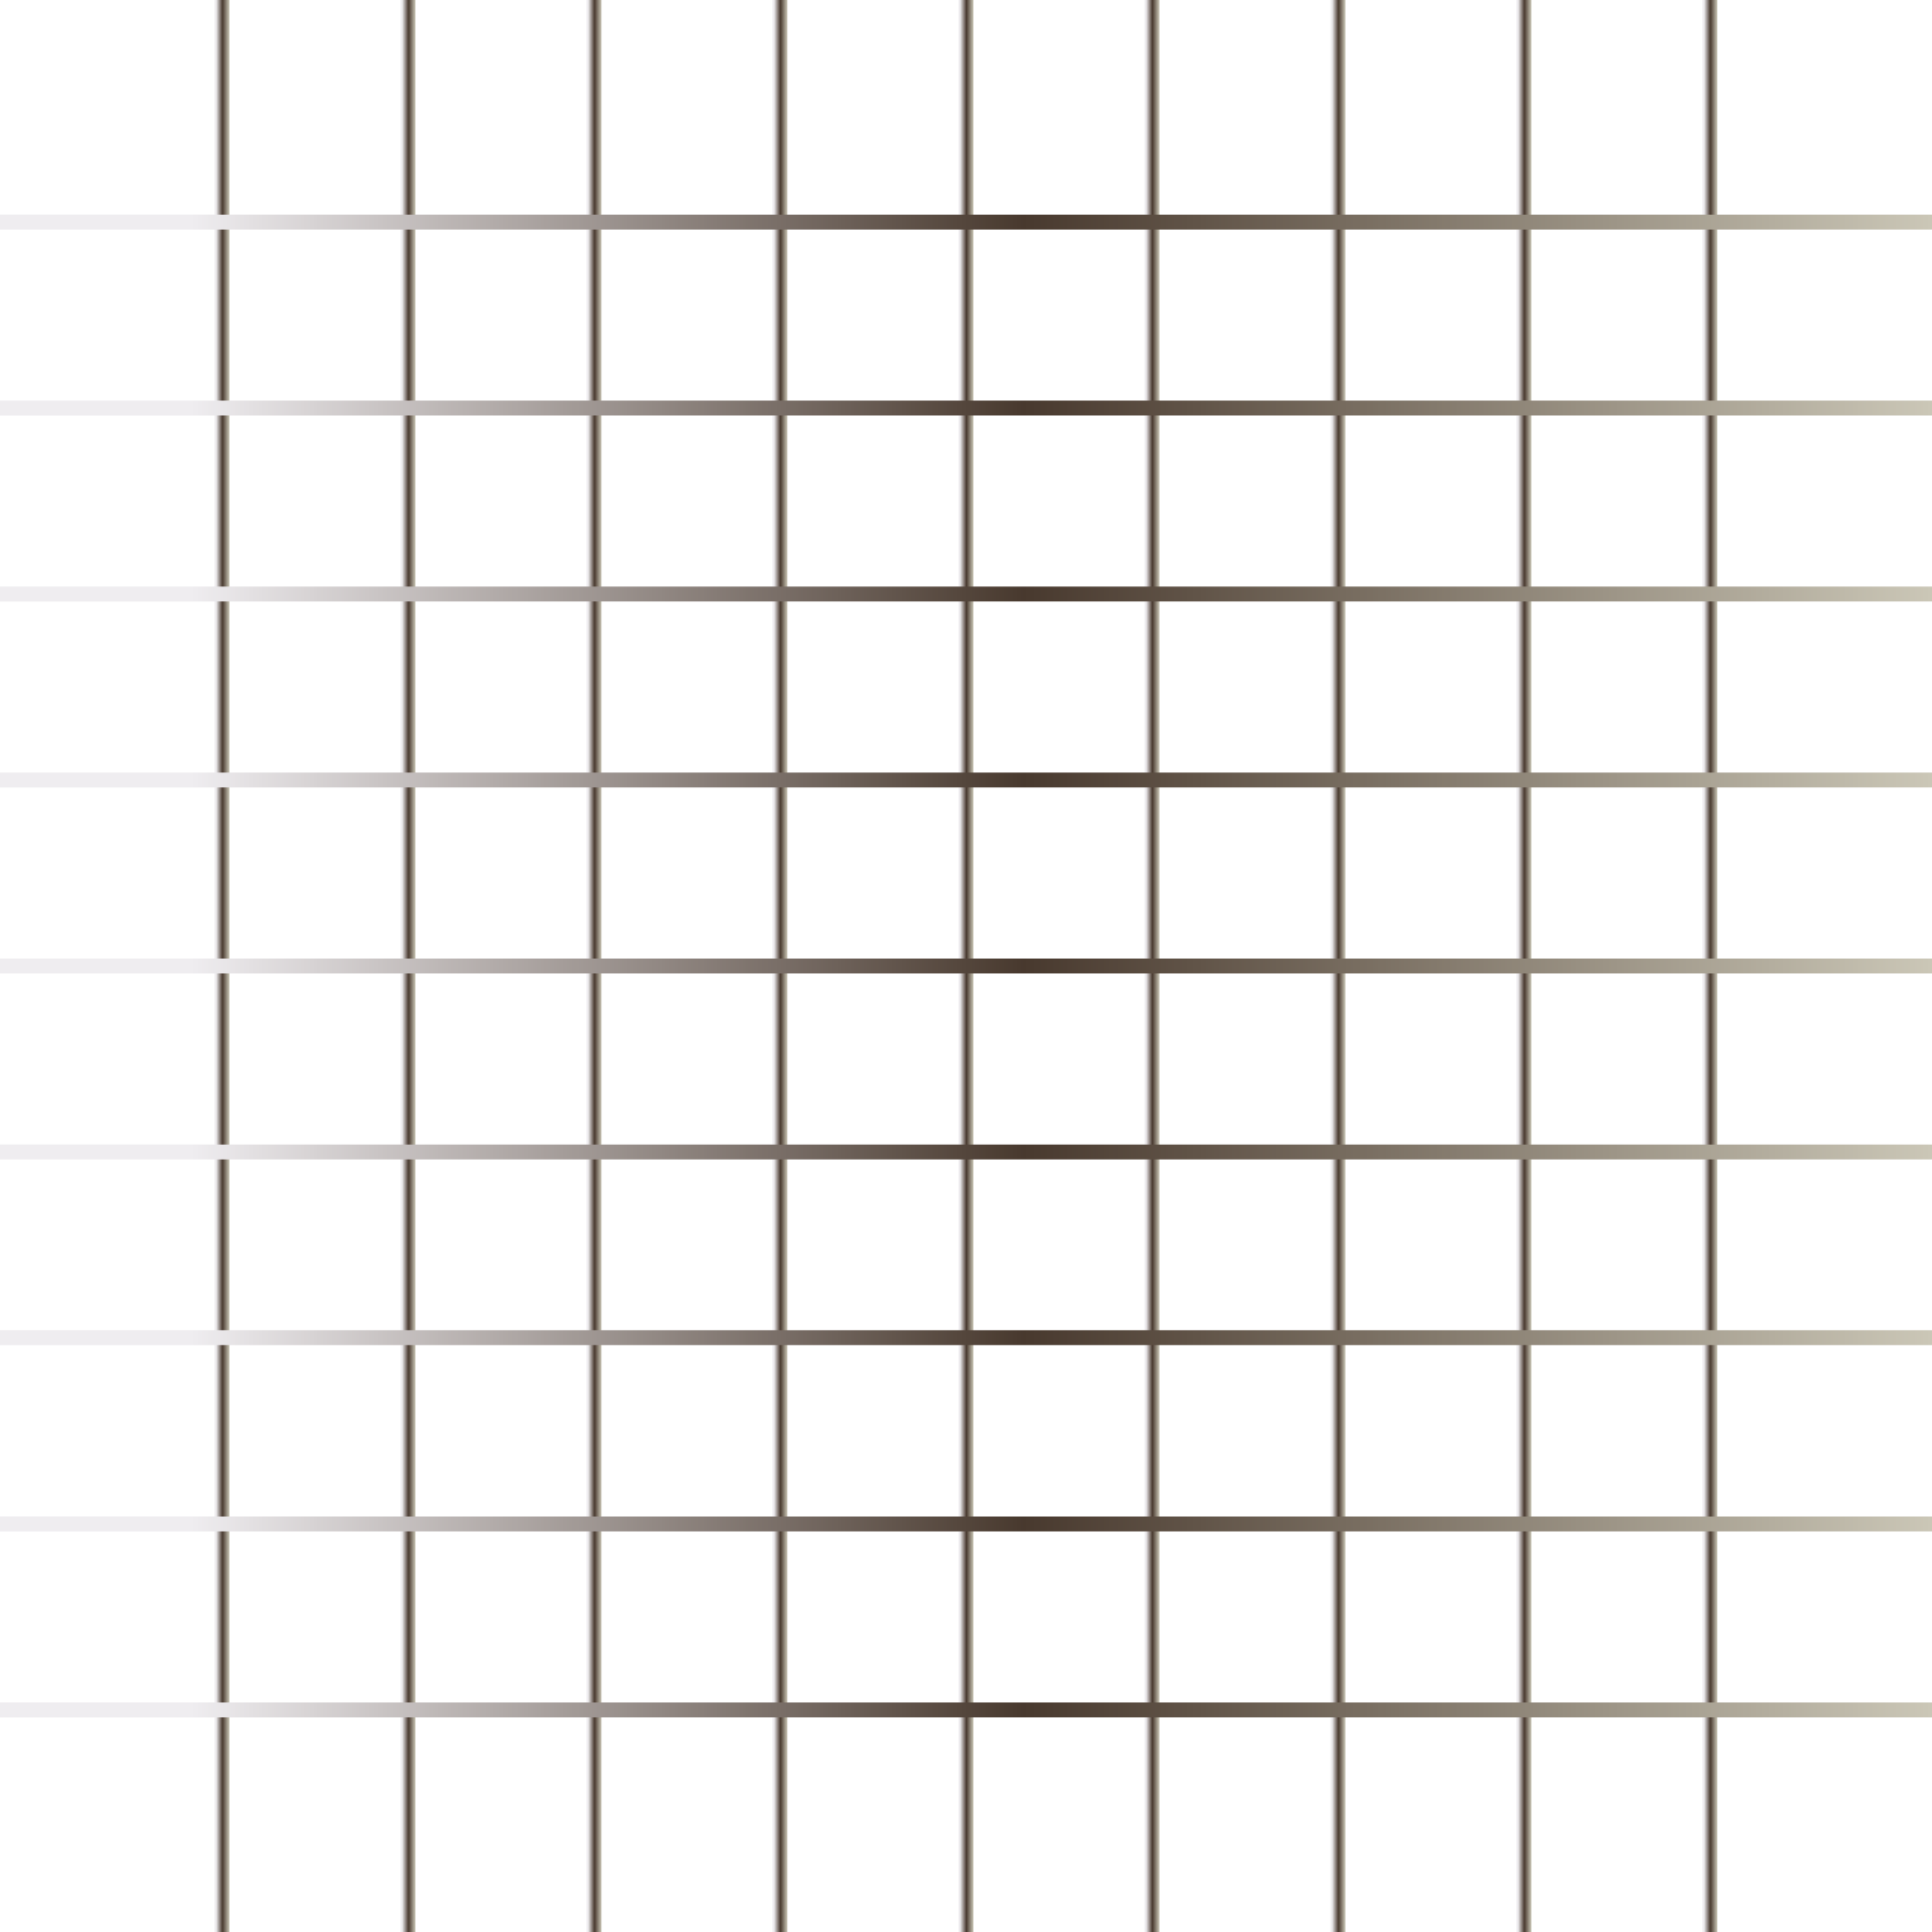
Asymptotic Analysis
Space Complexity: When an algorithm is running, it needs space to store inputs, variables, and program code. Space complexity is the amount of memory that is required to run an algorithm or process.
Time Complexity: Time complexity is the time taken by the algorithm to execute each set of instructions. When solving a problem using an algorithm, it's important to choose the most efficient one to save time and computational resources.
Linear o(1) and constant space complexity O(n)

Slide 4
Asymptotic notation is a method used to compare the efficiency of different algorithms. It is not feasible to compare two algorithms directly as it heavily depends on the hardware and tools used for the comparison, such as the operating system, CPU model, and processor generation. Even if the time and space complexity of two algorithms are calculated on the same system, their performance may still be affected by subtle changes in the system environment.
Big-Oh (O) notation: Worst Case
Big Omega (Ω) notation: Best Case
Big Theta (Θ) notation: Average Case

Slide 5
How to calculate complexity?
Identify the Input Size: Determine what parameter(s) influence the size of the input to the code. For example, if your code operates on an array, the input size is the length of the array, denoted as "n."
Identify the Operations: Identify the significant operations in the code that contribute to its overall execution time. Common operations include loops, recursive calls, and specific arithmetic or logical operations.
Count the Basic Operations: For each identified operation, count the number of times it is executed in terms of the input size "n." Express this count as a function of "n" without considering any constant factors.
Find the Dominant Term: If the code contains multiple operations, identify the one with the highest growth rate concerning "n." This dominant term represents the primary factor determining the time complexity.
Express the Time Complexity: Write the time complexity using Big O notation by retaining only the dominant term and removing any constant factors or lower-order terms.

Slide 6
Common Time Complexities
O(1) - Constant Time: The execution time remains constant, regardless of the input size.
O(log n) - Logarithmic Time: The execution time increases logarithmically with the input size.
O(n) - Linear Time: The execution time grows linearly with the input size.
O(n log n) - Linearithmic Time: The execution time increases as a product of the input size and its logarithm.
O(n^2) - Quadratic Time: The execution time grows quadratically with the input size.
O(2^n) - Exponential Time: The execution time grows exponentially with the input size

Slide 7
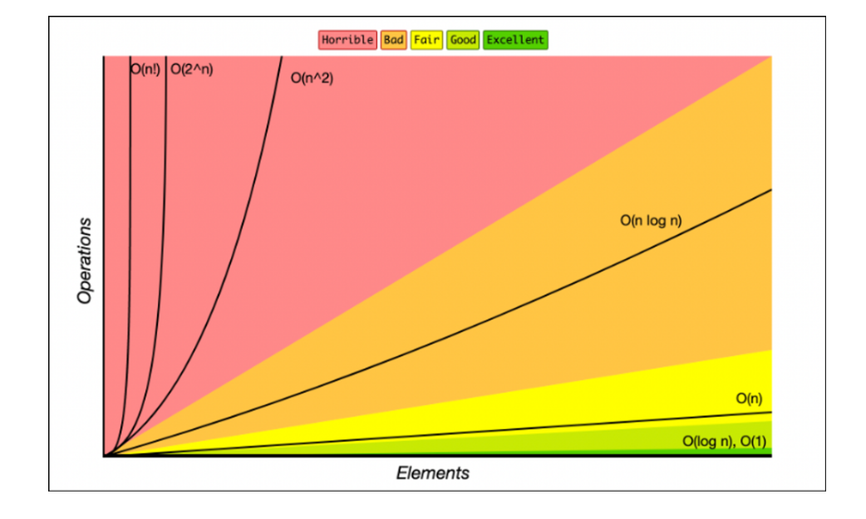

Slide 8
Algorithm IN JAVASCRIPT
Recursion
Linear Search
Binary Search
Bubble Sort
Merge Sort
Quick Sort

Slide 9
Q & A

Slide 10
Thank You

