Slide 1

Welcome to
New age upskilling platform for high growth careers
By Urvshi Singla

Slide 2
Session Agenda
Introduction to React
How to Work with React
Setup ReactJs
Introduction to JSX
Babel
Virtual DOM

Slide 3
HTML
RUNTIME ENGINE
What is JavaScript Engine: Computer do not understand the Javascript code.
Javascript engine takes javascript, and converts it into something it does understand- machine code.
Types of JavaScript Runtime engine.
e.g. Chrome: V8 engine
Mozilla: SpiderMonkey

Slide 4
HTML
WHAT IS NODE?
Node.js is an open-source, cross-platform runtime environment that is built on Google Chrome's JavaScript Engine(V8).
Node.js is the platform needed for the React.js development.
Node bundles a React application into a single file for easy compilation using webpack.
Installation Link: https://nodejs.org/en/download/

Slide 5
HTML
NPM: NODE PACKAGE MANAGER
Essential JavaScript development tools that help you build powerful applications using modern open source code.
Site Link: https://www.npmjs.com/

Slide 6
HTML
HOW TO BUILD WORKFLOW
Use Dependency Management tool (npm or yarn)
We need a bundler (webpack)
Babel (Transcompiler)
Use Development Server

Slide 7
HTML
WHAT IS REACTJS?
A JavaScript library for building dynamic UI.
It is an open-source, component-based front end library responsible only for the view layer of the application.
ReactJS works as views using a component based system.
Building block of ReactJs
Basic Concepts
https://reactjs.org/
https://beta.reactjs.org/

Slide 8
HTML
HISTORY
It came into existence in 2011, when a software engineer(Jordan Walke) at Facebook created the library ReactJs.
Facebook decided to make it open source in May 2013.
Build encapsulated components that manage their own state, then compose them to make complex UIs.
It was initially developed and maintained by Facebook and was later used in its products like WhatsApp & Instagram.

Slide 9
HTML
REACT DOM

Slide 10
HTML
Text Editor
Install Visual Studio Code

Slide 11
SETUP REACT ENVIRONMENT
Step 1: Install Node visit https://nodejs.org
Step 2: NPM will install automatically with node
Step 3: By using create-react-app
npm install -g create-react-app
create-react-app my-app
To Run: cd my-app
npm start

Slide 12
HTML
Browser Extension
Add React Developer Tools as Browser extension.

Slide 13
HTML
React Version
29 May 2013, First React version was released React 0.3.0
April 2016, React version was released React 15.0
On September 26, 2017, React 16.0 was released to the public.
On February 16, 2019, React 16.8 was released to the public. The release introduced React Hooks.
On August 10, 2020, React v17.0, notable as the first major release without major changes to the React developer-facing API.
On March 29, 2022, React 18 was released

Slide 14
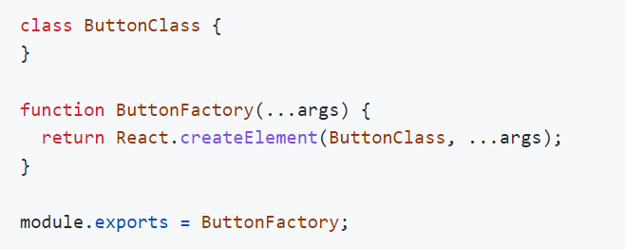


Factories
This is React 0.12.

Slide 15
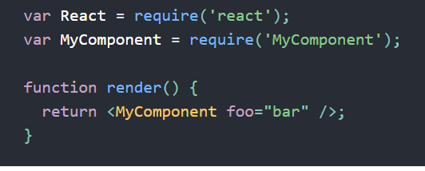
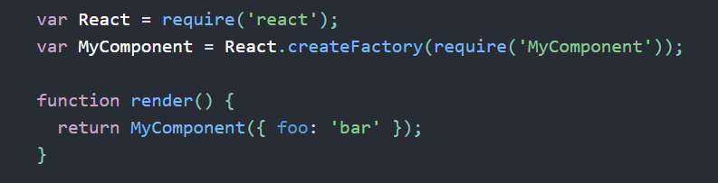
Factories
With JSX
Without JSX

Slide 16
JSX
Fundamentally, JSX just provides syntactic sugar for the React.createElement(component, props, ...children)
Using Dot Notation for JSX Type
User-Defined Components Must Be Capitalized
JSX Children
JSX Expression
Passing props

Slide 17
WHY REACTJS?
Virtual DOM
SPA VS MPA
Unidirectional Data Flow
JSX
Component Based System

Slide 18
HTML
SPA VS MPA
SPA
A SPA is an app that works inside a browser and does not require page reloading during use.
It is just one web page that you visit which then loads all other content using JavaScript — which they heavily depend on.
SPA requests the markup and data independently and renders pages straight in the browser.
Typically it has only one reactDOM.render() call because we have one root app component which hosts other react component
Used By Gmail, Google Maps, Facebook
MPA
MPA is considered a more classical approach to app development. The multi-page design pattern requires a page reload every time the content changes.
Every Change i.e. displaying the data or submit data back to server requests rendering a new page from the server.
Before deploying a web application, you need to consider the goal of it. If you know you need multiple categories — use a multi-page site.
Used By extensive product portfolios, for example, e-commerce businesses.

Slide 19
Virtual DOM
UI Component App.js
Browser DOM
JSX
VirtualDom (New)
VirtualDom (Current)
Difference Updated

Slide 20
Q & A

Slide 21
Thank You

