Slide 1

Welcome to
New age upskilling platform for high growth careers
By Urvshi Singla

Slide 2
Session Agenda
Introduction to JSX
Babel
Virtual DOM
Components, State

Slide 3
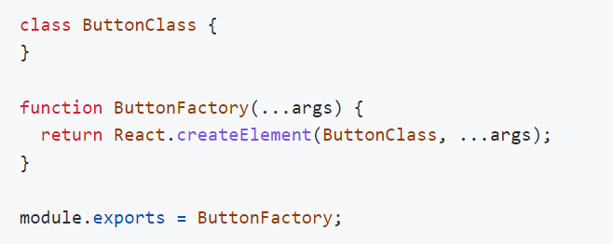


Factories
This is React 0.12.

Slide 4
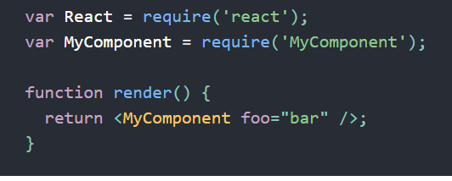
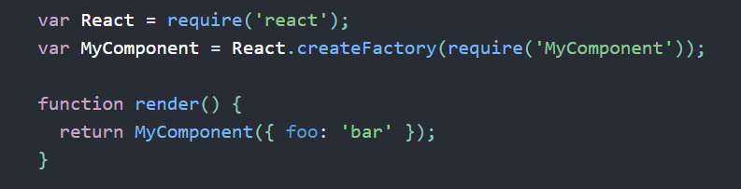
Factories
With JSX
Without JSX

Slide 5
JSX
Fundamentally, JSX just provides syntactic sugar for the React.createElement(component, props, ...children)
Using Dot Notation for JSX Type
User-Defined Components Must Be Capitalized
JSX Children
JSX Expression
Passing props

Slide 6
WHY REACTJS?
Virtual DOM
SPA VS MPA
Unidirectional Data Flow
JSX
Component Based System

Slide 7
Virtual DOM
UI Component App.js
Browser DOM
JSX
VirtualDom (New)
VirtualDom (Current)
Difference Updated

Slide 8
HTML
SPA VS MPA
SPA
A SPA is an app that works inside a browser and does not require page reloading during use.
It is just one web page that you visit which then loads all other content using JavaScript — which they heavily depend on.
SPA requests the markup and data independently and renders pages straight in the browser.
Typically it has only one reactDOM.render() call because we have one root app component which hosts other react component
Used By Gmail, Google Maps, Facebook
MPA
MPA is considered a more classical approach to app development. The multi-page design pattern requires a page reload every time the content changes.
Every Change i.e. displaying the data or submit data back to server requests rendering a new page from the server.
Before deploying a web application, you need to consider the goal of it. If you know you need multiple categories — use a multi-page site.
Used By extensive product portfolios, for example, e-commerce businesses.

Slide 9
HTML
App
Display
DisplayTwo
DisplayData

Slide 10
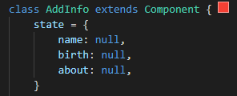
BUILDING BLOCKS OF REACTJS
Component
State
Props

Slide 11
HTML
TYPES OF COMPONENT
UI/Stateless/Function Component
Class/ Container/State Component
Doesn’t contain state
Receive data from props
Only concerned with the UI
Use Function to create
Contain state
Contain Lifecycle Methods
Not concerned with the UI
Use Class to create
In React16.8, React Hooks were introduced. It provided a way to create state(useState) and handling state change effects(useEffect).

Slide 12
Q & A

Slide 13
Thank You

