Slide 1
HTML
Today’s Topics
How to Update State
DOM Events
Form & Form Validation
Inverse Data Flow
Styling ReactJs
By Urvashi

Slide 2
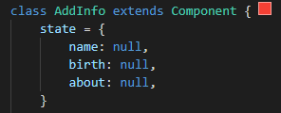
BUILDING BLOCKS OF REACTJS
Component
State
Props

Slide 3
Virtual DOM
UI Component App.js
Browser DOM
JSX
VirtualDom (New)
VirtualDom (Current)
Difference Updated

Slide 4
HTML
SPA VS MPA
SPA
A SPA is an app that works inside a browser and does not require page reloading during use.
It is just one web page that you visit which then loads all other content using JavaScript — which they heavily depend on.
SPA requests the markup and data independently and renders pages straight in the browser.
Typically it has only one reactDOM.render() call because we have one root app component which hosts other react component
Used By Gmail, Google Maps, Facebook
MPA
MPA is considered a more classical approach to app development. The multi-page design pattern requires a page reload every time the content changes.
Every Change i.e. displaying the data or submit data back to server requests rendering a new page from the server.
Before deploying a web application, you need to consider the goal of it. If you know you need multiple categories — use a multi-page site.
Used By extensive product portfolios, for example, e-commerce businesses.

Slide 5
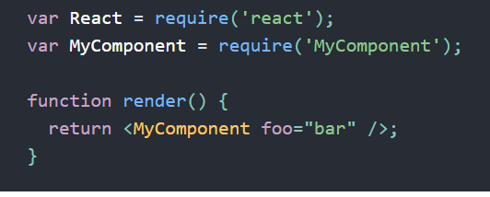
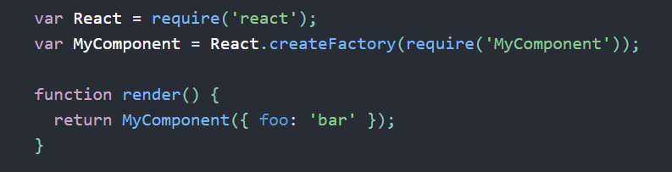
Factories
With JSX
Without JSX

Slide 6
JSX
Fundamentally, JSX just provides syntactic sugar for the React.createElement(component, props, ...children)
Using Dot Notation for JSX Type
User-Defined Components Must Be Capitalized
JSX Children
JSX Expression
Passing props via HTML attribute

Slide 7
WHY REACTJS?
Virtual DOM
SPA VS MPA
Unidirectional Data Flow
JSX
Component Based System

Slide 8
FORM AND FORM VALIDATION
React uses forms to allow users to interact with the web page.
It is a set of input values, enter by the user.
It’s like user is inputting the value.
Form Validation
Front-end Validation
It checks input by the user is correct or not.
What validation need to be checked is decided by the developer/according to the application requirement.
We need events
Regex: https://regex101.com/

Slide 9
HTML
Inverse Data Flow
In React, inverse data flow allows us to send data between parent and child components as props. However, components that are cousins or siblings cannot directly communicate with each other.
Steps to create inverse data flow.
Define the function in the parent component.
Send function via HTML attribute.
Invoke the function in the child.
Send data back up to the parent as props.

Slide 10
HTML
WAYS TO ADD DESIGNING/STYLING TO WEBISTE
Add CSS to ReactJS
Using Framework:
- Material UI: https://mui.com/material-ui/
- Bootstrap 5: https://getbootstrap.com/docs/5.0/getting-started/introduction/
- Materialize CSS: https://materializecss.com/
- React Bootstrap

Slide 11
HTML
Q & A

Slide 12
HTML
Thank You!

